Slide 1
인공지능 직관적으로 이해하기
: Understanding AI Intuitively
20.Jan.2022
강규란 인턴연구생
Kyuran Kang Research Intern
PDSE lab
SungKyunKwan University

Slide 2
6주차 : Week 6
20.Jan.2022
강규란 인턴연구생
Kyuran Kang Research Intern

Slide 3
1월 목표 (Goal of the Month)
신경망 처음부터 끝까지 구현하기
Literally Implement Neural Network from Scratch
PDSE Lab
CONFIDENTIAL

Slide 4
1월 목표 (Goal of the Month)
신경망 처음부터 끝까지 구현하기
Literally Implement Neural Network from Scratch
Forward
Pass
PDSE Lab
CONFIDENTIAL

Slide 5
1월 목표 (Goal of the Month)
신경망 처음부터 끝까지 구현하기
Literally Implement Neural Network from Scratch
Forward
Pass
Backward Pass
PDSE Lab
CONFIDENTIAL

Slide 6
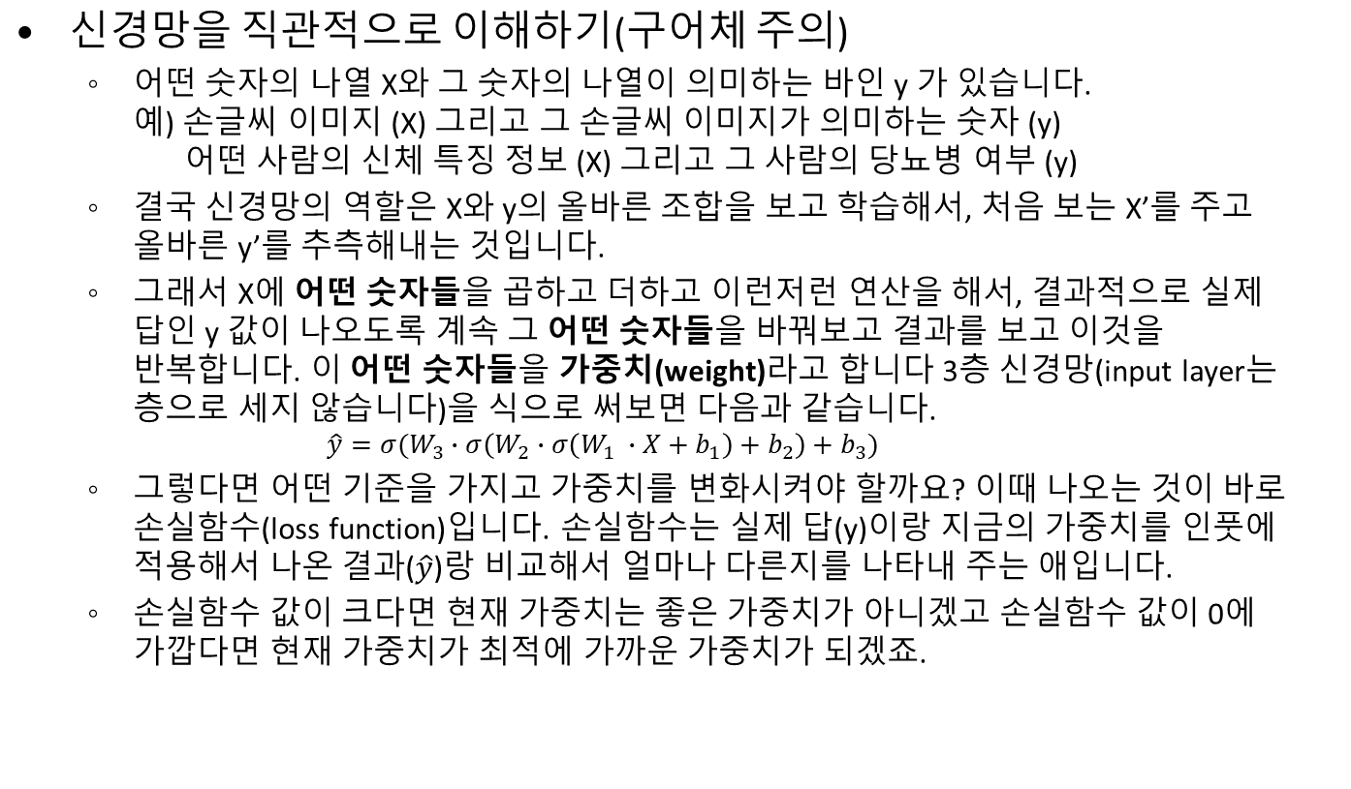
먼저 복습! (But First, Let’s Review!)
PDSE Lab
CONFIDENTIAL

Slide 7
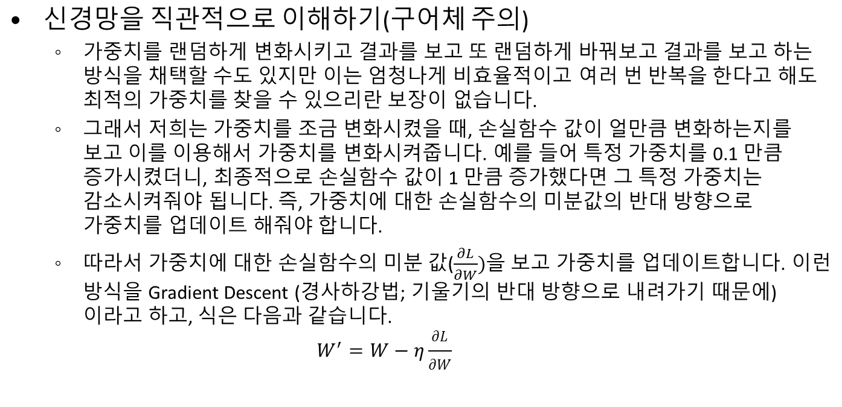
먼저 복습! (But First, Let’s Review!)
PDSE Lab
CONFIDENTIAL

Slide 8
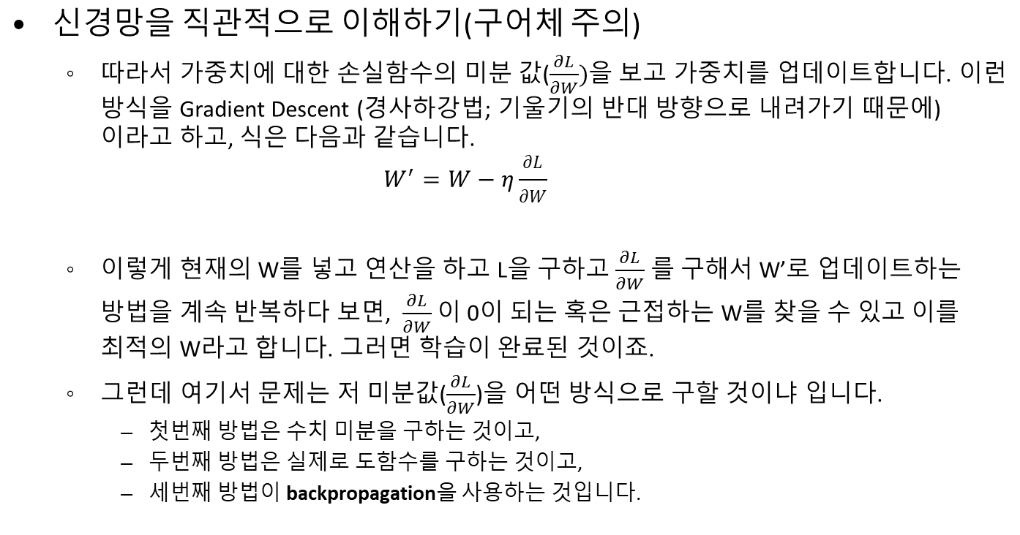
먼저 복습! (But First, Let’s Review!)
PDSE Lab
CONFIDENTIAL

Slide 9
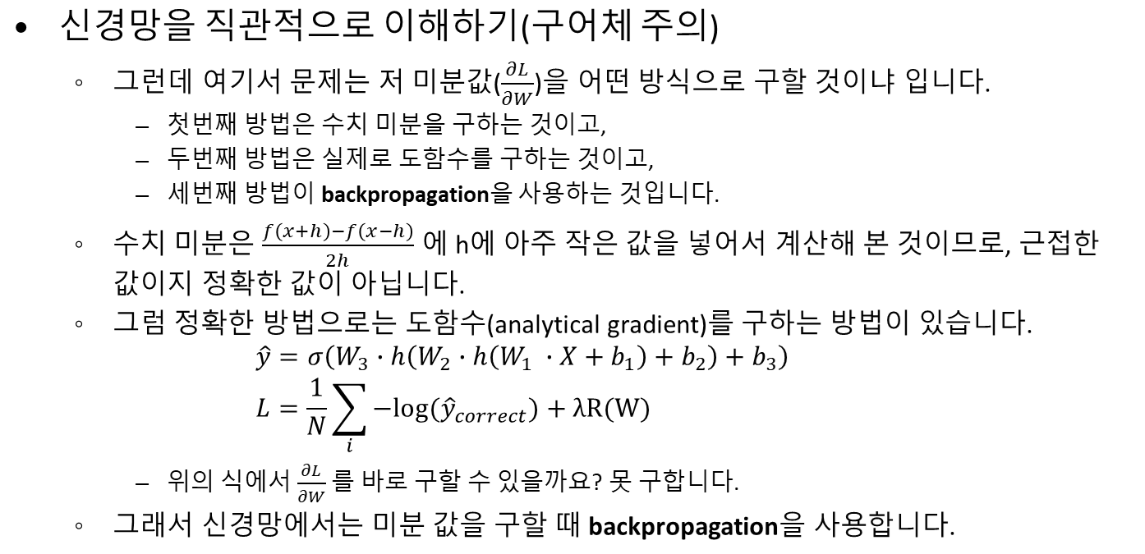
먼저 복습! (But First, Let’s Review!)
PDSE Lab
CONFIDENTIAL

Slide 10
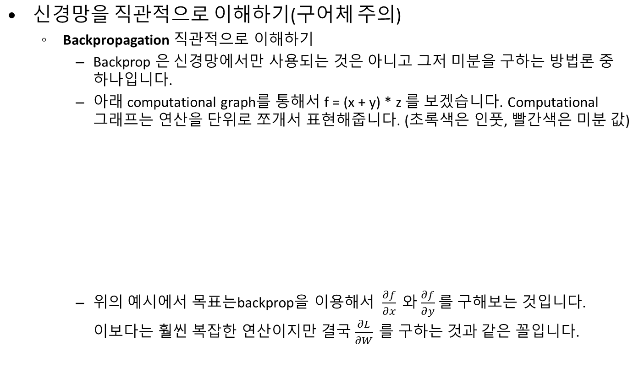
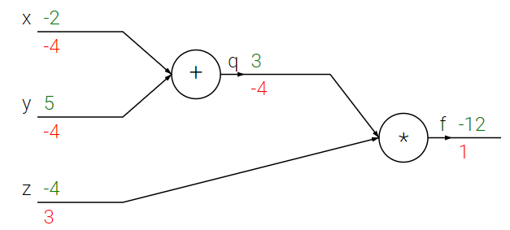
먼저 복습! (But First, Let’s Review!)
PDSE Lab
CONFIDENTIAL

Slide 11
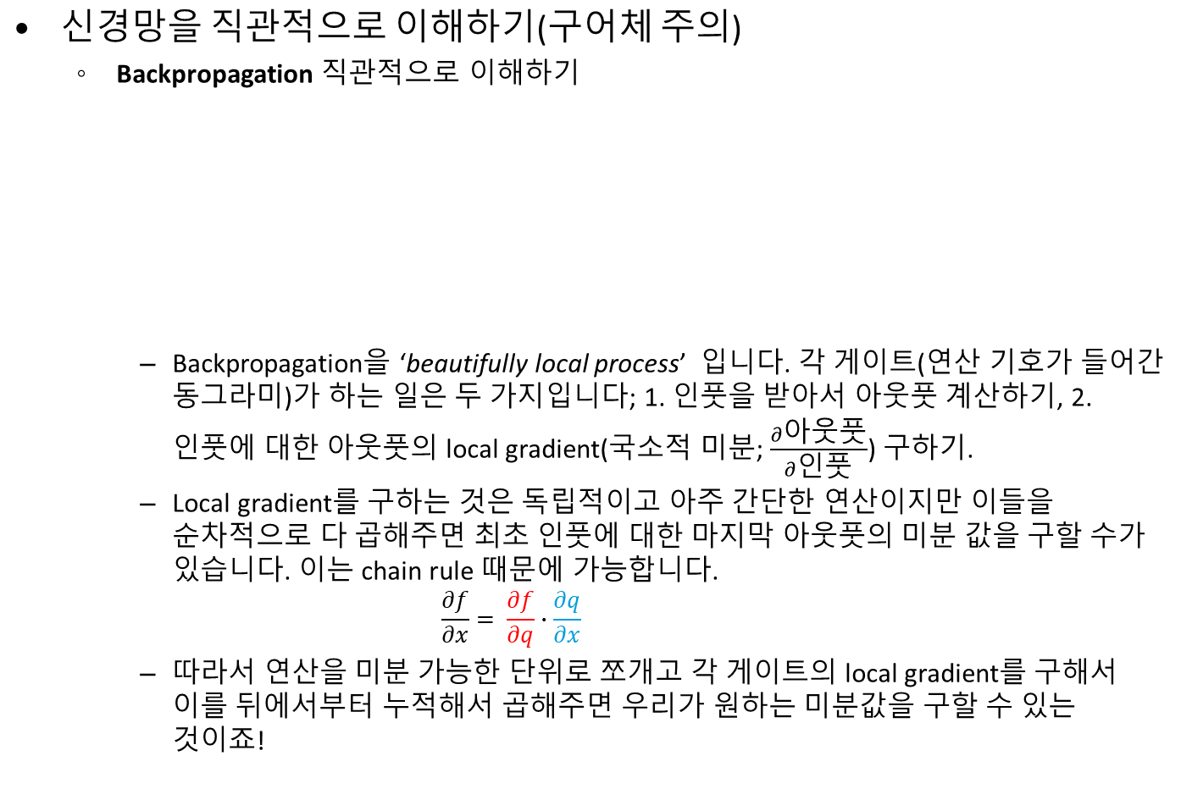
먼저 복습! (But First, Let’s Review!)
PDSE Lab
CONFIDENTIAL

Slide 12
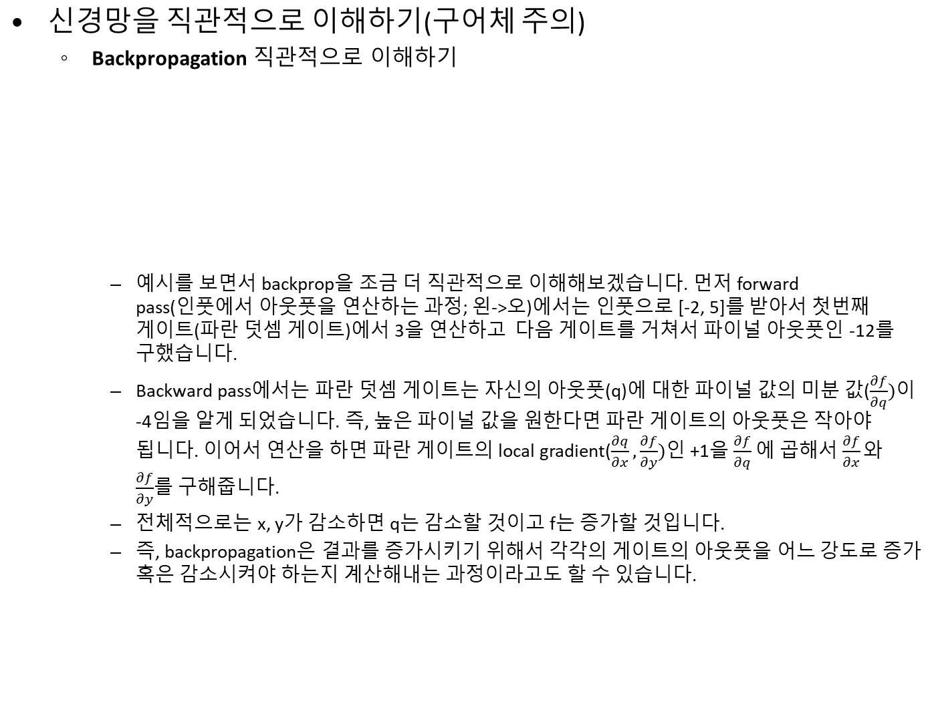
먼저 복습! (But First, Let’s Review!)
PDSE Lab
CONFIDENTIAL

Slide 13
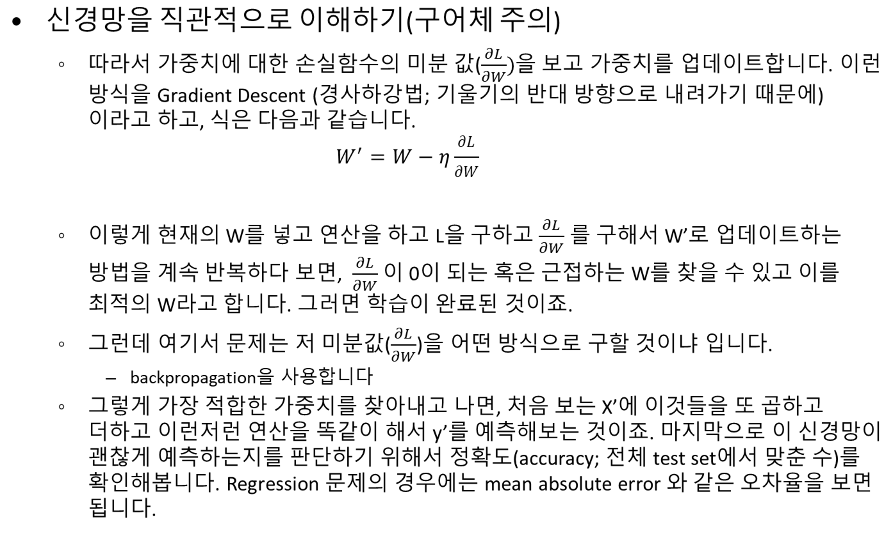
먼저 복습! (But First, Let’s Review!)
PDSE Lab
CONFIDENTIAL

Slide 14
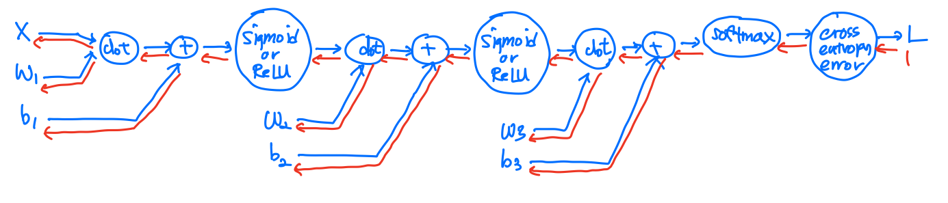
The Big Picture
따라서 필요한 local gradient는
  Dot product
  Addition
  sigmoid
  ReLU
  softmax와 cross_entropy_error (합쳐서 softmas-with-loss)
PDSE Lab
CONFIDENTIAL

Slide 15
Let’s Implement Two-Layer-Neural-Network
https://github.com/MitchellPritchett/pdse_ai_workshop
PDSE Lab
CONFIDENTIAL

Slide 16


Thank you!

