Slide 1
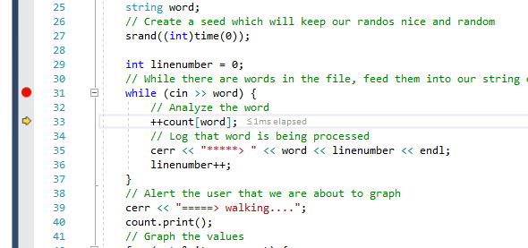
First word
++count[word]

Slide 2
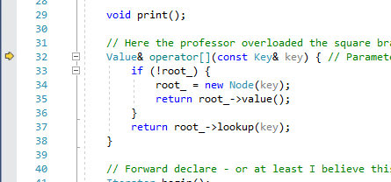

Slide 3
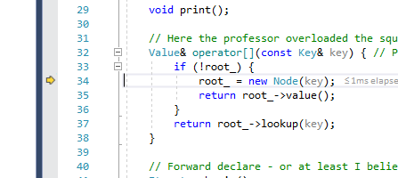
Since this is the first word, we hit root_=new Node(key); and send back value which is incremented by the ++count[word] back in main

Slide 4
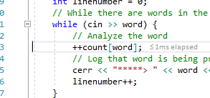

Slide 5
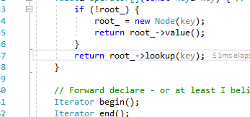
We skip past root_ check because this is our second word. We now call root_->lookup(key);
Interesting because this is a method of root. This method is being called on root. Could this help with my rebalancing method?

Slide 6
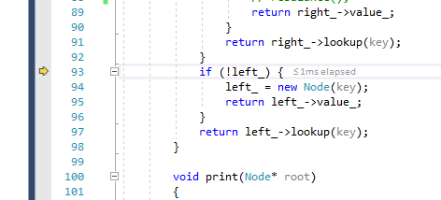
We’re in the lookup method now with the second word, we’ve made it past the identical key, and if key is greater than current key, so by default the key is smaller than current key and we must go left. We now check if there is a left

Slide 7
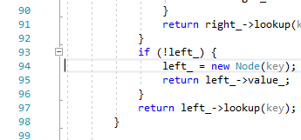
There is indeed no left (second word) so we put a new node there

Slide 8
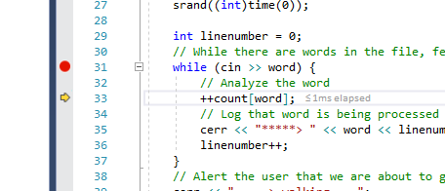
We return the value again (of our second word) and it is incremented by the ++count[word]

Slide 9
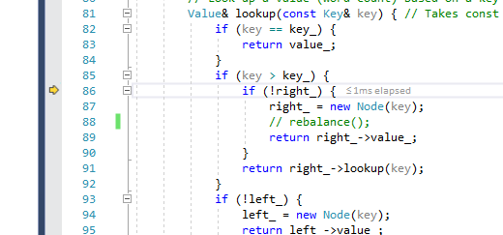
(Third word) it’s going right this time. Nothing special

Slide 10
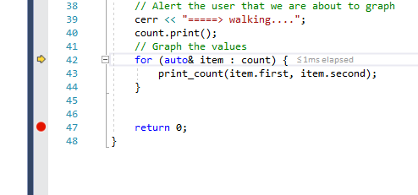
We fast forwarded and the tree is formed now correctly. We are at the range based for loop and this does the magic. (tree is unsorted still)

Slide 11
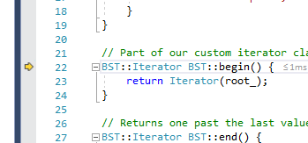
We first hit begin()
We return Iterator(root_)

Slide 12
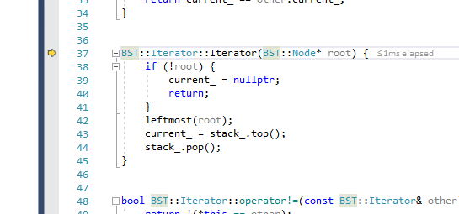
We are now in the Iterator constructor
current_ is a temp node in the Iterator class. If we pass a nullptr to this constructor. We set current_ to nullptr and return/essentially send tfo of the method we’re done

Slide 13
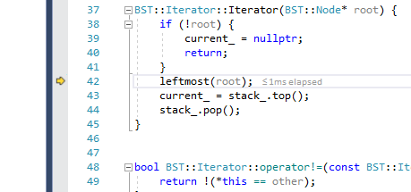
First time hitting leftmost()
We hit the range based for loop, then begin(), then an Iterator constructor with root sent

Slide 14
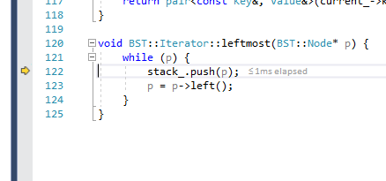
Our first time inside leftmost(), first run-through (top layer of the onion/hasn’t recursed yet)

Slide 15
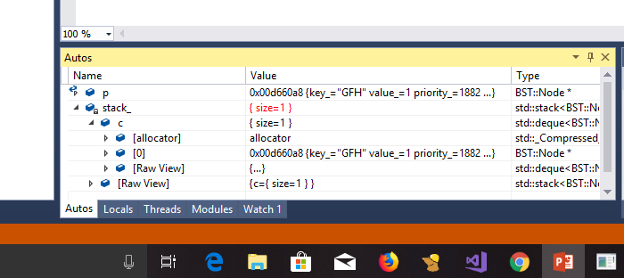
First push to stack. Our stack now has our root

Slide 16
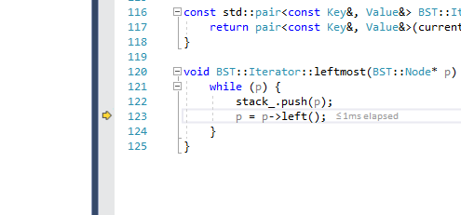
Luckily, this is not a freak case, so we have (atleast) one more node to the left of p(root) so we can set p=p->left() w/o making it null immediately and satisfy the while (p) and push to the stack again

