Slide 1
CAB302 Assignment 2 GUI Test Plan
The Spicy Memeliners
Andrew Carr: andrew.carr@connect.qut.edu.au
Mitchell Harvey: m21.harvey@connect.qut.edu.au

Slide 2
The Basics
This file is a template to help you organise your GUI test results.
Please delete this slide before submission
For each test, you will need to provide at least 2 screenshots of your application – data entry and result. For Test 1, this will need to happen twice, each time showing the error. It is not necessary to execute corrected inputs for Test 1.
For Tests 1,2,4 and 5, we already know the input data and results
For Test 3, you need to specify it, and the expected result (you know both of these as they are from a supplied log that you choose).
(And yes, you can fake the screenshots, but we can also demand that you demo the application with one of us present).

Slide 3
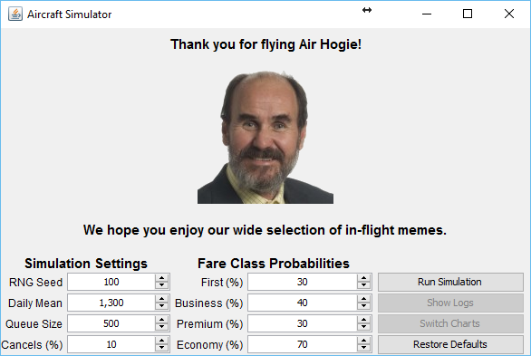
Test 1 Input Screen Shot 1
The Main page opens with various settings available to the user, and 4 buttons. The two “Show Logs, and Switch Charts are disabled to start with until the simulation has been run.
In this screen, the user enters incorrect data in the passenger split range. The combined total of Passengers must be 100% - no more, no less
[meanDailyBookings=1300.0, sdDailyBookings=mean*0.33, seed=100, firstProb=0.3, businessProb=0.4, premiumProb=0.3, economyProb=0.7, maxQueueSize=500, cancellationProb=0.1]

Slide 4
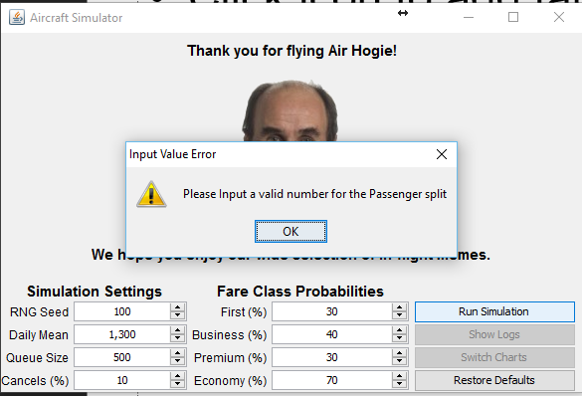
Test 1 Error Screen Shot 1
The Error message that is displayed to the user. The Simulation is not run until the user fixes any errors and Clicks “Run Simulation Again
[meanDailyBookings=1300.0, sdDailyBookings=mean*0.33, seed=100, firstProb=0.3, businessProb=0.4, premiumProb=0.3, economyProb=0.7, maxQueueSize=500, cancellationProb=0.1]

Slide 5
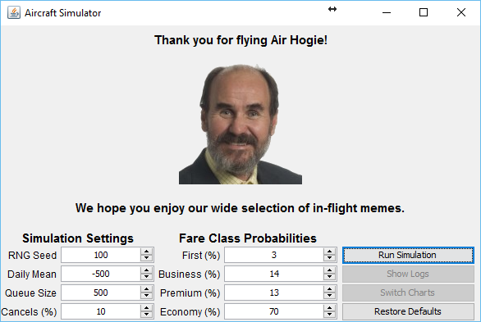
Test 1 Input Screen Shot 2
The user attempts to create a Simulation with a Queue of -500 which violates the <0 rule that it has applied to it.
[meanDailyBookings=-500, sdDailyBookings=mean*0.33, seed=100, firstProb=0.03, businessProb=0.14, premiumProb=0.13, economyProb=0.7, maxQueueSize=500, cancellationProb=0.1]

Slide 6
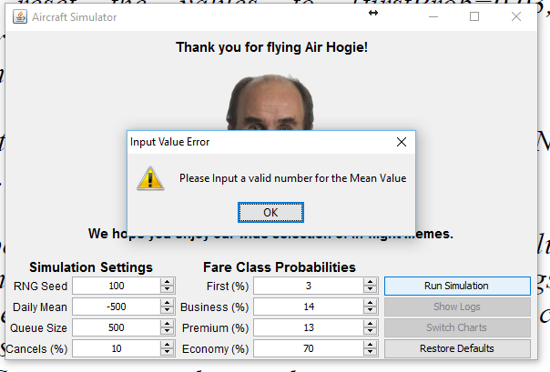
Test 1 Error Screen Shot 2
The Error message that will appear to prompt the user to re ender their details and then try again
[meanDailyBookings=-500, sdDailyBookings=mean*0.33, seed=100, firstProb=0.03, businessProb=0.14, premiumProb=0.13, economyProb=0.7, maxQueueSize=500, cancellationProb=0.1]

Slide 7

Test 2 Input Screen Shot
The User provides valid values in all the fields, therefore the simulation should run error free
meanDailyBookings=1300.0, sdDailyBookings=429.0, seed=100, firstProb=0.03, businessProb=0.14, premiumProb=0.13, economyProb=0.7, maxQueueSize=0, cancellationProb=1.0]

Slide 8
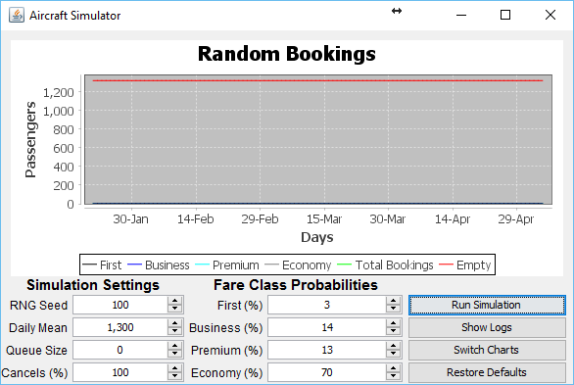
Test 2 Output Screen Shot
The Graph that is created from the provided parameters. Note that the “Show Logs” & “Switch Charts” Buttons are now active
meanDailyBookings=1300.0, sdDailyBookings=429.0, seed=100, firstProb=0.03, businessProb=0.14, premiumProb=0.13, economyProb=0.7, maxQueueSize=0, cancellationProb=1.0]

Slide 9

Test 3 Input Screen Shot
Another Successful parameter Set where the user has changed the Cancelation Probability to 0%
meanDailyBookings=1300.0, sdDailyBookings=429.0, seed=100, firstProb=0.03, businessProb=0.14, premiumProb=0.13, economyProb=0.7, maxQueueSize=500, cancellationProb=0]

Slide 10
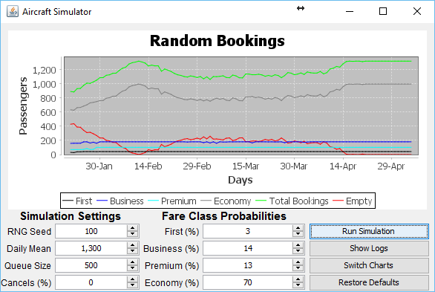
Test 3 Output Screen Shot
meanDailyBookings=1300.0, sdDailyBookings=429.0, seed=100, firstProb=0.03, businessProb=0.14, premiumProb=0.13, economyProb=0.7, maxQueueSize=500, cancellationProb=0]

Slide 11
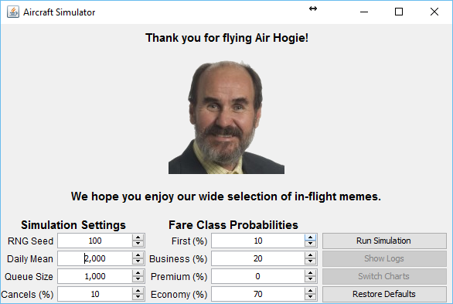
Test 4 Input Screen Shot
Another test with a valid input, this time testing the charts’ display correctly
Simulator [meanDailyBookings=2000.0, sdDailyBookings=660.0, seed=100, firstProb=0.1, businessProb=0.2, premiumProb=0.0, economyProb=0.7, maxQueueSize=1000, cancellationProb=0.1]

Slide 12
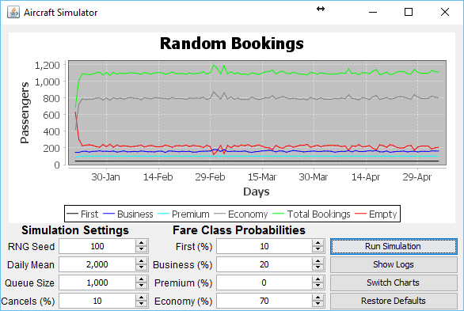
Test 4 Output Chart 1
The Chart displaying a Line graph of the Daily Statistics
Simulator [meanDailyBookings=2000.0, sdDailyBookings=660.0, seed=100, firstProb=0.1, businessProb=0.2, premiumProb=0.0, economyProb=0.7, maxQueueSize=1000, cancellationProb=0.1]

Slide 13
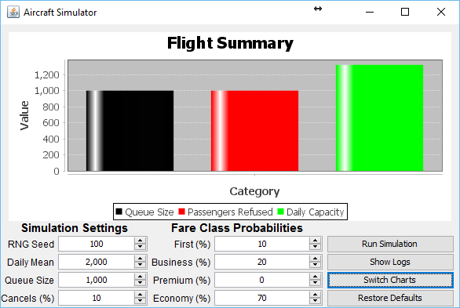
Test 4 Output Chart 2
The Chart displaying a Bar graph of the Final Flight Summary
Simulator [meanDailyBookings=2000.0, sdDailyBookings=660.0, seed=100, firstProb=0.1, businessProb=0.2, premiumProb=0.0, economyProb=0.7, maxQueueSize=1000, cancellationProb=0.1]

Slide 14
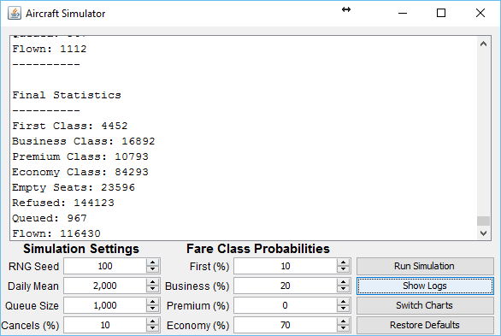
Test 4 Output Logs
The Produced Log Output
Simulator [meanDailyBookings=2000.0, sdDailyBookings=660.0, seed=100, firstProb=0.1, businessProb=0.2, premiumProb=0.0, economyProb=0.7, maxQueueSize=1000, cancellationProb=0.1]

Slide 15
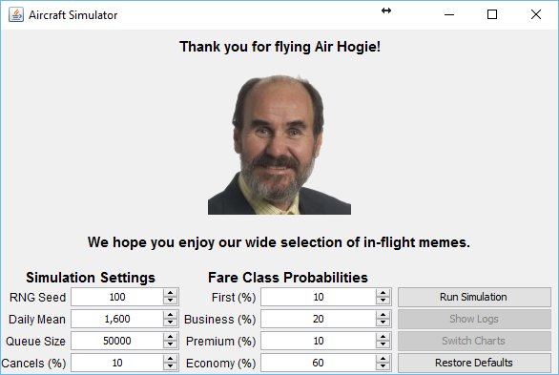
Test 5 Input Screen Shot
Another test with a valid input, this time testing the charts’ display correctly
Simulator [meanDailyBookings=1600.0, sdDailyBookings=528.0, seed=100, firstProb=0.1, businessProb=0.2, premiumProb=0.1, economyProb=0.6, maxQueueSize=50000, cancellationProb=0.1]

Slide 16
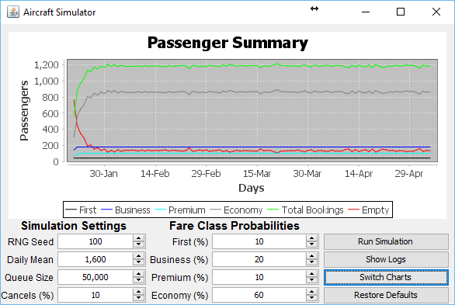
Test 5 Output Chart 2
The Chart displaying a Line graph of the Daily Statistics
Simulator [meanDailyBookings=1600.0, sdDailyBookings=528.0, seed=100, firstProb=0.1, businessProb=0.2, premiumProb=0.1, economyProb=0.6, maxQueueSize=50000, cancellationProb=0.1]

Slide 17
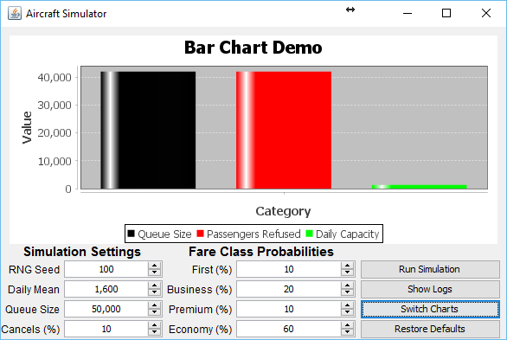
Test 5 Output Chart 2
The Chart displaying a Bar graph of the Final Flight Summary
Simulator [meanDailyBookings=1600.0, sdDailyBookings=528.0, seed=100, firstProb=0.1, businessProb=0.2, premiumProb=0.1, economyProb=0.6, maxQueueSize=50000, cancellationProb=0.1]

Slide 18
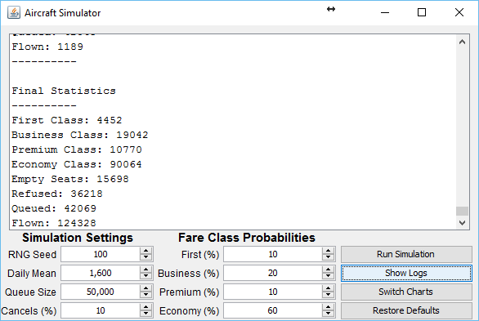
Test 5 Output Chart 2
The Produced Log Output
Simulator [meanDailyBookings=1600.0, sdDailyBookings=528.0, seed=100, firstProb=0.1, businessProb=0.2, premiumProb=0.1, economyProb=0.6, maxQueueSize=50000, cancellationProb=0.1]

