Slide 1
CAB302 Assignment 2 GUI Test Plan
The Spicy Memeliners
Andrew Carr: andrew.carr@connect.qut.edu.au
Mitchell Harvey: m21.harvey@connect.qut.edu.au

Slide 2
The Basics
This file is a template to help you organise your GUI test results.
Please delete this slide before submission
For each test, you will need to provide at least 2 screenshots of your application – data entry and result. For Test 1, this will need to happen twice, each time showing the error. It is not necessary to execute corrected inputs for Test 1.
For Tests 1,2,4 and 5, we already know the input data and results
For Test 3, you need to specify it, and the expected result (you know both of these as they are from a supplied log that you choose).
(And yes, you can fake the screenshots, but we can also demand that you demo the application with one of us present).

Slide 3
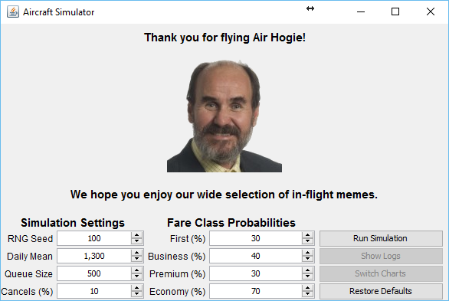
Test 1 Input Screen Shot 1
[meanDailyBookings=1300.0, sdDailyBookings=mean*0.33, seed=100, firstProb=0.3, businessProb=0.4, premiumProb=0.3, economyProb=0.7, maxQueueSize=500, cancellationProb=0.1]

Slide 4
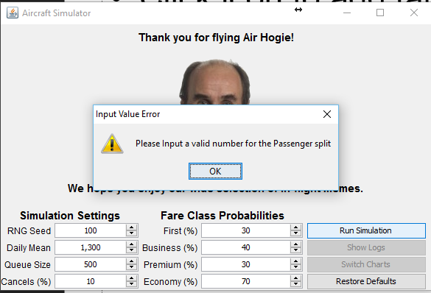
Test 1 Error Screen Shot 1
[meanDailyBookings=1300.0, sdDailyBookings=mean*0.33, seed=100, firstProb=0.3, businessProb=0.4, premiumProb=0.3, economyProb=0.7, maxQueueSize=500, cancellationProb=0.1]

Slide 5
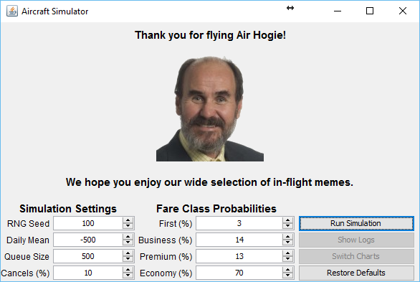
Test 1 Input Screen Shot 2
[meanDailyBookings=-500, sdDailyBookings=mean*0.33, seed=100, firstProb=0.03, businessProb=0.14, premiumProb=0.13, economyProb=0.7, maxQueueSize=500, cancellationProb=0.1]

Slide 6
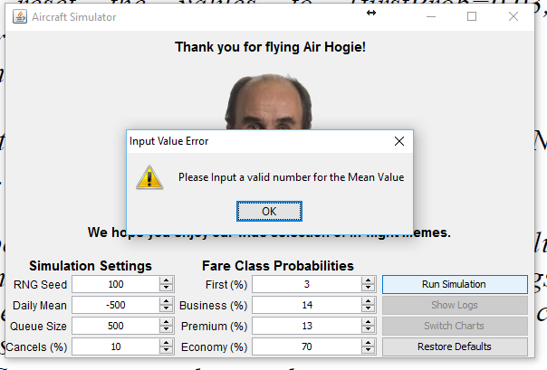
Test 1 Error Screen Shot 2
[meanDailyBookings=-500, sdDailyBookings=mean*0.33, seed=100, firstProb=0.03, businessProb=0.14, premiumProb=0.13, economyProb=0.7, maxQueueSize=500, cancellationProb=0.1]

Slide 7

Test 2 Input Screen Shot
meanDailyBookings=1300.0, sdDailyBookings=429.0, seed=100, firstProb=0.03, businessProb=0.14, premiumProb=0.13, economyProb=0.7, maxQueueSize=0, cancellationProb=1.0]

Slide 8
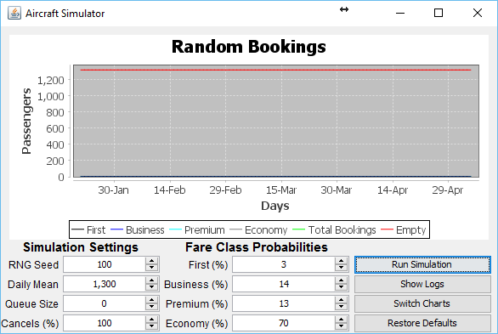
Test 2 Output Screen Shot
meanDailyBookings=1300.0, sdDailyBookings=429.0, seed=100, firstProb=0.03, businessProb=0.14, premiumProb=0.13, economyProb=0.7, maxQueueSize=0, cancellationProb=1.0]

Slide 9
Test 3 Test Data
Simulator [meanDailyBookings=1300.0, sdDailyBookings=429.0, seed=100, firstProb=0.03, businessProb=0.14, premiumProb=0.13, economyProb=0.7, maxQueueSize=500, cancellationProb=0.0]
EXAMPLE ONLY – You choose
124:1414:F42:J180:P102:Y889:T1213:E108:Q496:R36070
125:781:F42:J180:P102:Y872:T1196:E125:Q496:R36958
126:1584:F42:J180:P102:Y855:T1179:E142:Q496:R38667
20160525_203007: End of Simulation
Final Totals: [F4424:J18922:P10652:Y88120:T122118:E17908:R39305]

Slide 10

Test 3 Input Screen Shot

Slide 11
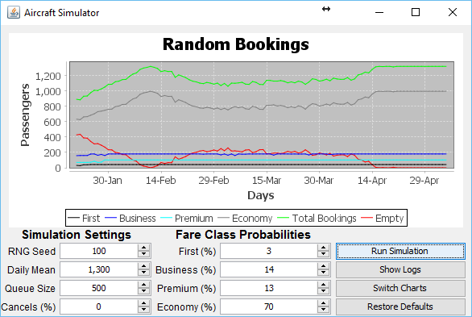
Test 3 Output Screen Shot

Slide 12
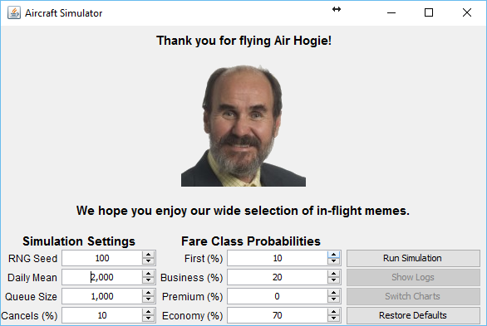
Test 4 Input Screen Shot
Simulator [meanDailyBookings=2000.0, sdDailyBookings=660.0, seed=100, firstProb=0.1, businessProb=0.2, premiumProb=0.0, economyProb=0.7, maxQueueSize=1000, cancellationProb=0.1]

Slide 13
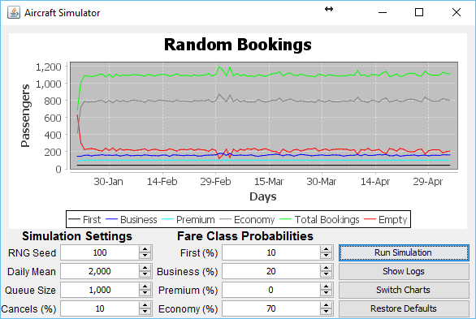
Test 4 Output Chart 1
Simulator [meanDailyBookings=2000.0, sdDailyBookings=660.0, seed=100, firstProb=0.1, businessProb=0.2, premiumProb=0.0, economyProb=0.7, maxQueueSize=1000, cancellationProb=0.1]

Slide 14
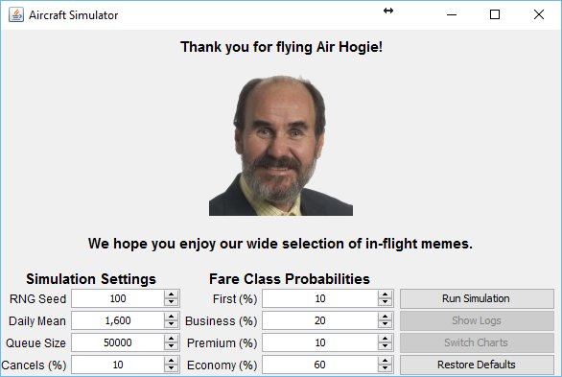
Test 5 Input Screen Shot
Simulator [meanDailyBookings=1600.0, sdDailyBookings=528.0, seed=100, firstProb=0.1, businessProb=0.2, premiumProb=0.1, economyProb=0.6, maxQueueSize=50000, cancellationProb=0.1]

Slide 15
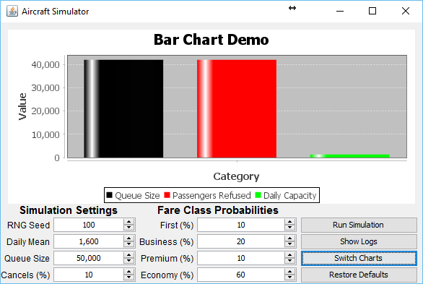
Test 5 Output Chart 2
Simulator [meanDailyBookings=1600.0, sdDailyBookings=528.0, seed=100, firstProb=0.1, businessProb=0.2, premiumProb=0.1, economyProb=0.6, maxQueueSize=50000, cancellationProb=0.1]

