Slide 1
An Analysis on MCU Movies

Slide 2
By the end of 2021…
MCU currently has 27 movies:
Starting with Iron Man which debuted on May 2nd, 2008.
Latest release is Spider-Man: No Way Home which debuted on December 17th, 2021.
Over the past 13 years, these movies have earned a grand total of $25.7 billion dollars against a total production budget of a $5.3 billion dollars.

Slide 3
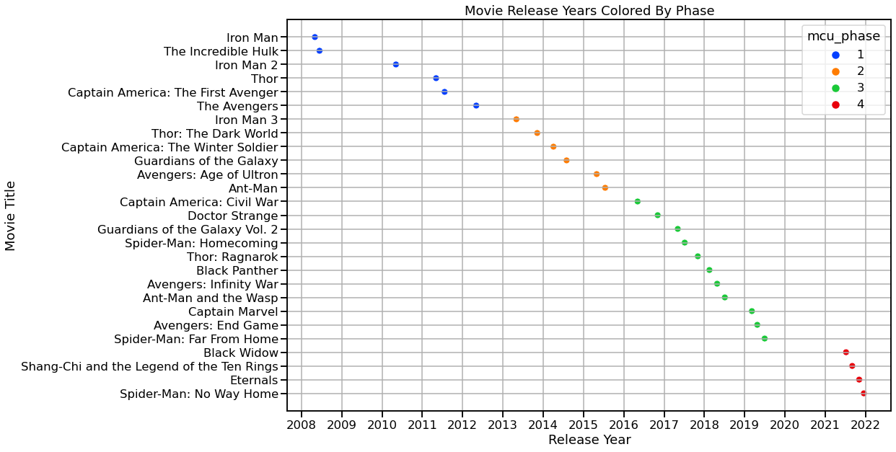
An entire universe organized into 4 phases

Slide 4
Movie Averages By Phase
Phase | Critic Rating | Audience Score | Opening Weekend | Worldwide Box Office | Net Profit
1 | 80.0 | 79.0 | $104.0 million | $634.4 million | $466.4 million
2 | 81.0 | 84.2 | $116.3 million | $876.6 million | $679.1 million
3 | 89.1 | 83.4 | $162.6 million | $1226.8 million | $1014.5 million
4 | 77.5 | 91.3 | $121.8 million | $776.3 million | $588.8 million

Slide 5
Which now asks the question….
Which movie is the best one?

Slide 6
Evaluation Process
27 movies
They will be ranked among 5 criteria:
Opening Weekend Income
Worldwide Box Office Income
Net Profit
Critic Score
Audience Score
Top ranking receives 27 points, last place receives 1 point
Top movie after the 5 categories is the best movie

Slide 7
Opening Weekend Income

Slide 8
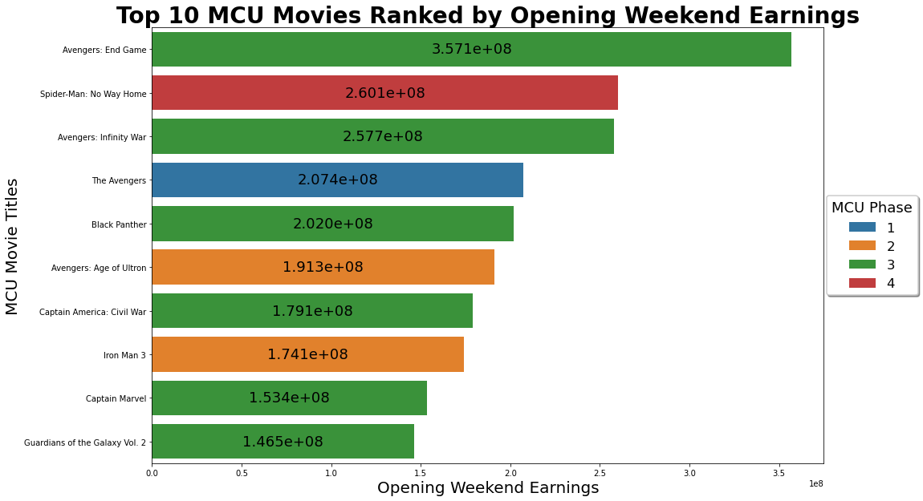

Slide 9
Point Standings – Top 10
Avengers: End Game - 27
Spider-Man: No Way Home – 26
Avengers: Infinity War – 25
The Avengers – 24
Black Panther - 23
Avengers: Age of Ultron – 22
Captain America: Civil War – 21
Iron Man 3 – 20
Captain Marvel – 19
Guardians of the Galaxy 2 - 18

Slide 10
Point Standings – The Rest
Iron Man 2 - 17
Thor: Ragnarok – 16
Spider-Man: Homecoming – 15
Iron Man – 14
Captain America: WS – 13
Guardians of the Galaxy – 12
Spider-Man: FFH - 11
Thor: The Dark World - 10
Doctor Strange – 9
Black Widow – 8
Ant-Man and the Wasp – 7
Shang-Chi and TLOTR – 6
Eternals – 5
Thor – 4
Captain America: TFA – 3
Ant-Man – 2
The Incredible Hulk - 1

Slide 11
Worldwide Box Office Income

Slide 12
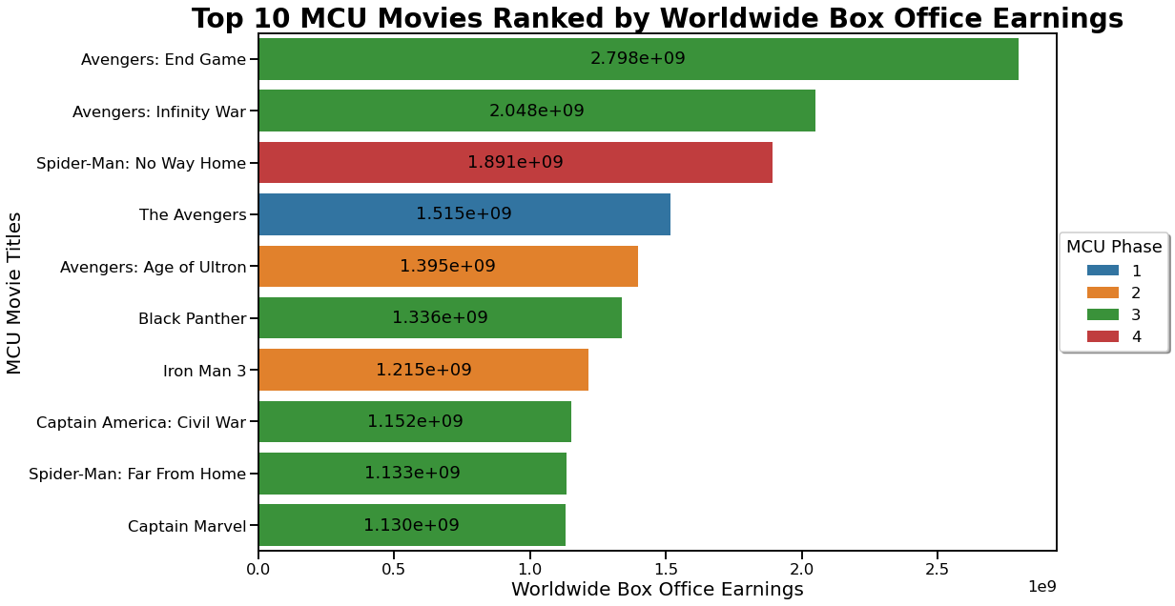

Slide 13
Point Standings – Top 10
Avengers: End Game - 54
Avengers: Infinity War – 51
Spider-Man: No Way Home – 51
The Avengers – 48
Avengers: Age of Ultron - 45
Black Panther – 45
Iron Man 3 – 41
Captain America: Civil War – 41
Captain Marvel – 37
Guardians of the Galaxy 2 - 34

Slide 14
Net Profit Income

Slide 15
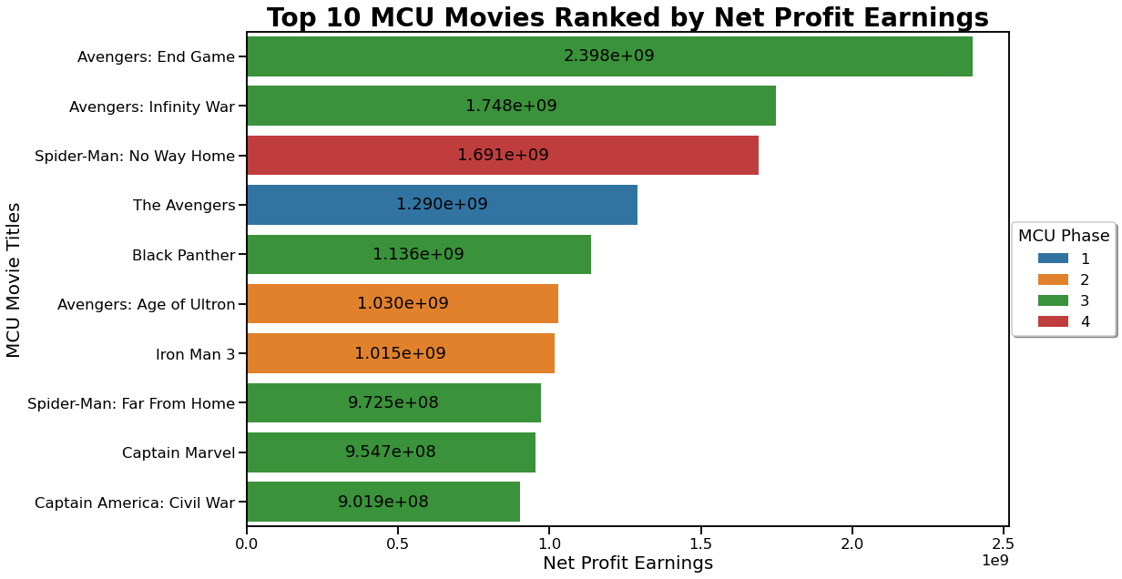

Slide 16
Point Standings – Top 10
Avengers: End Game - 81
Avengers: Infinity War – 77
Spider-Man: No Way Home – 76
The Avengers – 72
Black Panther - 68
Avengers: Age of Ultron – 67
Iron Man 3 – 62
Captain America: Civil War – 59
Captain Marvel – 56
Spider-Man: FFH - 50

Slide 17
Point Standings – The Rest
Guardians of the Galaxy 2 - 49
Spider-Man: Homecoming – 49
Thor: Ragnarok – 47
Guardians of the Galaxy – 40
Captain America: WS – 39
Iron Man 2 – 35
Doctor Strange - 33
Thor: The Dark World - 32
Iron Man – 30
Ant-Man and the Wasp – 27
Thor – 16
Ant-Man – 16
Shang-Chi and TLOTTR – 16
Black Widow – 13
Eternals – 12
Captain America: TFA – 9
The Incredible Hulk - 3

Slide 18
Critic Rating

Slide 19
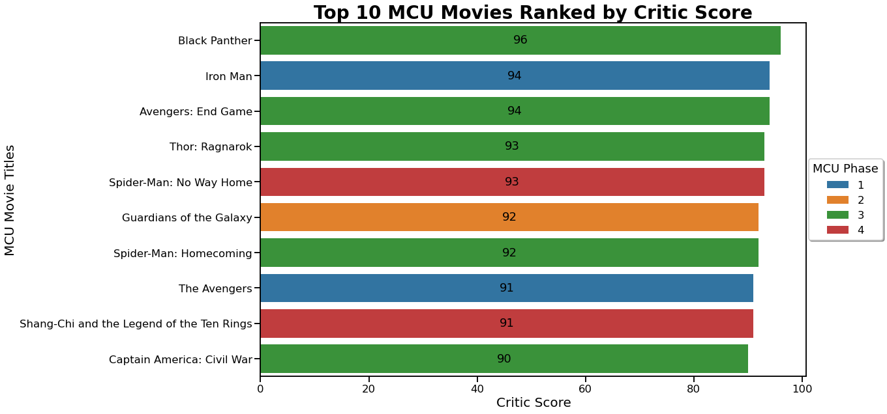

Slide 20
Point Standings – Top 10
Avengers: End Game - 106
Spider-Man: No Way Home – 99
Black Panther – 95
The Avengers – 92
Avengers: Infinity War - 89
Captain America: Civil War – 77
Iron Man 3 – 72
Avengers: Age of Ultron – 72
Thor: Ragnarok – 71
Spider-Man: Homecoming - 70

Slide 21
Audience Score

Slide 22
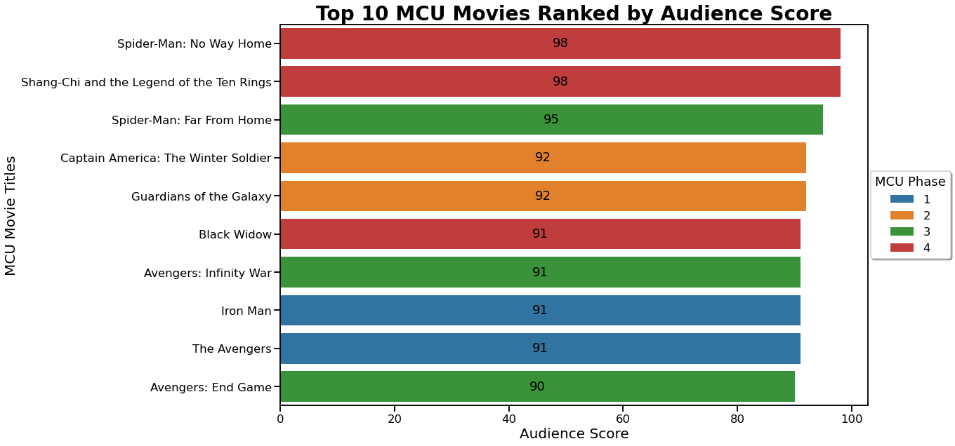

Slide 23
Point Standings – The Rest
Avengers: Age of Ultron - 83
Iron Man 3 – 80
Captain America: TWS – 80
Guardians of the Galaxy 2 – 78
Iron Man – 76
Captain Marvel – 66
Doctor Strange - 61
Shang-Chi and TLOTTR - 61
Ant-Man and the Wasp – 51
Black Widow – 43
Iron Man 2 – 42
Ant-Man – 39
Thor: The Dark World – 38
Thor – 28
Captain America: TFA – 21
Eternals – 20
The Incredible Hulk - 8

Slide 24
Point Standings – Top 10
Spider-Man: NWH - 126
Avengers: End Game – 124
The Avengers – 111
Avengers: Infinity War – 110
Black Panther - 104
Captain America: Civil War – 94
Spider-Man: FFH – 91
Guardians of the Galaxy – 85
Spider-Man: Homecoming – 85
Thor: Ragnarok - 85

Slide 25
Summary
Phase | Avg. Pts Scored
1 | 47.67
2 | 67.50
3 | 86.27
4 | 62.50

Slide 26
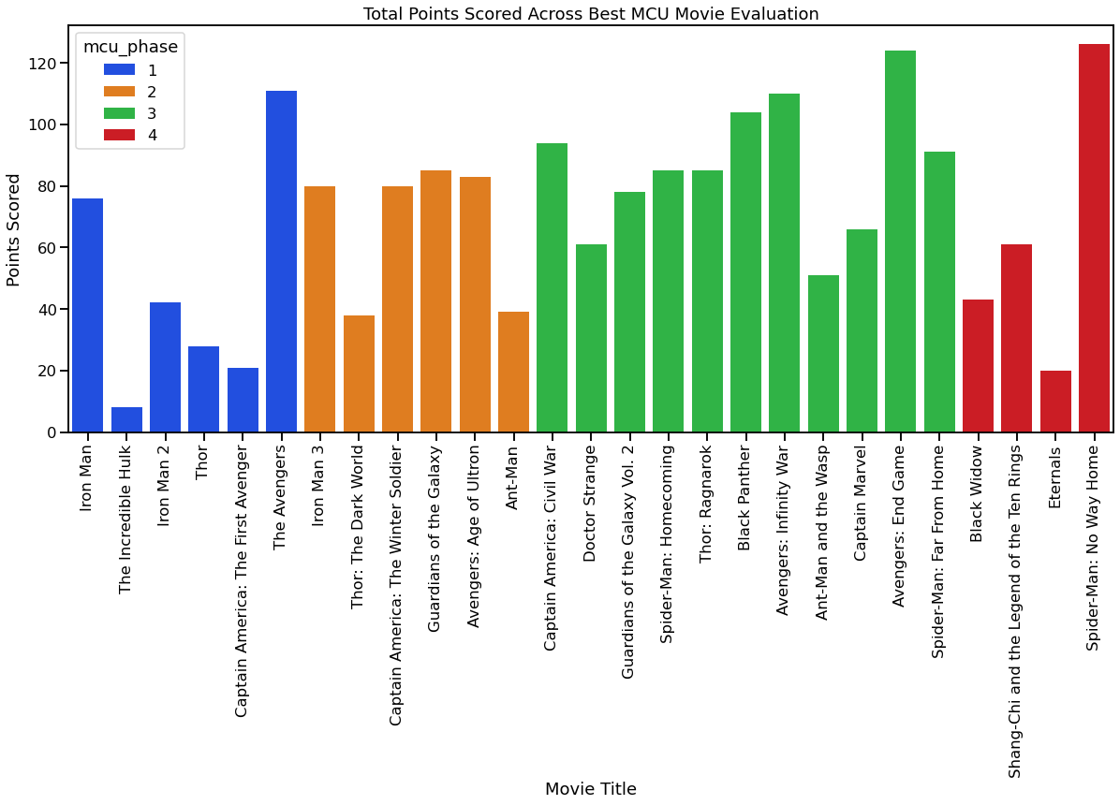

Slide 27
Special Thanks
To Kaggle user, David Ong, for providing the dataset
Marvel for making these fantastic movies!

Slide 28
Source
Jupyter Notebook and Slideshow Found Here

