Slide 1
Bubble Bonanza
We have a free-floating chair

Slide 2
Our Team
Producer
Mitchell
Programmers
John
June
Mitchell
Artists
Drew
Lauren
Sound
Lauren

Slide 3
Design
Billy dropped his toys in the fish tank.
Shoot bubbles at the toys to make them float to the surface.
Clear all the toys as fast as possible.

Slide 4
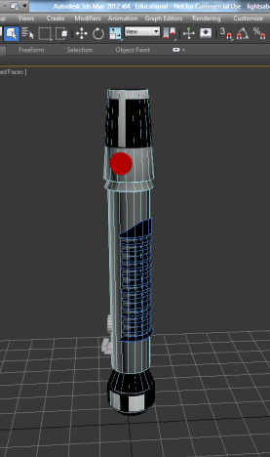
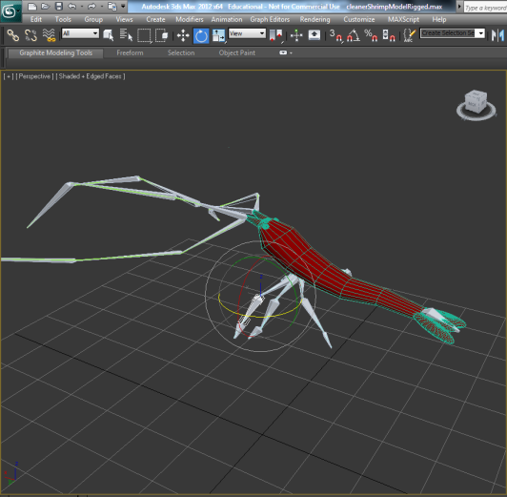
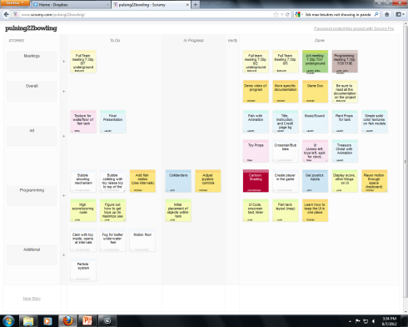
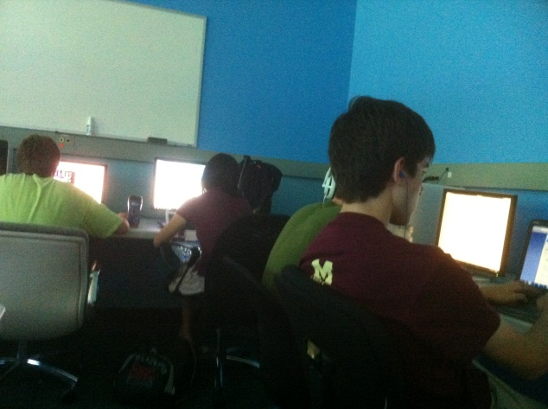
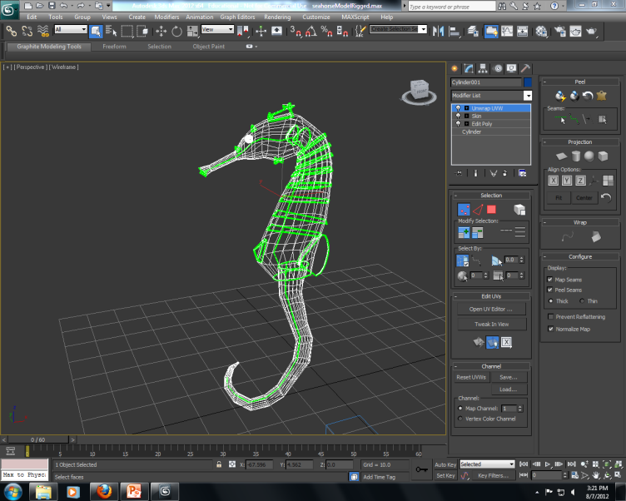
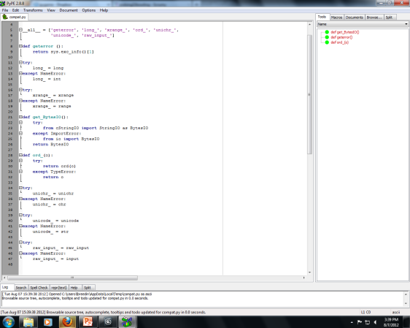
Development

Slide 5
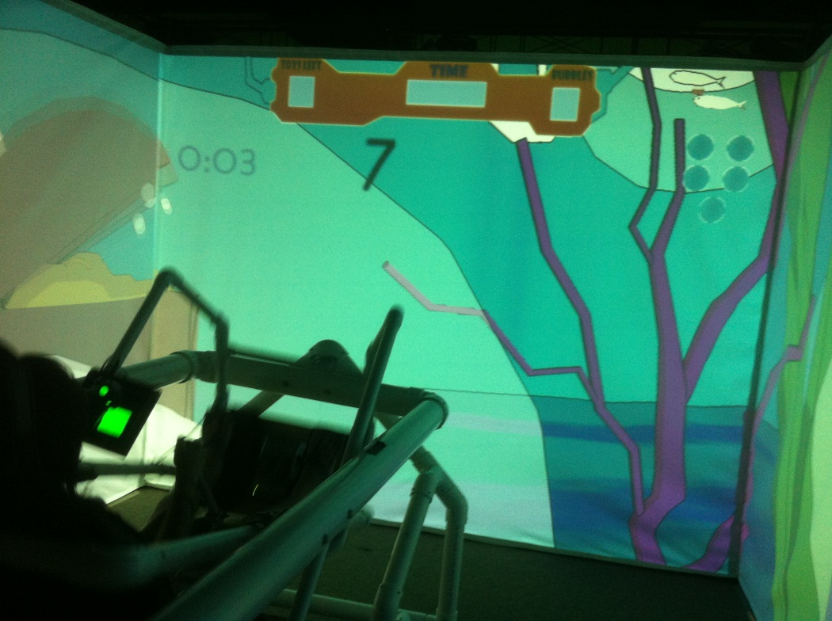
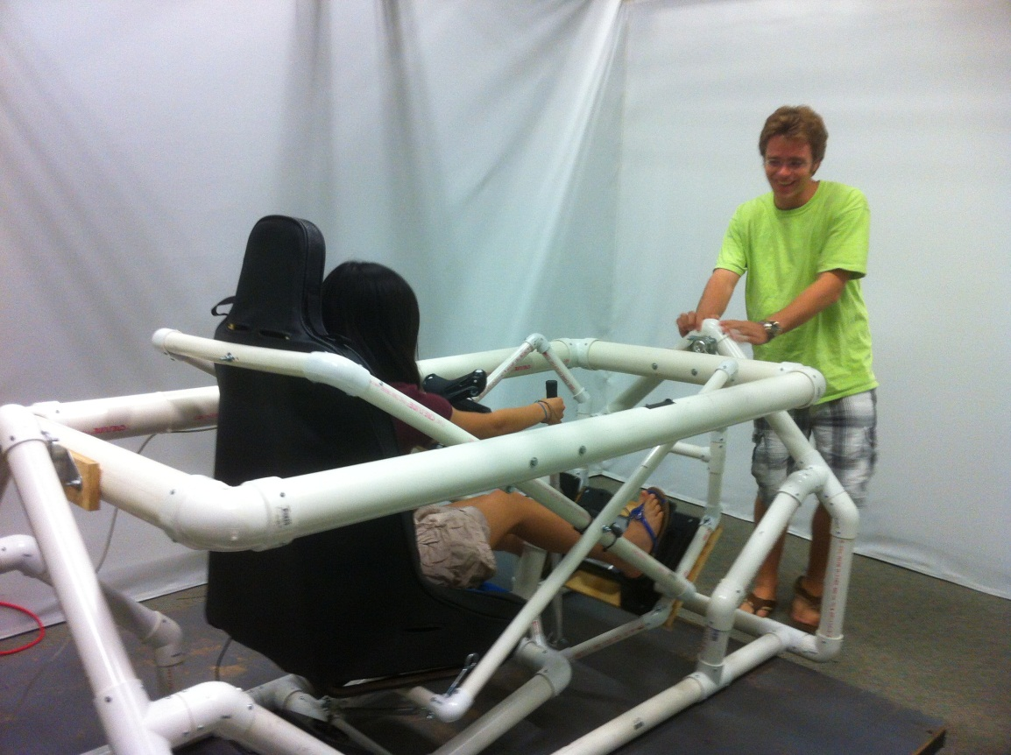
Hardware

Slide 6
Gameplay

Slide 7
Lessons Learned

Slide 8
Thanks!

