Slide 1



Yale SCHOOL OF THE ENVIRONMENT Research Computing
GitHub Workshop

Slide 2
Yale SCHOOL OF THE ENVIRONMENT Research Computing
Who?
Mitchell Horn, Senior Research Data Analyst, YSE
Stanley Tan, Research Data Support, YSE
What?
GitHub (slides here: github.com/mitchellxh/git-workshop-1)
Why?
Version Controlling, Collaborative Research, Software Tools, & more
How?
Slides, Demo, and Hands-on Practical
Goal?
Create your own GitHub account & explore what’s relevant to your work

Slide 3


Yale SCHOOL OF THE ENVIRONMENT Research Computing

Slide 4

Yale SCHOOL OF THE ENVIRONMENT Research Computing

Slide 5
Yale SCHOOL OF THE ENVIRONMENT Research Computing
Microsoft
Amazon
Google

Slide 6
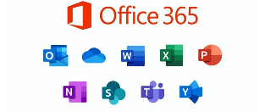


Yale SCHOOL OF THE ENVIRONMENT Research Computing
Microsoft
Amazon
Google
GitHub
GitHub

Slide 7



Yale SCHOOL OF THE ENVIRONMENT Research Computing
Microsoft
Amazon
Google
Azure
AWS
Google Cloud
GitHub
GitHub

Slide 8



Yale SCHOOL OF THE ENVIRONMENT Research Computing
Microsoft
Amazon
Google
Azure
AWS
Google Cloud
GitHub
CodeCommit
Google Collab
GitHub
GitHub

Slide 9
Yale SCHOOL OF THE ENVIRONMENT Research Computing
Microsoft
Amazon
Google
Azure
AWS
Google Cloud
GitHub
CodeCommit
Google Collab
GitHub
GitHub

Slide 10
Yale SCHOOL OF THE ENVIRONMENT Research Computing
GitHub
THE CLOUD
Remote place you store and share your programming work
Owned by Microsoft (circa 2018)
Expansive and difficult to exhaustively explain
https://github.com/

Slide 11
Yale SCHOOL OF THE ENVIRONMENT Research Computing
GitHub
Programming/Software Development
Version Control
Distribution – making things publicly accessible
Documentation – making things usable

Slide 12
Yale SCHOOL OF THE ENVIRONMENT Research Computing
GitHub
Programming/Software Development
Version Control
Distribution – making things publicly available
Documentation – making things usable

Slide 13


Yale SCHOOL OF THE ENVIRONMENT Research Computing
Version Control
Project: ideal-espresso
Time

Slide 14
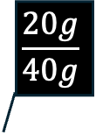
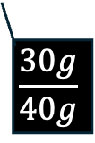
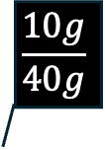
Yale SCHOOL OF THE ENVIRONMENT Research Computing
Version Control
Project: ideal-espresso
$$\frac{10g}{40g}$$
$$\frac{20g}{40g}$$
Time
$$\frac{30g}{40g}$$

Slide 15

Yale SCHOOL OF THE ENVIRONMENT Research Computing
Version Control
Project: ideal-espresso
$$\frac{10g}{40g}$$
$$\frac{20g}{40g}$$
Time
$$\frac{30g}{40g}$$

Slide 16

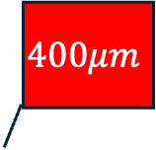
Yale SCHOOL OF THE ENVIRONMENT Research Computing
Version Control
Project: ideal-espresso
$$400μm$$
$$320μm$$
$$\frac{10g}{40g}$$
$$\frac{20g}{40g}$$
Time
$$\frac{30g}{40g}$$

Slide 17
Yale SCHOOL OF THE ENVIRONMENT Research Computing
Version Control
Project: ideal-espresso
$$400μm$$
$$320μm$$
$$\frac{10g}{40g}$$
$$\frac{20g}{40g}$$
Time
$$\frac{30g}{40g}$$

Slide 18
Yale SCHOOL OF THE ENVIRONMENT Research Computing
Version Control
Project: ideal-espresso
$$400μm$$
$$320μm$$
$$\frac{10g}{40g}$$
$$\frac{20g}{40g}$$
Time
$$\frac{30g}{40g}$$

Slide 19


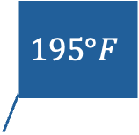
Yale SCHOOL OF THE ENVIRONMENT Research Computing
Version Control
Project: ideal-espresso
$$400μm$$
$$320μm$$
$$\frac{10g}{40g}$$
$$\frac{20g}{40g}$$
Time
$$\frac{30g}{40g}$$
$$195°F$$
$$200°F$$

Slide 20
Yale SCHOOL OF THE ENVIRONMENT Research Computing
Version Control
Project: ideal-espresso
$$400μm$$
$$320μm$$
$$\frac{10g}{40g}$$
$$\frac{20g}{40g}$$
Time
$$\frac{30g}{40g}$$
$$195°F$$
$$200°F$$

Slide 21
Yale SCHOOL OF THE ENVIRONMENT Research Computing
Version Control
Project: ideal-espresso
$$400μm$$
$$320μm$$
$$\frac{10g}{40g}$$
$$\frac{20g}{40g}$$
Time
$$\frac{30g}{40g}$$
$$195°F$$
$$200°F$$

Slide 22
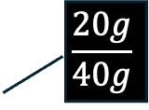


Yale SCHOOL OF THE ENVIRONMENT Research Computing
Version Control
Project: ideal-espresso
$$\frac{20g}{40g}$$
$$320μm$$
Time
$$200°F$$

Slide 23


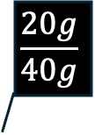
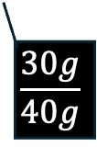
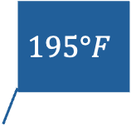
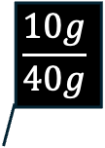
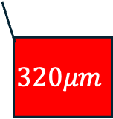
Yale SCHOOL OF THE ENVIRONMENT Research Computing
Version Control
Project: ideal-espresso
$$\frac{20g}{40g}$$
$$\frac{10g}{40g}$$
$$\frac{20g}{40g}$$
$$400μm$$
$$195°F$$
$$320μm$$
Time
$$\frac{30g}{40g}$$
$$320μm$$
$$200°F$$
$$200°F$$

Slide 24
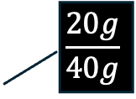

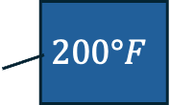
Yale SCHOOL OF THE ENVIRONMENT Research Computing
Version Control
$$\frac{20g}{40g}$$
Time
$$320μm$$
$$200°F$$

Slide 25
Yale SCHOOL OF THE ENVIRONMENT Research Computing
Colombian Beans
Version Control
Ethiopian Beans
$$\frac{20g}{40g}$$
Indian Beans
Time
$$320μm$$
$$200°F$$

Slide 26
Yale SCHOOL OF THE ENVIRONMENT Research Computing
Colombian Beans
Version Control
Ethiopian Beans
$$\frac{20g}{40g}$$
Indian Beans
Time
$$320μm$$
Light Roast
$$200°F$$
Med Roast
Dark Roast

Slide 27
Yale SCHOOL OF THE ENVIRONMENT Research Computing
Version Control
$$\frac{20g}{40g}$$
Time
$$320μm$$
Calibration Matrix
 | Ethiopian | Colombian | Indian
Light Roast | Bright, acidic; 22g/46g | Balanced, fruity; 20g/42g | Mild, nutty; 20g/40g
Medium Roast | Juicy, winey; 20g/42g | Sweet, caramelly; 20g/42g | Full body, smooth; 19g/40g
Dark Roast | Bold, roasty; 19g/40g | Heavy caramel; 18g/38g | Smoky, chocolatey; 18g/38g
$$200°F$$

Slide 28
Yale SCHOOL OF THE ENVIRONMENT Research Computing
GitHub
Programming/Software Development
Version Control
Distribution – making things publicly accessible
Documentation – making things usable

Slide 29
Yale SCHOOL OF THE ENVIRONMENT Research Computing
Terms
Key GitHub Items
directory: a folder containing files
repository: a directory that is tracked by git. ( repo )
branch: a particular version of a repository
main: the original branch
readme: a text file that explains the scope of the project

Slide 30
Yale SCHOOL OF THE ENVIRONMENT Research Computing
GitHub Examples
Open Data
MODIS Remote Sensing Data
Educational Resources
Environmental Data Science
Ecological Data Resource Directory
Packages
EPHTrack R (Public Health)
coldpool (sea temperatures)
Pandas Genomics
Personal Bio
Template
Jesse Eaton (example)

Slide 31

Yale SCHOOL OF THE ENVIRONMENT Research Computing
GitHub Activity 1
https://github.com/

Slide 32
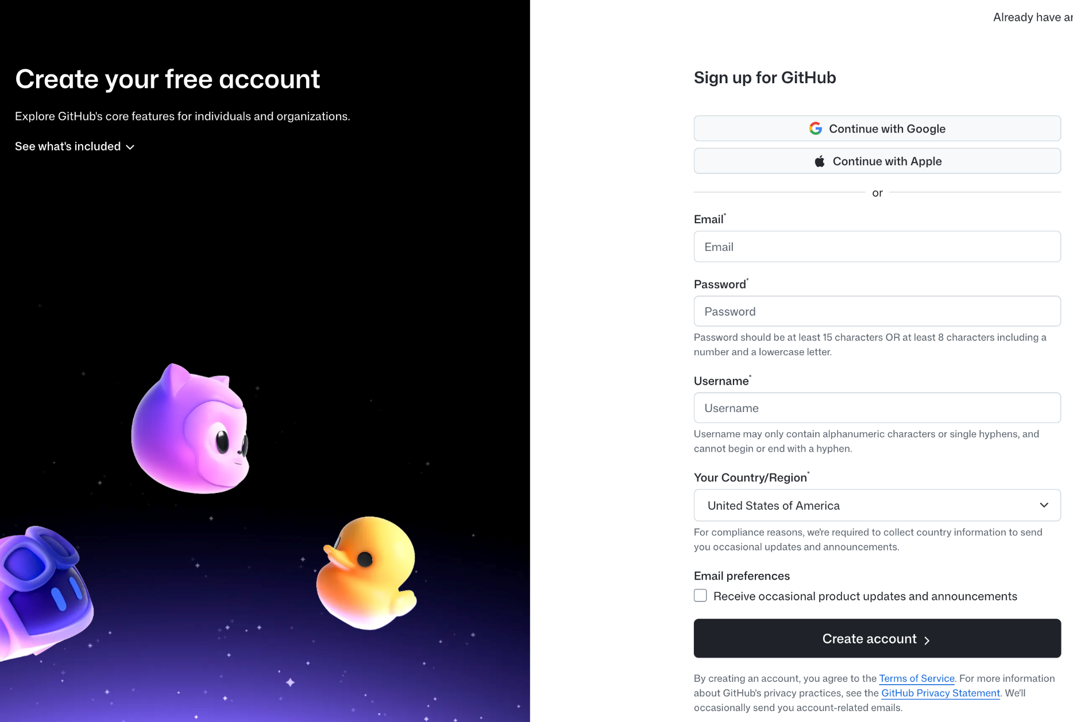
Yale SCHOOL OF THE ENVIRONMENT Research Computing
GitHub Activity 1: Make an Account

Slide 33
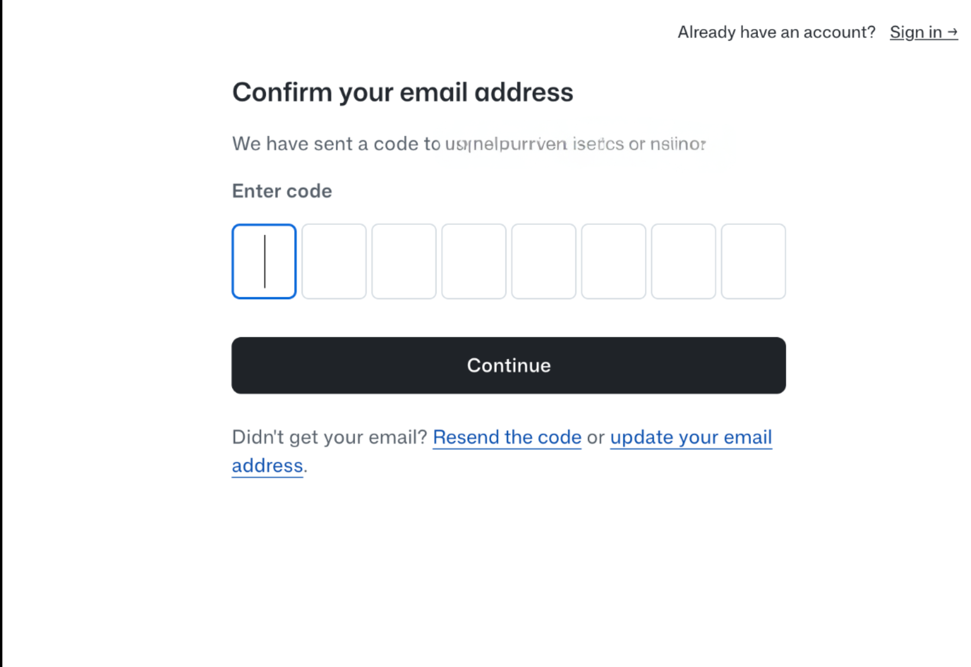
Yale SCHOOL OF THE ENVIRONMENT Research Computing
GitHub Activity 1
GitHub Activity 1: Make an Account

Slide 34
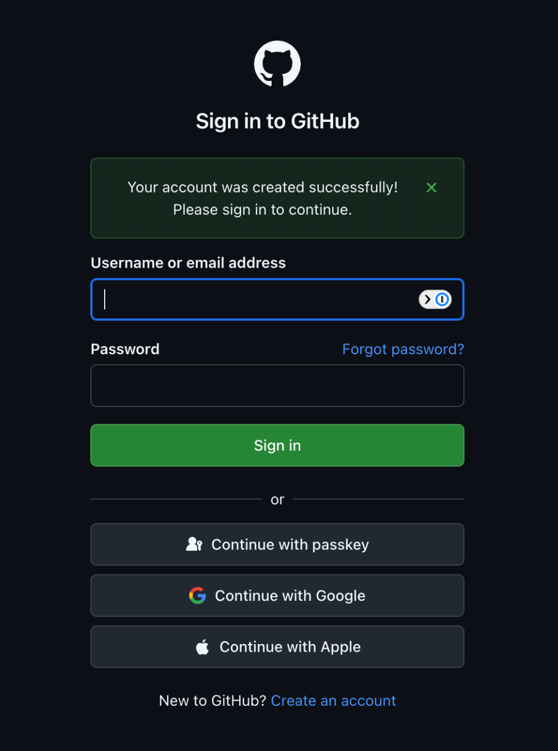
Yale SCHOOL OF THE ENVIRONMENT Research Computing
GitHub Activity 1: Make an Account

Slide 35
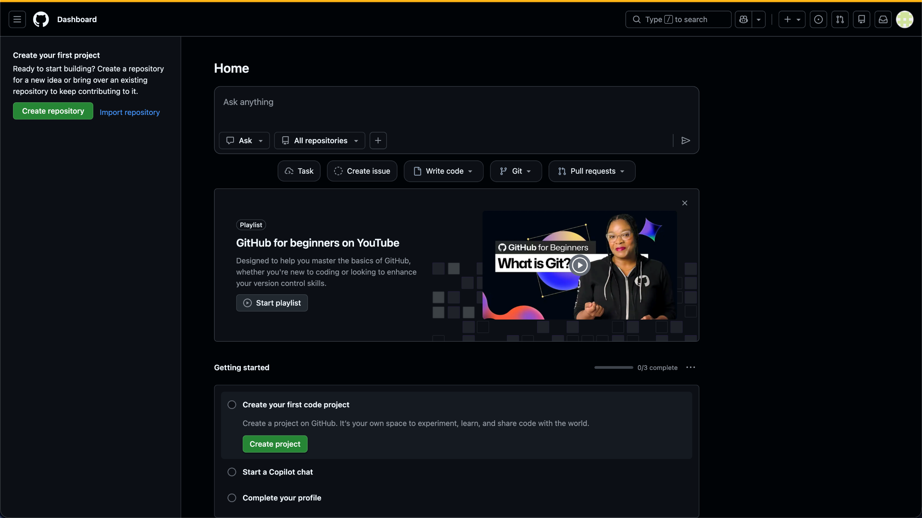
Yale SCHOOL OF THE ENVIRONMENT Research Computing
GitHub Activity 1: Make an Account

Slide 36
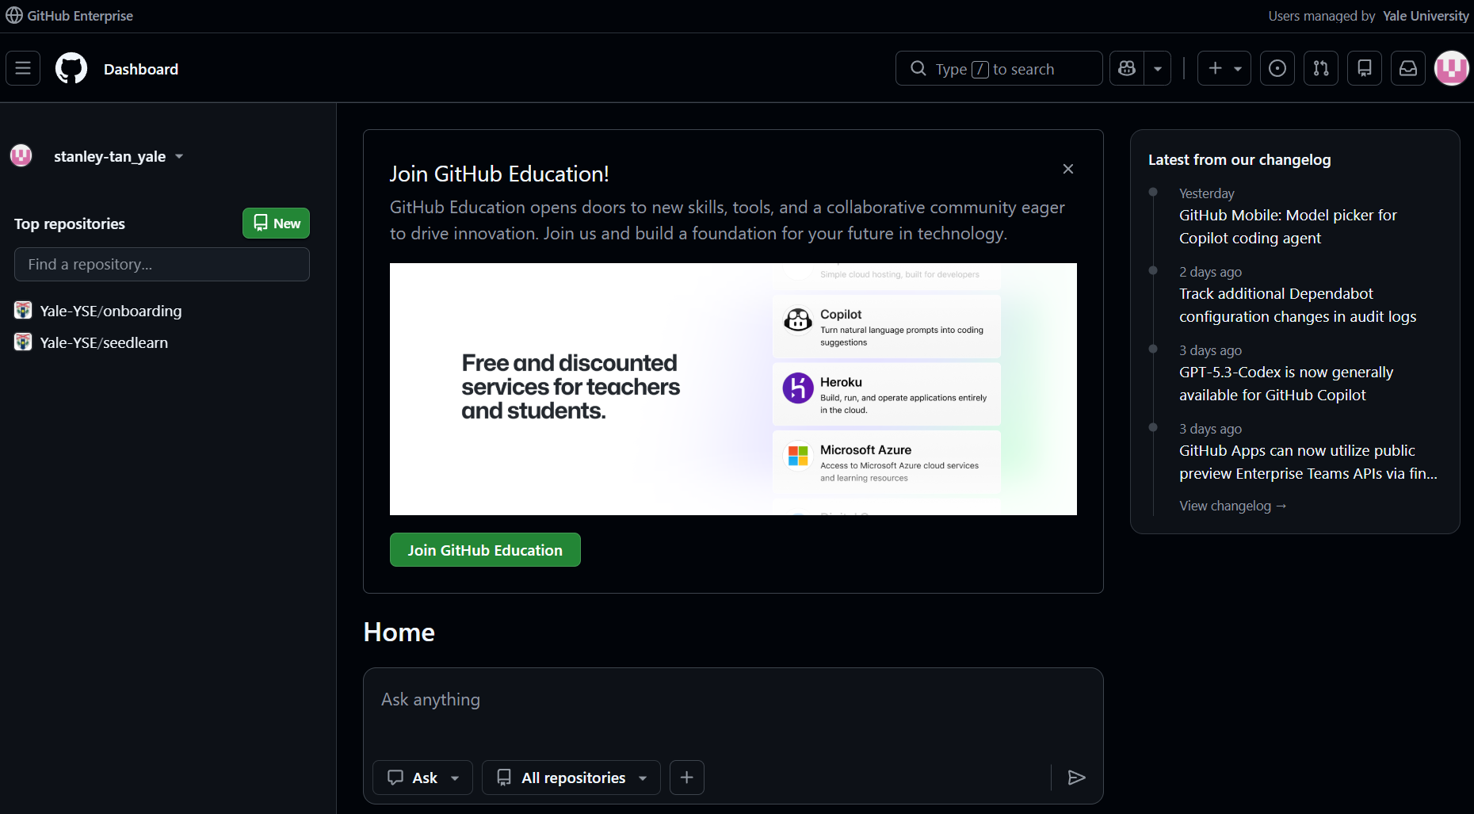
Yale SCHOOL OF THE ENVIRONMENT Research Computing
GitHub Activity 2: Create a Repository

Slide 37
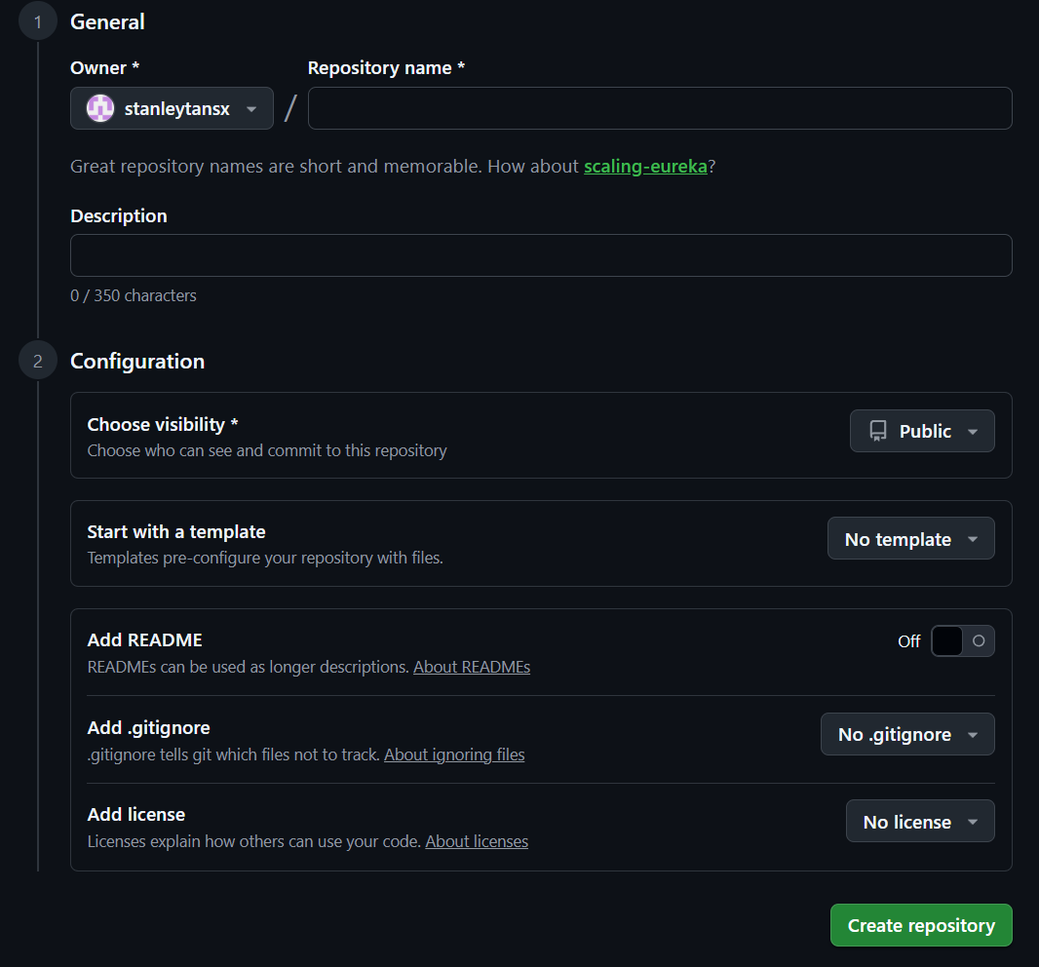
Yale SCHOOL OF THE ENVIRONMENT Research Computing
GitHub Activity 2: Create a Repository

Slide 38
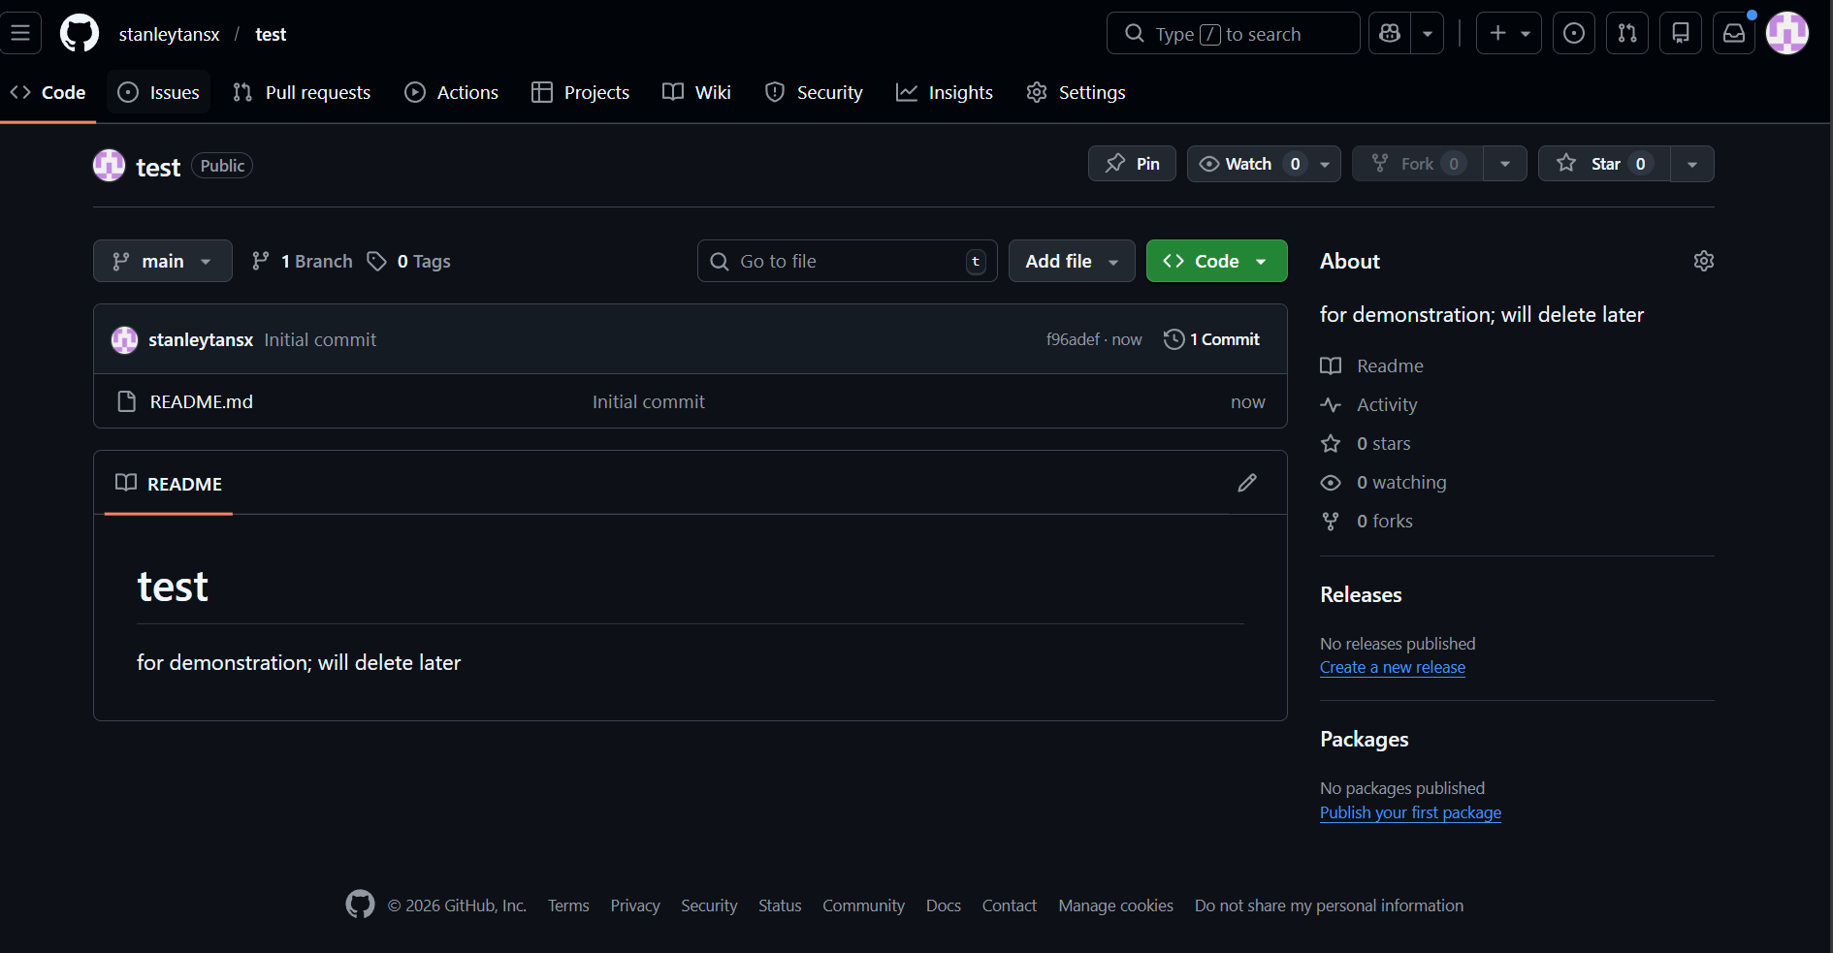
Yale SCHOOL OF THE ENVIRONMENT Research Computing
GitHub Activity 2: Create a Repository

Slide 39
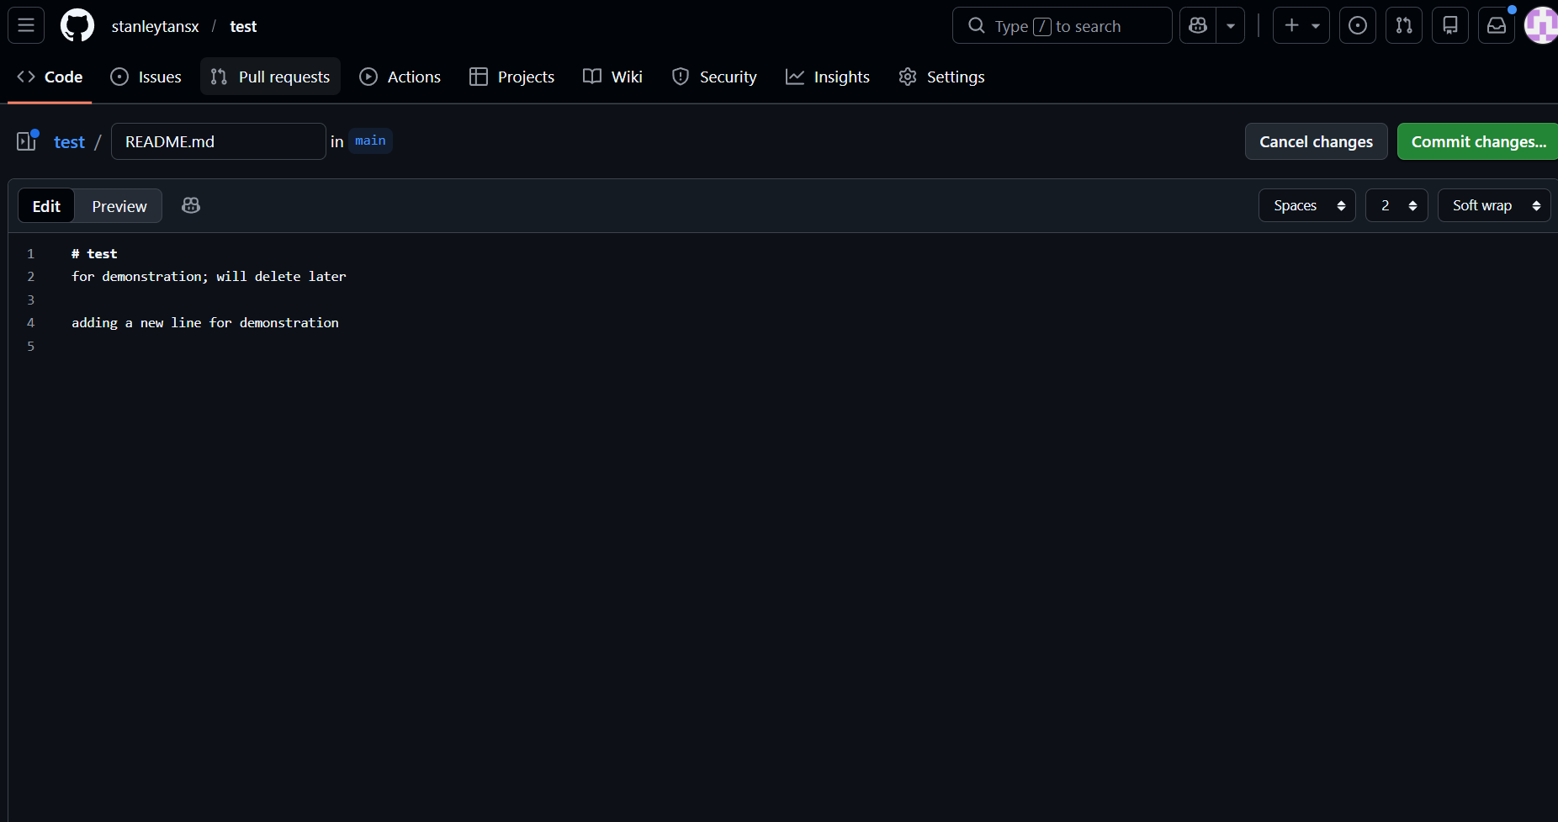
Yale SCHOOL OF THE ENVIRONMENT Research Computing
GitHub Activity 2: Create a Repository

Slide 40
Yale SCHOOL OF THE ENVIRONMENT Research Computing
GitHub Activity 2: Create a Repository

Slide 41
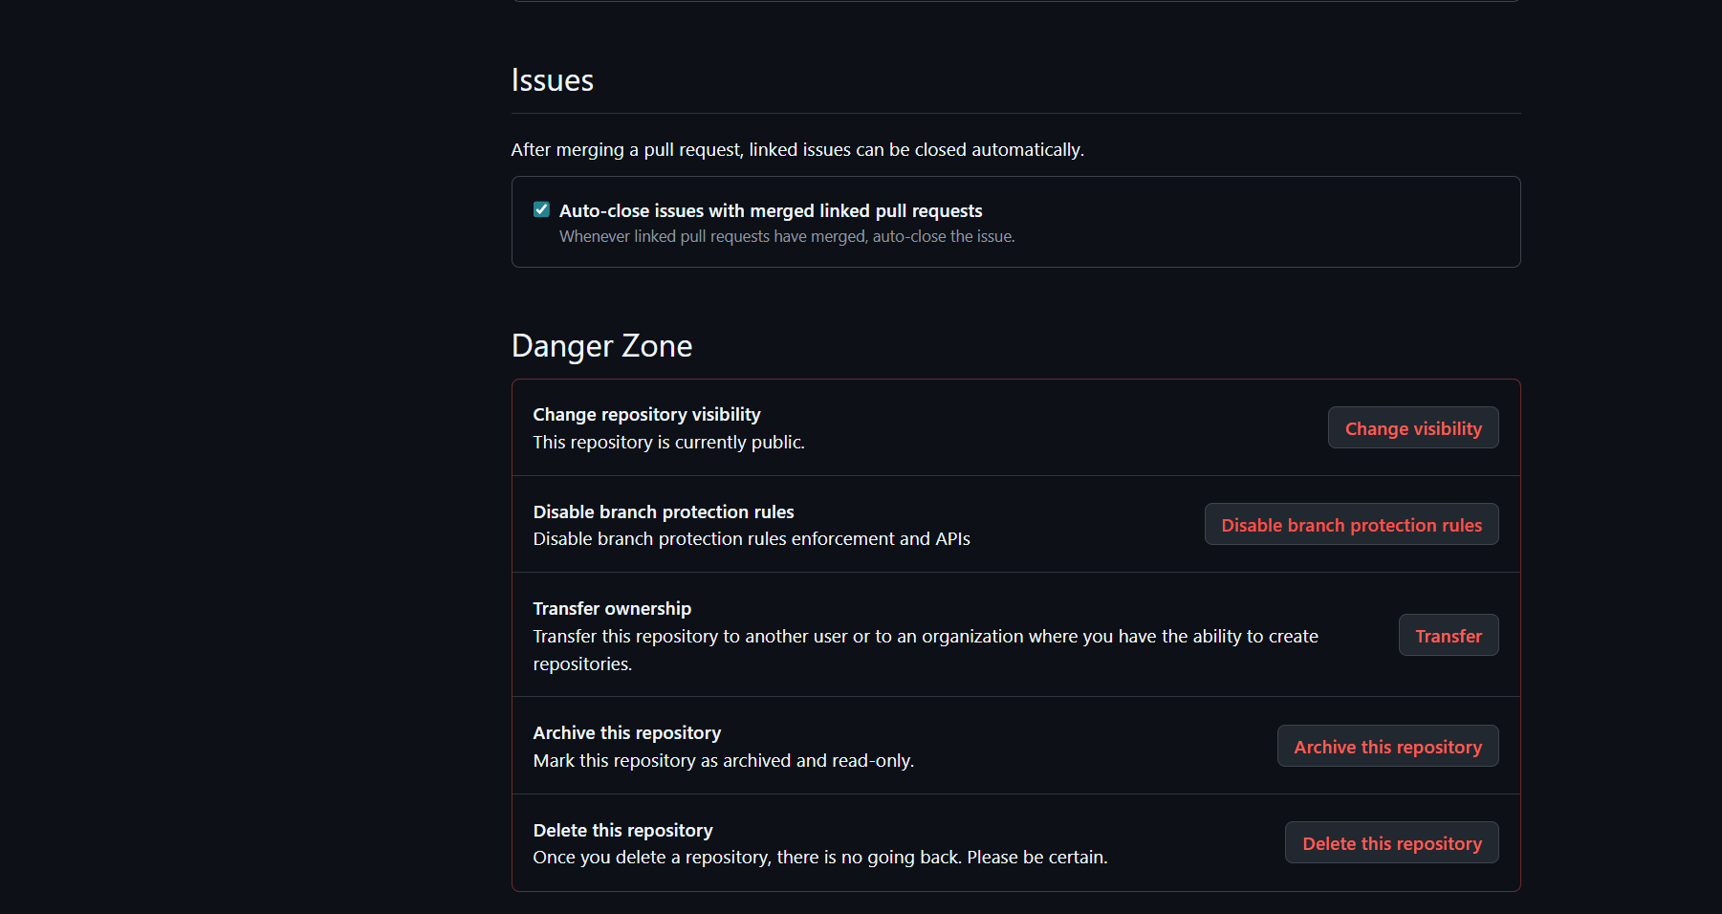
Yale SCHOOL OF THE ENVIRONMENT Research Computing
GitHub Activity 2: Create a Repository

Slide 42
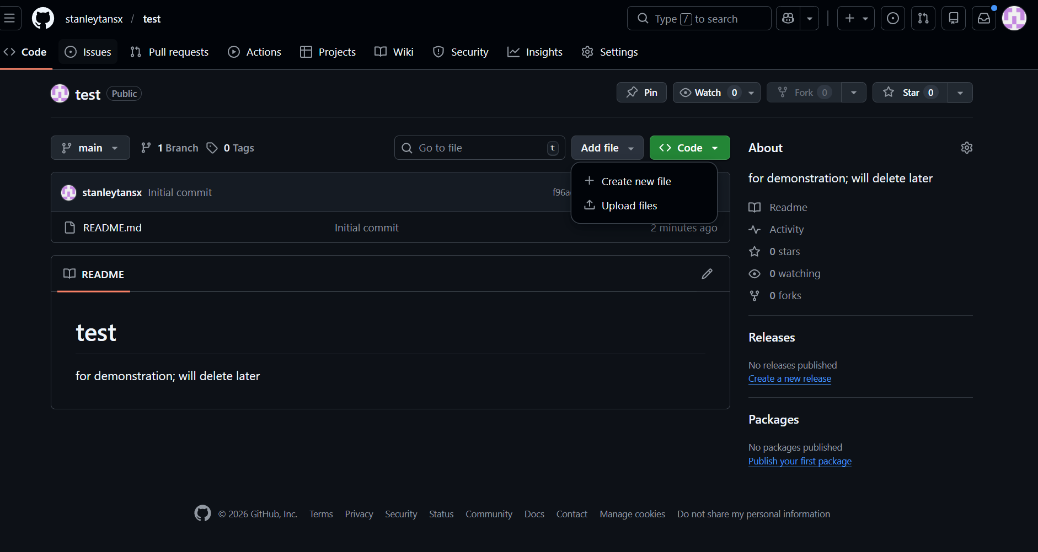
Yale SCHOOL OF THE ENVIRONMENT Research Computing
GitHub Activity 2: Create a directory and file

Slide 43
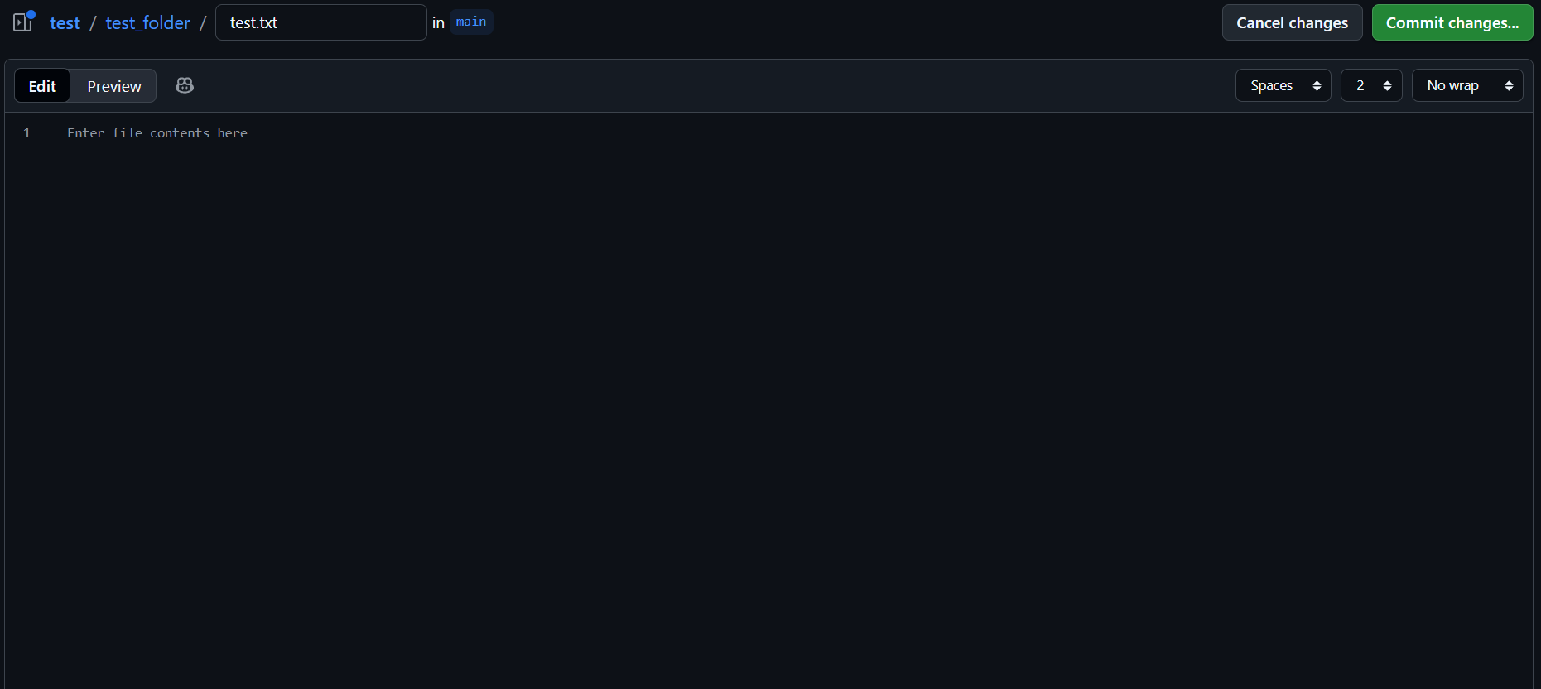
Yale SCHOOL OF THE ENVIRONMENT Research Computing
GitHub Activity 2: Create a directory and file

Slide 44
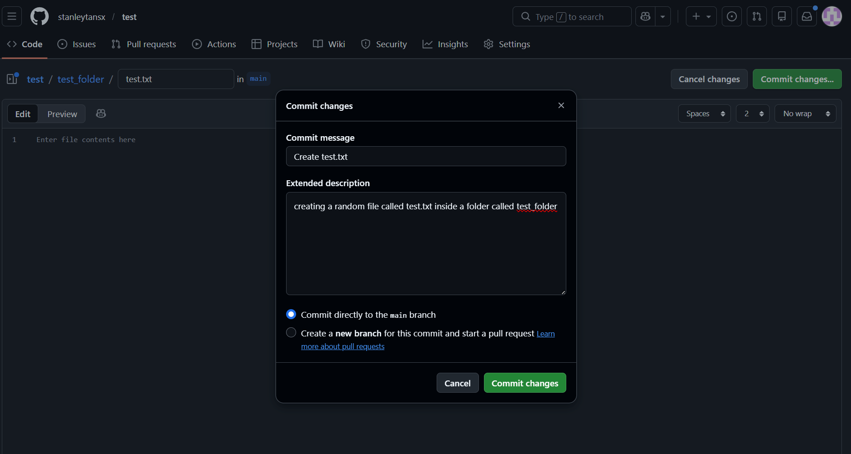
Yale SCHOOL OF THE ENVIRONMENT Research Computing
GitHub Activity 2: Create a directory and file

Slide 45
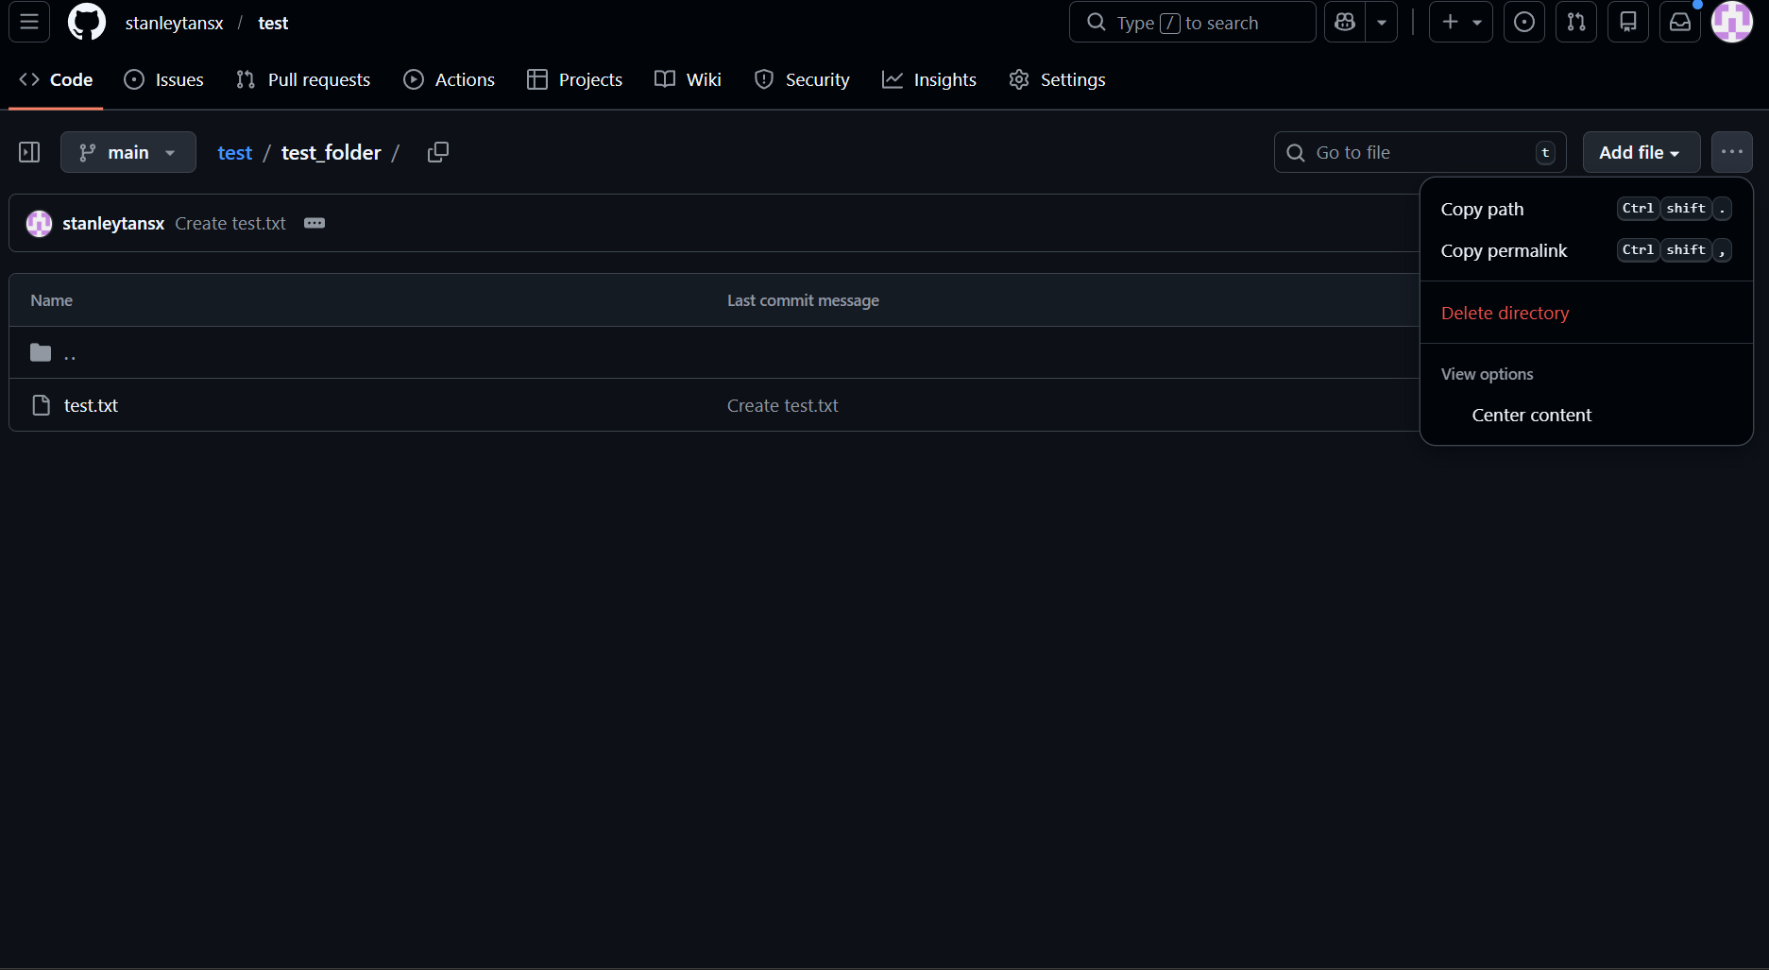
Yale SCHOOL OF THE ENVIRONMENT Research Computing
GitHub Activity 2: Create a directory and file

Slide 46
Yale SCHOOL OF THE ENVIRONMENT Research Computing
GitHub Activity 3:
Go to:
github.com/mitchellxh/git-workshop-1

Slide 47
Yale SCHOOL OF THE ENVIRONMENT Research Computing
Optional Activity: Getting Access to GitHub Education
GitHub Education is a platform that provides free access to a wide range of developer tools, cloud services, and educational content.
Graduate and undergraduate students at educational institutions can register on GitHub for the Education benefits. Benefits include Copilot Pro, 180 monthly Codespaces hours, and premium tools in the Student Developer Pack.
Follow the steps in the following slides to register for GitHub Education (you first must have an existing GitHub account!).

Slide 48
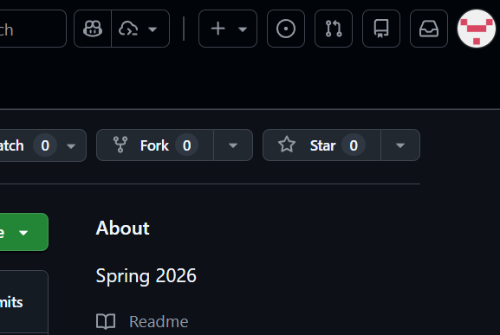
Yale SCHOOL OF THE ENVIRONMENT Research Computing
Optional Activity: Getting Access to GitHub Education
Step 1: Click on your profile and go to Settings

Slide 49
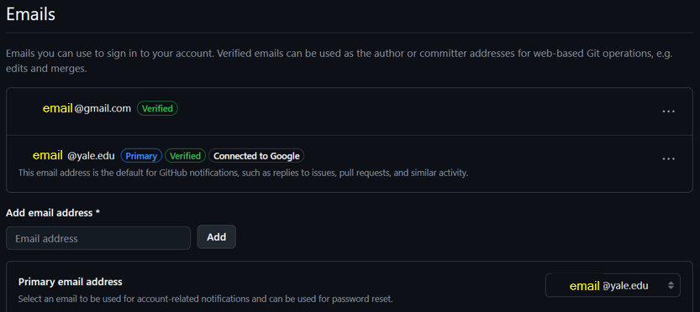
Yale SCHOOL OF THE ENVIRONMENT Research Computing
Optional Activity: Getting Access to GitHub Education
Step 2: On the left panel, under Access, click Emails; ensure that you add your Yale email (all in lowercase; e.g. first.last@yale.edu) and set it as the primary email

Slide 50
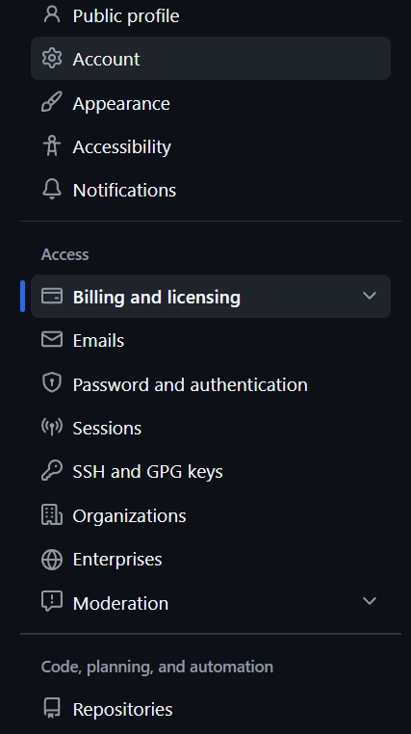
Yale SCHOOL OF THE ENVIRONMENT Research Computing
Optional Activity: Getting Access to GitHub Education
Step 3: On the left panel, under Access, click Billing and licensing

Slide 51
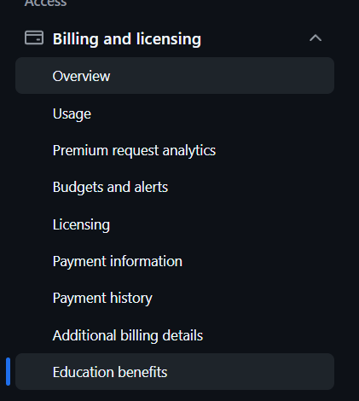
Yale SCHOOL OF THE ENVIRONMENT Research Computing
Optional Activity: Getting Access to GitHub Education
Step 4: Click Education benefits

Slide 52
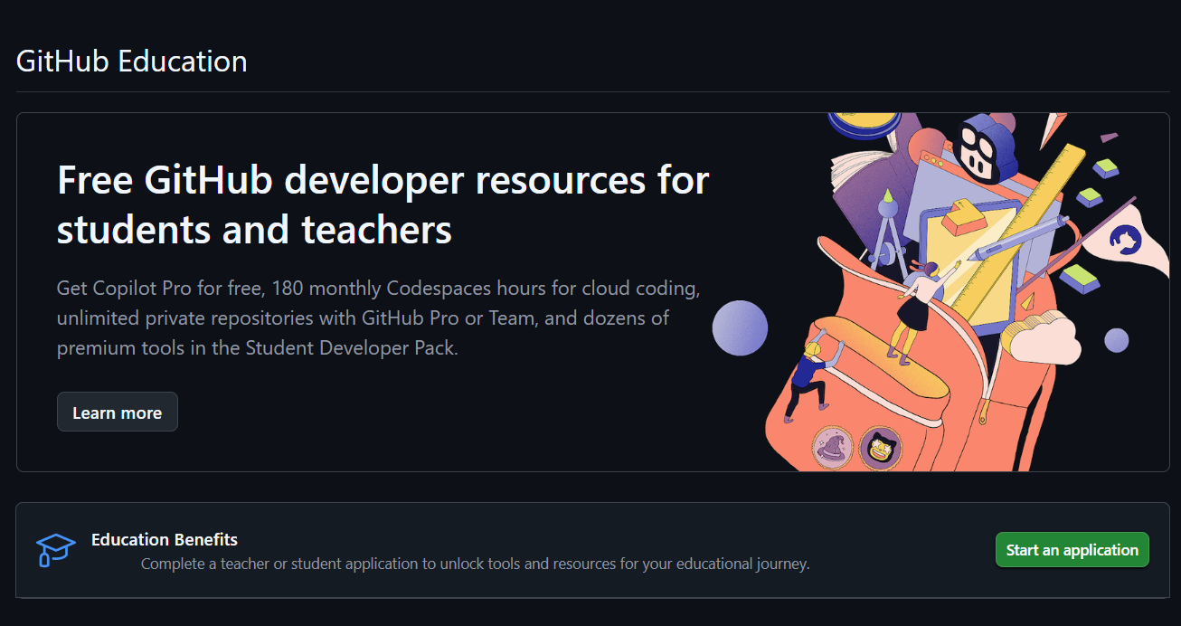
Yale SCHOOL OF THE ENVIRONMENT Research Computing
Optional Activity: Getting Access to GitHub Education
Step 5: Start the application

Slide 53
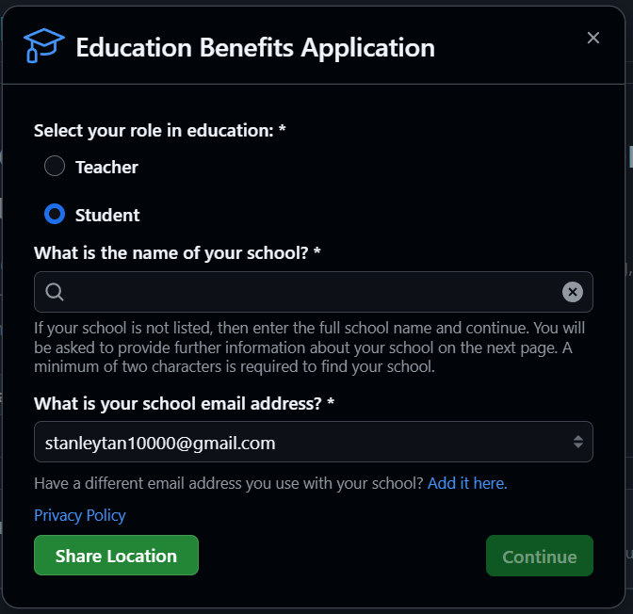
Yale SCHOOL OF THE ENVIRONMENT Research Computing
Optional Activity: Getting Access to GitHub Education
Step 6: Complete the application, use your Yale email for school email

Slide 54
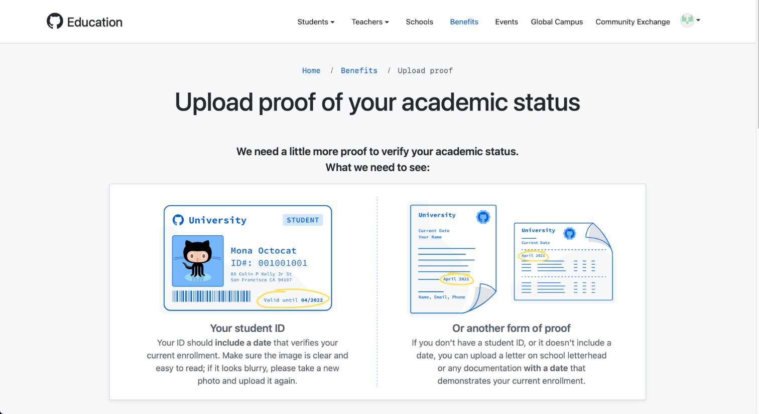
Yale SCHOOL OF THE ENVIRONMENT Research Computing
Optional Activity: Getting Access to GitHub Education
Step 7: Upload Yale ID or transcript to verify student status. Before submitting the ID, enable location on your device you are using for GitHub to verify that you are close to the educational institute (e.g. New Haven)

Slide 55
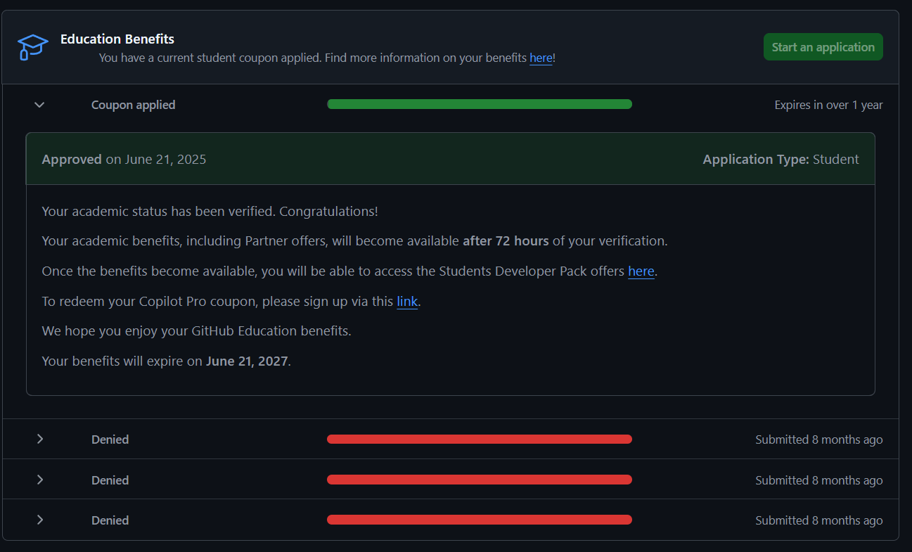
Yale SCHOOL OF THE ENVIRONMENT Research Computing
Optional Activity: Getting Access to GitHub Education
Step 8: Check the outcomes of the application (usually it takes a few minutes) and the interface will show if the application was successful or not. If was denied, there will be a reason stated and use that to troubleshoot.

Slide 56
Yale SCHOOL OF THE ENVIRONMENT Research Computing
Optional Activity: Getting Access to GitHub Education
If the application is successful, congratulations! Do explore the many resources on GitHub Education, there are many great educational materials.
Reach out if you encounter any issues!

