Slide 1


Yale SCHOOL OF THE ENVIRONMENT
Research Computing
GitHub Workshop II
Spring 2026

Slide 2
Yale SCHOOL OF THE ENVIRONMENT
Research Computing
Who?
Mitchell Horn, Senior Research Data Analyst, YSE
Stanley Tan, Research Data Support, YSE
What?
Git & GitHub – Part 2
Why?
Connect your computer to GitHub and publish your work
How?
Hands-on: SSH setup, git commands, and GitHub Pages
Goal?
Your own live website at github.io

Slide 3
Yale SCHOOL OF THE ENVIRONMENT
Research Computing
Recap: Part 1
Created a GitHub account
Set up GitHub Education benefits
Used the GitHub web interface:
Created repositories (public vs. private)
Created and edited files in the browser
Starred and forked repositories
Learned key terms: repository, branch, main, README
Today: we leave the browser and work from the command line.

Slide 4
Yale SCHOOL OF THE ENVIRONMENT
Research Computing
Before We Start
1. You have a GitHub account and can log in
2. You have a terminal with git installed
Recommended: get an interactive session on YCRC Bouchet
To check if git is installed:
git --version

Slide 5
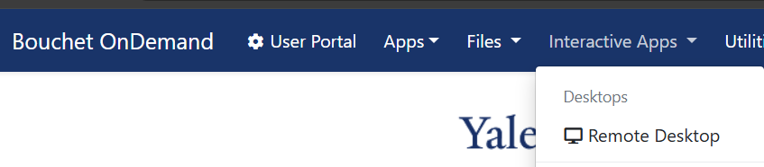
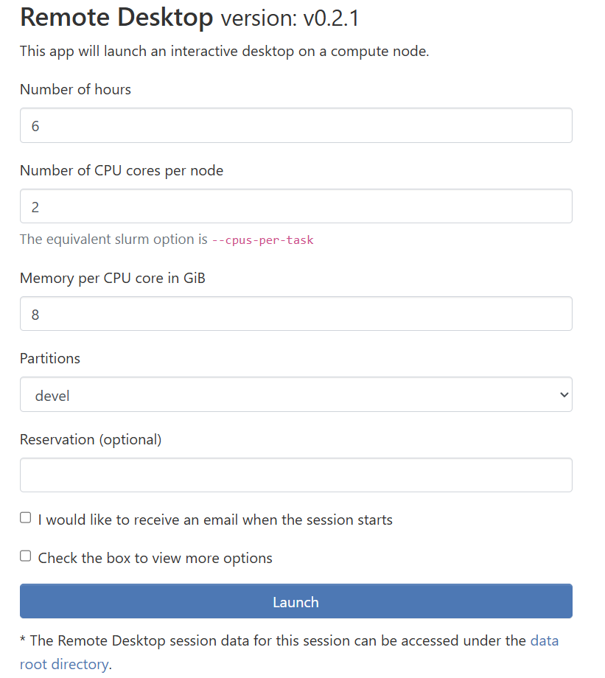
Yale SCHOOL OF THE ENVIRONMENT
Research Computing
YCRC Bouchet Interactive Session
1. ood-bouchet.ycrc.yale.edu (Yale Network / VPN)
2.
3.
Hours: 6
CPUs: 2
Memory: 2
Partition: devel

Slide 6
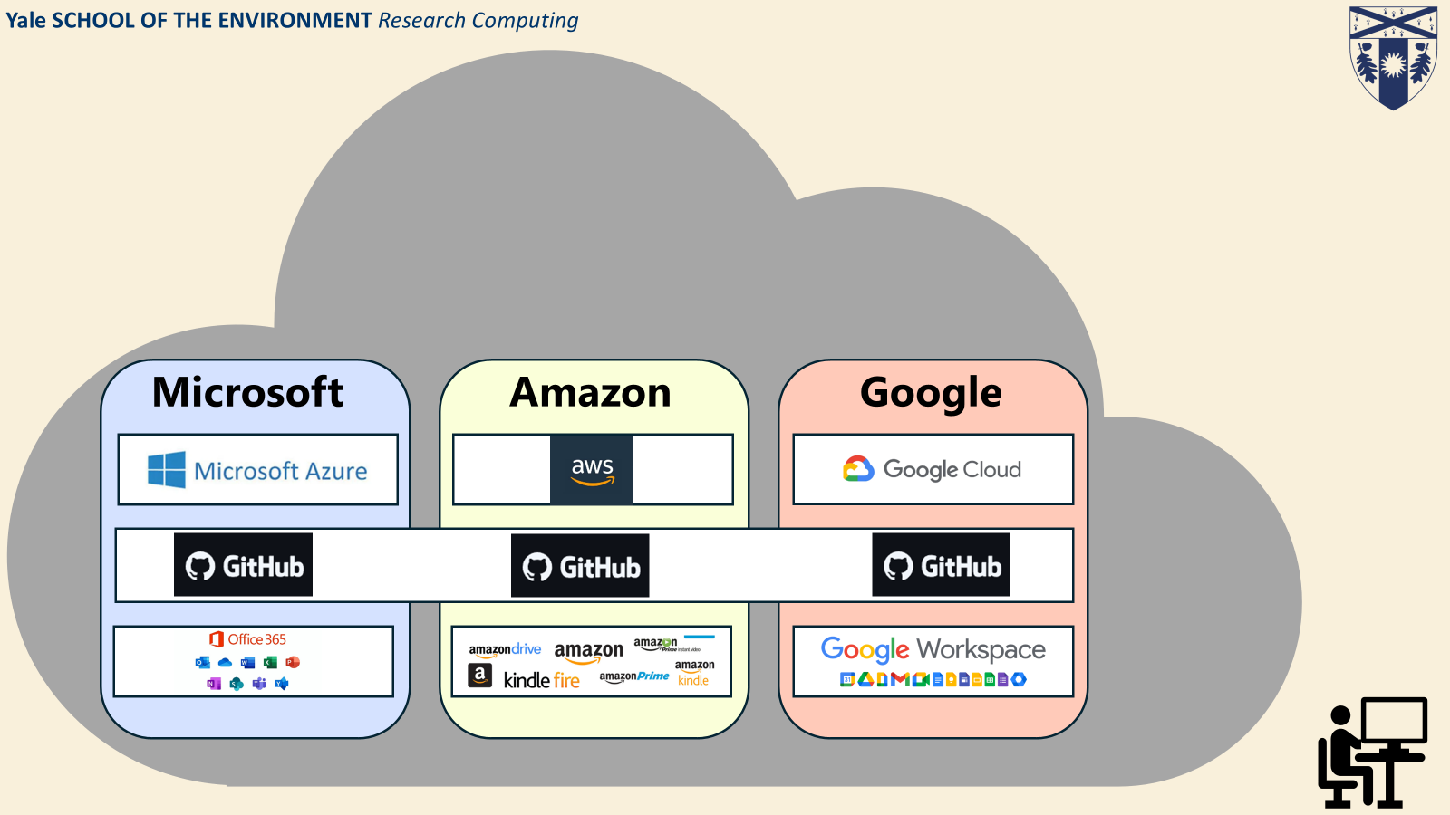
Yale SCHOOL OF THE ENVIRONMENT
Research Computing
Where Does GitHub Live?
[PLACEHOLDER: Copy cloud diagram from Workshop 1, Slides 7-9]
The cloud providers and where GitHub fits:
• Microsoft → Azure, GitHub
• Amazon → AWS, CodeCommit
• Google → Google Cloud, Colab
GitHub is a cloud service for storing and sharing code.
CLOUD SERVICES

Slide 7


Yale SCHOOL OF THE ENVIRONMENT Research Computing
GitHub
THE CLOUD
Remote place you store and share your programming work
Owned by Microsoft (circa 2018)
Expansive and difficult to exhaustively explain
https://github.com/

Slide 8
Yale SCHOOL OF THE ENVIRONMENT
Research Computing
git
≠
GitHub
git — Software installed on your computer. A version control tool.
GitHub — A cloud service that hosts git repositories. A website.
git is how your computer talks to GitHub.

Slide 9
Yale SCHOOL OF THE ENVIRONMENT
Research Computing
Connecting Your Computer to GitHub
To connect your computer to GitHub, GitHub needs to verify who you are.
Why not just a password?
GitHub removed password authentication in August 2021
Passwords are easily phished and reused across sites
SSH keys are cryptographic — far more secure
Once set up, no need to enter credentials again
Tokens expire, need regular management & cycling
Solution: SSH keys — a secure, passwordless connection.

Slide 10



Yale SCHOOL OF THE ENVIRONMENT
Research Computing
How SSH Keys Work
Create a lock (public-key) and key (private-key)
your device

Slide 11

Yale SCHOOL OF THE ENVIRONMENT
Research Computing
How SSH Keys Work
Create a lock (public-key) and key (private-key)
Share the lock (public-key) with the remote server
your device
remote server
GitHub
YCRC
AWS

Slide 12

Yale SCHOOL OF THE ENVIRONMENT
Research Computing
How SSH Keys Work
Create a lock (public-key) and key (private-key)
Share the lock (public-key) with the remote server
Initiate an SSH connection from your device
your device
remote server
GitHub
YCRC
AWS
"Hi, it's Mitch's Laptop..."

Slide 13
Yale SCHOOL OF THE ENVIRONMENT
Research Computing
How SSH Keys Work
Create a lock (public-key) and key (private-key)
Share the lock (public-key) with the remote server
Initiate an SSH connection from your device
Remote server recognizes your device and presents lock
your device
remote server
GitHub
YCRC
AWS
"Oh, it's you.."

Slide 14
Yale SCHOOL OF THE ENVIRONMENT
Research Computing
How SSH Keys Work
Create a lock (public-key) and key (private-key)
Share the lock (public-key) with the remote server
Initiate an SSH connection from your device
Remote server recognizes your device and presents lock
Your device recognizes the lock and presents the key
your device
remote server
GitHub
YCRC
AWS

Slide 15

Yale SCHOOL OF THE ENVIRONMENT
Research Computing
How SSH Keys Work
Create a lock (public-key) and key (private-key)
Share the lock (public-key) with the remote server
Initiate an SSH connection from your device
Remote server recognizes your device and presents lock
Your device recognizes the lock and presents the key
Connection Established
your device
remote server
GitHub
YCRC
AWS

Slide 16
Yale SCHOOL OF THE ENVIRONMENT
Research Computing
How SSH Keys Work
SSH uses a key pair:
Private key (🔒 stays on YOUR computer — never share!)
Public key (🔓 goes to GitHub — like giving them your lock)
The analogy:
You give GitHub a lock (public key). Only your key (private key) can open it. When you connect, GitHub tests if your key fits the lock. If it does — you're in.

Slide 17
Yale SCHOOL OF THE ENVIRONMENT
Research Computing
SSH Setup: Step 1 – Generate Your Key Pair
Navigate to your SSH directory:
cd ~/.ssh
Generate a new SSH key:
ssh-keygen -t ed25519 -C "YOUR_GITHUB_EMAIL@email.com"
When prompted for a passphrase: press Enter twice (skip it).
Verify your keys were created:
ls -la
You should see two files:
github_class ← private key (NEVER share)
github_class.pub ← public key (this goes to GitHub)

Slide 18
Yale SCHOOL OF THE ENVIRONMENT
Research Computing
SSH Setup: Step 2 – Copy Your Public Key
Display your public key:
cat id_ed25519.pub
You'll see something like:
ssh-ed25519 AAAAC3Nza...long_string... YOUR_GITHUB_EMAIL@email.com
Select and copy ALL of it.
Tip: Ctrl+Shift+C to copy in most terminals

Slide 19
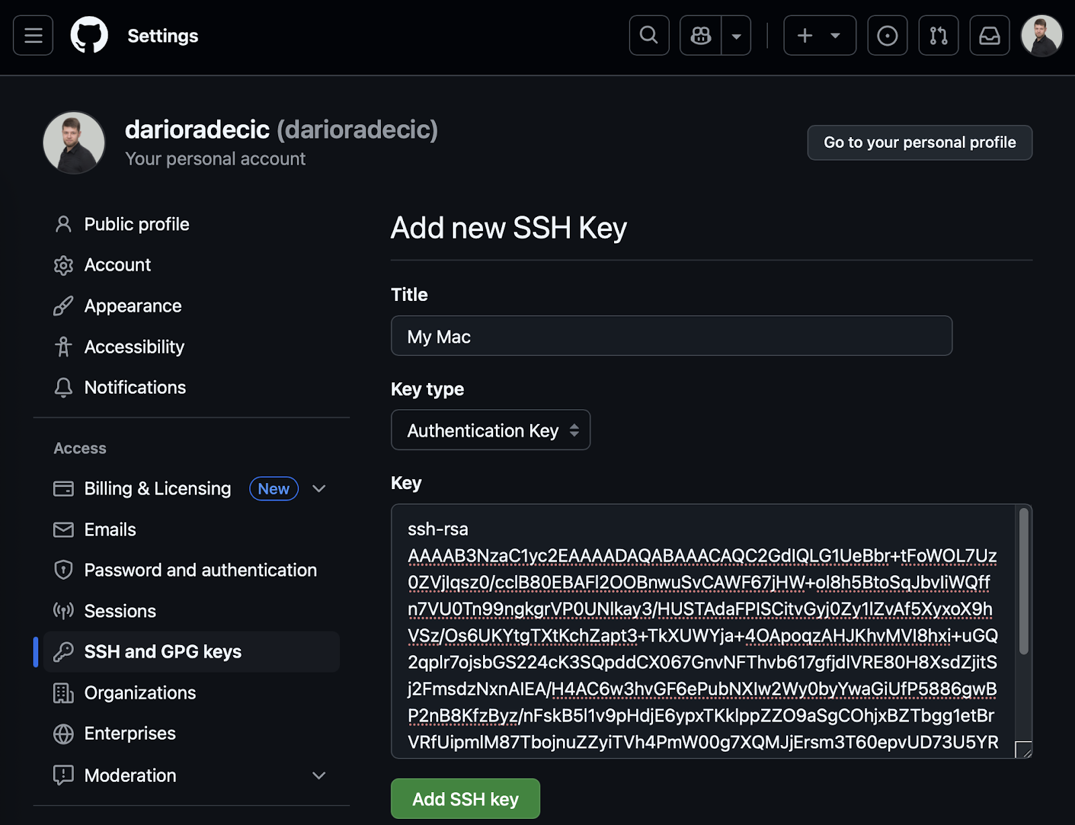
Yale SCHOOL OF THE ENVIRONMENT
Research Computing
SSH Setup: Step 3 – Add Key to GitHub
Go to GitHub.com → Profile picture → Settings
Click "SSH and GPG keys" (left sidebar)
Click "New SSH key" (green button)
Title: name of your computer (e.g., "Bouchet HPC")
Key type: Authentication Key
Paste the entire public key into the Key field
Click "Add SSH key"

Slide 20
Yale SCHOOL OF THE ENVIRONMENT
Research Computing
SSH Setup: Step 4 – Configure & Test
Test your connection:
ssh -T git@github.com
You should see:
"Hi [your-username]! You've successfully authenticated..."
If you see a warning about authenticity, type yes and press Enter.

Slide 21
Yale SCHOOL OF THE ENVIRONMENT
Research Computing
Git Setup: Tell Git Who You Are
One-time setup — use your real name and email:
git config --global user.name "Your Name"
git config --global user.email "your.email@example.com"
Verify:
git config --global --list
(press q to exit the list)
This attaches your name to every commit you make.
✅ You are now connected to GitHub from your computer!

Slide 22
Yale SCHOOL OF THE ENVIRONMENT
Research Computing
git clone
Copy a GitHub repository to your local machine.
What it does:
• Downloads all files from the repository
• Creates a folder on your computer with the repo name
• Sets up the connection (remote) back to GitHub
• Preserves the full version history
Think of it as: downloading a project AND its history, with a live link back to GitHub.

Slide 23
Yale SCHOOL OF THE ENVIRONMENT
Research Computing
Activity: Clone the Workshop Repository
Open your terminal and type:
cd ~/Desktop
git clone https://github.com/mitchellxh/git-workshop-2.git
cd git-workshop-2
Verify:
ls -l
You should see: index.html, style.css, script.js, README.md
clone : a git command that makes a local copy of a GitHub repository

Slide 24
Yale SCHOOL OF THE ENVIRONMENT
Research Computing
Activity: Personalize Your Page
Open index.html in your text editor:
Find YOUR_USERNAME → replace with your GitHub username
Change the heading to something personal
Save the file
Now use git to save your work:
git status # see what changed (files in red)
git add . # stage all changes (files turn green)
git commit -m "Personalize my GitHub page" # save a snapshot

Slide 25
Yale SCHOOL OF THE ENVIRONMENT
Research Computing
New Terms
git status: Check what files have been modified
git add: Stage changes (tell git what to include in the next save)
git commit: Save a snapshot of your staged changes with a message
staging area: The "waiting room" between editing and committing
So far everything has happened locally on your computer.
Next: send it to GitHub.

Slide 26
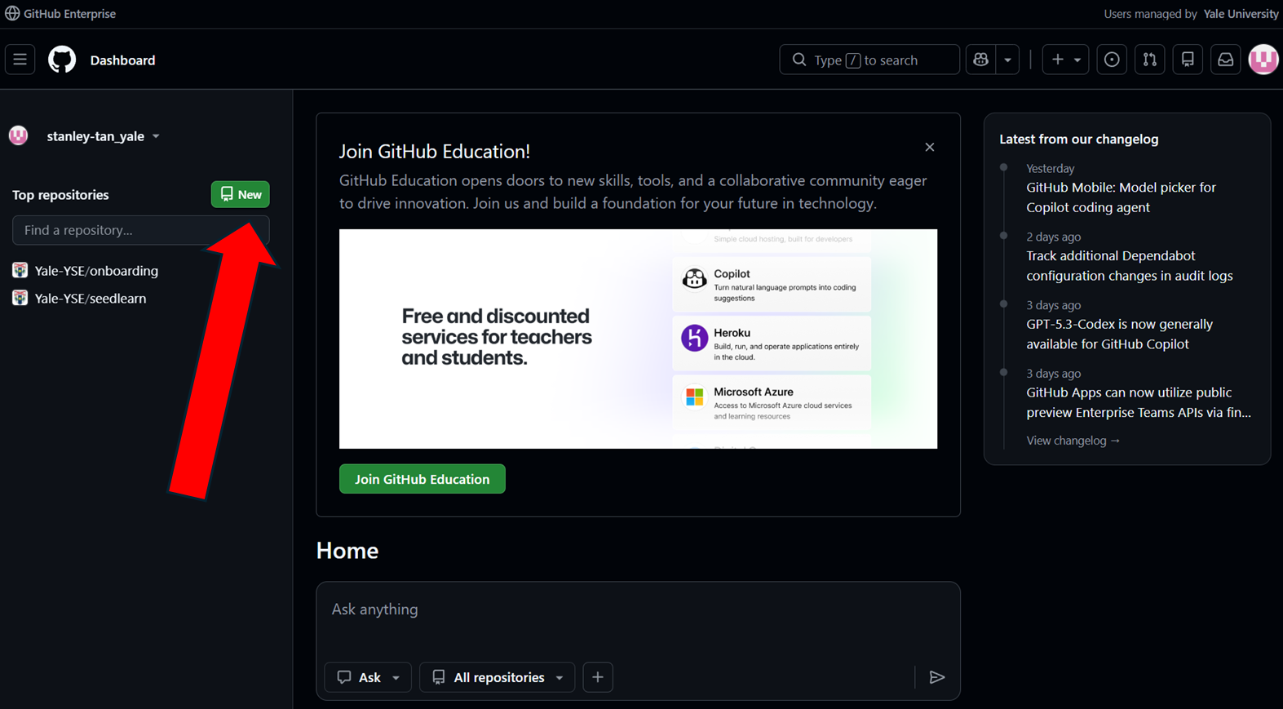
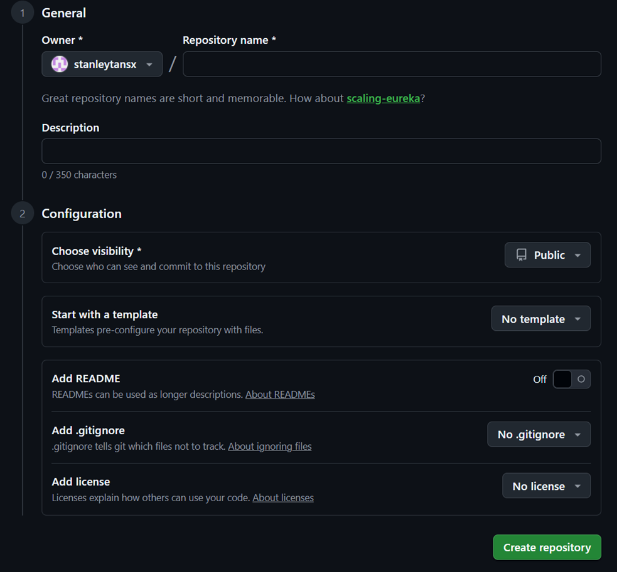
Yale SCHOOL OF THE ENVIRONMENT
Research Computing
Activity: Create Your Repository on GitHub
On GitHub.com:
Click + → "New repository"
Name it: my-first-website
Set it public/private
Do NOT initialize with README (we already have files)
Click "Create repository"

Slide 27
Yale SCHOOL OF THE ENVIRONMENT
Research Computing
Activity: Connect & Push
Back in your terminal:
git remote remove origin
# disconnect from the template
git remote add origin git@github.com:YOUR_USERNAME/my-first-website.git
2. # connect to YOUR repo
git push -u origin main
3. # upload your code to GitHub
If error about 'main':
git branch -M main && git push -u origin main
git push: upload your local commits to GitHub

Slide 28
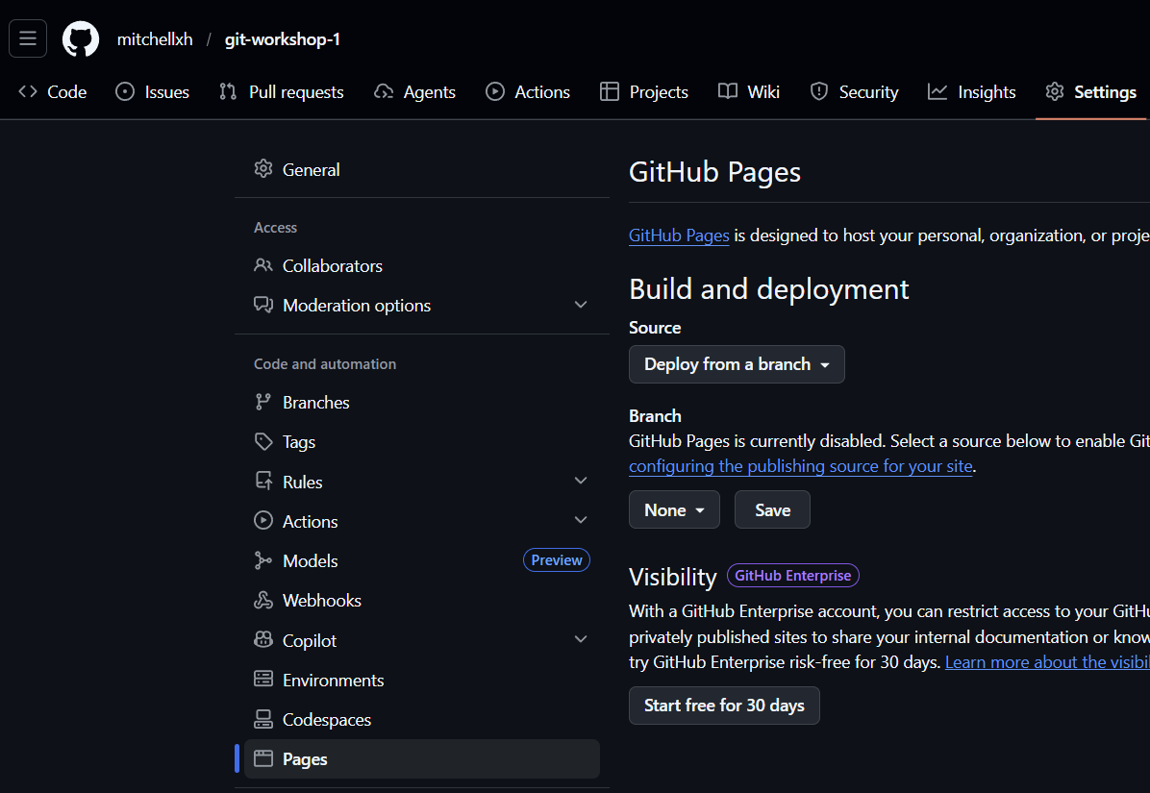
Yale SCHOOL OF THE ENVIRONMENT
Research Computing
Activity: Enable GitHub Pages
In your repository on GitHub.com:
Click Settings → Pages (sidebar)
Source: "Deploy from a branch"
Branch: main
Click Save
Check the Actions tab for build progress
After 2-5 minutes, visit:
https://YOUR_USERNAME.github.io/my-first-website/
🎉 Your website is live!

Slide 29
Yale SCHOOL OF THE ENVIRONMENT
Research Computing
Activity: Make Another Change
Try changing colors in style.css, then:
git status
git add .
git commit -m "Update site styles"
git push
Your GitHub Pages site will automatically update!
The full workflow:
Save → Add → Commit → Push

Slide 30
Yale SCHOOL OF THE ENVIRONMENT
Research Computing
What's Next?
• Customize your site: colors, sections, interactivity
• Learn branching: git branch, git checkout, git merge
• Explore collaboration: Issues, Pull Requests
• Add a custom domain to your GitHub Pages site
Resources:
• GitHub Skills: skills.github.com
• Pro Git Book: git-scm.com/book
• GitHub Pages Docs: docs.github.com/pages

