Slide 1



Yale SCHOOL OF THE ENVIRONMENT
Research Computing
Git & GitHub Workshop

Slide 2
Yale SCHOOL OF THE ENVIRONMENT
Research Computing
Who?
  Mitchell Horn, Senior Research Data Analyst, YSE
What?
  Git & GitHub
Why?
  Version Controlling and Collaborate your Research
How?
  Follow a hands-on practical on your laptop
Goal?
  Create your own GitHub page (and learn anything in the process)

Slide 3


Yale SCHOOL OF THE ENVIRONMENT
Research Computing
You have a GitHub account.
  Yes
  No github.com/signup
2. You have a git installed.
  Yes
  No gist.github.com/mitchellxh

Slide 4
Yale SCHOOL OF THE ENVIRONMENT
Research Computing
Step 1: Get the instructions
Open your terminal, RStudio, IDE
  This is the software you will use to access the command line
And type the following:
  git clone https://github.com/mitchellxh/test-page.git
command line interface (CLI): a text-based interface to interact with a computer's operating system

Slide 5
Yale SCHOOL OF THE ENVIRONMENT
Research Computing
Step 2: Open the instructions
Open your file browser and open the file:
  instructions.md
If you are comfortable, you can open in any text editor you like!
.md : Is a plain text format called Markdown. It is a commonly used for created formatted documents.

Slide 6
Yale SCHOOL OF THE ENVIRONMENT
Research Computing
git
≠
GitHub

Slide 7
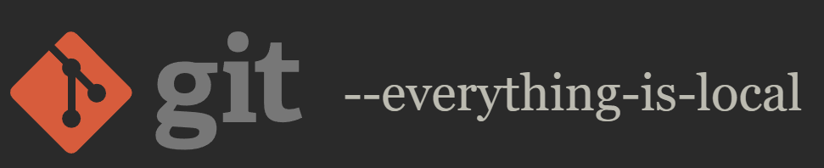
Yale SCHOOL OF THE ENVIRONMENT
Research Computing
git
THE SOFTWARE
  Installed and used on your local machine
  fast and simple-ish
  https://git-scm.com/

Slide 8

Yale SCHOOL OF THE ENVIRONMENT
Research Computing
GitHub
THE CLOUD
  Remote place you store and share your work
  Owned by Microsoft
  Expansive and difficult
  https://github.com/

Slide 9
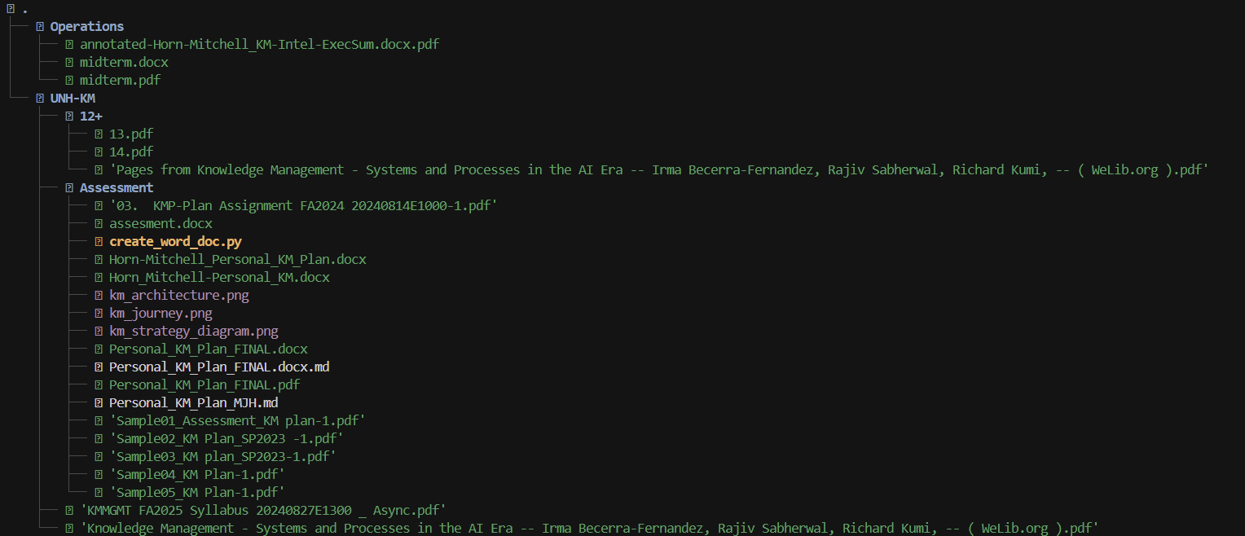
Yale SCHOOL OF THE ENVIRONMENT
Research Computing
Version Control

Slide 10
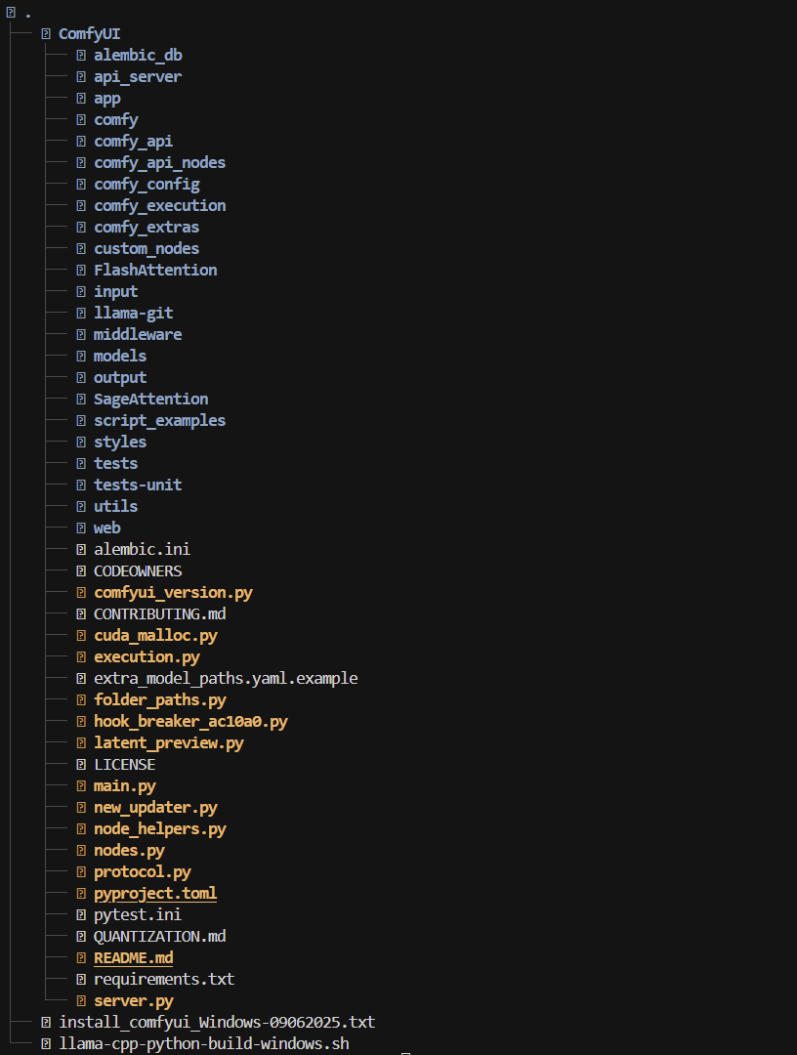
Yale SCHOOL OF THE ENVIRONMENT
Research Computing
Version Control

Slide 11
Yale SCHOOL OF THE ENVIRONMENT
Research Computing
Terms
directory: a folder containing files
repository: a folder containing files, that is tracked by git. (a.k.a. repo)
clone: a git command, make a local repository that is a copy of a GitHub repository
pull: a git command, update a local repository to match its GitHub repository
push: a git command, update the GitHub repository to match a local repository

Slide 12
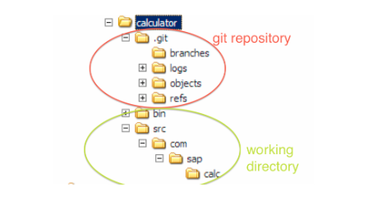
Yale SCHOOL OF THE ENVIRONMENT
Research Computing
Step 11.

Slide 13
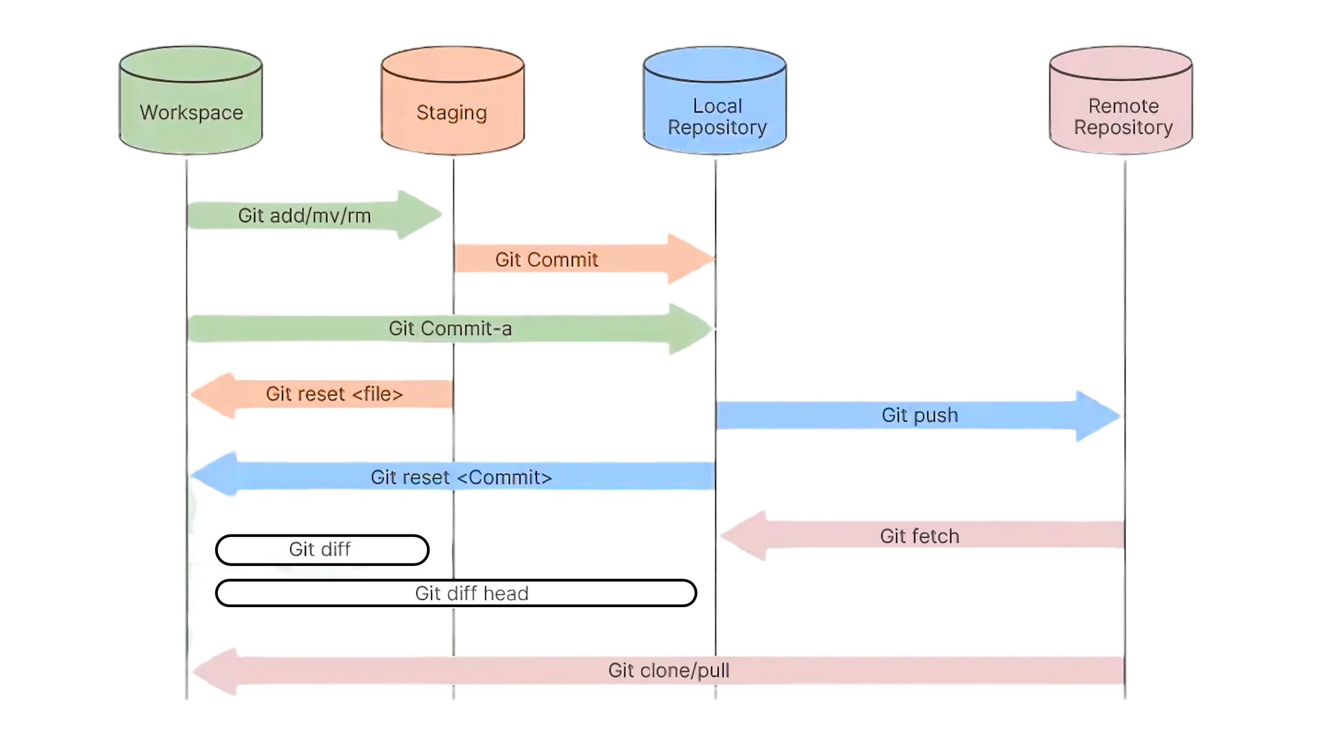
Yale SCHOOL OF THE ENVIRONMENT
Research Computing
Step 11.

