Slide 1
Enter Your Name: <>
Select Your Team from the List of Teams Below:

Slide 2
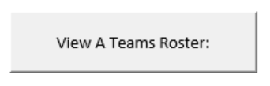
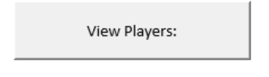
Welcome <Name> of the <Team>!
Welcome to the MAIN MENU!
Please choose one of the following:

Slide 3

Welcome <Name> of the <Team>!
Choose a team to view the current roster:
Notes:
Start Option A

Slide 4

Welcome <Name> of the <Team>!
The Current Draftees of the <team> :
Offense:
Player 1: <name> (delete)
Player 2: <name> (delete)
Defense
Player 1: <name> (delete)
Player 2: <name> (delete)
Notes:
If this is the team of the CEO the “Delete” feature will be available. ??In the NFL draft once a player is drafted, they can’t be undrafted. How do you want this functionality built in?

Slide 5

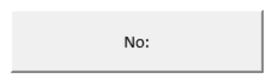
Welcome <Name> of the <Team>!
Please confirm you want to delete <Player Name>.

Slide 6
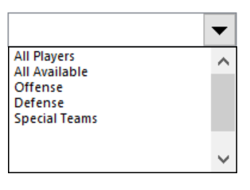
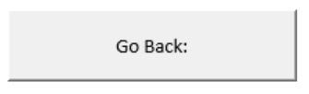
Welcome <Name> of the <Team>!
Choose How to View Players:
Notes:
Start Option B

Slide 7
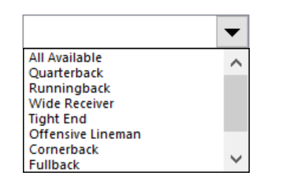
Welcome <Name> of the <Team>!
Choose Position
Notes:
Depending on Previous Choice, The list will show either the positions for only the offense or defense or s.t.’s or all three

Slide 8
Welcome <Name> of the <Team>!
This is the list of all players:
Status | Name | Class (Offense, Defense, Special Teams) | Position
Available | LName, FName | Offense | Quarterback
Drafted | LName, FName | Defense | Cornerback
Available | LName, FName | Offense | Runningback
Drafted | LName, FName | Special Teams | Kicker
Drafted | LName, FName | Defense | Linebacker

Slide 9
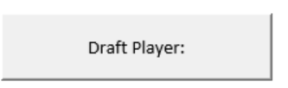
Welcome <Name> of the <Team>!
Here are the stats for <Player>
Category: | Stat:
40 Yard Dash Time | X seconds
Completed Pass % | X %
# of Touchdowns last season | X
# of Interceptions last season | X
Total Yards Passed last season | X

Slide 10
Congratulations <PlayerName>!
You have been drafted by the <Team>!

