Slide 1

Effect of Rating on
Movie Production Costs
Rate of Return
Kimberley Mitchell
October 7, 2016
Metis NYC-ds9 Project 2

Slide 2
Business Case
Whether producing an indie film, or next summer’s blockbuster, it helps to know what factors predict a favorable rate of return on investment.
This project is designed to help a production company shape their movie project portfolio for the best return on investment.

Slide 3

Inspiration
    De Vany, A., & Walls, W. (2002). Does Hollywood Make Too Many R‐Rated Movies? Risk, Stochastic Dominance, and the Illusion of Expectation. The Journal of Business, 75(3), 425-451. doi:1. Retrieved from http://www.jstor.org/stable/10.1086/339890 doi:1
Using movie data from 1982 – 1996, De Vany & Walls showed by stochastic dominance, that movie studios could maximize their rate of return by making more PG and PG-13 movies, thereby reducing the proportion of R rated films.
This study in this paper, uses multiple linear regression to identify which ratings generate the best rate of return for the time period from 2000 to 2015, while taking into consideration several other factors of interest.

Slide 4
Methodology: Data Used
Target:
Rate of return = Worldwide Gross / Total Production Budget
Example:
$30 million return on $10 million budget = rate of return = 3
Data Sources:
the-record.com – financial data
IMDB database
awardsdatabase.oscars.org – Academy Awards database
Predictors:
  Film duration – in minutes
  Content Rating – G, PG, PG-13, R
  Star power – Number of prior Oscar nominations for any of the 3 principle actors
  Color / black & white
  Year of release

Slide 5
Methodology: Data Transformations
Target:
  ln(worldwide gross / total production budget)
Predictors:
  Imputed 0.2% of movie durations with mean
  Dummy variables for movie ratings and color vs. black & white

Slide 6
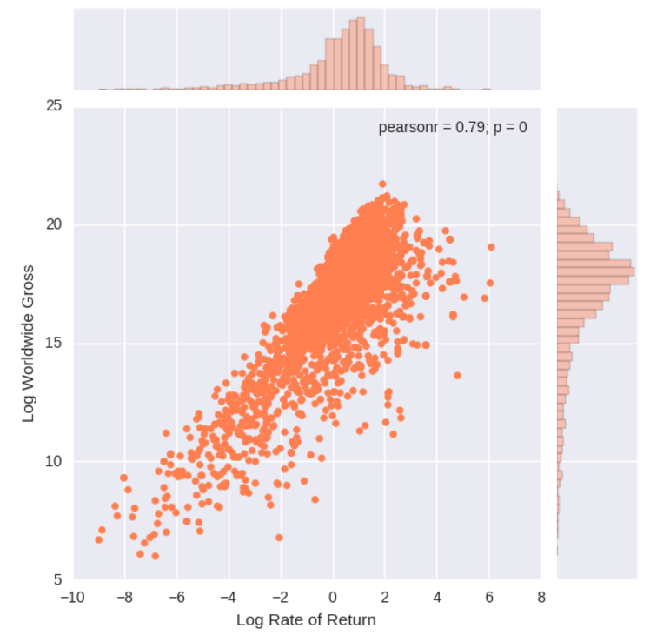
Target Variable: Log Rate of Return

Slide 7
Results: Regression Models
 | Initial Model |  | Final Model
Response variable | ln(rate of return) |  | ln(rate of return)
R-squared | 0.076 |  | 0.103
Adjusted R squared | 0.072 |  | 0.099
N (sample size) | 2227 |  | 2227
Model degrees of freedom | 10 |  | 5
F Statistic / Prob F-stat | 18.26 | 1.73E-32 | 25.42 | 4.10e-46
 | coef | P>|t| | coef | P>|t|
duration | 0.0093 | 0.000 | 0.0093 | 0.000
title_year | 0.0088 | 0.261
num_stars | 0.0014 | 0.946
dum_ Black and White | -0.1466 | 0.524
dum_NC-17 | 1.9993 | 0.046
dum_Not Rated | 0.2088 | 0.508
dum_PG | 2.3762 | 0.000 | 2.2538 | 0.000
dum_PG-13 | 2.1717 | 0.000 | 2.0483 | 0.000
dum_R | 1.6878 | 0.000 | 1.5591 | 0.000
dum_G | 2.7414 | 0.000 | 2.5971 | 0.000
Intercept | -12.9504 | 0.197 | -2.5009 | 0.000

Slide 8
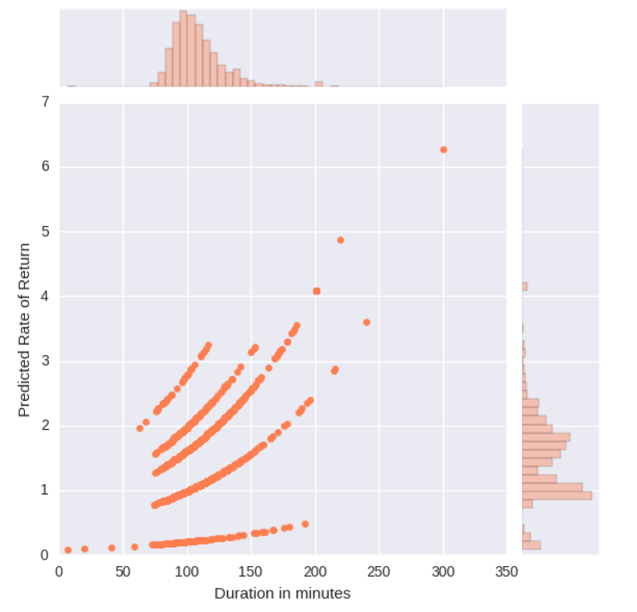
Results: Model Prediction
PG-13
G
PG
R

Slide 9
Conclusion and Recommendations
Although the low r-squared value indicates other significant sources of variability not captured here, we were able to identify significant effects of both the film’s rating and duration on the return on investment.
  It seems that the lower the content rating, and therefore the wider the potential audience, the higher return on production costs. So the making of R-rated films should perhaps be downplayed in favor of G, PG and PG-13 films.
  The finding that films with longer duration showed an improved rate of return should not be taken to the extreme as very little data was represented in very long or very short films and it is unlikely that the underlying function is truly linear.

