Slide 1
Poverty Extent via Community Factors
Classification Project
Kimberley Mitchell
kim@who-knows.com

Slide 2

Project Goal
Identify social characteristics to predict United States counties with a high poverty rate
Notes:
2010-2014 American Community Survey 5-Year Estimates, aggregated by county, http://factfinder.census.gov/faces/nav/jsf/pages/index.xhtml.
A prediction model can be used to predict the class label of unknown records. So we are using several social characteristics of these counties to predict whether they have above-median poverty levels when compared to the rest of the counties in the United States.

Slide 3
Data: Dependent Variable
Poverty rate:
  Per United States county
  Binned: above (1) or below (0) median
  Median county poverty rate = 16.0%
Interactive poverty rate map:
  http://mitchki.com/D3/poverty.html
Source: 2010-2014 American Community Survey 5-Year Estimates, aggregated by county, http://factfinder.census.gov/faces/nav/jsf/pages/index.xhtml
Notes:
2010-2014 American Community Survey 5-Year Estimates, aggregated by county, http://factfinder.census.gov/faces/nav/jsf/pages/index.xhtml.
A prediction model can be used to predict the class label of unknown records. So we are using several social characteristics of these counties to predict whether they have above-median poverty levels when compared to the rest of the counties in the United States.

Slide 4
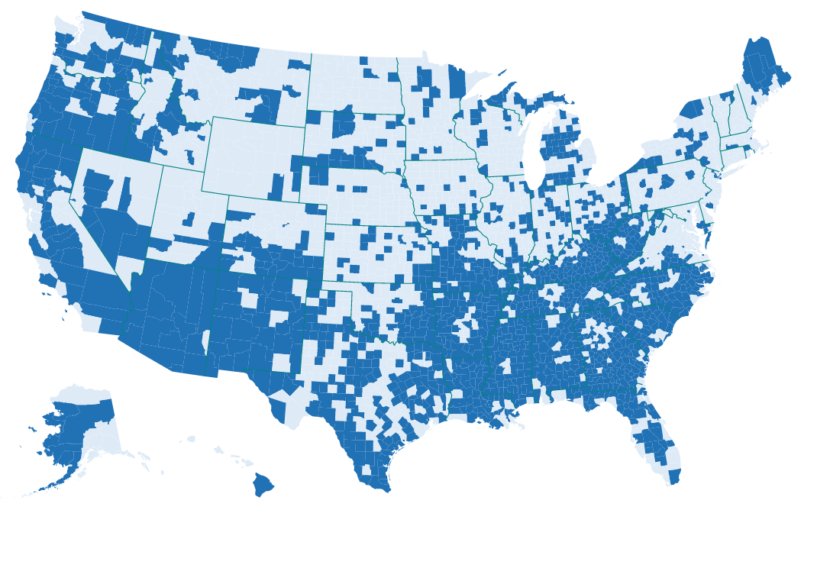
Label: High / Low Poverty

Slide 5
Feature Categories
Household configuration
Commute type
Occupations, Industries
Workforce characteristics
Rural /Urban (by population density)
Population transcience
Citizenship, language, fertility
Educational attainment

Slide 6
Methods
Exploratory Feature Analysis
Models
  Logistic Regression (also w/ regularization)
  Naive Bayes Classification
  Random Forest Classification
Notes:
Process
Exploratory Data Analysis:
Correlations
Individual Distributions
Logistic and Regularized Logistic with python Statsmodels package
Identify significant features
Random Forest with python Scikit-learn package
Precision/Recall curve
ROC Curve
Feature Important
Logistic Regression
Coefficients on final model

Slide 7
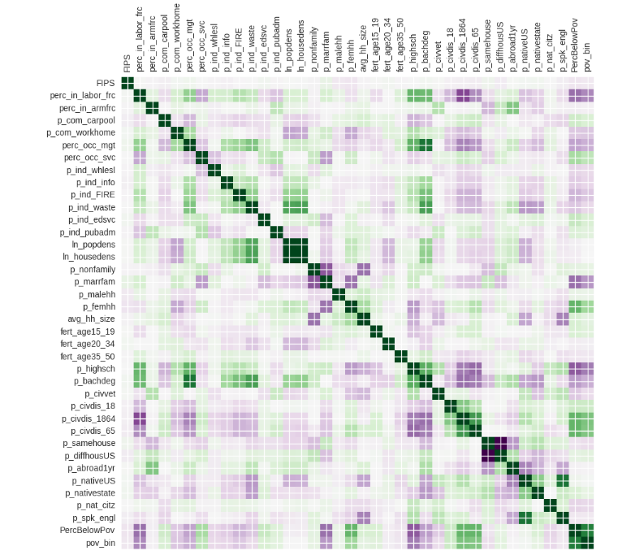
Exploratory Feature Analysis
Heat map –
Feature / Label correlations
Notes:
Purpose is
to view possible correlations with labels
To detect and eliminate strong multicolinearity

Slide 8
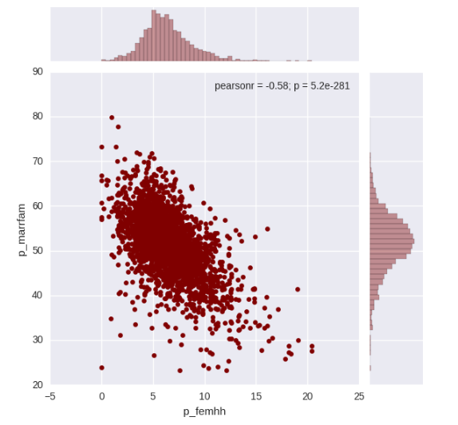
Exploratory Data Analysis
Joint plot –
Tool to explore joint distributions

Slide 9
Model Development Strategy
Initial model - .80 to .85 accuracy score
Reduced feature set via:
  Logistic classification p-values & regularization
  Random trees feature importance
Estimated logistic coefficients

Slide 10
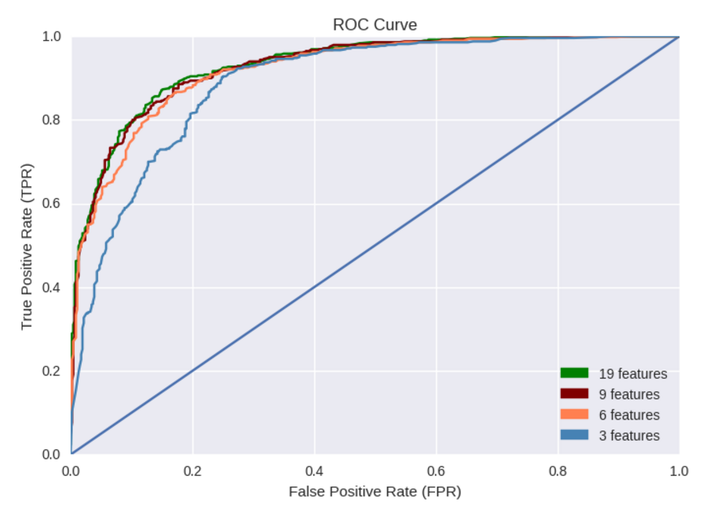
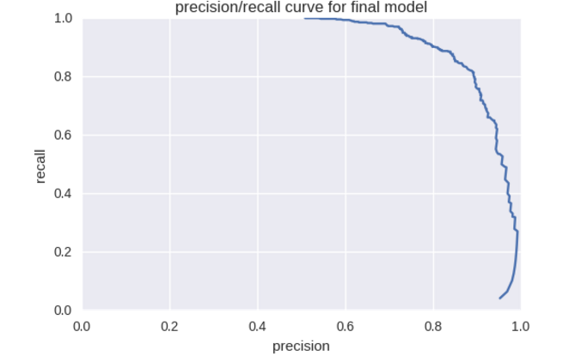
Random Forest Results
Random Forest Classifier
9 Features Accuracy: 0.855
AUC: 0.927

Slide 11
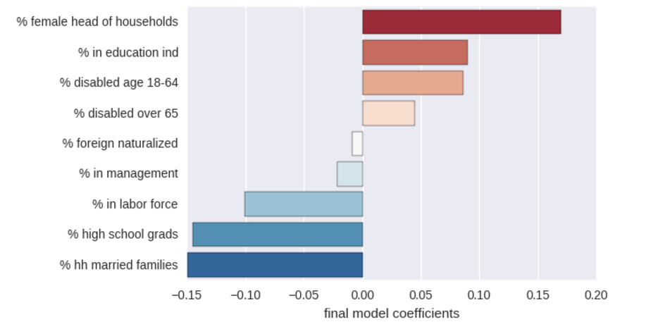
Logit Coefficient Results
Logit (statsmodels) from Random Forest feature importances
- Coefficients show change in odds of above-median poverty
Notes:
Unlike linear regression, the impact of an
independent variable X depends on its value
And the values of all other independent variables

Slide 12
Conclusions
From a few key factors, we can predict high / low poverty rates.
Future work:
  Check trends for consistency over time
  Check if same factor universe can predict other measures of well-being

Slide 13

Questions???
Kimberley Mitchell
kim@who-knows.com

