Slide 1
Text Mining Analysis:
Data-focused job listings
Kimberley Mitchell
http://mitchki.com
kim@who-knows.com
November, 2016

Slide 2
Project Goals
Develop understanding of the job market for data related skills.
Step 1: Detect distinctions between job postings (classification modeling)
between data-related keywords
between data-centric cities
Step 2: Identify latent topics (topic modeling)

Slide 3
Factors investigated
Job type keywords:
  Data scientist
  Data engineer
  Data architect
  Data analyst
  Statistician
Cities
  New York, NY
  San Francisco, CA
  San Jose, CA
  Boston, MA
  Seattle, WA
  Chicago, IL
  Washington, DC

Slide 4

Methodology
Data
  Use indeed.com API to request 1000 URLs for each combination of job type and city
  Scrape each URL to obtain job listings, store in MongoDB
  Clean, tokenize, and vectorize; split into test and train
Modeling
  Multinomial Naive Bayes to distinguish among job types, then drill down to distinguish cities
    Precision/recall confusion matrix to measure models
    Identify keywords for each job type
  Latent Dirichlet Allocation (LDA) to extract latent topics
    Compare keywords with original job type categories

Slide 5
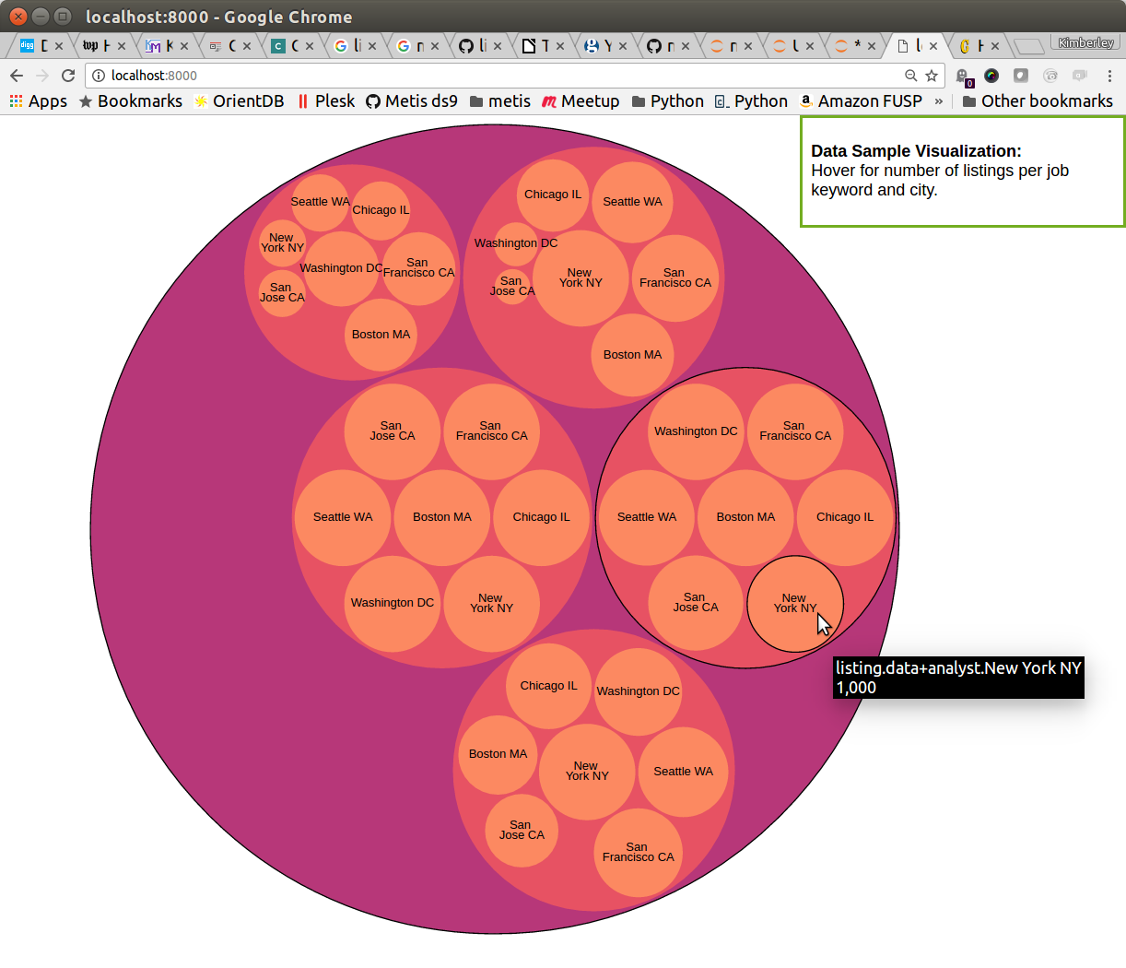
Data Sample Visualization
http://mitchki.com/D3/joblist.html

Slide 6
Results: Job types (test set)
precision recall f1-score support
data+analyst 0.76 0.78 0.77 2120
data+architect 0.74 0.58 0.65 1658
data+engineer 0.60 0.78 0.67 2126
data+scientist 0.77 0.56 0.65 1267
statistician 0.94 0.95 0.95 844
avg / total 0.73 0.72 0.72 8015
Test Set Accuracy: 0.76

Slide 7
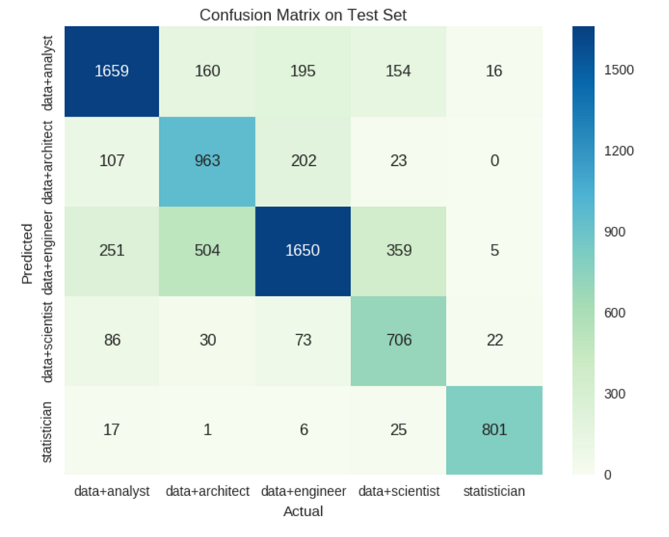
Confusion Matrix: Job types

Slide 8
Unique features among top 50 per job type
Data analyst: 'analyst', 'communication', 'financial', 'marketing', 'process', 'reporting', 'responsibilities'
Data architect: 'application', 'architecture', 'client', 'cloud', 'enterprise', 'understanding', 'web'
Data engineer: 'build', 'building', 'computer', 'engineer', 'engineers', 'test'
Data scientist: 'care', 'center', 'health', 'learning', 'medical', 'scientists'
Statistician: climate', 'excellent', 'field', 'lead', 'manage', 'programming', 'quality', 'quantitative', 'sas', 'statistical', 'study'

Slide 9
Common terms among top 50 per keyword
Intersection of all 5 keywords:
  ability', 'business', 'development', 'environment', 'including', 'information', 'knowledge', 'management', 'product', 'project', 'required', 'services', 'skills', 'strong', 'team', 'technical', 'the', 'we', 'work', 'working', 'years', 'you'

Slide 10
Results: cities
precision recall f1-score support
Boston,MA 0.98 0.60 0.75 235
Chicago,IL 0.96 0.60 0.74 177
New+York,NY 0.81 0.49 0.61 300
San+Francisco,CA 0.39 0.96 0.56 227
Seattle,WA 0.87 0.69 0.77 219
Washington,DC 0.71 0.61 0.65 56
avg / total 0.79 0.66 0.68 1214
Accuracy Score(Test): 0.65

Slide 11
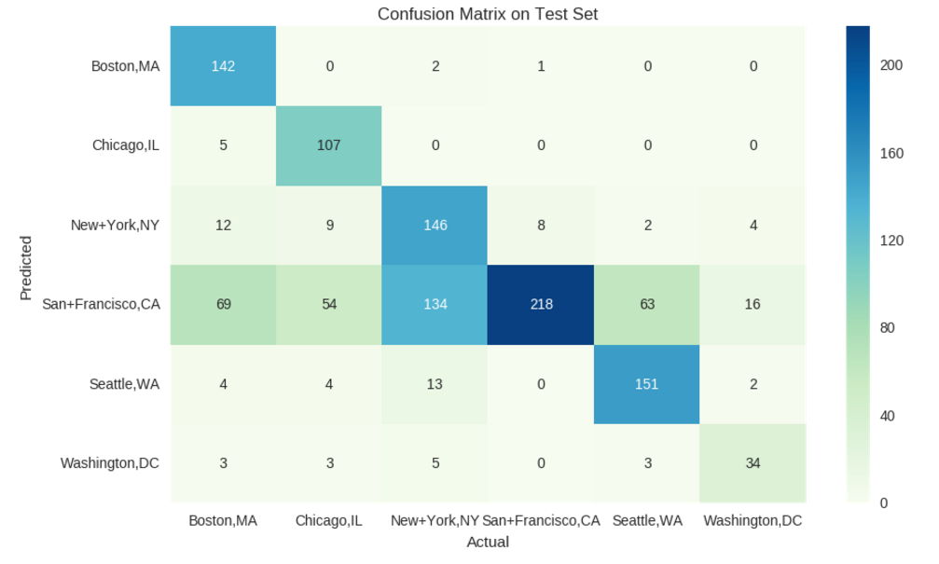
Confusion Matrix: cities

Slide 12
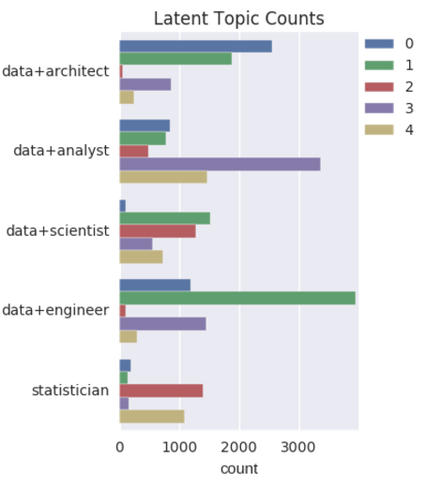
LDA latent topics (n=5)
Topic 0 - technical, solutions, design, technology, management, security, requirements, knowledge, systems, support
Topic 1 - you, software, your, new, design, systems, engineering, science, company, from
Topic 2 - research, clinical, health, medical, statistical, care, analysis, staff, all, including
Topic 3 - management, support, all, information, project, required, by, including, job, systems
Topic 4 - sales, you, product, marketing, analytics, customer, analysis, products, strong, teams

Slide 13
Conclusions
Decent results – able to distinguish among several types of data-related jobs
Representing a snapshot with respect to a single job board at a specific time.
  Further work: Find out whether these results are stable over more job boards, over time.
Kimberley Mitchell
kim@who-knows.com
http://mitchki.com

