Slide 1


The Economic Impact of Ford and the F-Series
September 2020
Note: I am recreating this deck to practice my deck making skills
ETA: 5ish hours (incl. dinner)

Slide 2

Context for document
Summary of the study
The importance of the F-Series and Ford to the US economy through the lenses of employment, GDP, and manufacturing impact … were investigated
Approach
BCG evaluated the impact of the F-Series and Ford across 4 dimensions:
Employment impact
Economic impact
Current and historical US presence
Product usage

Slide 3

Employment impact GDP impact Manufacturing impact Usage impact

Slide 4

The F-Series supports nearly half a million American jobs
F-SERIES
Illustrative: Chart title

Slide 5
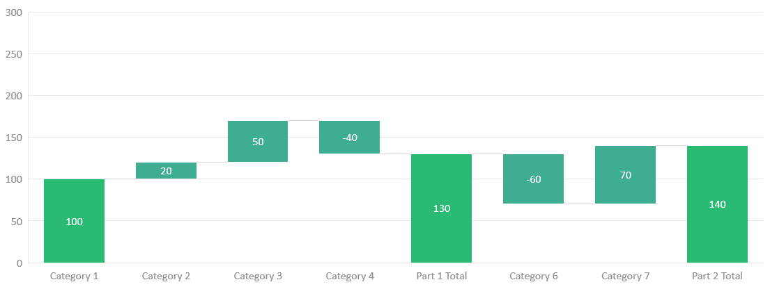
Ford USA contributes ~$100 billion to US GDP through production and multiplier effects
FORD
Illustrative: I love waterfall charts
Multiplier Effect
After sales and re-spending (42B)
Product GDP contribution
Manufacturing and sales ($58 billion)

