Slide 1
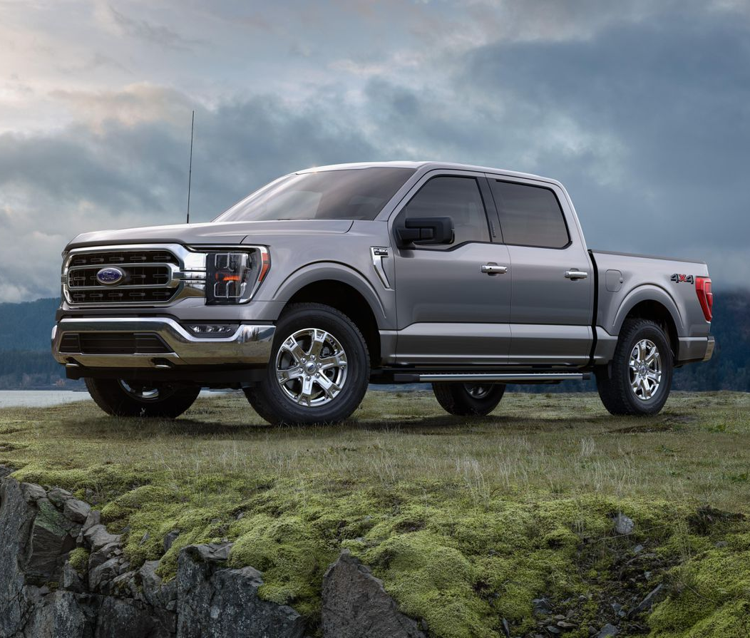
The Economic Impact of Ford and the F-Series
September 2020

