Slide 1
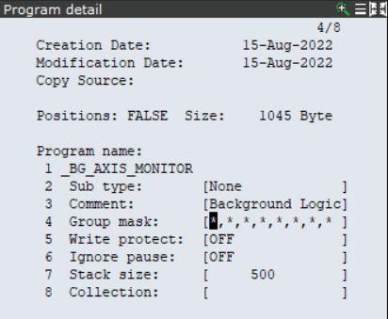
Background Logic (BG)
CANNOT CONTAIN JMP LBL or CALL.
Will not run with a Motion Group Masked.
Do not put wait statements in BG Routines.
Typically, a routine is a list of IF THEN statements monitoring inputs, outputs, and/or registers.
The scan rate of a BG Routine is 8 milliseconds.
A BG Routine CANNOT be edited if it is running. You must STOP execution before editing.
Create a program – Typically I’ll name my BG routines “_BG_<SOMETHING>.” In this example, we will create an Axis Monitoring Routine.
Reset Motion Group Mask.

Slide 2
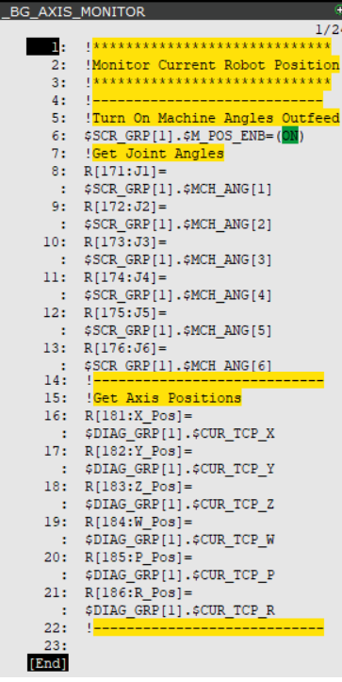
2. Add your logic.

Slide 3
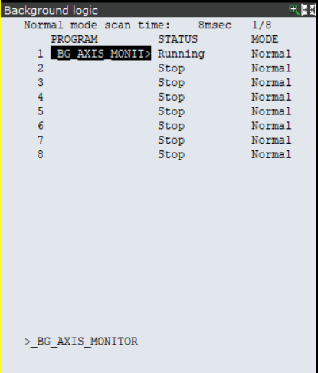
Add your BG Routine to the list and RUN.
MENU->SETUP->BG LOGIC
Add your Routine name to the list.
Select RUN.
NOTE: Your BG Routine cannot be in the editor when selecting RUN.

Slide 4
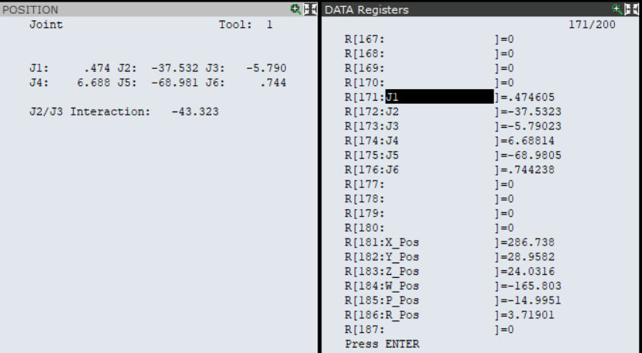
BG Routine is Running.

Slide 5
Other Examples

Slide 6
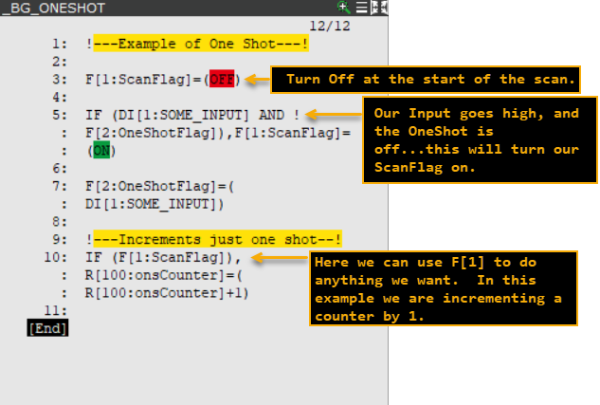
One shot of some input.

Slide 7
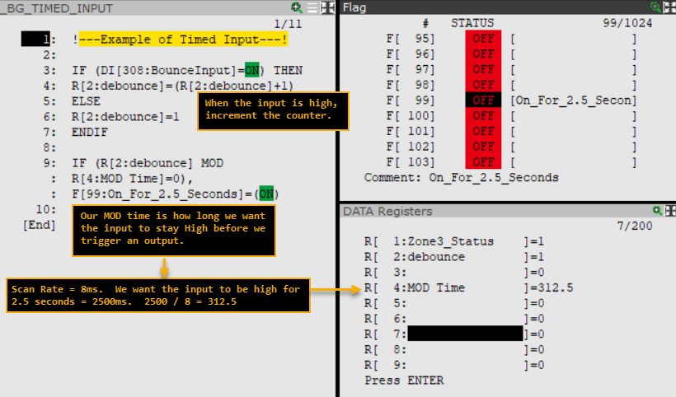
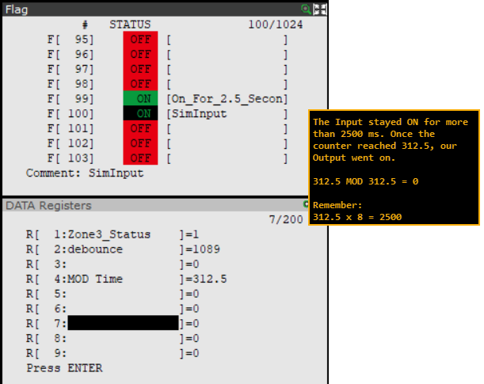
Timed Input.

Slide 8
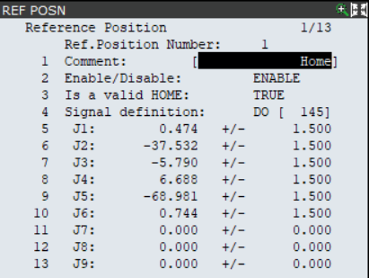
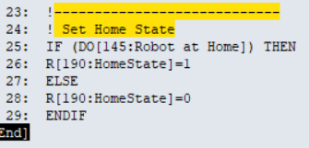
Home Reference Position with BG Routine
Let’s say we recorded a reference position at home and assigned a DO to this position.
Then we monitor this DO in our BG Routine.

Slide 9
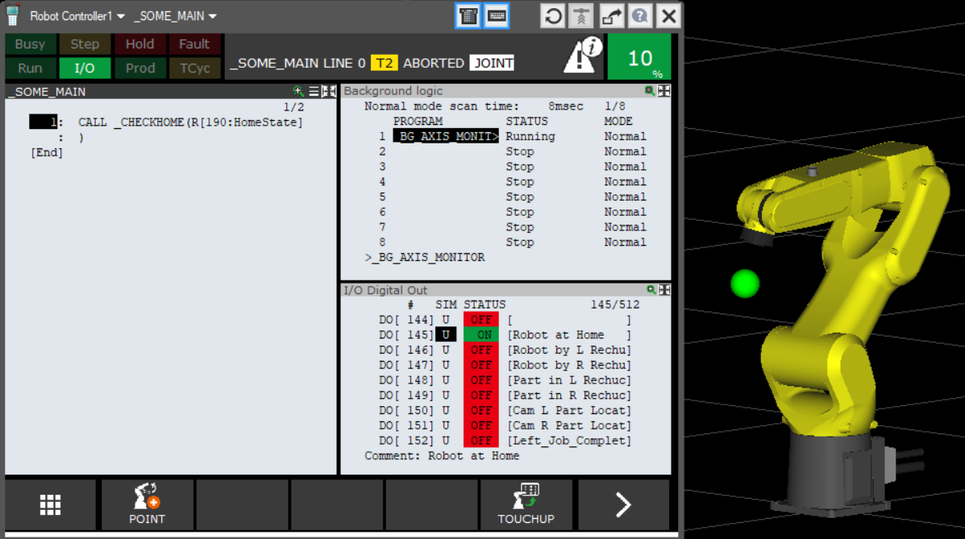
You could modify a Home routine to accept an argument. We call the Home routine and pass the Register we are setting in the BG Routine.
If you are already home, do nothing.
If you are not at home, go home.
So anywhere in your overall process you need to check if you are HOME, you could just CALL this with an argument.
Instead of an IF THEN everywhere.

Slide 10
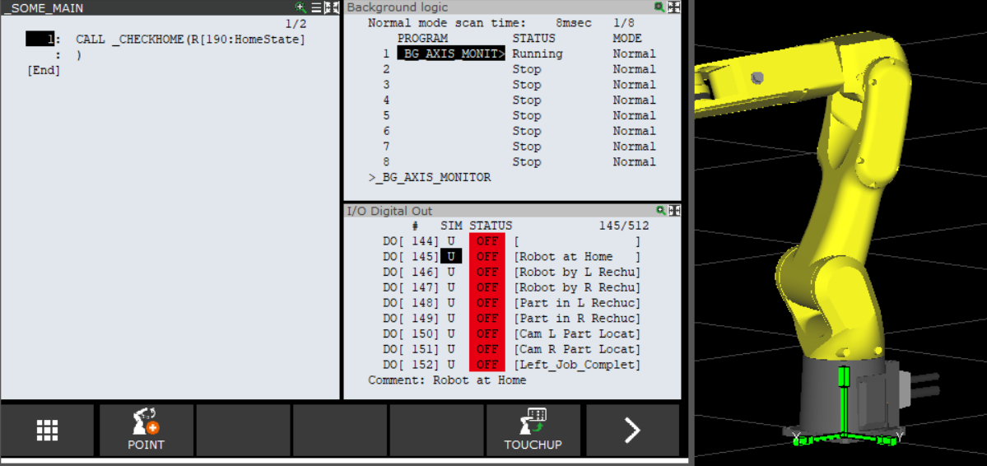
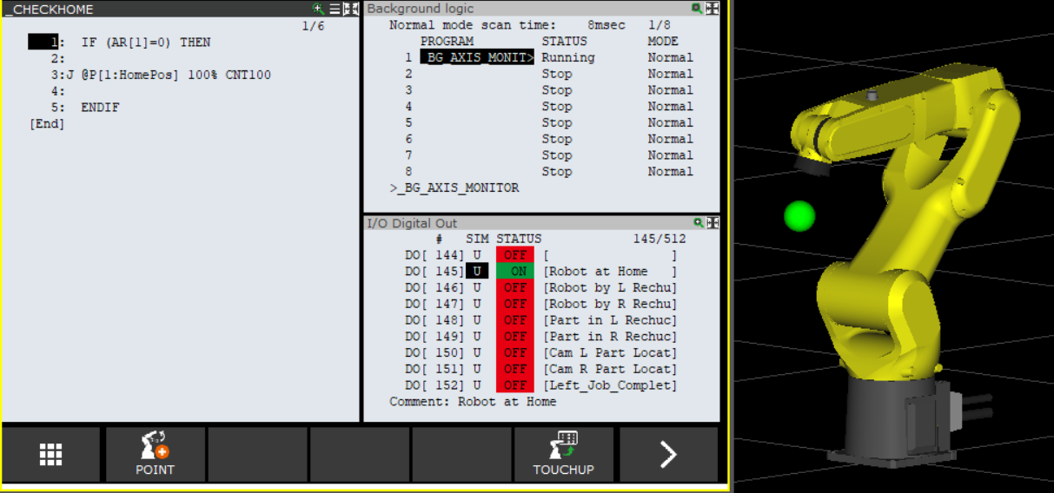
If the first Argument passed = 0, go home.

Slide 11
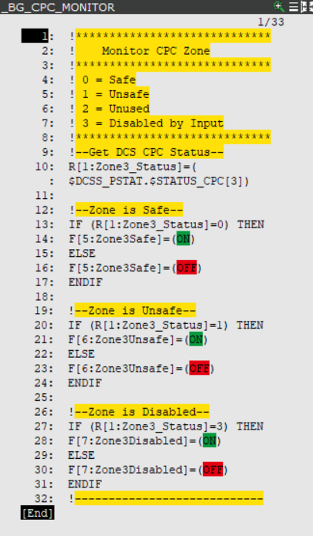
DCS Zone Monitor: BG Example

Slide 12
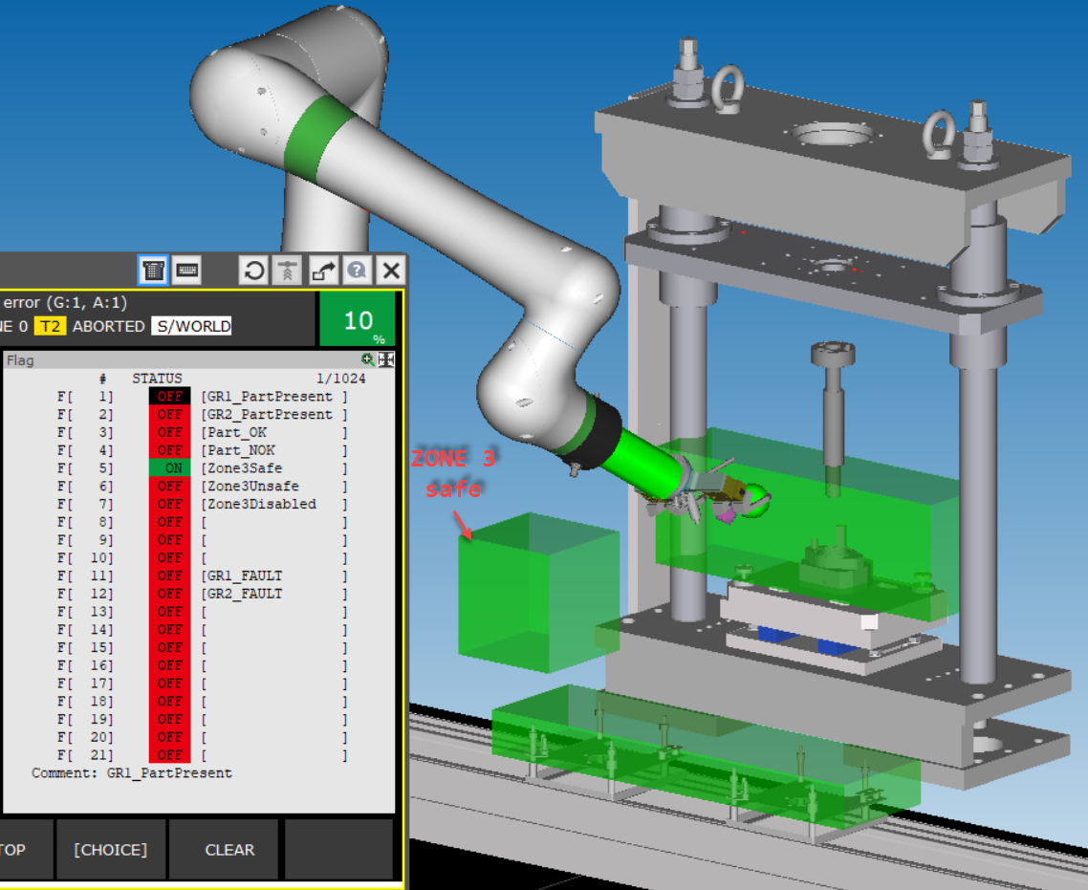
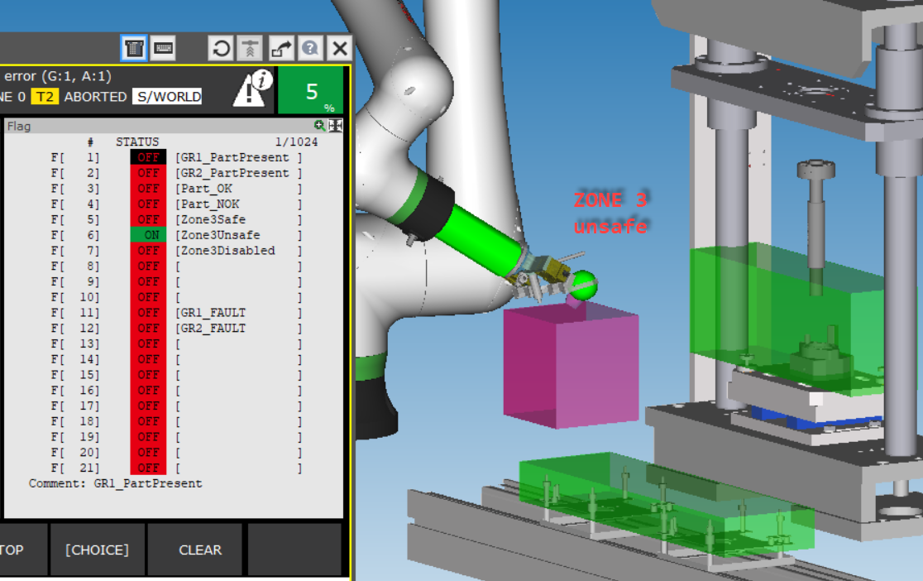
The EOAT is clear of Zone 3.
The EOAT has encroached Zone 3.

Slide 13
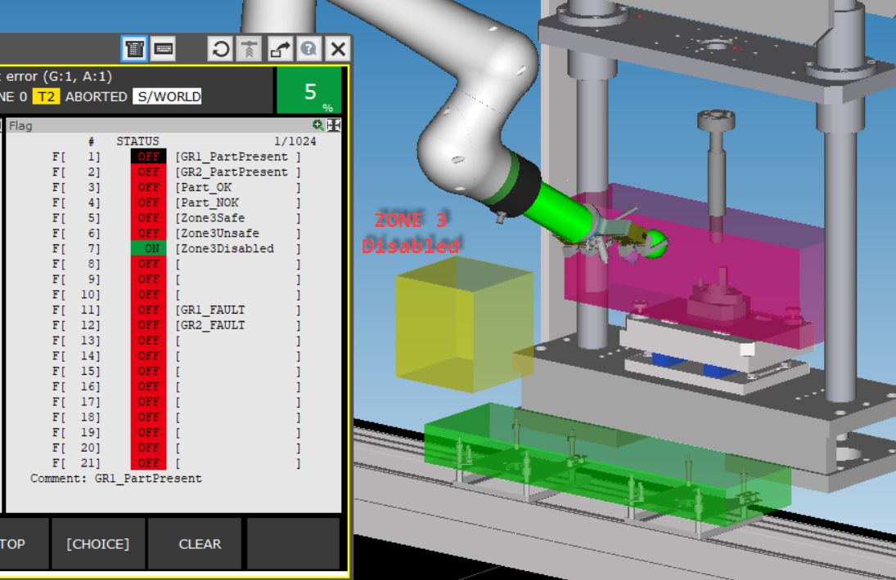
You can disable the zone if you need to pass through or handle a specific state.

Slide 14
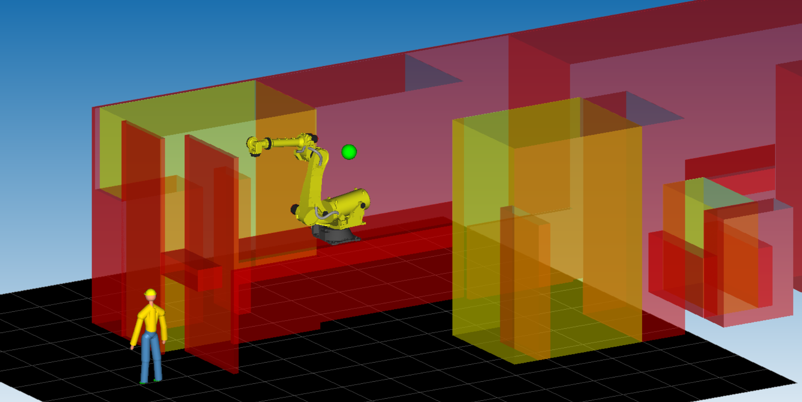
Complicated DCS – Robot on Rails above two CNCs with a middle outfeed conveyor.

