Slide 1
Programming Bootcamp
Lecture 2 – Good coding practices: performance and version control

Slide 2
Why doing things properly matters
In an extended project, you’ll likely be revisiting and editing the same piece of code over and over.
Code speed = running speed + development speed
Running speed
Choose better language
Performance tips
Optimize your algorithm (rest of the course)
Development speed:
Good coding practices (e.g., notational conventions)
Proper version control will allow you to easily backtrack and experiment with program features.

Slide 3
Outline
Running speed
Choose better language
Performance tips
Optimize your algorithm (rest of the course)
Development speed:
Good coding practices (e.g., notational conventions)
Proper version control will allow you to easily backtrack and experiment with program features.

Slide 4
Machine Code
Code performance generally depends on how directly it talks to your computer.
At basic level, computers communicate in zeros and ones.
Humans are bad at writing in zeros and ones, so we instead write in symbolic representations of them.
The symbolic representation that corresponds most directly to machine code is called assembly.

Slide 5
Do not write in assembly.
“Hello World” in assembly: org 0x100 ; .com files always start 256 bytes into the segment mov dx, msg ; the address of or message in dx mov ah, 9 ; ah=9 - "print string" sub-function int 0x21 ; call dos services mov ah, 0x4c ; "terminate program" sub-function int 0x21 ; call dos services msg db 'Hello, World!', 0x0d, 0x0a, '$' ; $-terminated message

Slide 6
Compilation
Most languages achieve high performance by converting the language into assembly before running it.
This process is called compilation.
This process is most obvious in languages like FORTRAN or C, where you have to compile the code manually before running it.
Languages that don’t convert their code into assembly are typically called interpreted languages.
For the computer, this is like executing directions in Spanish if the computer only knew English.
Note: this is often a false dichotomy: many languages have options to be interpreted or compiled

Slide 7
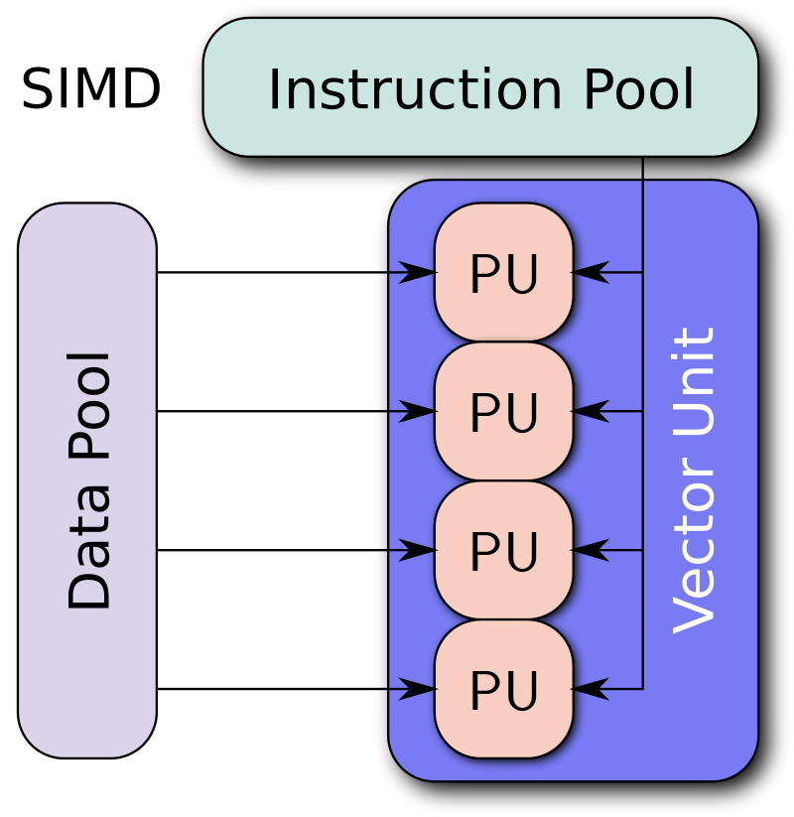
Vectorization
Two meanings to this
First: conversion of a computer program from scalar implementation to vector implementation (i.e.: operating on a single data point at a time to multiple).
Typically done automatically when code is compiled.

Slide 8
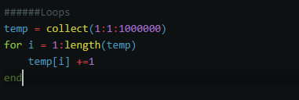

Vectorization
Second meaning: ditching loops in favor of matrix operations.
This is very important in languages like Matlab and R
Reason: matrix operations in these languages are typically written in C.

Slide 9
More on Vectorization
In simple cases, vectorization is easy and intuitive.
Vectorizing complex loops and functions, however, can be extremely difficult and detract considerably from readability.
Vectorization is not required in Julia for performance.

Slide 10
Outline
Running speed
Choose better language
Performance tips
Optimize your algorithm (rest of the course)
Development speed:
Good coding practices (e.g., notational conventions)
Proper version control will allow you to easily backtrack and experiment with program features.

Slide 11
Julia performance tips 1
https://docs.julialang.org/en/v1/manual/performance-tips/
Julia compiles functions when run for the first time – JIT (just in time) compilation.
Anything substantial in your program should be housed in a function so that it can be turned into assembly.
Split up big tasks into several functions.
Functions explicitly clarify inputs and outputs.

Slide 12
Julia performance tips 2
Avoid global variables.
A global variable can be changed anytime, anywhere, inside or outside a function.
Difficult for the compiler to optimize code using global variables!
Global constants are acceptable.
E.g., beta = 0.9, etc.
Type declarations can help complier optimize performance.
Type declarations make code run faster in many languages.
Not necessary in Julia because variable types can be inferred by compiler.
Can help in some cases in Julia.
Use function f(x::Array{Float64,2}) instead of function f(x)

Slide 13
Julia performance tips 3
Julia’s profiler also allows you to hunt for bottlenecks.
@profile
Julia’s timer tracks running time and memory usage.
@time
Do not store unnecessary output!

Slide 14
Outline
Running speed
Choose better language
Performance tips
Optimize your algorithm (rest of the course)
Development speed:
Good coding practices (e.g., notational conventions)
Proper version control will allow you to easily backtrack and experiment with program features.

Slide 15
Optimize your algorithm
Use analytical solutions if any (e.g., gradient, choice variable).
Drop reduncdant state variables (e.g., if only z = x+y matters, then only create 1 grid for z, instead of 2 for x and y separately).
Reasonable initial guess is important!
Interpolation
Parallelization
Numerical integration

Slide 16
Outline
Running speed
Choose better language
Performance tips
Optimize your algorithm (rest of the course)
Development speed:
Good coding practices (e.g., notational conventions)
Proper version control will allow you to easily backtrack and experiment with program features.

Slide 17
Good coding practices
https://docs.julialang.org/en/v1/manual/style-guide
Consistent indentation
Show the Atom button!
Use naming conventions consistent with Julia base
https://docs.julialang.org/en/v1/manual/style-guide/#Use-naming-conventions-consistent-with-Julia-base/
Avoid using names in Julia base (e.g., pi).

Slide 18
Outline
Running speed
Choose better language
Performance tips
Optimize your algorithm (rest of the course)
Development speed:
Good coding practices (e.g., notational conventions)
Proper version control will allow you to easily backtrack and experiment with program features.

Slide 19
Version control
Economists complain frequently about how hard it is to maintain good version control, especially in collaborative projects.
Computer scientists figured out a good system for version control in 2005.
This system is called Git.
Main features
Can be used for any text-based file type.
Never have to have a file name like “draft_v3_final_FINAL” ever again
COMPLETE documentation of changes made (and when)
Easily allows for multiple people to work on the same file simultaneously.
Drawback: No files > 100Mb

Slide 20
Basic Terminology
Softwares
Git: basic software. Can be run entirely locally
Github: Online application that allows Git to update and pull repositories from the cloud
Github desktop: GUI application for Git
Commands
Commit: essentially, an approved change to some code.
Push: apply code changes to a repository (requires writing privileges)
Pull: retrieve changes from a repository (allows collaboration across machines)
Pull Request: Request that somebody else incorporate changes suggested by you.
Fork: Copy somebody else’s repository on Github to your own Github page.
Clone: Copy somebody else’s repository to your local machine.
Branch: Create a working copy of repository to make changes that will eventually be merged back into the master code (think: testing out new feature).

