Slide 1
Programming Bootcamp
Lecture 3 – Optimization

Slide 2
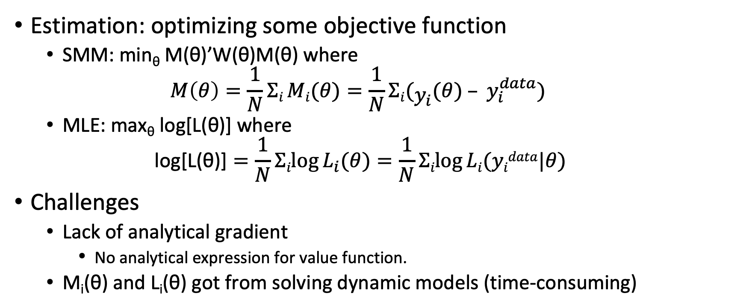
Where is this useful?
Estimation: optimizing some objective function
SMM: min_{θ} M(θ)’W(θ)M(θ) where
$$M\left(θ\right)=\frac{1}{N}Σi Mi(θ)=\frac{1}{N}Σi(y_{i}(θ) – y_{i}^{data})$$
MLE: max_{θ} log[L(θ)] where
$$\text{log}\text{[}\text{L}\text{(}\text{θ}\text{)}\text{]}=\frac{1}{N}Σilog⁡L_{i}(θ)=\frac{1}{N}Σilog⁡Li(yidata|θ)$$
Challenges
Lack of analytical gradient
No analytical expression for value function.
M_{i}(θ) and L_{i}(θ) got from solving dynamic models (time-consuming)

Slide 3
Outline
Brute-force: enumerate all candidates
Derivative free: Nelder Mead
Derivative needed
Univariate optimization: Brent’s method
Multivariate optimization
Newton-type algorithm (analytical gradient available)
BFGS, LBFGS, BHHH (analytical gradient not available/efficient: use numerical approximation)

Slide 4
Brute-force method
Is used when
parameter is low dimensional or
finding a plausible initial guess.
It can be accelerated by parallelization.
Infeasible when the parameter is high-dimensional.

Slide 5
Derivative-Free method
Workhorse method: Nelder-Mead
Essentially an intelligent grid search
Starts with simplex and moves/shrinks simplex downhill
First proposed in 1965
Original algorithm turned out to have horrible theoretical properties
Lagarias et al (1998): “A counterexample . . . Gives a family of strictly convex functions in two dimensions and a set of initial conditions for which the Nelder-Mead algorithm converges to a non-minimizer.”

Slide 6
Box-constrained univariate optimization
Examples
Choice of search intensity, normalized between 0 and 1
Choice of labor supply between 0 and 60 hours
Choice of next-period assets over asset space
Relatively easy case
Most common method used: Brent’s method
Essentially an intelligent grid search using secants and bisections
Fairly robust and fast

Slide 7
Multivariate Optimization
How to best optimize multivariate functions depends on the availability of the function’s derivatives.
If function is twice-differentiable and has analytic gradient/Hessian, just provide gradient/Hessian optimization algorithm.
Newton-Rhapson
Otherwise, use quasi-Newtonian methods when
No analytical gradients (model is complex)
Calculating analytical gradient is time-consuming (e.g., apply implicit function theorem and inverting matrices).

Slide 8
Newton-Rhapson method
max_{β} l(β)
Taylor expansion around k-th parameter guess β^{k}
l(β)≈l(β^{k})+g(β^{k})(β−β^{k})+ 1/2(β−β^{k})’H(β^{k})(β−β^{k})
g(β^{k}) and H(β^{k}) are gradient and Hessian at β^{k}
FOC (wrt β): g(β^{k}) + H(β^{k})(β−β^{k}) = 0
Update β^{k+1} =β^{k} −H(β^{k})⁻¹g(β^{k})
NR method is preferable when the function is globally concave (e.g. Probit)

Slide 9
Quasi-Newtonian Methods
Essentially applies Newton’s method but with numerical approximates of the gradient.
β^{k+1} =β^{k} −H(β^{k})⁻¹g(β^{k})
Two ways of doing this
Finite differences: perturb the function input slightly and see how output changes (default)
Automatic differentiation: Chain rule is calculated numerically. Allows computer to establish rules/heuristics for the derivatives of functions.
Most common algorithm of this type: BFGS.
Or LBFGS

Slide 10
Important Caveats: Initial Guesses
Convexity again matters
Multivariate optimization routines usually require a starting guess.
This guess matters
Can affect the speed at which the solution is found considerably.
A bad guess can also result in the algorithm obtaining the wrong answer.
Best practice: try to provide reasonable guesses and assess robustness of algorithm to alternate guesses.

Slide 11
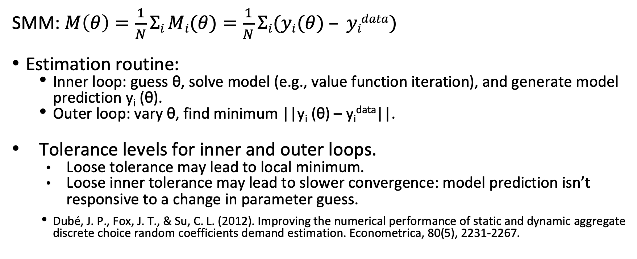
Important Caveats: Tolerance Level
SMM: $M\left(θ\right)=\frac{1}{N}Σi Mi(θ)=\frac{1}{N}Σi(yi(θ) – yidata)$
Estimation routine:
Inner loop: guess θ, solve model (e.g., value function iteration), and generate model prediction y_{i} (θ).
Outer loop: vary θ, find minimum ||y_{i} (θ) – y_{i}^{data}||.
Tolerance levels for inner and outer loops.
Loose tolerance may lead to local minimum.
Loose inner tolerance may lead to slower convergence: model prediction isn’t responsive to a change in parameter guess.
Dubé, J. P., Fox, J. T., & Su, C. L. (2012). Improving the numerical performance of static and dynamic aggregate discrete choice random coefficients demand estimation. Econometrica, 80(5), 2231-2267.

Slide 12
After-class reading
Use transformation of variables to simplify a constrained optimization problem to an unconstrained optimization problem.

Slide 13
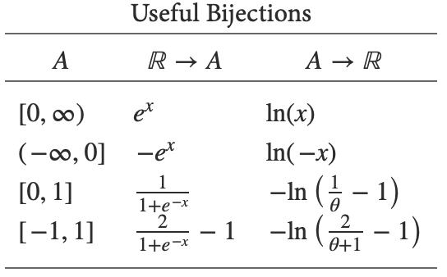
Simplify constrained optimization
Reference: https://jblevins.org/notes/bijections
Use transformation of variables to convert a constrained optimization problem to an unconstrained one.
Note: sometimes exp(x) is sensitive to large x. One can use ln(1+exp(x))
Remember to apply chain rule for the transformed variable!

Slide 14
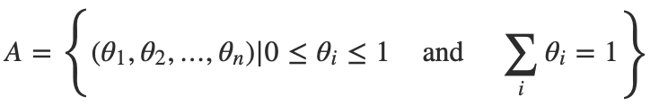
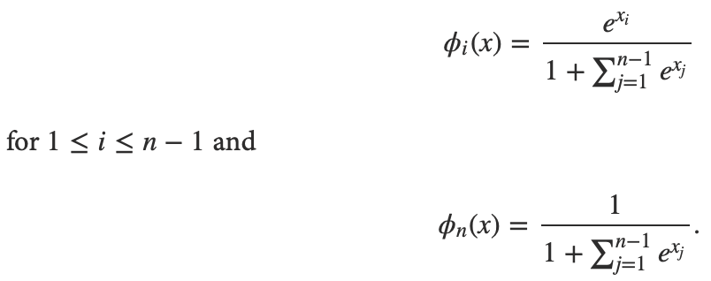
Simplify constrained optimization
A multidimensional transformation is useful when the parameters represent probabilities.

