Slide 1
Building a RAG Pipeline on Engaging

Slide 2
Preparation
Create an account on Engaging: orcd-ood.mit.edu

Slide 3
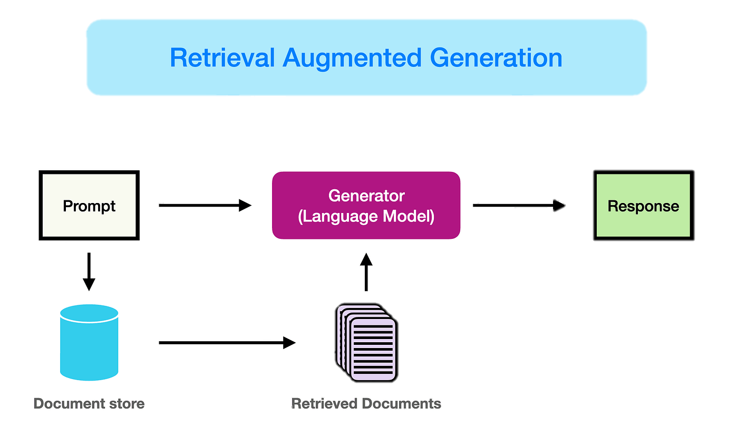
What is RAG?
Medium

Slide 4


RAG on Engaging
Other options:
  Notebook LM
  ChatGPT application
Advantages of developing your own:
  Greater customization
  Data privacy

Slide 5
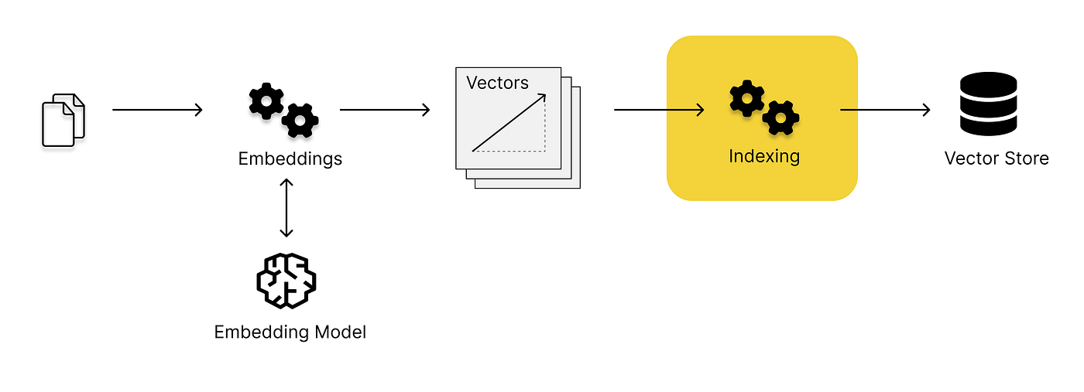
Vector Stores
Documents (PDFs, .md files, etc.)
Medium

Slide 6
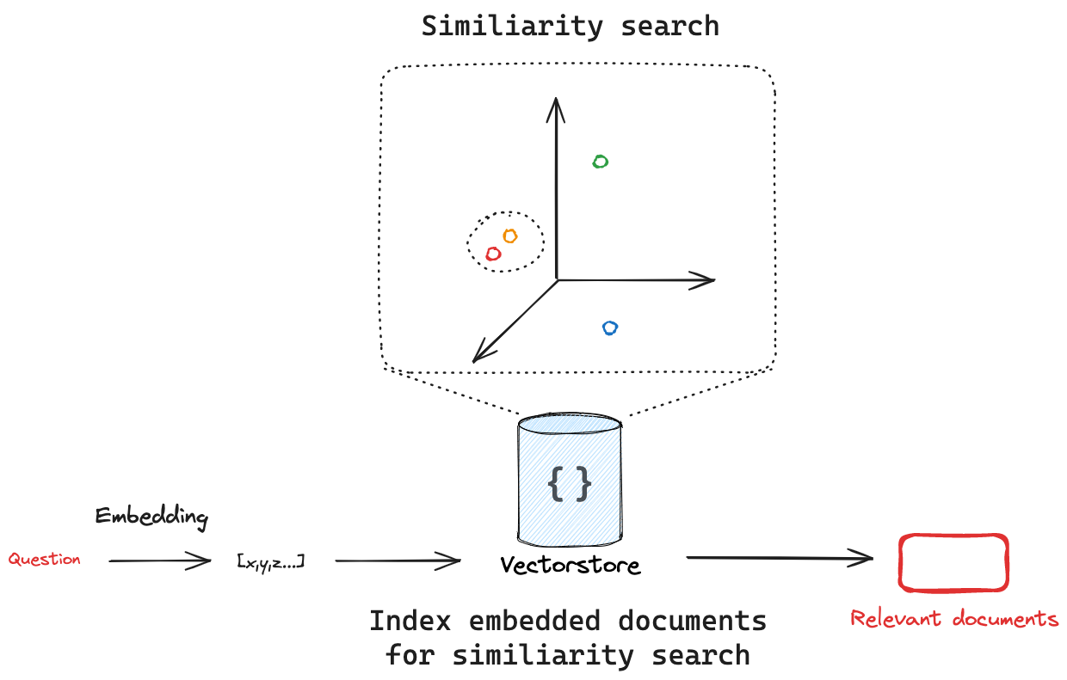
Vector Stores
LangChain

Slide 7
Setting up
Start a Jupyter session on orcd-ood.mit.edu
  4 CPU cores
  16GB memory
  Allocate GPU
Clone this GitHub repository: https://github.com/mitdbg/practical-programming-with-data

Slide 8
Accessing HuggingFace
Create a HuggingFace account
Request access to mistralai/Ministral-8B-Instruct-2410
Create a user access token

Slide 9
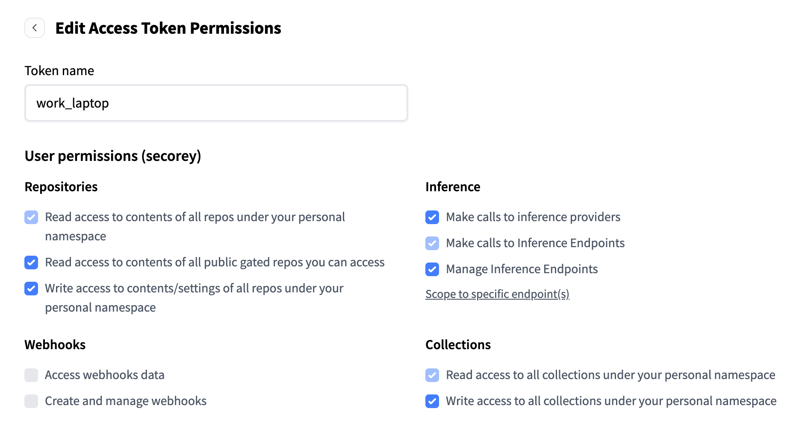
Edit HF Access Token Permissions

Slide 10
Requesting Resources on Engaging
$ ssh <username>@orcd-login002.mit.edu
$ salloc -N 1 -n 8 -p mit_normal_gpu -G l40s:1

Slide 11
Using Containers

Slide 12
Example on ORCD Documentation

Slide 13
Creating a Vector Store

Slide 14
Running RAG

