Slide 1
Celery
Harnessing the Messeging Power of RabbitMQ
Rick Harding
http://blog.mitechie.com
http://lococast.net
@mitechie

Slide 2
Web Applications Baby!
Web pages now web apps
Actually perform functions
  Send email
  Perform filesystem manipulations
  Trigger background tasks, notifications, caching

Slide 3
Example: Github
Create new repo
Generate download tarballs
Generate branch/fork graphs
Email notifications

Slide 4
Example Pinboard.in
Delicious Alternative
Leaked Delicious was 'sunset'
Pinboard Import from Delicious
Generate tag clouds

Slide 5
Starter Application
Our App: Headshrinker
Upload image
Generate a thumbnail image
Provide via url

Slide 6
Design 1
Upload Image File
Process it with Python Imaging Library
Return Thumbnail URL
Let's code!

Slide 7
Code Time!
Git co master
Quick Pylons App
/thumbnail/index

Slide 8
super app everyone!
Now what happens when reddit comes to visit?
CPU pegging yay!
How can we split our workload up across multiple machines?

Slide 9
What do we do?
Serve upload html

Slide 10
What do we do?
Serve upload html
Handle file upload

Slide 11
What do we do?
Serve upload html
Handle file upload
Store our copy of original

Slide 12
What do we do?
Serve upload html
Handle file upload
Store our copy of original
Generate thumbnail

Slide 13
What do we do?
Serve upload html
Handle file upload
Store our copy of original
Generate thumbnail
Render both images

Slide 14
Thumbnail Server
Store the file on a network share

Slide 15
Thumbnail Server
Store the file on a network share
Web front end writes file and needs to tell thumbnail server to get to work

Slide 16
Thumbnail Server
Store the file on a network share
Web front end writes file and needs to tell thumbnail server to get to work
Thumnail server shrinks, and needs to get file to a url

Slide 17
Thumbnail Server
Store the file on a network share
Web front end writes file and needs to tell thumbnail server to get to work
Thumnail server shrinks, and needs to get file to a url
Maybe serve these outside the app, media.ourapp.com

Slide 18
Say What?
HTTP Server
media.ourapp.com
???
File Share
Thumbnailer

Slide 19
Server Communication
Great, but how?

Slide 20
Server Communication
Great, but how?
Messaging Server
  Upload server: Add message to queue
  Thumbnail server: Reads new messages from queue

Slide 21
Messaging Servers
ActiveMQ
ZeroMQ
RabbitMQ
Beanstalkd
StompServer
...lots of options, read up on best for you

Slide 22
So Messaging What?
Upload the file
Store the original to file share
Send message to queue with file path
Get filename from Message Queue
Generate the thumbnail image
Until thumbnail exists...throw 404

Slide 23
Goals
Scalability:
  Splits CPU HTTP/PIL
  Scale Thumnailers

Slide 24
Goals
Scalability:
  Splits CPU HTTP/PIL
  Scale Thumnailers
Fault tolerance:
  Thumbnail Dies, requests queue

Slide 25
Goals
Scalability:
  Splits CPU HTTP/PIL
  Scale Thumnailers
Fault tolerance:
  Thumbnail Dies, requests queue
Maintenance:
  Pause all work

Slide 26

Messaging Server - RabbitMQ
Erlang

Slide 27
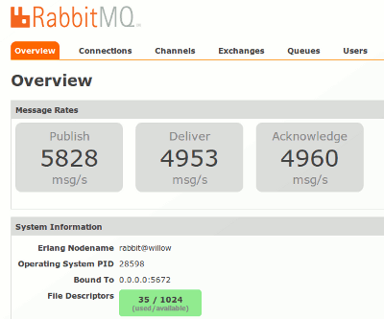
Messaging Server - RabbitMQ
Erlang
Transactional

Slide 28
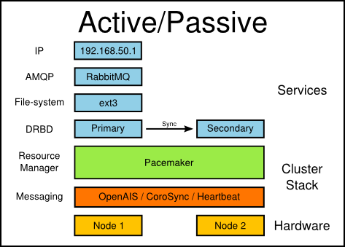
Messaging Server - RabbitMQ
Erlang
Transactional
HA Ready

Slide 29
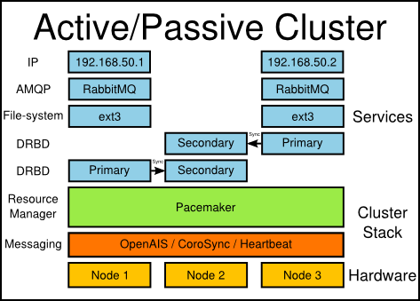
Messaging Server - RabbitMQ
Erlang
Transactional
HA Ready
Clustering

Slide 30
Messaging Server - RabbitMQ
Erlang
Transactional
HA Ready
Clustering
Persistant Queues

Slide 31
Messaging Server - RabbitMQ
Erlang
Transactional
HA Ready
Clustering
Persistant Queues
Vhosts for Queues

Slide 32
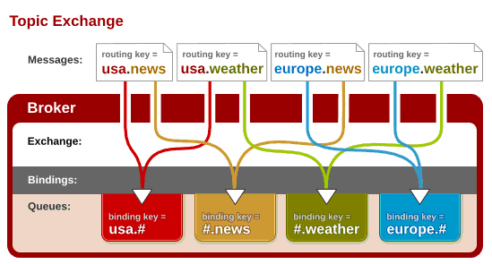
Messaging Server - RabbitMQ
Erlang
Transactional
HA Ready
Clustering
Persistant Queues
Vhosts for Queues
Multiple Queue per message

Slide 33
Celery
Our window to RabbitMQ

Slide 34
Celery
Our window to RabbitMQ
Python Library for Tasks

Slide 35
Celery
Our window to RabbitMQ
Python Library for Tasks
Support many queue backends (including sql)

Slide 36
Celery
Our window to RabbitMQ
Python Library for Tasks
Support many queue backends (including sql)
Periodic tasks (bye bye cron)

Slide 37
Celery
Our window to RabbitMQ
Python Library for Tasks
Support many queue backends (including sql)
Periodic tasks (bye bye cron)
Subtasks

Slide 38
Celery
Our window to RabbitMQ
Python Library for Tasks
Support many queue backends (including sql)
Periodic tasks (bye bye cron)
Subtasks
Callbacks

Slide 39
Celery
Our window to RabbitMQ
Python Library for Tasks
Support many queue backends (including sql)
Periodic tasks (bye bye cron)
Subtasks
Callbacks
Monitoring

Slide 40
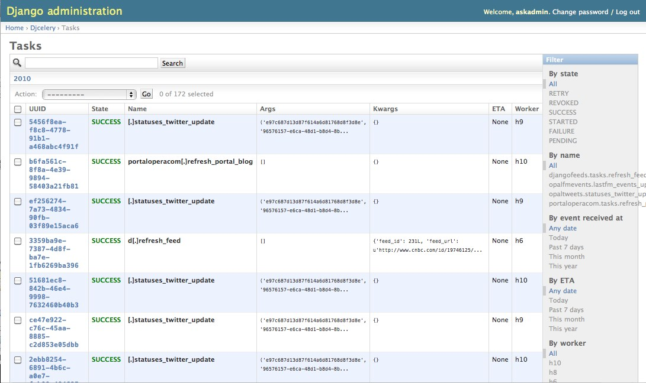
Monitoring

Slide 41

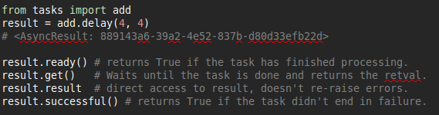
Celery Task

Slide 42
Code Update!
Git co celery
Add a task to thumbnail
Call task from our savefile action

Slide 43
Potential to Grow
HTTP Server
Celery Worker Nodes
RabbitMQ

Slide 44
What About Backend?
HTTP Server
Celery Worker Nodes
RabbitMQ
Backend Tasks
- Cache/Index Generation
- Data cleanup (Sessions?)
- Data imports

Slide 45
Celeryd -B
-B == with scheduler
Celerybeat db will be created for last run time
Cron-mode based on time vs 'last run'

Slide 46
RunStats Run...
Let's create a stat generator
Git co celery_schedule

Slide 47
Flexibility
Tasks can be any Python

Slide 48
Flexibility
Tasks can be any Python
Talk to DB servers, cache servers, etc

Slide 49
Flexibility
Tasks can be any Python
Talk to DB servers, cache servers, etc
Can check state (paused email domains)

Slide 50
Flexibility
Tasks can be any Python
Talk to DB servers, cache servers, etc
Can check state (paused email domains)
Can be set to retry (in 30s, up to 10 times)

Slide 51
Flexibility
Tasks can be any Python
Talk to DB servers, cache servers, etc
Can check state (paused email domains)
Can be set to retry (in 30s, up to 10 times)
Can spawn other tasks (subtasks, just plain other tasks)

Slide 52
New Considerations
What does the client/user expect?

Slide 53
New Considerations
What does the client/user expect?
1 second, 10 second, 1 minute?

Slide 54
New Considerations
What does the client/user expect?
1 second, 10 second, 1 minute?
One task can create 3 other tasks

Slide 55
New Considerations
What does the client/user expect?
1 second, 10 second, 1 minute?
One task can create 3 other tasks
State change between task created vs run

Slide 56
Final Thoughts
Think about separation up front

Slide 57
Final Thoughts
Think about separation up front
Helps make code modular

Slide 58
Final Thoughts
Think about separation up front
Helps make code modular
Prepare to scale early, not much extra code

Slide 59
Final Thoughts
Think about separation up front
Helps make code modular
Prepare to scale early, not much extra code
Cloud Friendly – imagine EC2 celery workers!

Slide 60
Thanks!
http://www.rabbitmq.com/
http://celeryproject.org/
http://blog.mitechie.com/
http://github.com/mitechie/
@mitechie

