Slide 1
CIS 634 Object Oriented Programming
Group Members:
1.Shaishav Shah
2. Mitee Patel
3.Tapan Desai
4. Kinjal Patel
Submitted to:
Prof. Weidong Xiong

Slide 2
Power Board Management

Slide 3
Responsibilities
Mitee Patel – Testing
Shaishav Shah – Code Implementation
Tapan Desai – Software Requirement Specification
Kinjal Patel – Design Documentation

Slide 4
Project Timeline (in days)
15 Days
30 days
40 Days
60 Days
Code work almost completed
Demo Work Completed
Problem Rectification and Implementation Ideas
Final implentation idea fixated and group work divided

Slide 5
Part : 1 Objective
The major goal of this project is to provide a desktop web application capable of managing and paying bills considering both the customer and administration perspectives.
To Achieve the goal, we will be using Java Language as its platform Independent Java is object-oriented. This allows you to create modular programs and reusable code. Additionally, OOPs concepts are also being kept in mind while developing this web application. Considering this, the project will use Java programming language for back-end development of the project.
The Front end would be designed in HTML+CSS. Using HTML would be easy as well as compatible to the system as we can convert the Designed UI from CorelDraw or any other designing platform easily.
For database, we would be using MY SQL.

Slide 6
Part : 2 Scope
This Project has two major players: User and Admin
Provide Secure log-in log out for both
Maintain a database for them

Slide 7
Part : 3 Software Requirement
1. VS Code 2. Ecilpse 3.Springboot Framework 4.React.js 5.Php Admin

Slide 8
Why SpringBoot
It is a framework which helps in connecting and validating the database.
It helps in authentication
It also encrypts the password. So, the admin cannot see the password set by user.

Slide 9
React.JS
Design simple views for each state in your application and React will efficiently update and render just the right components when your data changes.
Declarative views make your code more predictable and easier to debug.

Slide 10
Php MyAdmin
The main purpose of phpMyAdmin is to handle the administration of MySQL over the web.
Thus, we can use MySQL and Apache together at one place and not actually download the application

Slide 11
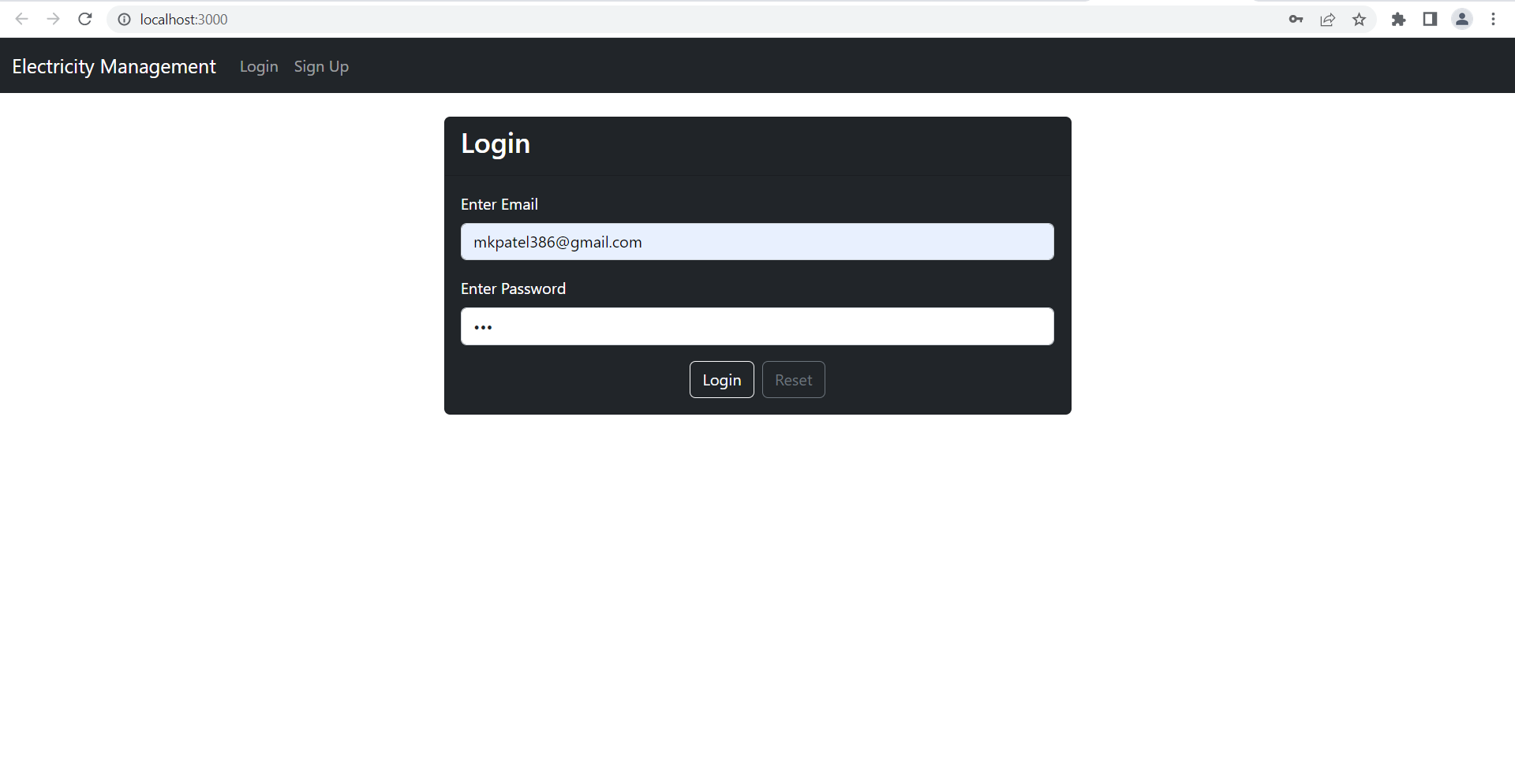
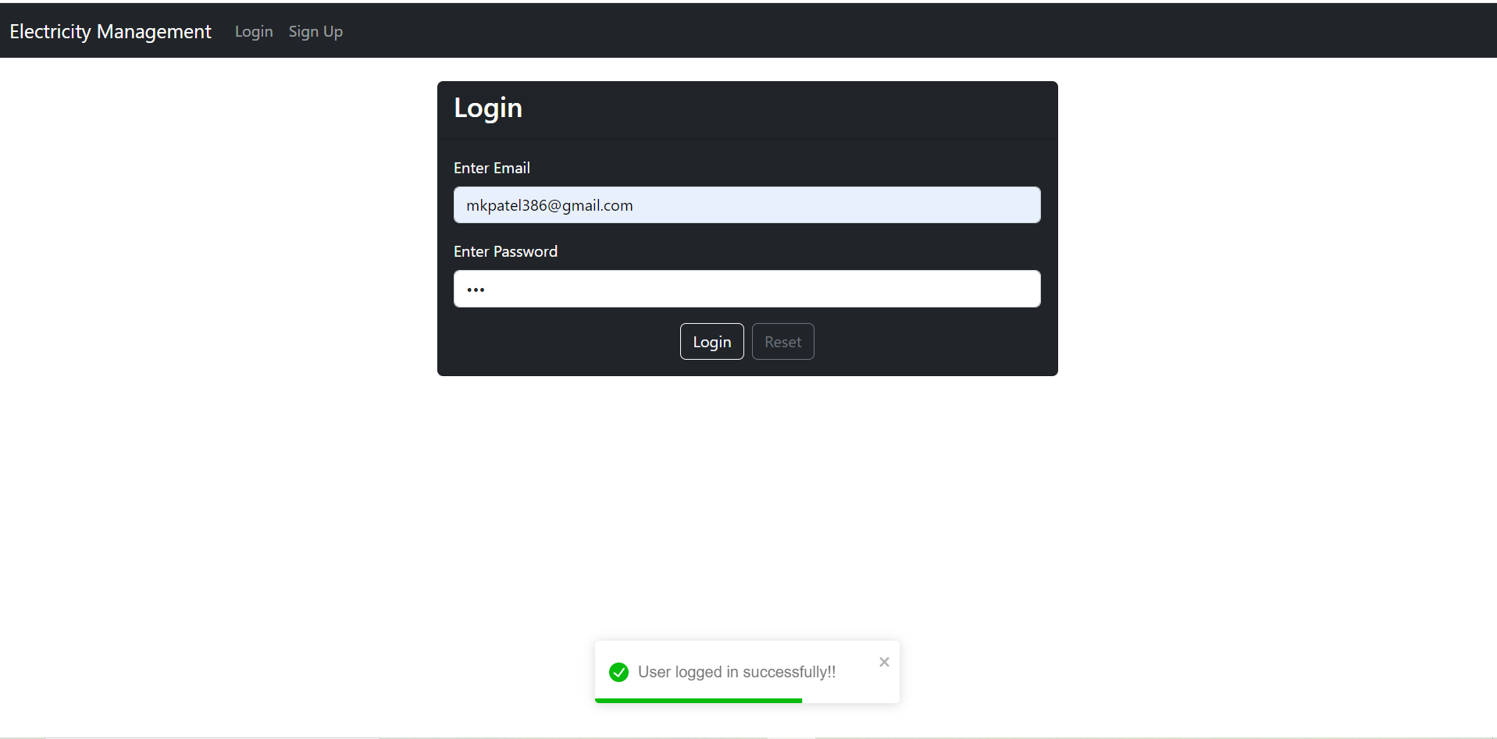
Part : 4 Implementation Authentication

Slide 12
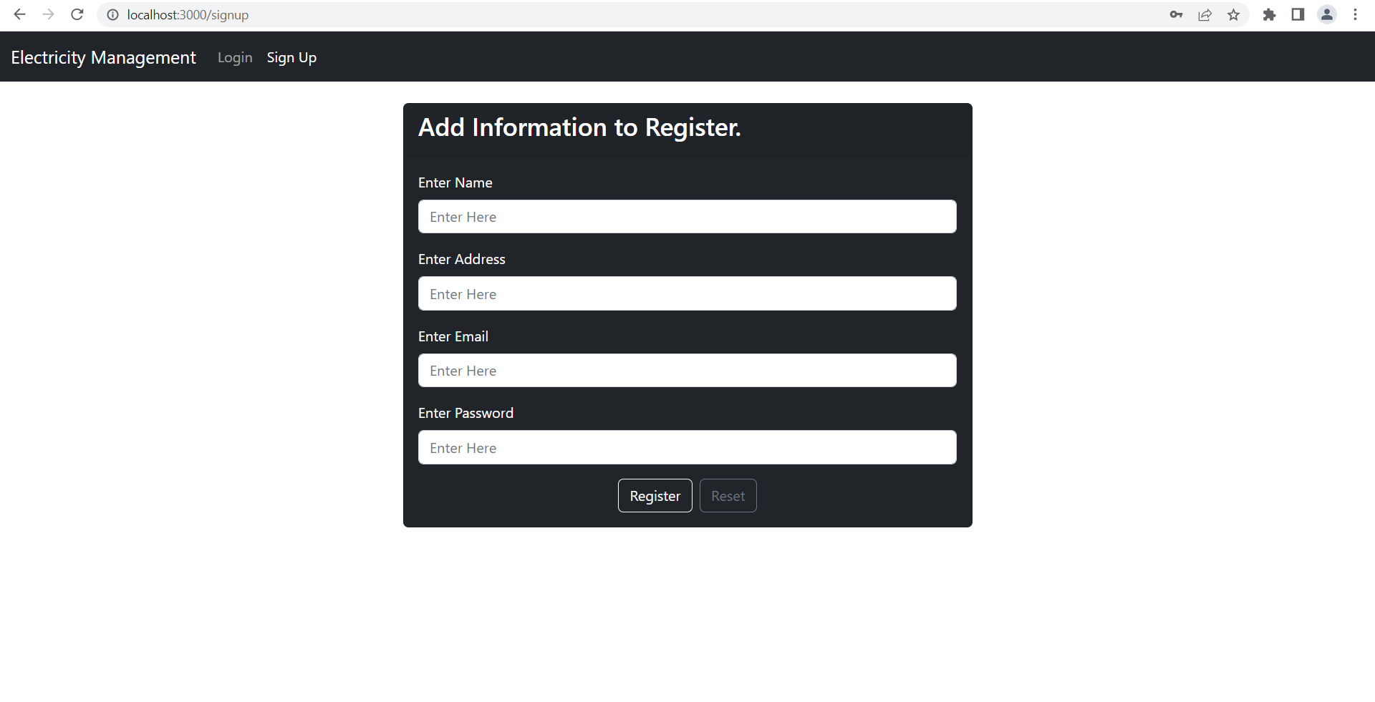
Part : 4 Implementation Register a User

Slide 13
Testing
Development Testing
Release testing
User testing

Slide 14
Future Scope
This can prove to be a good template to make Admin-User web applications
Additions can be made like payment confirmation mail or message
Elaborating the features on admin

Slide 15
DEMO

Slide 16
THANKS!

