Slide 1
CIS 634 Object Oriented Programming
Group Members:
1.Shaishav Shah
2. Mitee Patel
3.Tapan Desai
4. Kinjal Patel
Submitted to:
Prof. Weidong Xiong

Slide 2
Power Board Management

Slide 3
Project Timeline (in days)
15 Days
30 days
40 Days
60 Days
Code work almost completed
Demo Work Completed
Problem Rectification and Implementation Ideas
Final implentation idea fixated and group work divided

Slide 4
Part : 1 Objective
The major goal of this project is to provide a desktop web application capable of managing and paying bills considering both the customer and administration perspectives.
To Achieve the goal, we will be using Java Language as its platform Independent Java is object-oriented. This allows you to create modular programs and reusable code. Additionally, OOPs concepts are also being kept in mind while developing this web application. Considering this, the project will use Java programming language for back-end development of the project.
The Front end would be designed in HTML+CSS. Using HTML would be easy as well as compatible to the system as we can convert the Designed UI from CorelDraw or any other designing platform easily.
For database, we would be using MY SQL.

Slide 5
Part : 2 Scope
This Project has two major players: User and Admin
Provide Secure log-in log out for both
Maintain a database for them

Slide 6
Part : 3 Software Requirement
1. VS Code 2. Ecilpse 3.Springboot Framework 4.React.js 5.Php Admin

Slide 7
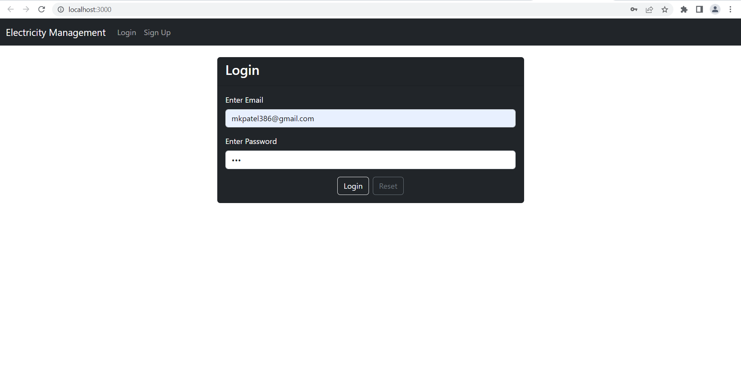
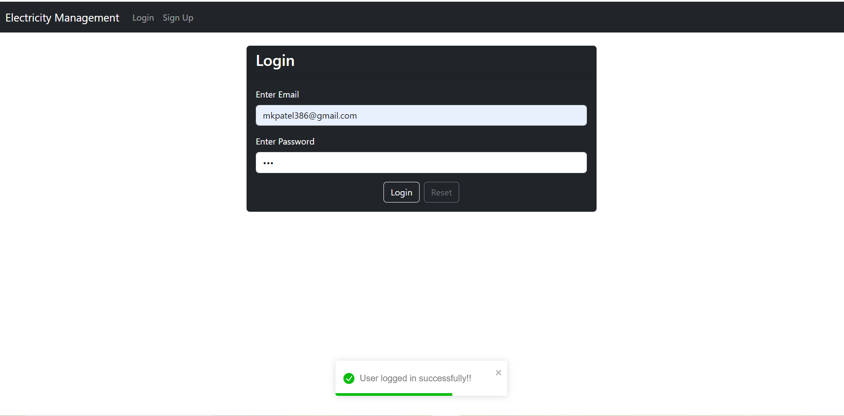
Part : 4 Implementation Authentication

Slide 8
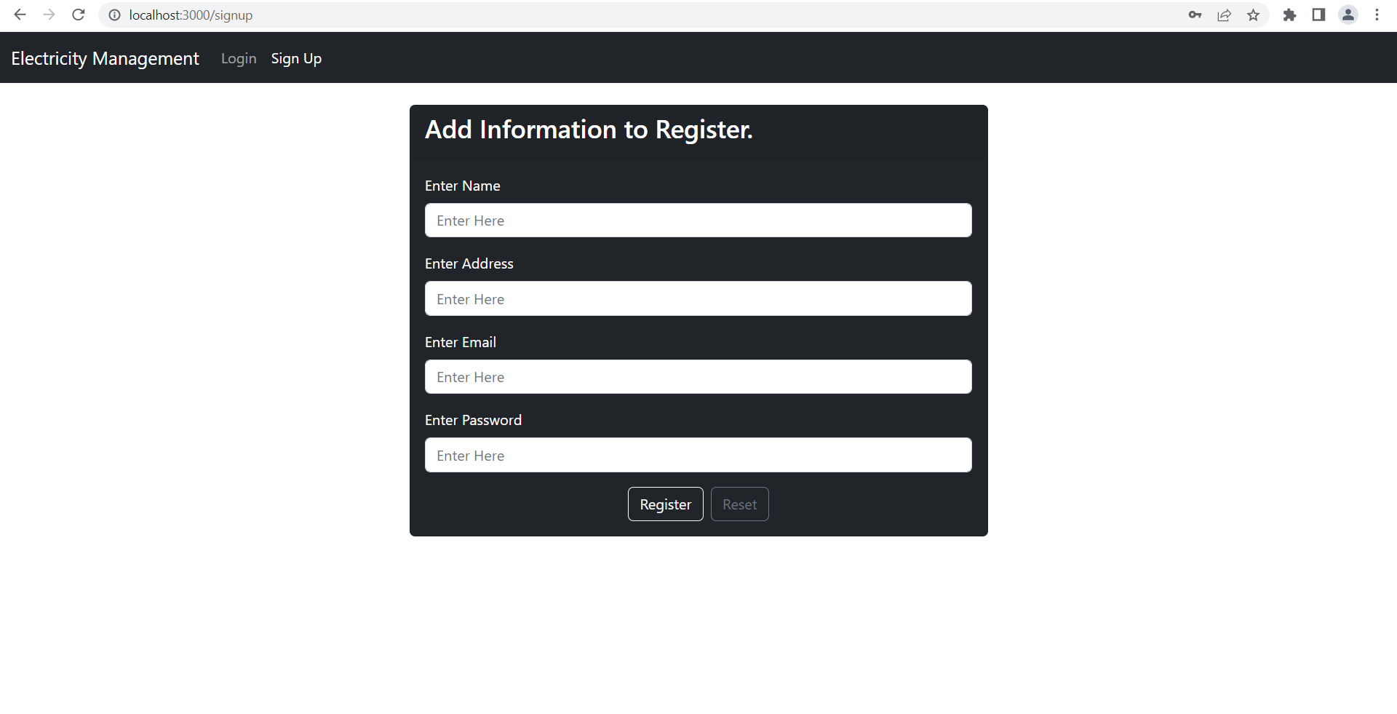
Part : 4 Implementation Register a User

Slide 9
THANKS!

