Slide 1
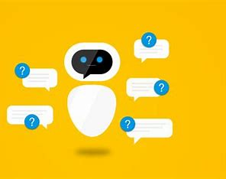
Chatbot in Dialogflow

Slide 2
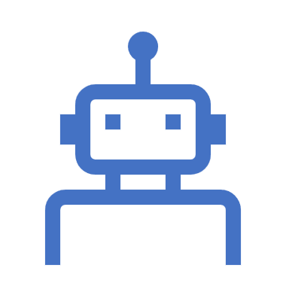
What is Chatbot ?
A chatbot is a software application designed to simulate human conversation through text or voice interactions. It utilizes artificial intelligence (AI) and natural language processing (NLP) technologies to understand and respond to user inputs in a conversational manner. Chatbots can be deployed on various platforms, such as websites, messaging apps, mobile apps, and voice assistants.

Slide 3
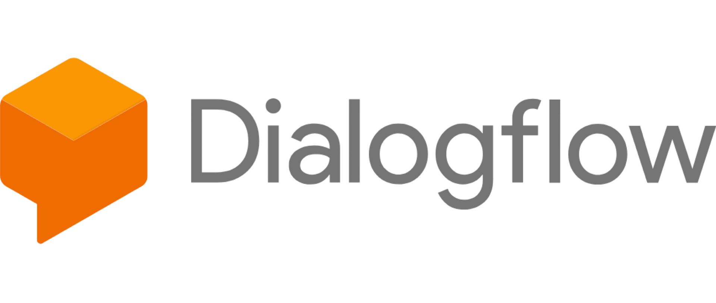
Dialogflow, now known as "Google Cloud Dialogflow," is a cloud-based platform developed by Google that enables developers to create and deploy conversational agents, or chatbots, with natural language understanding capabilities. It empowers businesses to build interactive and intelligent chatbots that can communicate with users through text or voice, providing a seamless and human-like conversational experience.

Slide 4
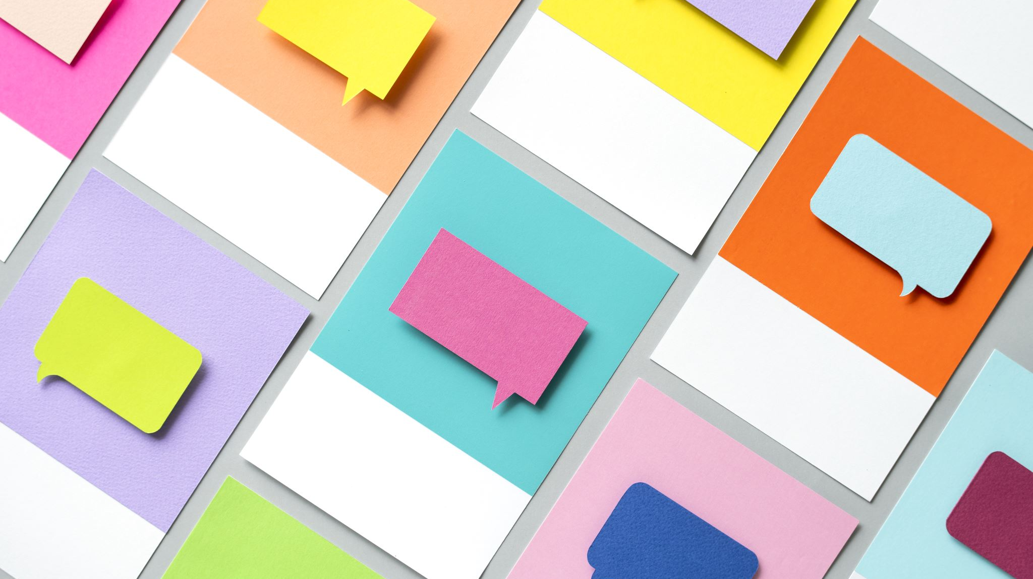
Key Features Section
Seamless Integration
Effortlessly integrate the chatbot into your website or app. No coding required!
Natural Language Processing
Understand and respond to users in their own words. Achieve human-like interactions.
Multi-Language Support
Break language barriers! Engage with users from around the globe in their preferred language.
Why Choose Dialogflow?
Cutting-Edge Technology
Powered by Google Cloud, Dialogflow offers state-of-the-art AI for top-notch performance.
Customization & Flexibility
Tailor the chatbot's personality and responses to match your brand's unique voice.
Rich Analytics
Gain insights into user interactions, fine-tune responses, and enhance user experience.

Slide 5
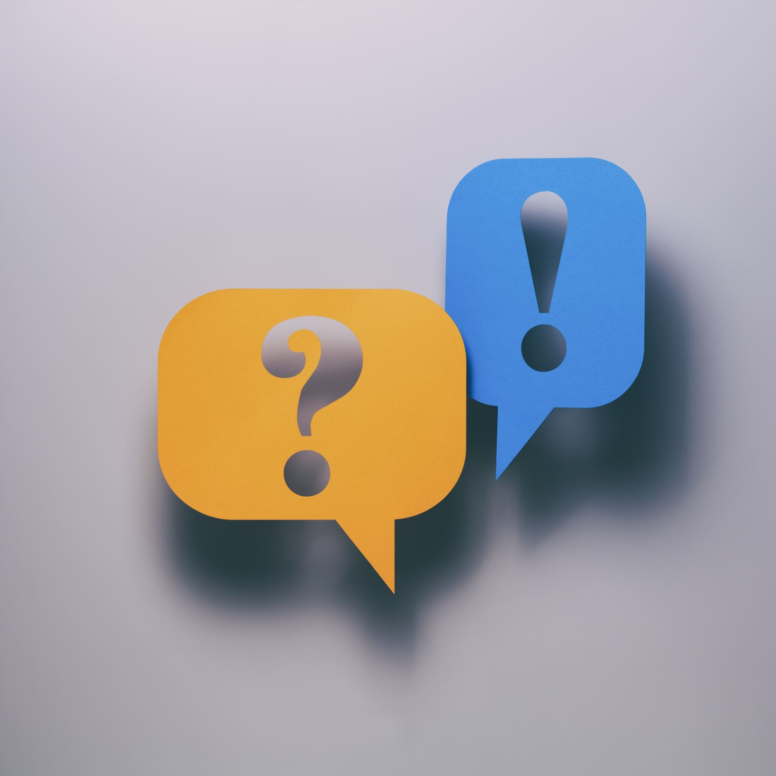
2. Project Objectives:
The main objectives of this project were as follows:
To create a chatbot using Dialogflow that can understand and respond to user input.
To integrate the chatbot with a suitable messaging platform.
To provide accurate and relevant responses to user queries.
To implement features such as intent recognition, context handling, and natural language understanding.

Slide 6

3. Methodology:
The project followed a systematic approach that included the following steps:
3.1. Requirement Analysis:
Identified the target audience and their potential queries.
Determined the scope and capabilities of the chatbot.
3.2. Dialogflow Setup:
Created a new project in Dialogflow.
Defined intents, which represent user queries, and added training phrases and responses.
Configured entities to extract specific information from user input.
3.3. Integration:
Integrated the Dialogflow chatbot with a chosen messaging platform (e.g., website, Facebook Messenger) using Dialogflow's integration options.
3.4. Natural Language Processing (NLP):
Utilized Dialogflow's built-in NLP capabilities to understand user input and map it to relevant intents.
Implemented context handling to maintain conversational context and provide coherent responses.
3.5. Testing and Iteration:
Conducted thorough testing to identify and rectify issues related to intent recognition, response accuracy, and user experience.
Iteratively refined the chatbot's training data and responses to improve its performance.

Slide 7
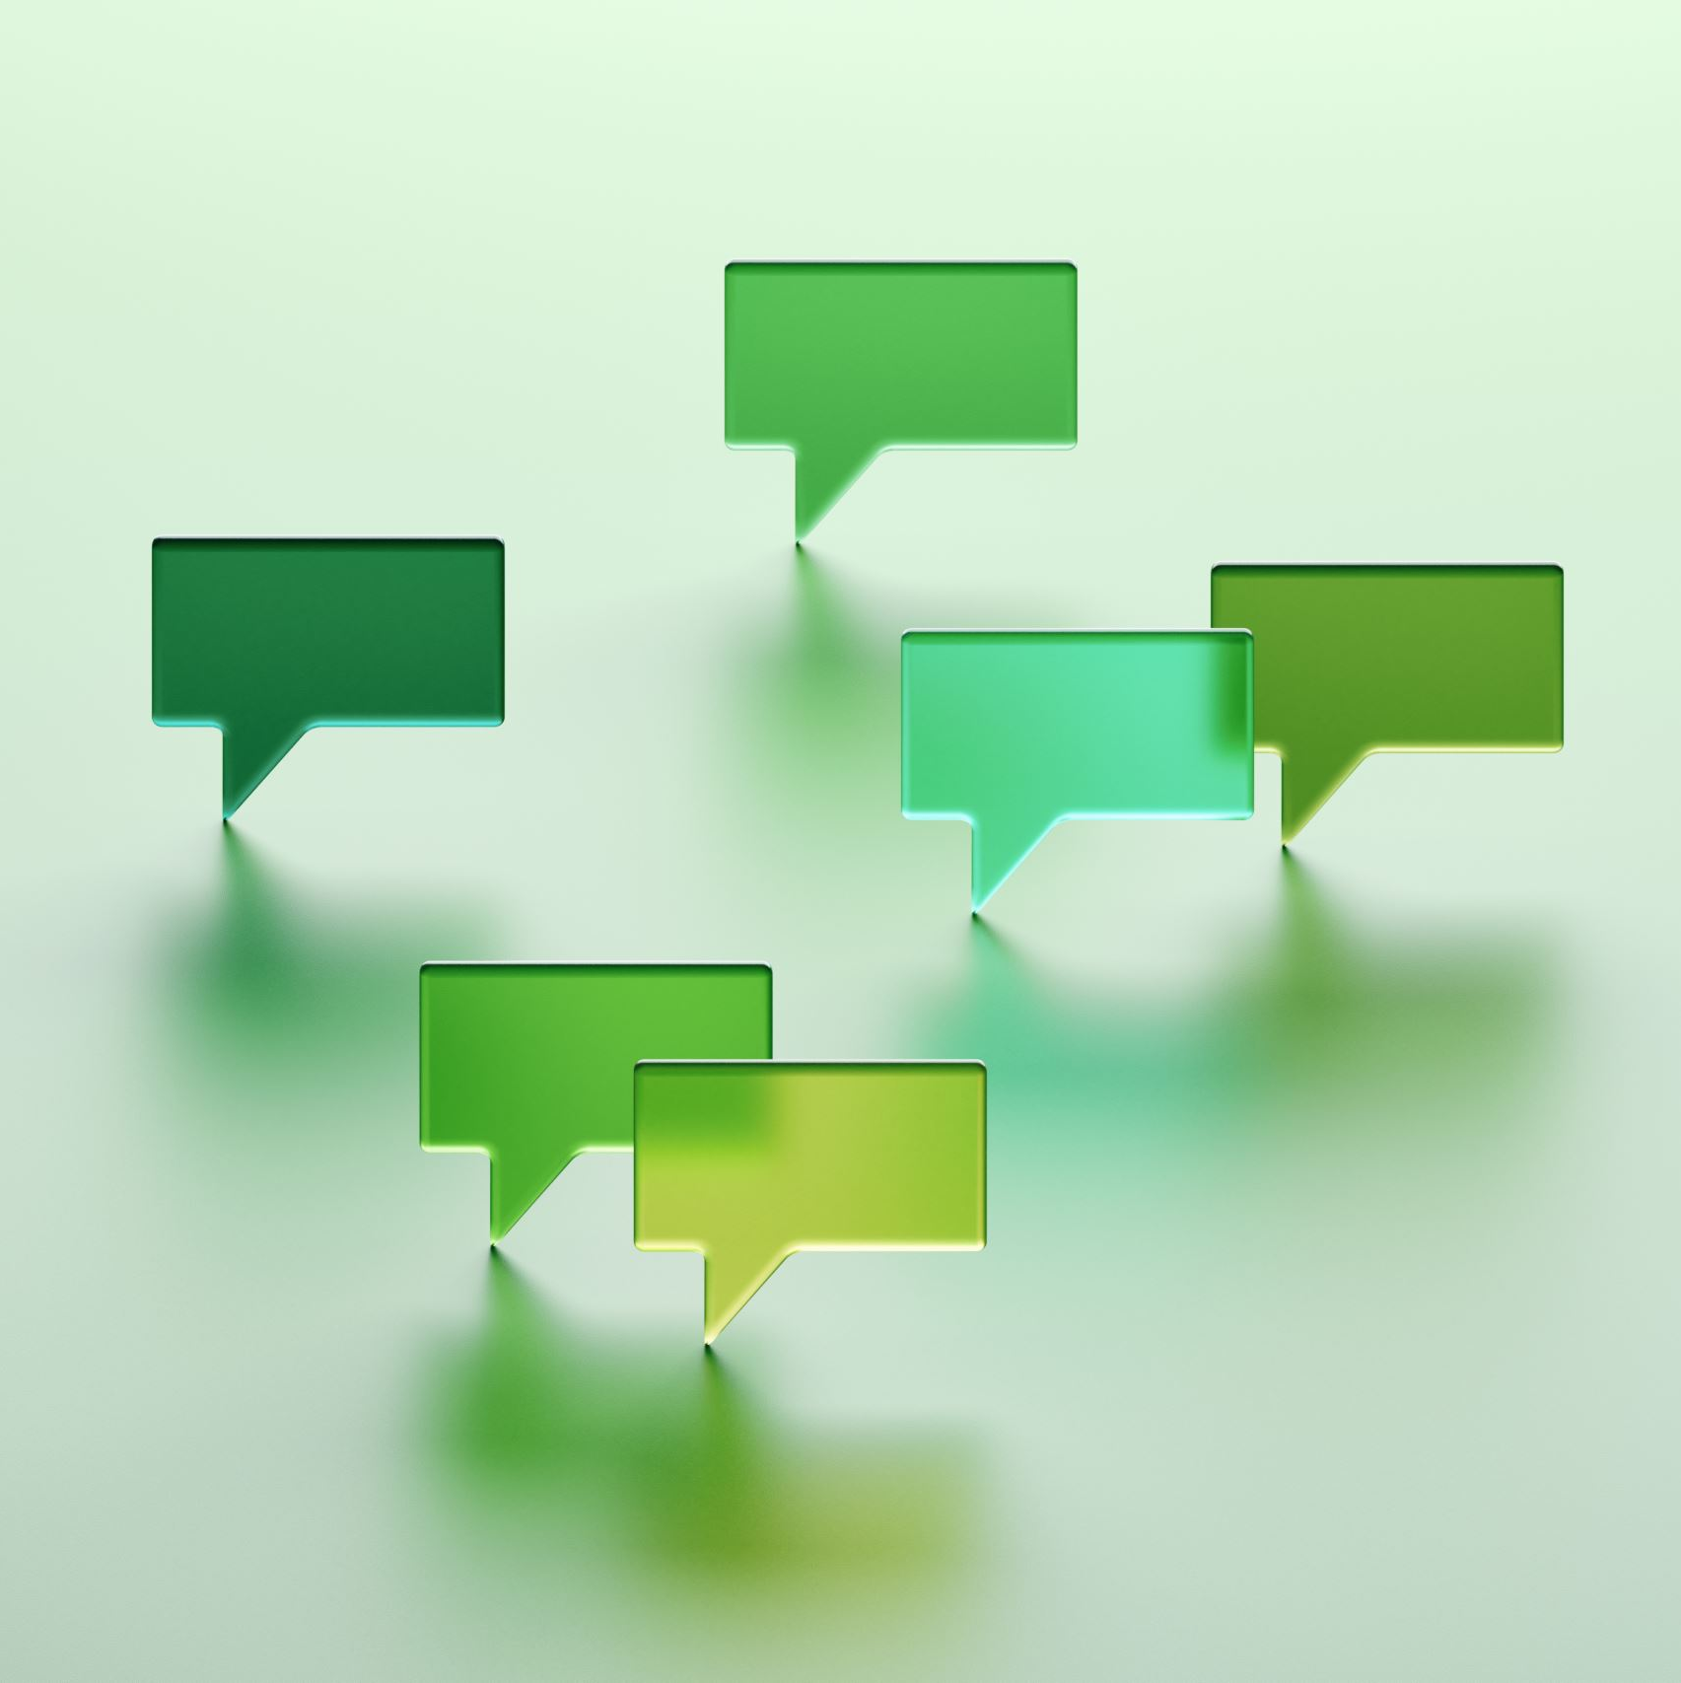
4. Features Implemented:
The developed chatbot included the following features:
4.1. Intent Recognition:
Trained the chatbot to understand and classify user intents based on provided training phrases.
Recognized various types of user queries, such as inquiries, commands, and requests.
4.2. Contextual Responses:
Implemented context management to maintain the conversation's flow and provide relevant responses.
Managed follow-up intents to handle multi-turn interactions.
4.3. Rich Responses:
Provided text-based responses for general queries.
Incorporated images, cards, and buttons for more interactive responses.
4.4. Entity Extraction:
Utilized entities to extract specific information from user input, enhancing the chatbot's ability to understand complex queries.

Slide 8

5. Results:
The developed chatbot demonstrated significant success in achieving its objectives. It effectively understood and responded to user queries, providing accurate information and assistance. The integration with the chosen messaging platform ensured seamless user engagement.

Slide 9

6. Challenges Faced:
Fine-tuning intent recognition to handle a wide range of user inputs.
Ensuring consistent and contextually appropriate responses in multi-turn conversations.

Slide 10
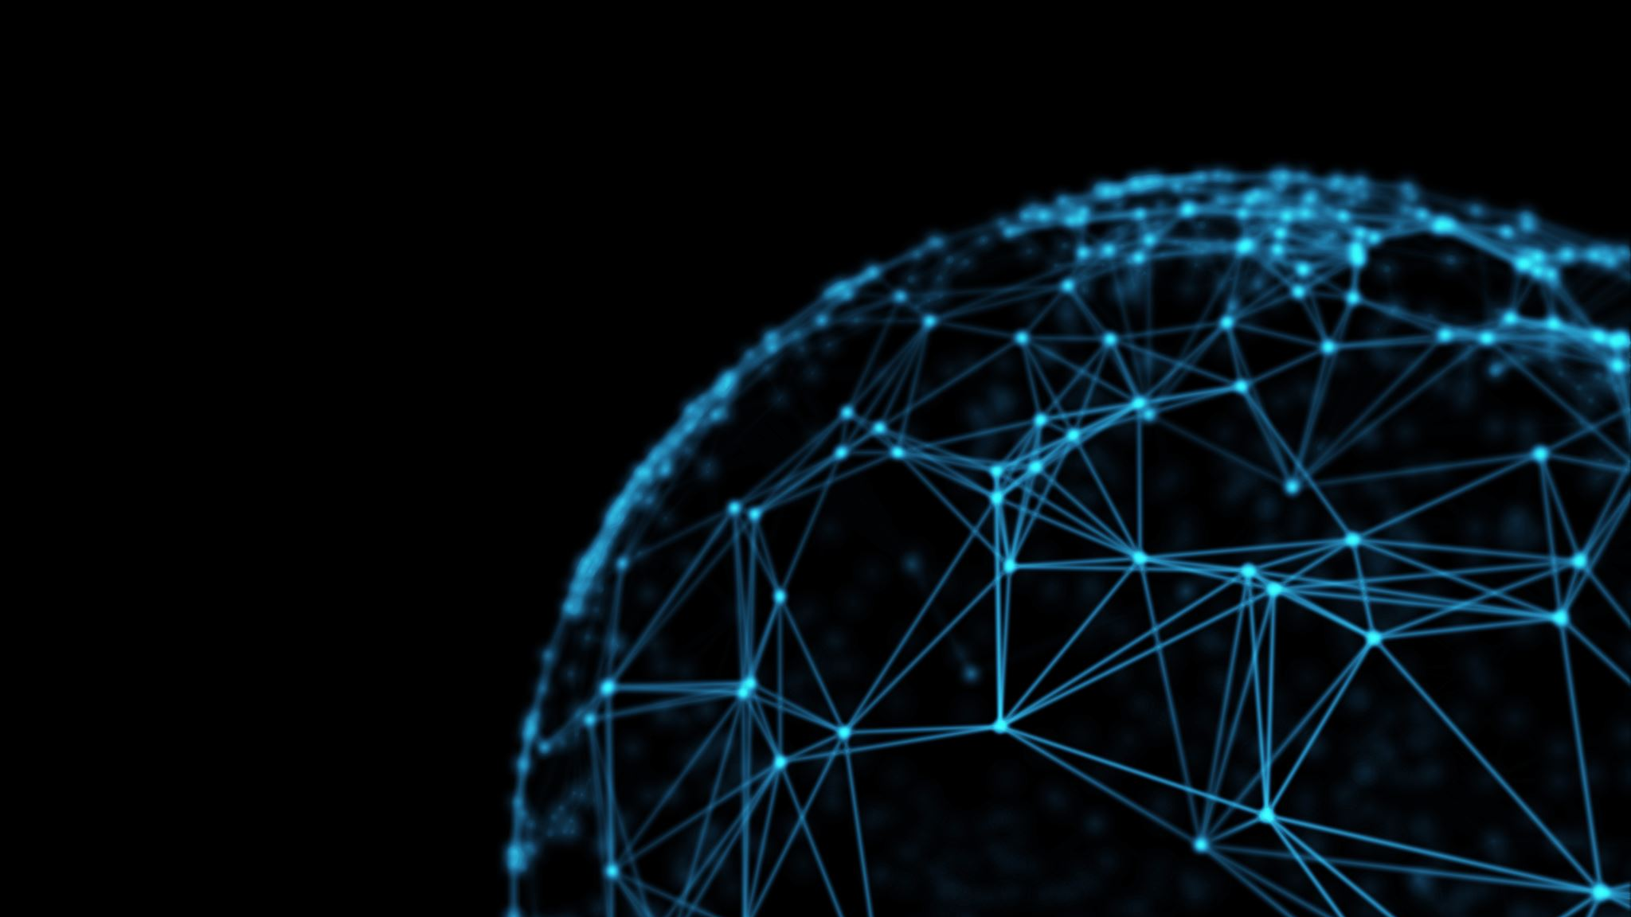
7. Future Enhancements:
Integration with additional messaging platforms to reach a broader audience.
Incorporation of machine learning techniques for more advanced natural language understanding.
Expansion of the chatbot's knowledge base to cover a wider range of topics.

Slide 11
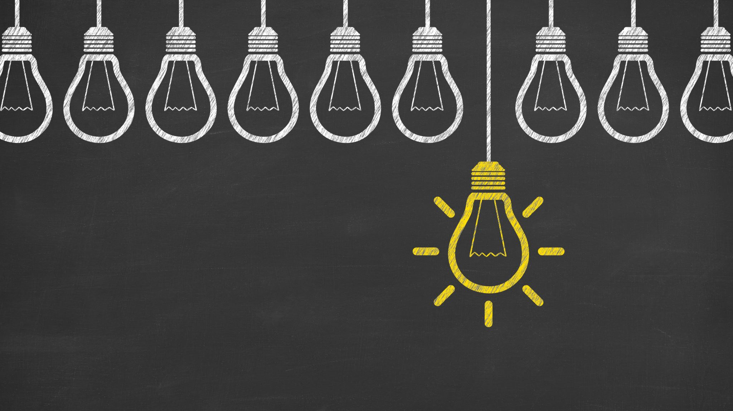
8. Conclusion:
The "Build a Chatbot in Dialogflow" project successfully developed a functional chatbot capable of interacting with users, understanding their queries, and providing relevant responses. The project highlighted the potential of using Dialogflow's NLP capabilities for creating intelligent conversational agents. The chatbot's ability to handle various user inputs and engage in meaningful conversations marks a significant achievement in the field of AI-driven customer interaction.

