Slide 1

Project Name : Hospitality Finance

Slide 2
Group Members
Amisha Pinge
Priyanka Swami
Suman Rawat
Yugandhara
Ankit Sharma
Mitesh R Bedre

Slide 3
Report Analytics & Dashboard Analytics for Stake-Holders
Key Metrics
- Total Departmental Expenses
- Total FF&E Reserves
- Total Management Fees
- Total Non Operating Expenses
- Total Revenue
- Total Rooms Available
- Total Rooms Revenue
- Total Rooms Sold
- Total Undistributed Expenses
- ADR (Average Daily Rate) : [Total Rooms Revenue] / [Total Rooms Sold]
- EBITDA : [Gross Operating Profit] - [Management Fees and NonOperating Expenses]
- EBITDA % : [EBITDA] / [Total Revenue]
- Gross Operating Income : [Total Revenue] - [Total Departmental Expenses]
- Gross Operating Income % : [Gross Operating Income] / [Total Revenue]
- Gross Operating Profit : [Gross Operating Income] - [Total Undistributed Expenses]
- Gross Operating Profit % : [Gross Operating Profit] / [Total Revenue]
- Management Fees and NonOperating Expenses : [Total Management Fees] + [Total Non Operating Expenses]
- Net Operating Income : [EBITDA] - [Total FF&E Reserves]
- Net Operating Income % : [Net Operating Income] / [Total Revenue]
- OCC (Occupancy Rate) : [Total Rooms Sold] / [Total Rooms Available]
- RevPAR (Revenue per Available Room) : [Total Rooms Revenue] / [Total Rooms Available]

Slide 4
Introduction
Hospitality financial management is typically used to ensure that the monetary components of a company like a hotel or restaurant is properly overseen and organized.
The primary goal of this project is :
Revenue Optimization: Achieve an increase in Total Revenue by enhancing ADR (Average Daily Rate) and RevPAR (Revenue per Available Room) through effective pricing strategies and premium service offerings.
Operational Efficiency: Improve Gross Operating Income % by optimizing departmental expenses while maintaining service quality to increase profitability.
Customer Engagement: Maintain or increase Occupancy Rate (OCC) through strategic marketing, enhanced customer experience, and competitive pricing.
Financial Stability: Reduce Management Fees and Non-Operating Expenses to bolster EBITDA (Earnings Before Interest, Taxes, Depreciation, and Amortization) .

Slide 5
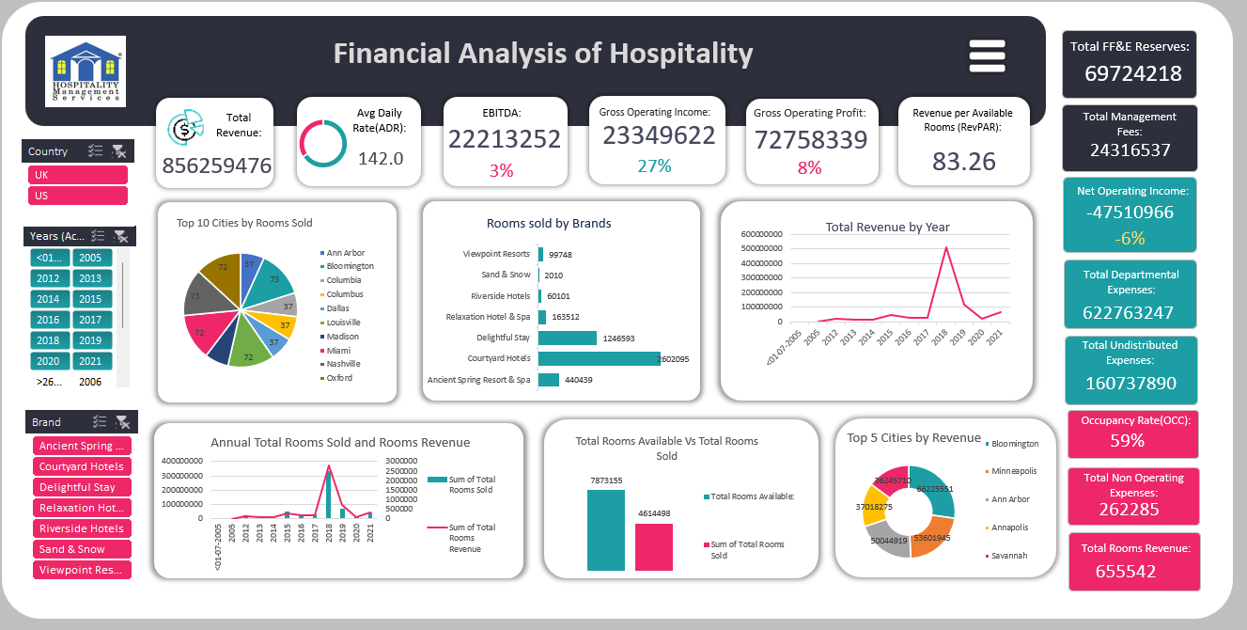
Excel dashboard

Slide 6
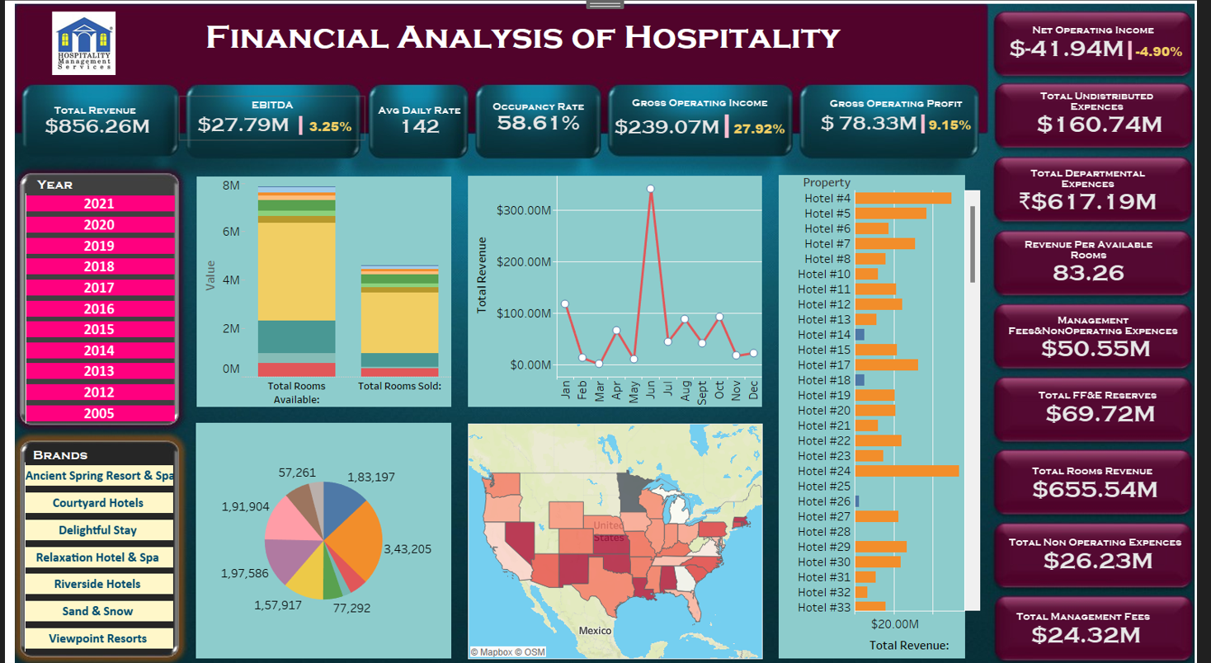
Tableau dashboard

Slide 7
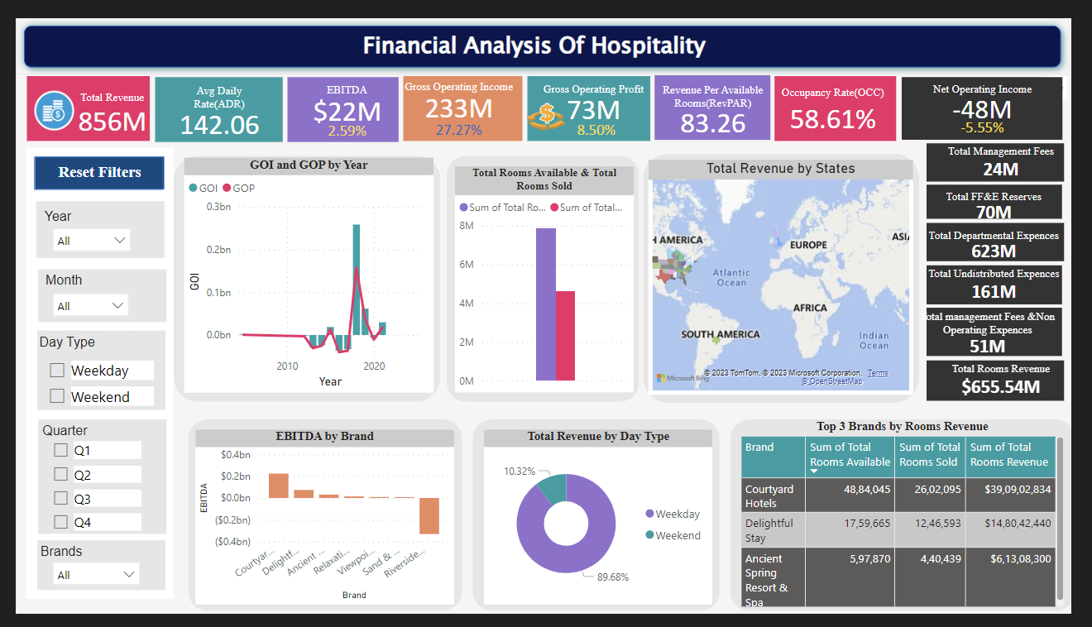
Power bi dashboard

Slide 8
Summary
Courtyards hotel is the most sold hotel amongst all brands.
US Revenue is much more higher than UK.
2018 is the most profitable year of all.
Weekday(89.68%) revenue is much higher than weekdend(10.32%) total revenue.

Slide 9
Thank You

