Slide 1
Breaking Language Barriers: Speech-to-Speech Translation for Unwritten Languages
Mitesh Kumar, M23MAC004
Sougata Moi, M23MAC008

Slide 2
Introduction and Application
Why focus on unwritten languages?
40% of the world’s languages lack standardized writing systems, making text-based translation methods impractical.
Examples include many endangered languages and oral dialects like Taiwanese Hokkien.
Challenges faced by traditional S2ST systems:
Heavy reliance on text-based intermediate steps (e.g., ASR, MT, and TTS).
Lack of parallel text corpora for training models.
Difficulty in capturing tone, accent, and speaker characteristics without effective representations.
The Hokkien Case Study:
Taiwanese Hokkien is spoken by over 70% of Taiwan’s population (~15.8 million).
Lacks a widely adopted writing system; tonal language with complex tone sandhi (tone changes based on context).
Existing approaches using synthetic data have limited success due to low-resource nature of this language pair.

Slide 3
Proposed Solution and Real-World Importance
Proposed Solution:
Instead of text, use discrete unit-based representations that encode linguistic and non-linguistic speech features.
Bypasses the need for parallel text by translating speech directly into speech.
Real-world importance:
Enables communication in multilingual, low-resource environments (e.g., rural and oral-first communities).
Preserves oral languages by integrating them into digital ecosystems, promoting inclusivity and access.
Speech-to-Speech Translation For A Real-world Unwritten Language

Slide 4
Dataset
Training Data:
Human Annotated Data:
Hokkien→English: 61.4 hours total
English→Hokkien: 35 hours English + 51 hours Hokkien
Sources: Hokkien dramas, TAT dataset, MuST-C
Weakly Supervised Data:
English→Hokkien: 1.5k hours from Librispeech and TED-LIUM3
Hokkien→English: 8k hours from Hokkien dramas
Mined Data:
Hokkien→English S2T: 8.1k hours
English↔Hokkien S2ST: 197 hours
Test Data:
1.47 hours of English speech – 10 speakers (5 male, 5 female) for English
1.42 hours of Hokkien speech – 4 speakers (2 male, 2 female) for Hokkien

Slide 5
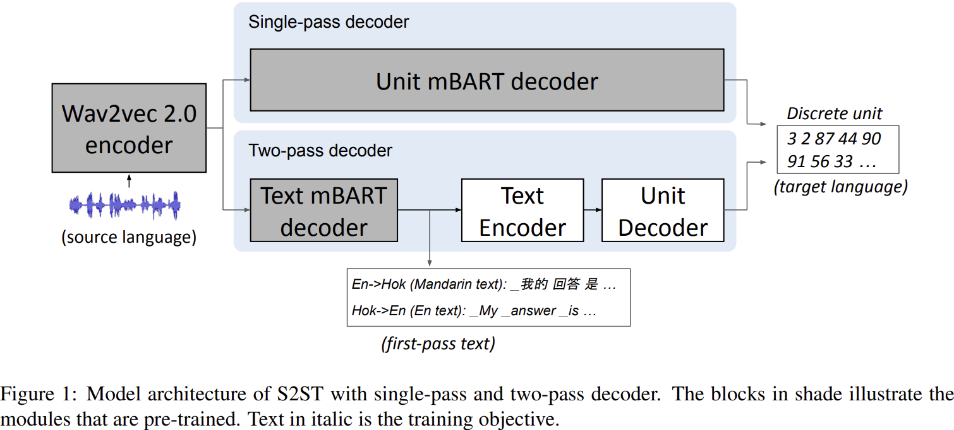
Model Architecture

Slide 6
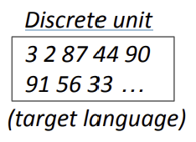
Model Architecture : Discrete Unit to Speech
Overview of the Model: The S2ST system consists of two core components:
Sequence-to-sequence S2UT model: Converts input source speech into target discrete units.
HiFi-GAN Vocoder: Converts discrete unit sequences into target Speech waveforms.
HiFi-GAN vocoder
Speech Waveform

Slide 7
Single-Pass Decoding (S2UT):
Key Components:
wav2vec 2.0 encoder:
Extracts 80-dim log-mel filterbank features and transforms input speech into meaningful representations.
Pre-trained on large speech datasets (e.g., LibriSpeech) using self-supervised learning.
unit mBART decoder:
Converts the encoded speech representations into sequences of discrete units.
Pre-trained using cross-entropy loss on unit sequences extracted via HuBERT clustering.

Slide 8
Single-Pass Decoding (S2UT):
How Single-Pass Decoding Works:
Source speech is passed through the wav2vec 2.0 encoder, generating latent speech representations.
These representations are directly decoded by the unit mBART decoder into discrete units that represent the target language speech.
The output discrete units are passed through a HiFi-GAN vocoder to generate the target waveform.

Slide 9
Two-Pass Decoding (UnitY):
Key Components:
wav2vec 2.0 encoder: Same as in the single-pass model, responsible for encoding input speech into latent representations.
Text mBART decoder:
Pre-trained on large corpora of Mandarin and English text.
Generates intermediate text representations based on the source speech.
Text Encoder: Processes the intermediate text into a format compatible with the unit decoder.
Unit Decoder: Converts the intermediate text representations into discrete units of target language speech.
HiFi-GAN vocoder: Converts the discrete units into the target speech waveform.

Slide 10
Two-Pass Decoding (UnitY):
How Two-Pass Decoding Works:
The input speech is processed by the wav2vec 2.0 encoder to generate latent speech representations.
These representations are fed into the text mBART decoder, which predicts an intermediate text
The text encoder processes the predicted text, and the unit decoder converts it into a sequence of discrete units.
The discrete units are then passed through the HiFi-GAN vocoder to generate the final target waveform.

Slide 11
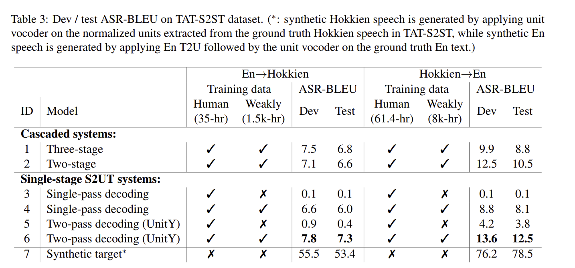
Evaluation

Slide 12
Conclusion & Future Scope
Conclusion:
This study developed the first English ↔ Hokkien S2ST system targeting an unwritten language.
Demonstrated the effectiveness of combining human-annotated, weakly supervised, and mined data in low-resource settings.
Showed that two-pass decoding leveraging high-resource intermediate languages (like Mandarin) significantly improves translation accuracy.
Highlighted the potential of discrete unit-based approaches for preserving and translating oral languages.

Slide 13
Conclusion & Future Scope
Future Scope:
Support for diverse languages: Expand the model’s applicability to other unwritten and endangered languages and we are still using a high resource language as reference, we need to reduce the importance of the reference language in the whole training process.
Real-time implementation: Work towards building efficient S2ST models suitable for real-time applications.
Robust domain adaptation: Ensure models perform consistently across varied real-world conditions and domains.

Slide 14
Thank You

