Slide 1
U1 · UTILITIES — POWER, ENERGY, TRANSMISSION & DISTRIBUTION
CRITICAL NOW
NEXORA AI
Power Outage Prediction & Grid Equipment Failure Advisor
An explainable AI copilot that fuses sensor health data, weather forecasts, and field reports to predict outages before they happen — and keeps a human in the loop on every decision.
Built for the 2026 Industry Problem Statements challenge · Powered by IBM Bob
[Team Name]

Slide 2
THE PROBLEM
Grid failures are still handled reactively
Transformer and substation failures cause blackouts that cost utilities $1M+ per hour and affect millions of people. Most utilities still run maintenance on fixed calendars — while sensors already measuring temperature, vibration, partial discharge, and oil quality show failure signatures weeks in advance.
COST OF INACTION
$1M+
lost per hour of blackout, borne by utilities and the millions of people they power
📅
Calendar-based maintenance
Assets get serviced on a schedule, not on real condition.
WEEKS
📡
Sensor data sits unused
Temperature, vibration & oil-quality signals aren't analysed in time.
of advance warning already sitting inside HUMS & condition sensors — unread
🌩️
Weather isn't factored in
Forecasts and asset health are never combined to act ahead of storms.
Weather events compound the risk, but forecasts and sensor data are never combined in time to pre-position crews.
02

Slide 3
OUR CHALLENGE — PROBLEM STATEMENT U1
What we set out to build
🔗
01
🎯
02
📊
03
🚨
04
Fuse the data
Predict what fails
Rank by impact
Plan the response
Combine asset health sensors, weather forecasts, and historical incident records into one view.
Forecast outage-prone areas and at-risk equipment before they trip.
Score assets by grid-impact severity, not just raw sensor risk.
Generate a prioritised maintenance and crew pre-positioning plan.
03

Slide 4
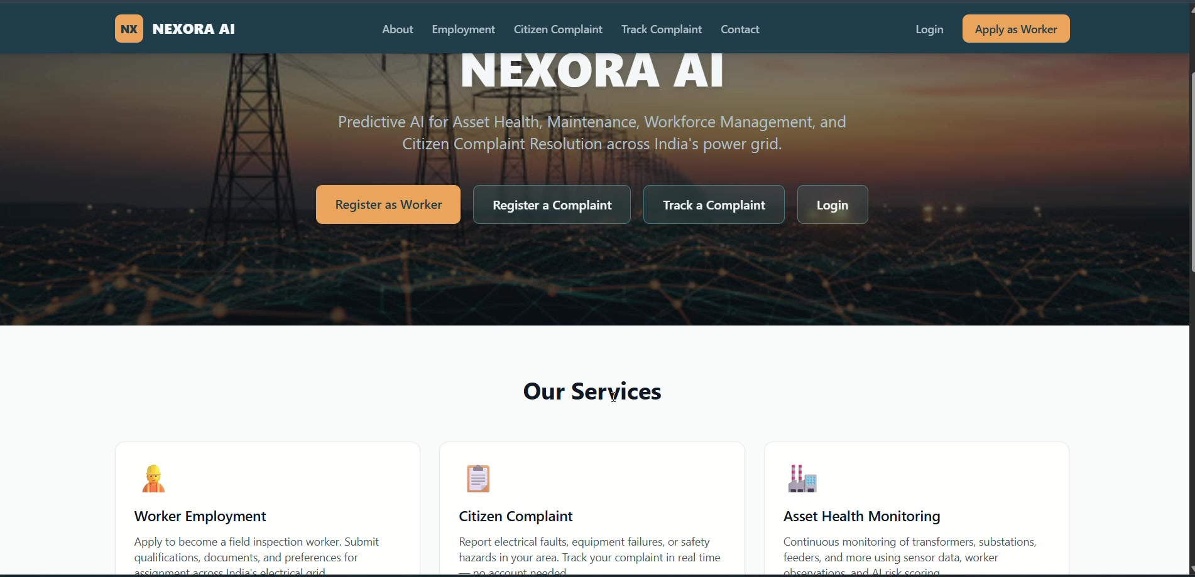
THE SOLUTION
Introducing NEXORA AI
NEXORA AI fuses worker field observations, sensor data, weather forecasts, historical incident records, GIS location data, and citizen complaints into one explainable risk engine. Every prediction is transparent, versioned, and requires administrator review before action is taken — AI as a decision-support tool, not a black box.
🧬
Multi-source data fusion
Live landing page — worker onboarding, citizen complaints & admin access in one platform
🔍
Explainable, versioned predictions
🧑‍✈️
Human-in-the-loop governance
🗺️
GIS + weather aware risk scoring
04

Slide 5
HOW IT WORKS
From raw signals to a crew action plan
🗂️
🧠
📋
✅
🔧
Ingest
Score Risk
Prioritise
Human Review
Dispatch
Sensor telemetry, weather forecasts, worker reports, complaints & incident history
→
AI risk engine scores every asset with contributing factors & confidence
→
Ranks the queue: risk × 0.4 + grid impact × 0.3 + failure prob. × 0.2 + urgency × 0.1
→
Administrator approves, rejects, or overrides — with a mandatory reason
→
Approved plan flows to crews & workers as a prioritised maintenance task
Nothing reaches a crew without sign-off:
“All plans require administrator approval before crew assignment.” — every prediction is versioned, timestamped, and reviewable.
05

Slide 6
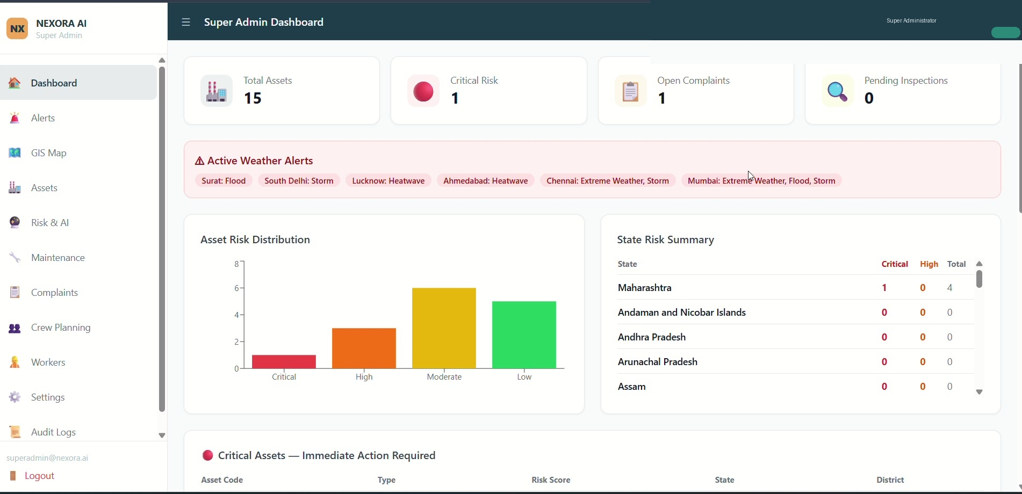
IN ACTION — COMMAND CENTRE
One dashboard, national grid visibility
Real-time KPIs
Total assets, critical-risk count, open complaints & pending inspections at a glance
Weather-aware
Active flood / storm / heatwave alerts overlaid on the same view as asset risk
Risk distribution
Every transformer, substation & feeder bucketed Critical → Low, state by state
Super Admin dashboard: live asset counts, critical-risk flags, and active weather alerts across states
06

Slide 7
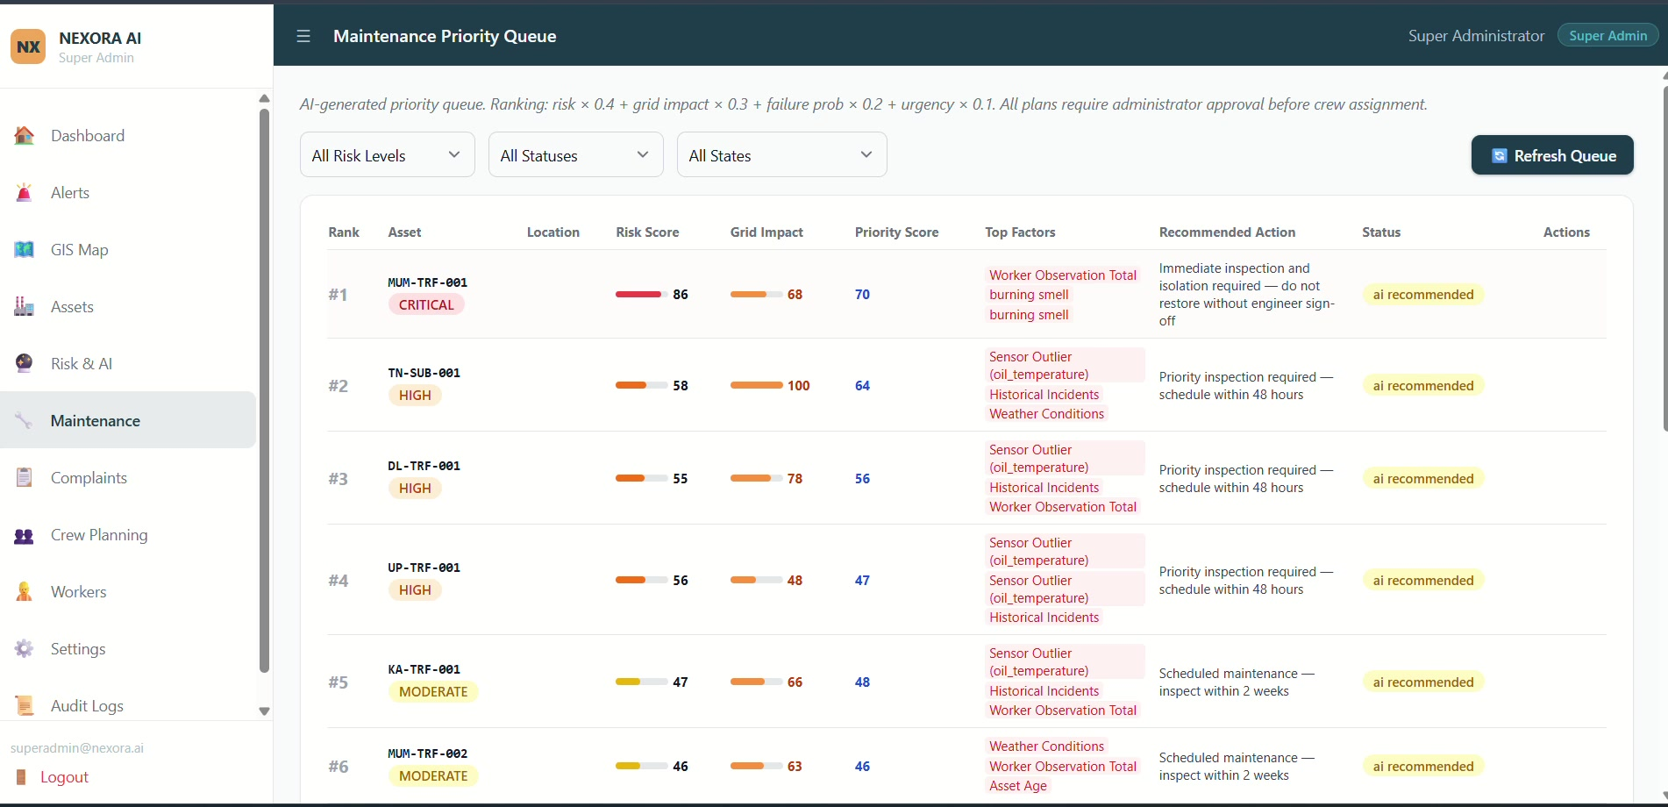
IN ACTION — PRIORITISED MAINTENANCE
The AI tells crews exactly what to fix first
AI-generated priority queue — ranked, explained, and awaiting administrator sign-off before dispatch
Risk × 0.4
Grid Impact × 0.3
Failure Prob. × 0.2
Urgency × 0.1
= Priority Score → Recommended Action & Status
07

Slide 8
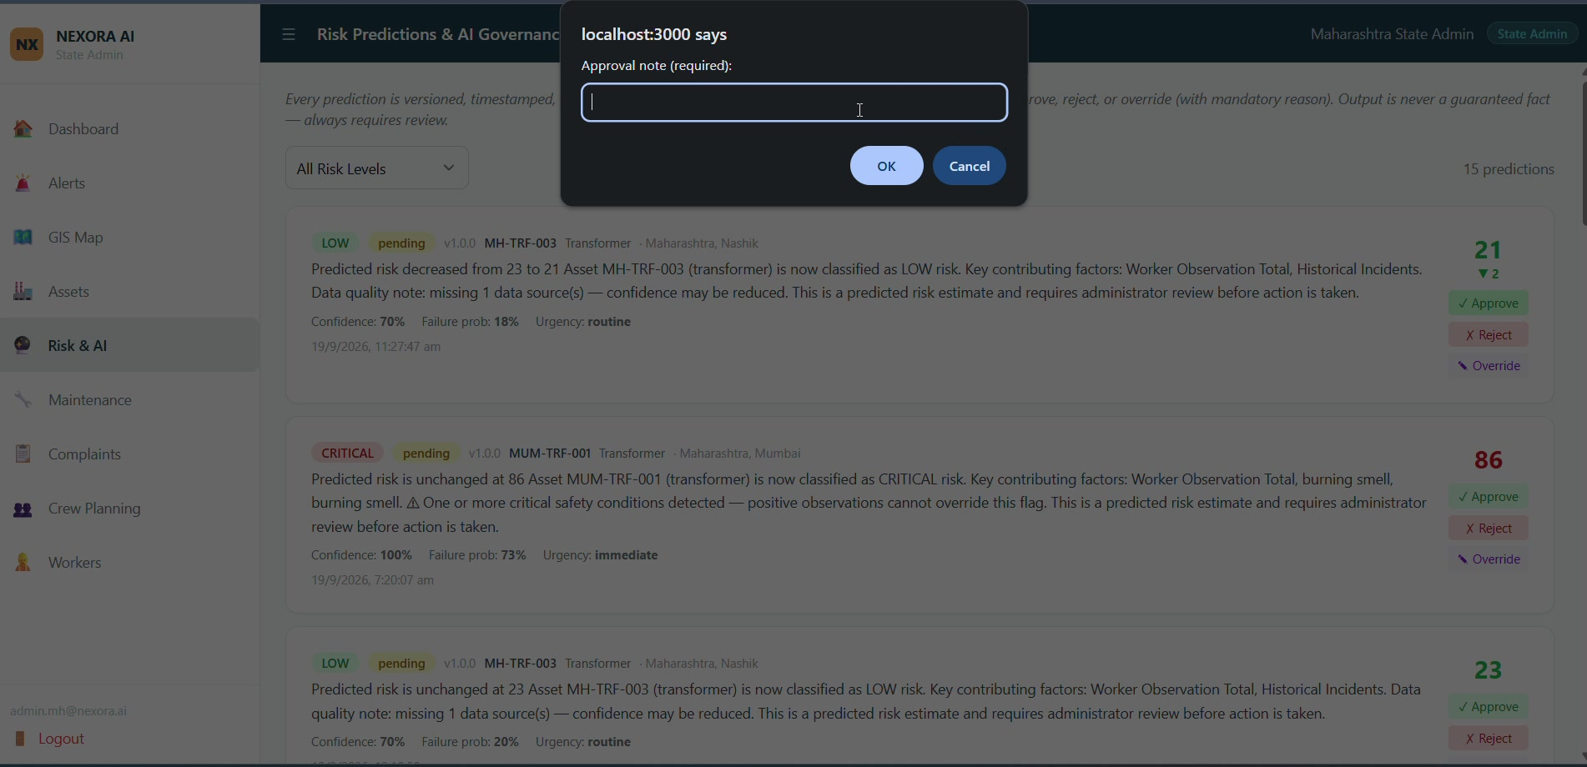
IN ACTION — TRUSTWORTHY AI
Explainable predictions, human-approved actions
100%
confidence shown per prediction, not hidden
v1.0.0
every prediction is versioned & timestamped
3 actions
Approve · Reject · Override — reason required
Risk Predictions & AI Governance — approve, reject, or override, with a mandatory note on every decision
08

Slide 9
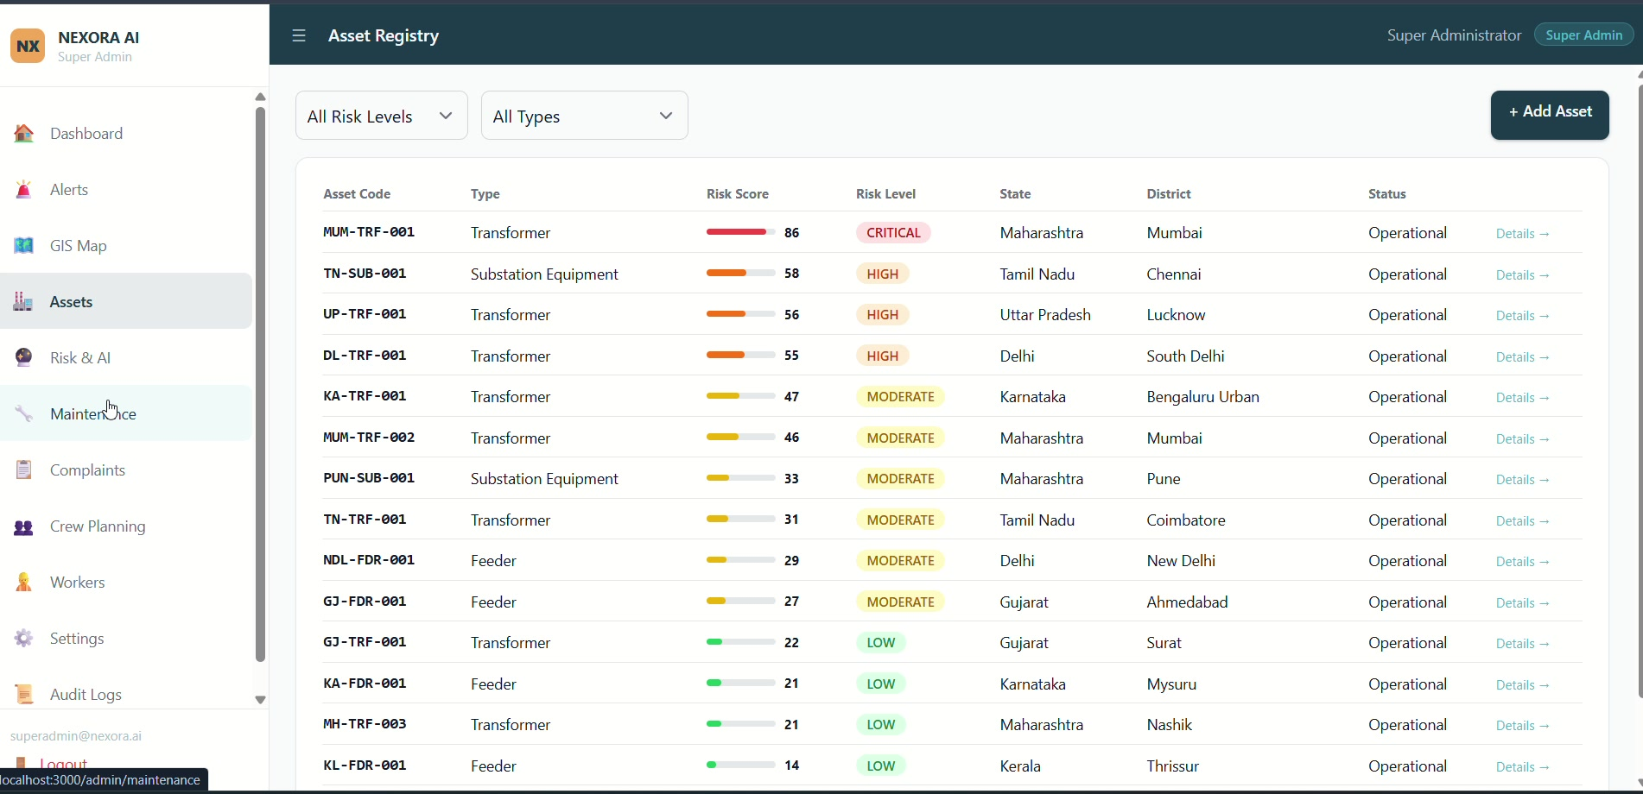
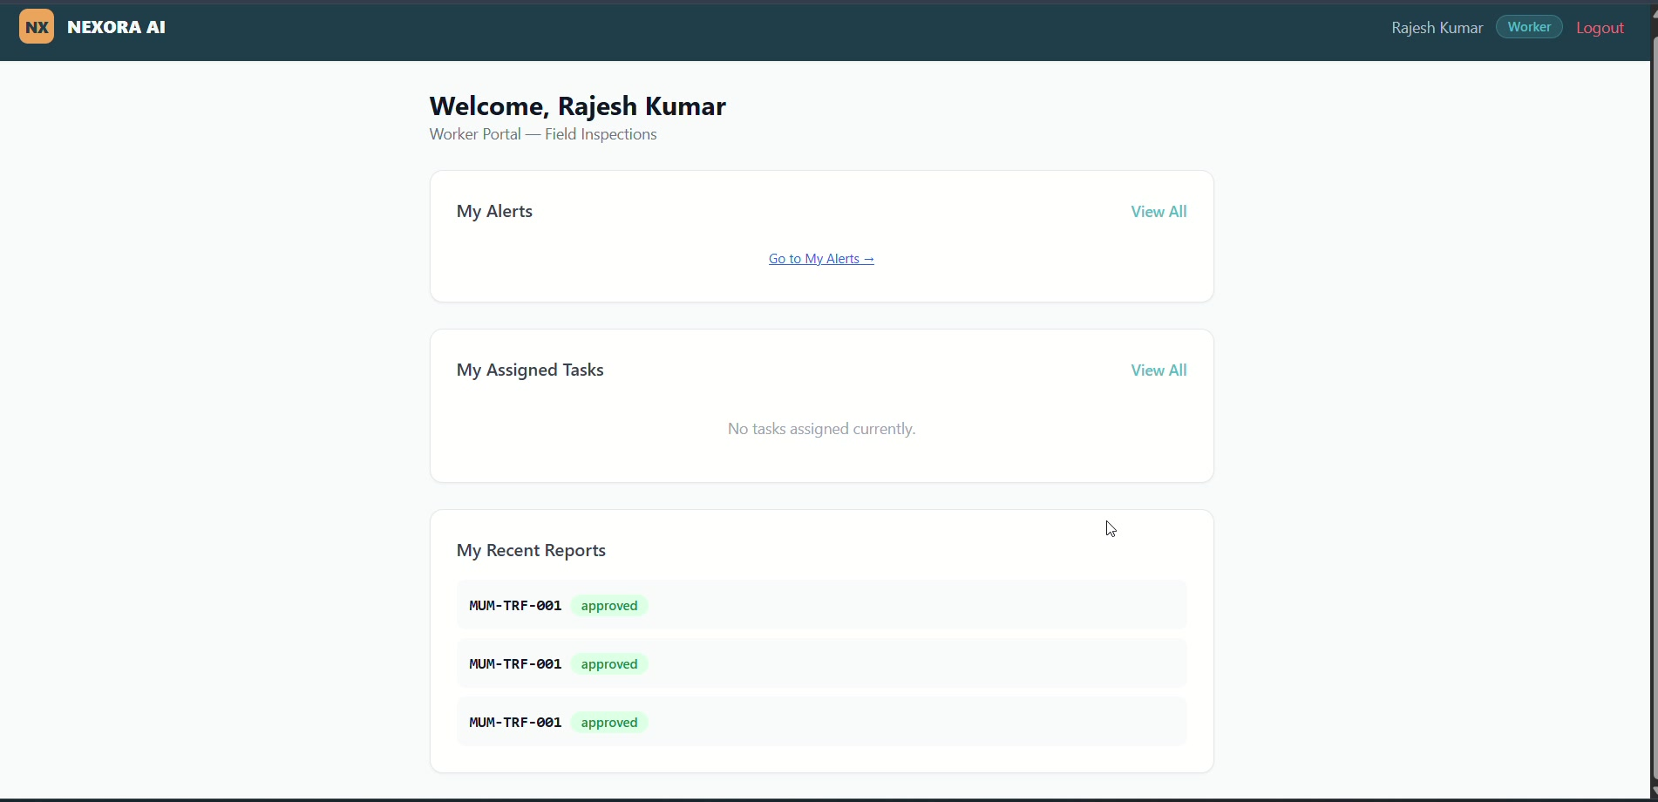
IN ACTION — END TO END
From state admin to boots on the ground
Asset Registry — every transformer, substation & feeder, scored and geo-tagged
Worker Portal — field inspectors see assigned alerts and submit approved reports
Super Admin — national view
State Admin — state/district isolation
Field Worker — mobile inspections
Citizen — complaint & tracking portal
Every role is backed by full state/district data isolation and audit trails — plus a live GIS map with weather overlays for every asset.
09

Slide 10
ALIGNMENT
Every requirement in the brief, delivered
PROBLEM STATEMENT U1 ASKS FOR
NEXORA AI DELIVERS
Combine asset health sensors, weather & historical incidents
✓
Unified risk engine fuses sensor, weather, worker & incident data
Predict outage-prone areas & at-risk equipment
✓
Versioned AI risk scores with confidence & contributing factors
Rank assets by grid-impact severity
✓
Weighted priority formula: risk, grid impact, failure prob., urgency
Generate a prioritised maintenance & crew plan
✓
Auto-built maintenance queue with recommended actions, gated by admin approval
10

Slide 11
WHAT'S NEXT
From prototype to grid-wide rollout
NOW
NEXT
THEN
LATER
Working prototype
Live sensor & SCADA feed
Crew optimisation
National scale-out
Multi-role platform, AI risk engine, GIS map, maintenance queue & governance workflow
Replace sample data with real HUMS / IoT telemetry and utility SCADA integration
Auto-suggested crew pre-positioning & routing ahead of forecast weather events
Onboard every state utility with full audit trails and offline-capable mobile app
11

Slide 12
Thank You
NEXORA AI — Predictive AI for Asset Health, Maintenance, Workforce Management & Citizen Complaint Resolution across India's power grid.
TEAM
[Team Name]
REPOSITORY
[GitHub repo link]
DEMO
[Live demo / video link]
CONTACT
support@nexora-ai.in
12

