Slide 1

GridShield
Civil-Engineering-Aware Power Grid Advisor
IBM BOB AI Hackathon 2026 · Challenge U1: Power Outage Prediction & Grid Equipment Failure Advisor
Team GridShield
Mitesh Rana · Yogi Patel · Krisha Patel · Jerry Sureja

Slide 2

THE PROBLEM
Predictable failures, caught too late
Maintenance is stuck on the calendar
$1M+
Most utilities still inspect and service equipment on a fixed schedule, even though sensors already streaming temperature, vibration, partial discharge, and oil-quality data show failure signatures weeks in advance.
per hour
Weather compounds the risk
What transformer and substation failures can cost utilities during a major outage — with millions of customers affected.
Storms, flooding, and wind loading accelerate failure in already-weak assets — poles with drainage issues, transformers with insulation degradation, substations near erosion-prone ground.
The two data sets never meet in time
Sensor health, weather forecasts, and historical incident records live in separate systems, so at-risk equipment isn't flagged and prioritized before it fails — only after.
Source: problem statement, IBM BOB AI Hackathon 2026
GridShield · IBM BOB AI Hackathon 2026
2

Slide 3

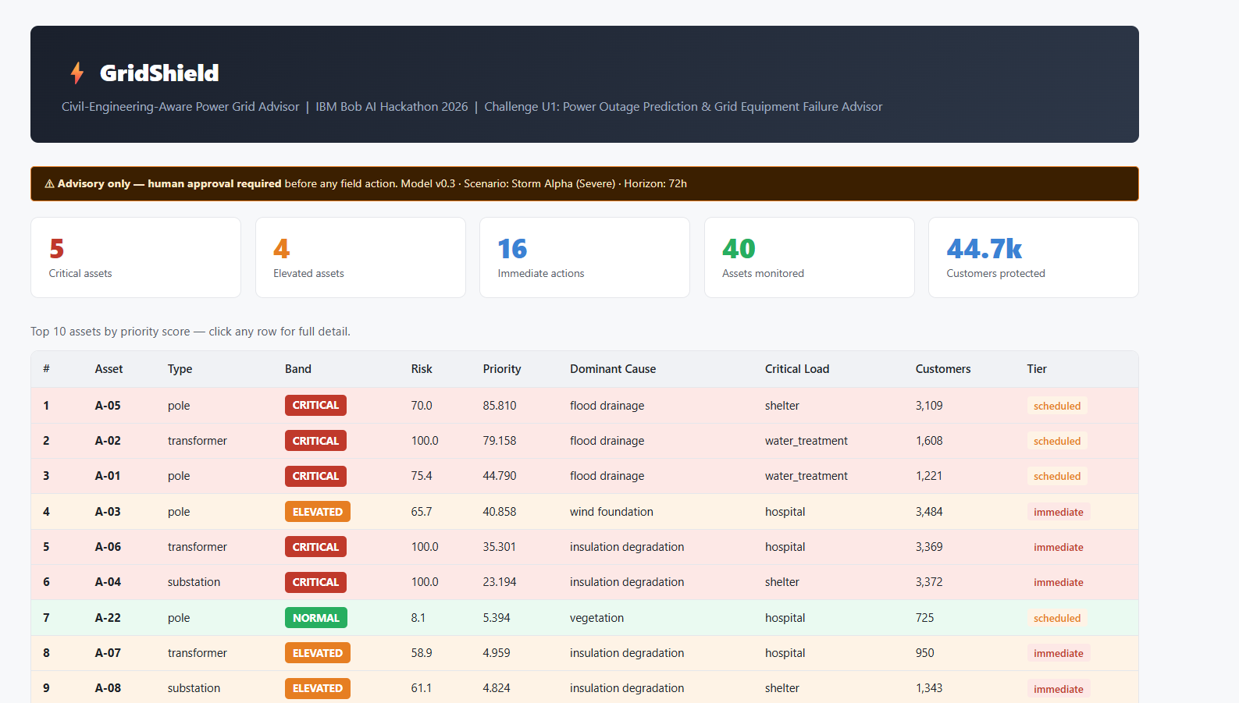
OUR SOLUTION
Turning raw grid data into a ranked action list
Combines three data sources
Civil/weather sensor readings, live weather forecasts, and historical incident records — for all 40 monitored assets.
Scores every asset 0–100
A risk score built from tilt, vegetation, rain, wind, erosion, corrosion, drainage, and age — the same factors a civil/grid engineer would check on site.
Ranks by real-world impact
priority score = risk × customer consequence ÷ intervention cost — so a cheap fix on a critical-load feeder can outrank a bigger, less urgent repair.
Recommends the next step
GridShield dashboard — top-10 priority queue with band, cause, load, and tier
Each asset gets an action tier (immediate / scheduled), an estimated cost, and a plain-language explanation — always advisory, with human sign-off required.
GridShield · IBM BOB AI Hackathon 2026
3

Slide 4




ARCHITECTURE
How GridShield turns data into a decision
Data Inputs
Risk Scoring
Priority Ranking
Advisory Output
Sensor health, weather forecast, incident history + civil factors (tilt, vegetation, drainage, age)
Per-asset 0–100 risk score from weighted civil/weather contributing factors
risk × customer consequence ÷ intervention cost across all 40 assets
Ranked queue, live map, asset detail, chat advisor, action tier + safety guardrail
Advisory only, by design — every output routes through a human-approval step before any field or switching action is taken.
GridShield · IBM BOB AI Hackathon 2026
4

Slide 5
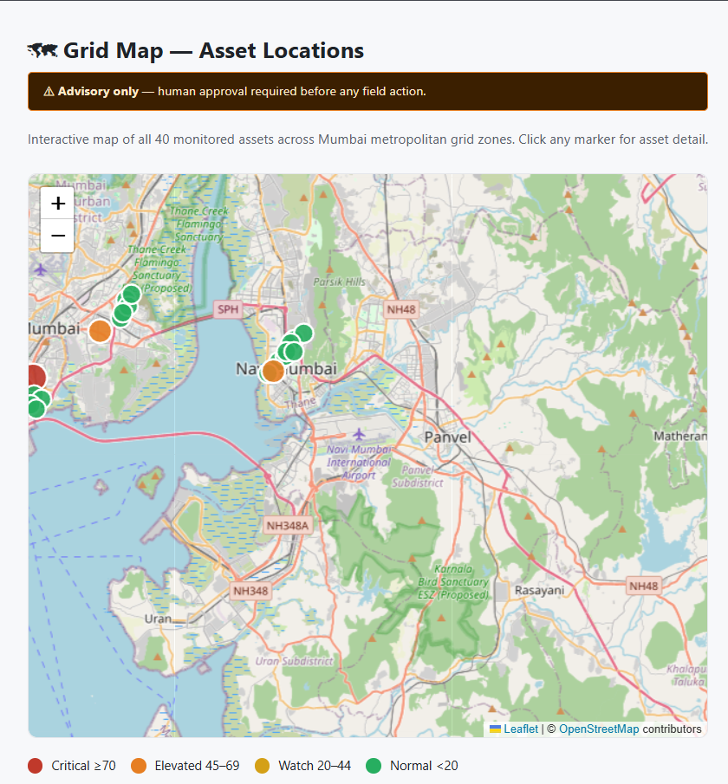
DEMO · KEY FEATURE
See risk on the map, not just in a table
All 40 assets, geolocated
Every monitored pole, transformer, and substation plotted across the grid zone — one live view of the whole network.
Color-coded by risk band
Critical, Elevated, Watch, and Normal markers match the same color language used throughout the dashboard, so crews can triage at a glance.
Click through to full detail
Selecting any marker opens that asset's risk breakdown, dominant cause, and recommended action tier — no separate lookup needed.
Built for field + control-room use
Designed so a dispatcher can see where risk is concentrated geographically, not just which asset ID ranks highest.
GridShield · IBM BOB AI Hackathon 2026
5

Slide 6

IBM TECHNOLOGIES
Built end-to-end with IBM BOB AI
Prompt-driven build
The dashboard, risk-scoring logic, asset-detail views, and chat advisor were generated and iteratively refined directly through BOB AI, from a single connected GitHub repository.
Conversational advisor
BOB AI powers the in-app Advisor Chat, which answers natural-language questions like “Why is A-01 ranked above A-15?” using the live asset data.
Built-in quality tooling
BOB's Model & Evaluation and Quality Panel views were used to check leakage/generalisation controls (time-based split, no post-outage features, temporal ordering) and confirm a passing stress test before demo.
GitHub-connected deployment
Changes are made against the connected repository and redeployed through BOB AI, keeping one source of truth for the app instead of a separate one-off build.
BOB Model & Evaluation panel — leakage & generalisation controls
✓
Time-based split
✓
No post-outage features
✓
Temporal ordering
✓
Feature independence
✓
Stress test passed
✓
Timestamped predictions
GridShield · IBM BOB AI Hackathon 2026
6

Slide 7
RESULTS & IMPACT
What GridShield surfaces right now
40
44.7k
5
16
Assets
monitored
Customers
protected
Critical assets
flagged
Immediate actions
recommended
From reactive to preventive
Instead of waiting for a failure to happen, GridShield's priority queue surfaces the assets most likely to cause customer-affecting outages — ranked by real-world consequence, not just raw risk — before a crew is dispatched. That means maintenance spend gets pointed at the highest-impact problem first, every time the model reruns for a new weather scenario.
GridShield · IBM BOB AI Hackathon 2026
7

Slide 8

TEAM
Team GridShield
MR
YP
KP
JS
Mitesh Rana
Yogi Patel
Krisha Patel
Jerry Sureja
Team Lead
Team Member
Team Member
Team Member
Thank you ….!
GridShield · IBM BOB AI Hackathon 2026
8

