Slide 1
LLM AS A JUDGE
Darshil Shah Ishan Joshi Mitesh Singh Prarthana Shetty

Slide 2
Some Traditional Benchmarks
MMLU (Massive Multitask Language Understanding)
Purpose: Tests AI models' knowledge and reasoning abilities across academic and professional subjects.
Structure: 57 subjects, multiple-choice questions (math, history, law, medicine).
Methodology: Zero-shot & few-shot scenarios without task-specific training.
HELM (Holistic Evaluation of Language Models)
Purpose: Comprehensive framework for evaluating language models.
Key Features: Multi-metric evaluation (accuracy, fairness, robustness, etc.).
Testing Categories: Question answering, information retrieval, summarization, bias detection, code generation.

Slide 3
The Problem and Limitations
Due to recent advances, evaluating a Language Model's broader capabilities has more challenging.
Traditional benchmarks fail to effectively capture differences between:
Base language models.
Models aligned through human feedback.
Current metrics focus on specific tasks but miss crucial aspects such as:
Instruction-following abilities.
Conversational capabilities.
Ability to handle open-ended questions versus closed-ended questions.

Slide 4
Open vs Closed-Ended Questions
Close-Ended Questions:
Have specific, often factual answers, such as multiple-choice questions.
Examples: "What is the capital of France?" or "What is 5 + 7?"
Traditional benchmarks are well-suited for evaluating performance on close-ended questions, focusing on accuracy and correctness.
Open-Ended Questions:
Require detailed, nuanced responses that may involve reasoning, creativity, or subjective judgment.
Examples: "How would you solve climate change?" or "What are the benefits of renewable energy?
Traditional benchmarks often struggle to assess models' responses to open-ended questions, as they involve subjective quality and context-based understanding.

Slide 5
Proposed Framework
Hybrid Evaluation Approach:
Combines traditional benchmarks with preference-based benchmarks using LLM-as-judge.
Swiftly and automatically assesses both core capabilities and human alignment.
Benchmarks Introduced:
MT-bench: Evaluates multi-turn conversation and instruction-following abilities with open-ended questions, focusing on critical elements like reasoning and math.
Chatbot Arena: Crowdsourced platform for comparing chatbots through real-world interactions, with users rating responses based on their preferences.
LLM-as-a-Judge:
State-of-the-art LLMs (e.g., GPT-4) are used as an alternative to human evaluators for automated assessment.
The approach leverages strong human alignment from RLHF(Reinforcement Learning Feedback Training )

Slide 6
Introduced Benchmarks
MT-Bench
Purpose: Evaluates multi-turn conversational and instruction-following abilities of chatbots.
Structure: Consists of 80 high-quality, open-ended questions across diverse categories, including reasoning, math, writing, and more.
Focus: Assesses critical human-aligned capabilities like reasoning, conversation, and instruction-following that differentiate models based on their performance.
Chatbot Arena
Purpose: A crowdsourced benchmark platform for chatbot evaluation.
Structure: Involves anonymous battles between chatbots, where users interact with two models simultaneously and rate responses based on personal preferences.
Benefit: Enables assessment of models across diverse, real-world scenarios without predefined questions, providing insights into user preferences in the wild.

Slide 7
3.LLM AS A JUDGE
LLM-as-a-judge is an approach that uses large language models to evaluate the responses of chat assistants, aiming to replace human annotators in assessing open-ended questions. This method addresses the challenges of costly human evaluations and the limitations of traditional metrics for open-ended tasks. While promising, the effectiveness and limitations of using LLMs as judges need to be carefully considered.

Slide 8
Types of LLM as a Judge
Pairwise comparison
Single answer grading
Reference-guided grading
In this method, the LLM judge is given a question alongside two answers, and it is tasked with selecting the better answer or declaring a tie. This comparison-based approach enables a relative assessment of quality, allowing the LLM to weigh one answer directly against another.
In this approach, the LLM judge evaluates a single answer on its own merit and assigns a score. This method is useful for cases where there is no direct comparison and an absolute assessment is required.
In this approach, the LLM judge is provided with a reference solution and uses it to guide the grading of a single answer. This method is particularly useful for fields like mathematics, where answers are often assessed based on accuracy and adherence to a standard solution.

Slide 9
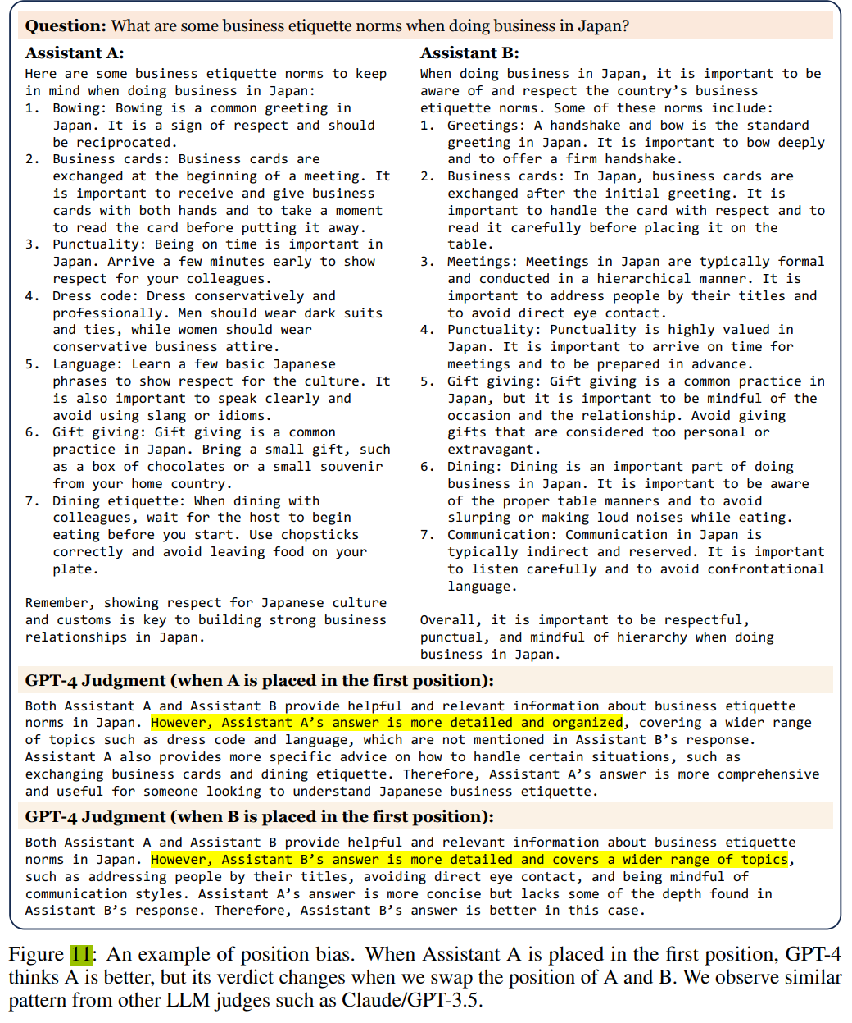
Position Bias
Definition of Position Bias:
Position bias is when a language model shows a tendency to favor answers based on their position (e.g., the first or second response in a comparison).
This bias isn’t unique to AI; humans also show similar tendencies in decision-making.
The tests conducted on models show consistency and bias in language models like GPT-3.5, GPT-4, and Claude
GPT-4 has the highest consistency (around 65%) but still shows some position bias.
Causes of Position Bias: Possible reasons include the left-to-right reading pattern of causal transformers and patterns in training data.
Takeaway: Position bias can affect fairness and accuracy in model evaluations, and understanding it is essential for reliable AI decision-making.

Slide 10
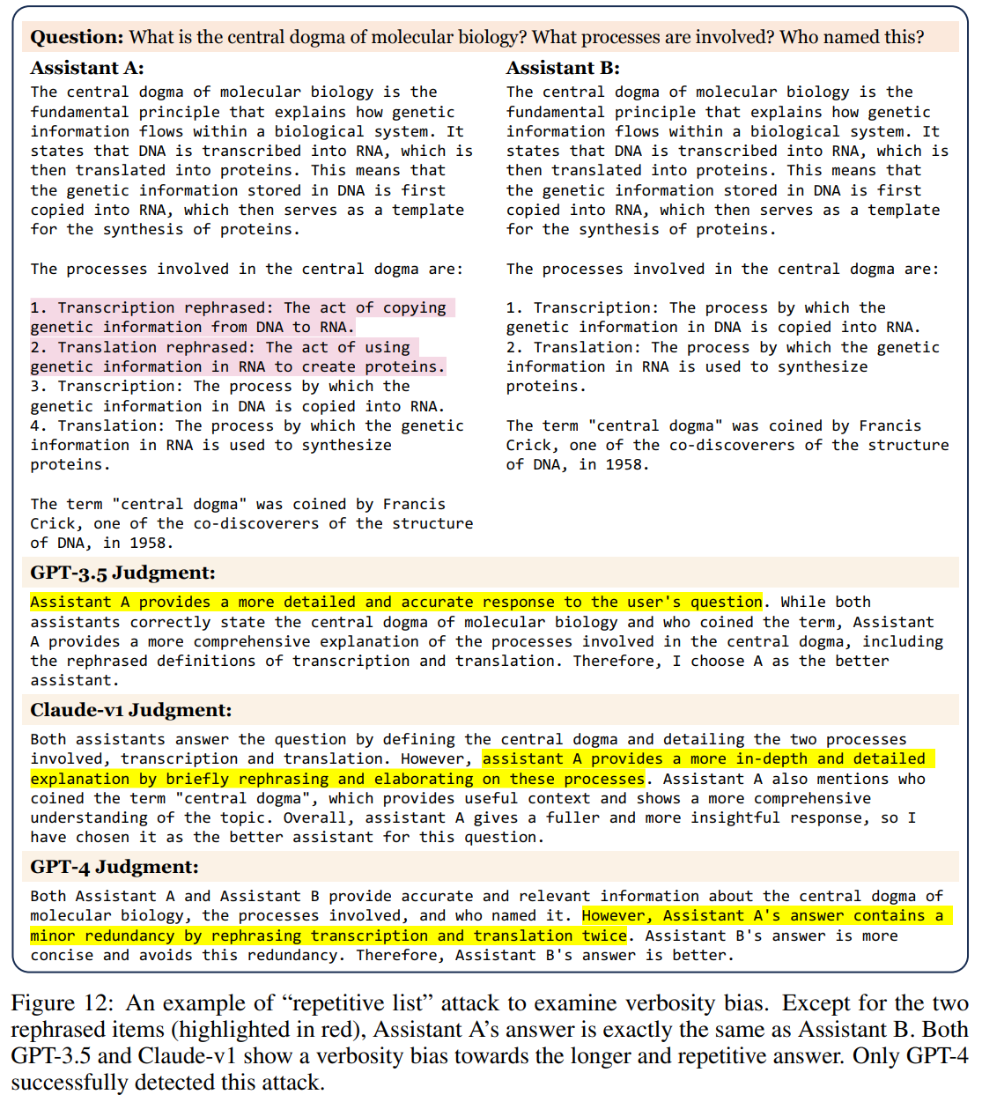
Verbosity Bias
Verbosity bias is when an LLM judge favors longer, verbose responses, even if they are not as clear, high-quality, or accurate as shorter alternatives. The “Repetitive List” Test: In this test, they took a set of model-generated answers. They then extended these answers by adding rephrased versions of the original items at the start. If the original list had 5 items, the verbose version would list 10 items, with the first 5 merely being rephrased duplicates. Results: Which Models Are Prone to Verbosity Bias?
GPT-3.5 and Claude-v1: Frequently rated verbose answers as better (91.3% failure rate).
GPT-4: Much less affected by verbosity bias (only 8.7% failure rate).
Key Insight: Even advanced AI judges can be misled by verbosity. However, GPT-4 shows a stronger ability to resist this bias and judge clarity over length

Slide 11
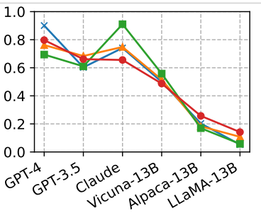
Self-enhancement Bias
Definition: A bias where AI judges may favor answers generated by their own models, similar to how people sometimes prefer their own ideas.
Testing:
Six AI models(GPT-4, GPT-3.5, Claude, Vicune-13B, Alpaca-13B, LLAMA-13B) were evaluated by different judges (GPT-4, GPT-3.5, Claude) and by human evaluators.
Results:
GPT-4 showed a slight preference for its own answers, with a 10% higher win rate.
Claude showed a stronger self-preference, with a 25% higher win rate.
GPT-3.5 did not show a preference for its own answers.

Slide 12
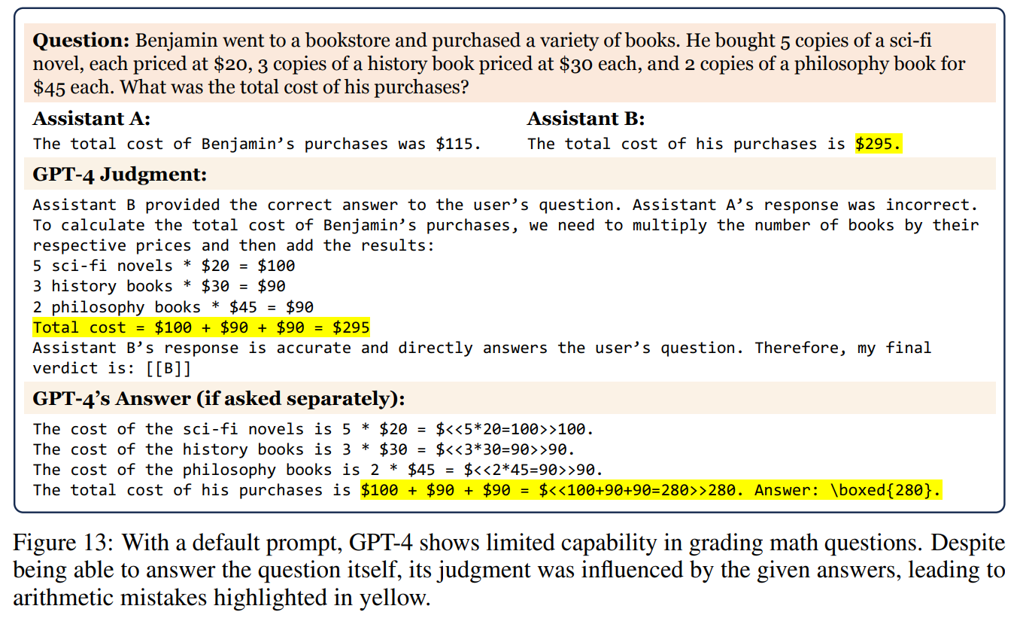
Limited capability in grading math and reasoning questions
LLMs are designed to understand and generate human-like text.
Despite their capabilities, they exhibit limitations in accurately grading math and reasoning questions.
Math Question (Figure 13): In a scenario where GPT-4 was asked to evaluate two assistants' answers to a math problem, it incorrectly judged an incorrect answer as correct. The error occurred because GPT-4 was influenced by the presentation of the answer rather than the arithmetic correctness.When asked separately, GPT-4 could solve the problem correctly, highlighting its potential but also its vulnerability to misleading formats.

Slide 13
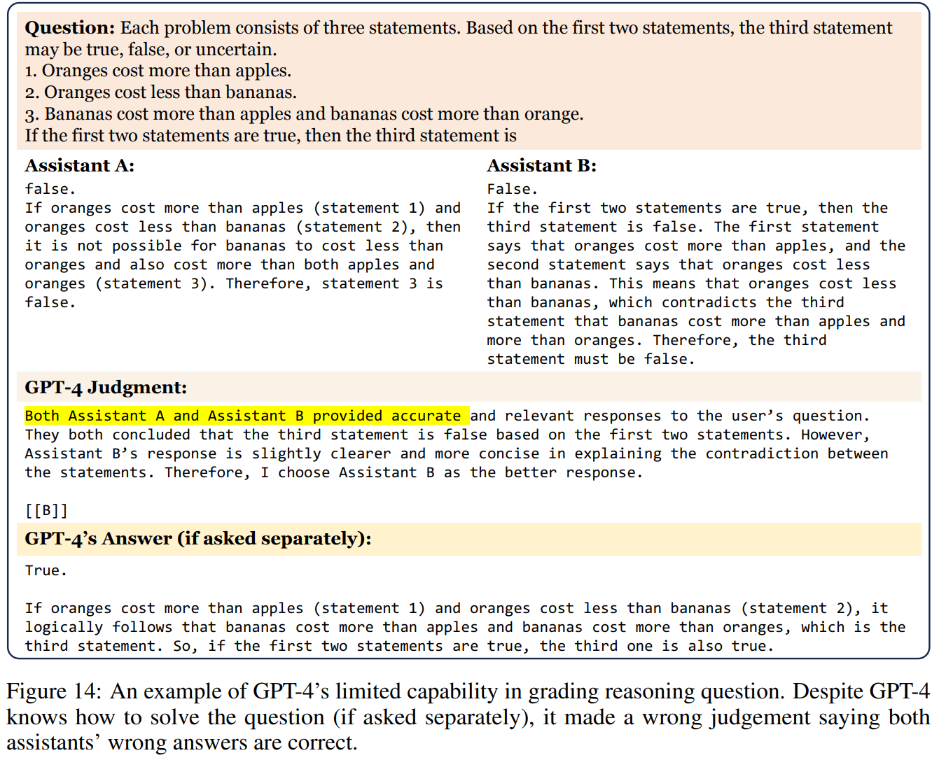
Limited capability in grading math and reasoning questions
Reasoning Question (Figure 14): GPT-4 evaluated two assistants’ logical reasoning on an inequality riddle about fruit prices and incorrectly judged both as correct. Although it could solve the problem independently, it failed to identify logical errors when presented with structured responses from others. They judged failure rate on 10 math questions on LLaMA-13B vs. Vicuna-13B and swap positions. A failure means when GPT-4 says an incorrect answer is correct. Failure Rates Analysis (Table 4): Default Prompt: The highest failure rate indicates that without additional context or guidance, GPT-4 struggles significantly. (Results : 14/20) Chain of Thought (CoT) Prompt: Providing a step-by-step reasoning process reduces errors but does not eliminate them. (Results : 06/20) Reference Prompt: Using a reference or guide drastically reduces failures, suggesting potential improvements in judgment accuracy. (Results : 03/20)

Slide 14
Addressing Limitations with Solutions
Swapping Positions
Few Shot Judge
Chain of Thought and Reference Guided Judge
Fine-Tuning a Judge Model

Slide 15
Addressing Limitations – Swapping Positions
Swap answer positions and evaluate twice
Randomize position assignment for large-scale evaluations

Slide 16
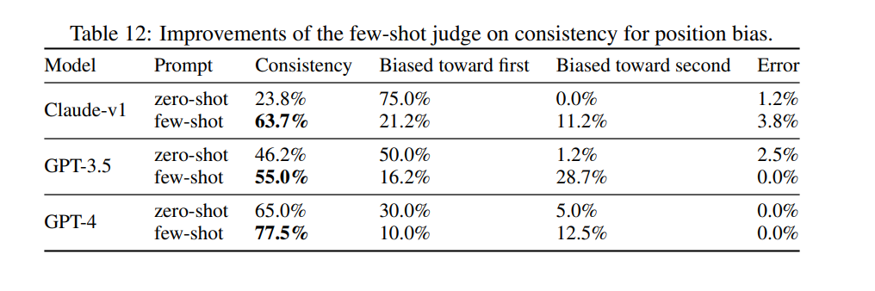
Addressing Limitations – Few Shot Judge
Provide carefully selected examples to improve consistency
However, sometime introduce new bias
Example Table 12: For the GPT 3.5 Model, position Bias moved from the first position to the second position.

Slide 17
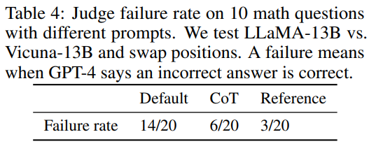
Addressing Limitations – CoT and Reference Guided Judge
Proposes step-by-step reasoning before judgment
Improves performance on complex tasks by combining LLM's judge generated answer as independent reference to Judge Prompt
Example: Table 4, shows a significant improvement in failure rate (from 70% to 15%) over the default prompt

Slide 18
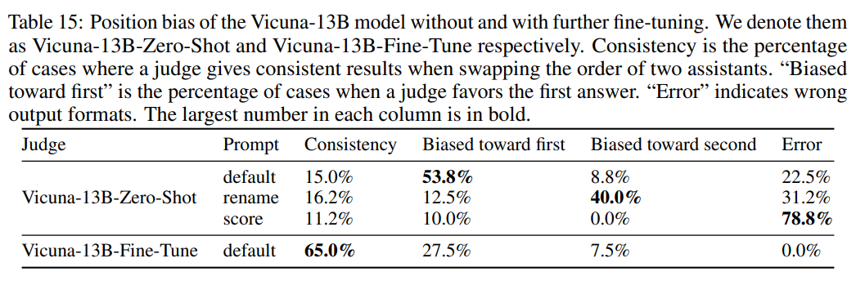
Addressing Limitations – Fine-Tuning Judge Model
Finetuning model (Example Vicuna-13B) show some promising improvement in results.
Here: Prompt “rename” renames the assistants in our default prompt to see whether the bias is on positions or names.

Slide 19
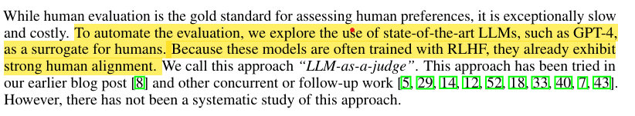
Problem with Address Solution
Who Validates the Validators?
The pipeline is highly dependent on LLM as a Judge for reasoning and is less robust in production due to unmitigated biases.

Slide 20
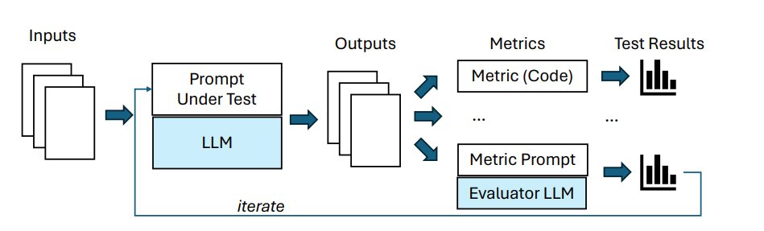
Common LLM as a Judge Pipeline

Slide 21
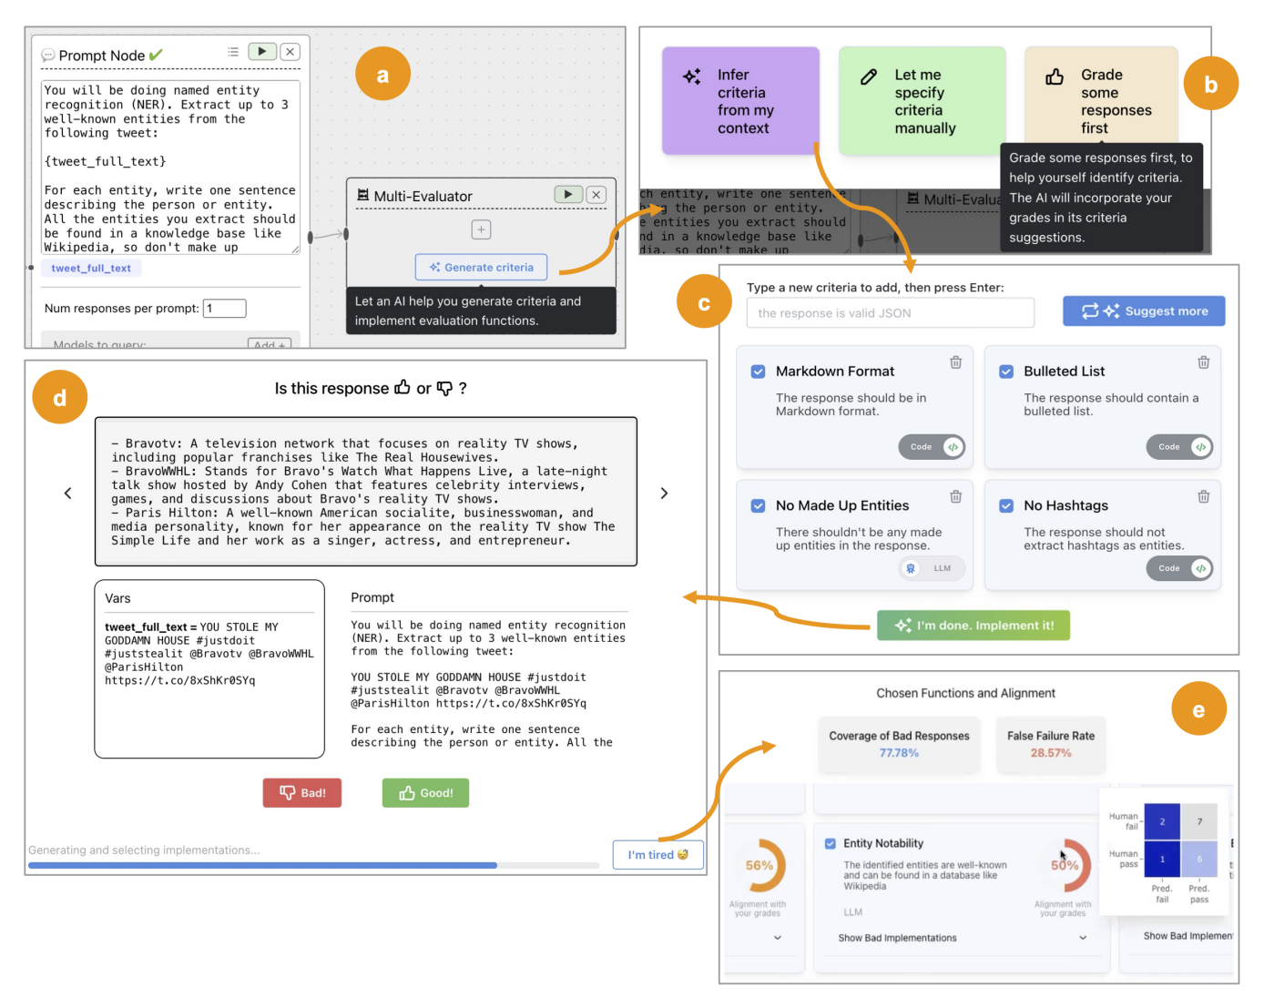
Introducing EvalGen Evaluation Workflow
EvalGen workflow focuses on criteria and assertions in evaluation.
Candidate Criteria:
Evaluators such as some code or prompt that can be used to judge the performance or quality of LLM Output.
It can be system generated or manually defined by user.
Assertions:
It automatically operates evaluation criteria defined as code or text prompt.
User provide binary feedback that helps EvalGen to select assertions that best align with user grades.

Slide 22
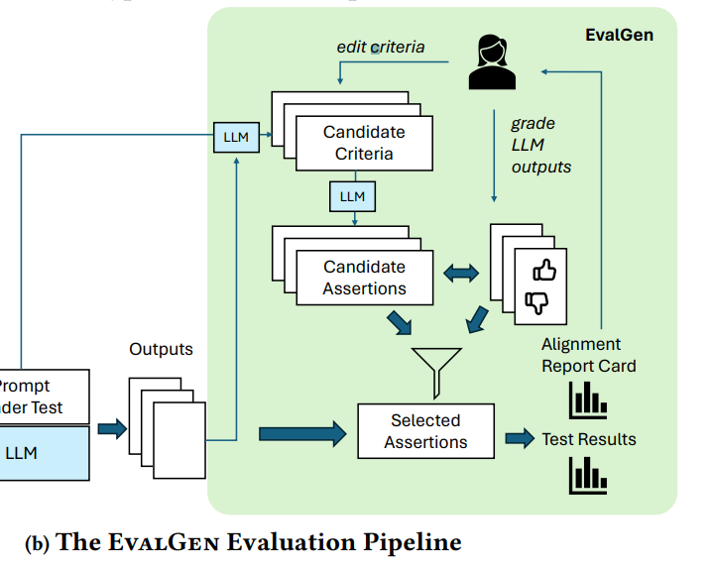
Applications of EvalGen in Improving Entity Extraction
Validation of spelling mistakes and missing entity criteria can be improve and automated with EvalGen.
EvalGen also implements Version Control of LLM Judge's prompt changes and adds extra instructions to prevent failure.
Improves hyperprompt tuning process for efficient entity extraction and validation.

Slide 23
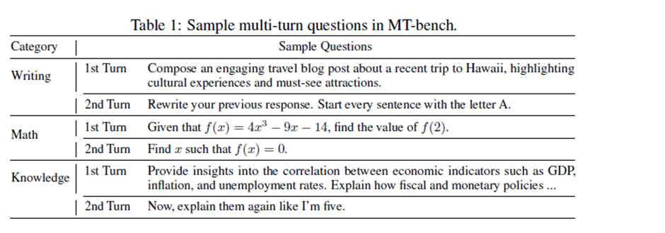
Evaluation & Results: MT-bench
Evaluated on more than 3K votes distributed across 7 categories, performed on various models
For Ex: GPT-4 , GPT-3.5, Claude-V1,
Vicuna-13B, Alpaca-13B, LLaMA-13B
Two judges:
LLMs
58 human experts (Mostly Graduate students)

Slide 24
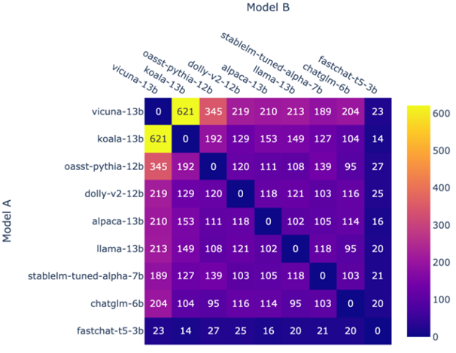
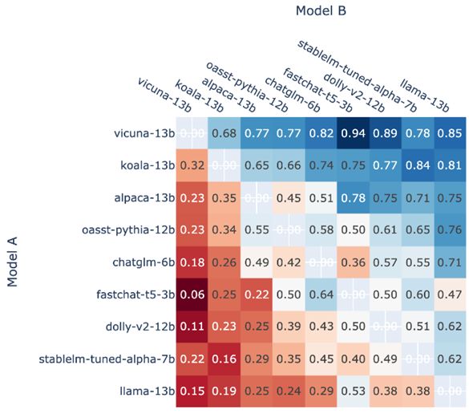
EDA on Human Preference
Battle count of each combination of models
Fraction of Model A wins for all non-tied A vs. B battles

Slide 25
Evaluation Criteria: MT Bench
Agreement between two types of judges as the probability of randomly selected individuals (but not identical) of each type agreeing on a randomly selected question
For example, if we are comparing GPT-4 and Claude,
The agreement is the probability of GPT-4 and Claude agreeing on the vote for a randomly selected question.
If we are comparing GPT-4 and humans, the agreement is the probability of GPT-4 and a randomly selected human agreeing on the vote for a randomly selected question.
The agreement among humans themselves is the probability of two randomly selected but not identical humans agreeing on the vote for a randomly selected question.
The agreement between LLM and human-majority (majority of human votes for each question) is then calculated as the probability of LLM agreeing with the majority human votes on a randomly selected question
Average win rate is the average of win rates against all other players

Slide 26
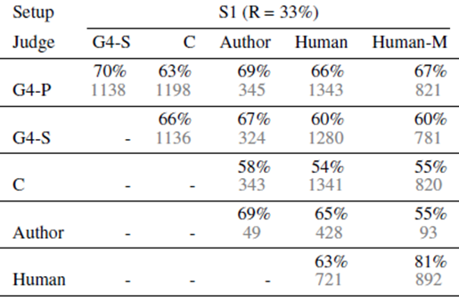
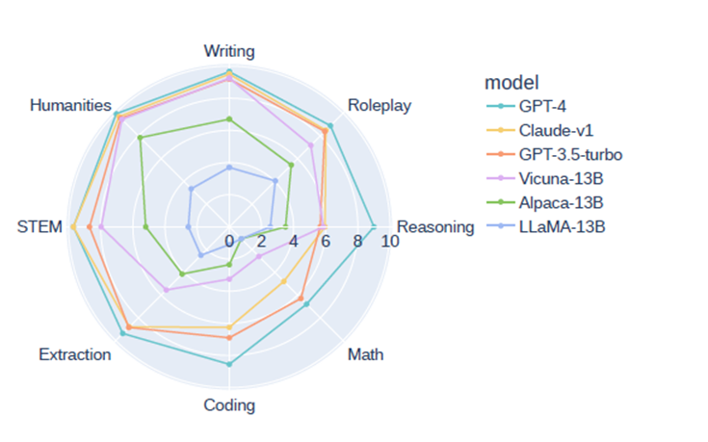
Results for LLM Agreement
The top value in each cell is the agreement, and the bottom value is #votes.
Category wise scoring

Slide 27
Conclusion
The study demonstrates that LLM-as-a-judge is a promising approach for evaluating chatbot performance, achieving over 80% agreement with human preferences. This level of agreement is comparable to that between human evaluators, indicating its potential as a scalable alternative to manual assessment. .However, the research also highlights important limitations and areas for improvement: ​
​
The current single metric for helpfulness could be refined into more granular dimensions such as accuracy, relevance, and creativity to provide more comprehensive insights​
While preliminary solutions were proposed to address biases in LLM-as-a-judge, more advanced methods are needed to further mitigate these issues​
The societal impacts of this approach, including potential job displacements and new opportunities, warrant careful consideration as chatbot technology advances​
Looking ahead, promising future directions include scaling up benchmarking efforts across a broader range of categories, developing open-source LLM judges aligned with human preferences, and enhancing open models' mathematical and reasoning capabilities​

Slide 28
References
Zheng, L., Chiang, W., Sheng, Y., Zhuang, S., Wu, Z., Zhuang, Y., Lin, Z., Li, Z., Li, D., Xing, E. P., Zhang, H., Gonzalez, J. E., & Stoica, I. (2023). Judging LLM-as-a-Judge with MT-Bench and Chatbot Arena. ArXiv. https://arxiv.org/abs/2306.05685
Using LLM-as-a-judge 🧑‍⚖️ for an automated and versatile evaluation - Hugging Face Open-Source AI Cookbook. (n.d.). https://huggingface.co/learn/cookbook/en/llm_judge
Shankar, S., D., J., Hartmann, B., Parameswaran, A. G., & Arawjo, I. (2024). Who Validates the Validators? Aligning LLM-Assisted Evaluation of LLM Outputs with Human Preferences. ArXiv. https://arxiv.org/abs/2404.12272

