Slide 1


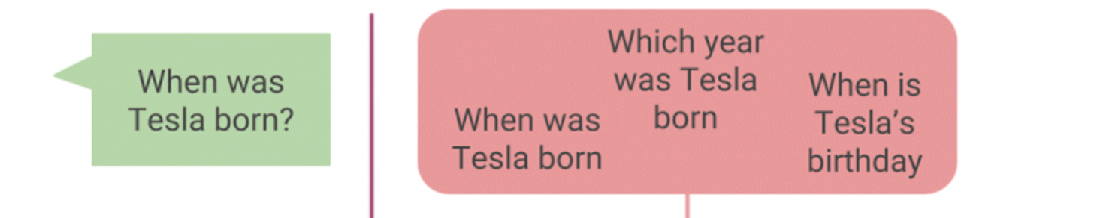
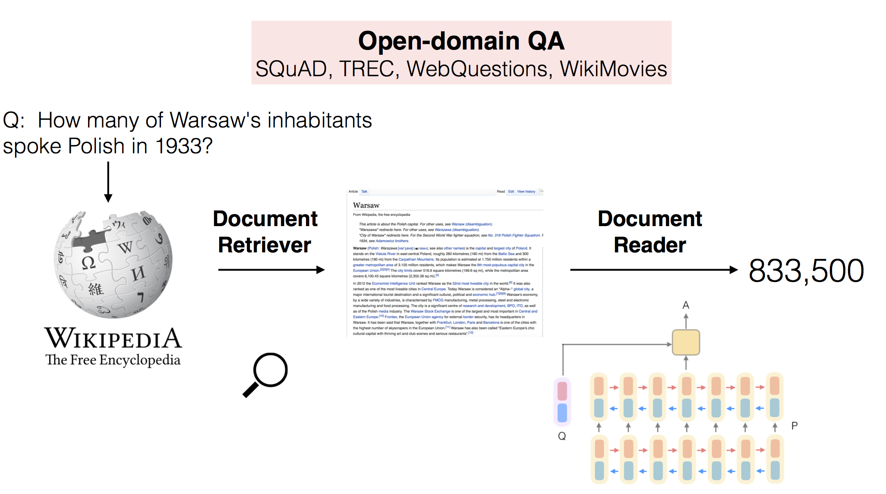
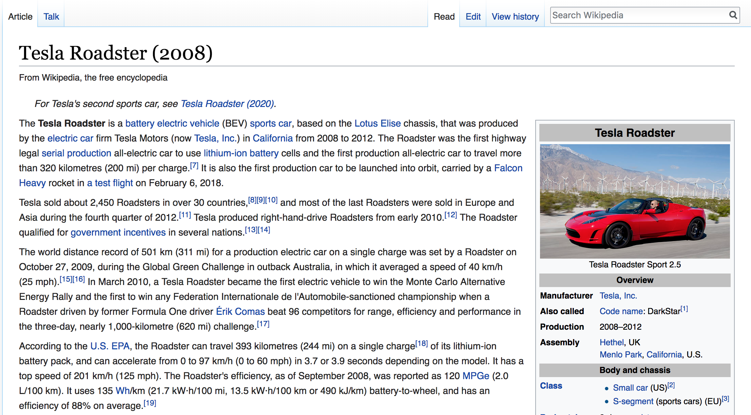
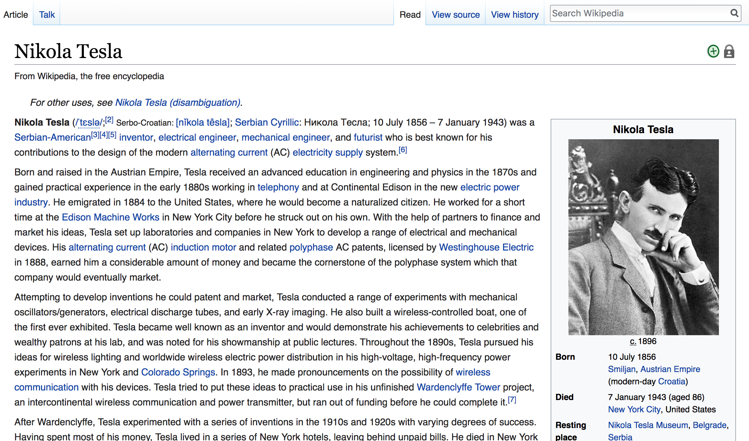
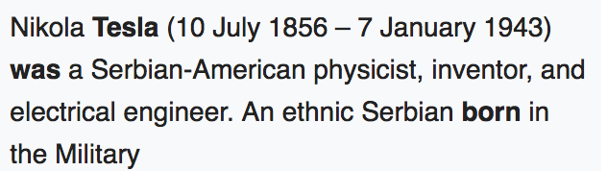
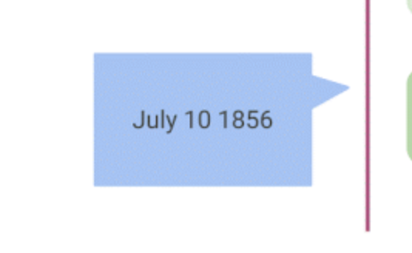
EDDIE: A Knowledge-Backed Intelligent Dialog Agent
Mitesh Kumar Singh (112078427)
Introduction
Implementation
Interactive and knowledge-backed intelligent dialog agent
Addresses user’s complex information needs
Future of search engines
An end-to-end deep neural network pipeline
Datasets
Tasks
1 – Question Answering
2 – Dialogue State Tracking
3 – Dialogue Generation
4 – User Modelling
Dataset | Description
SQuAD | Factoid, Extractive 100K QA pairs on 500+ wiki docs
CoQA | Contextual, Abstractive 127K QA pairs from 800+ dialogs
Models Explored
Features
Exact Answer – No search result dump
Contextual – Last n turns
Conversational – No spans from documents
Personalized – User’s age, gender, interests, past queries
Model | Dataset | EM Accuracy (%)
BERT | SQuAD 1.1 | 81.2
DrQA | SQuAD 1.1 | 69.5
DrQA + PGNet | CoQA | 55
QA Pipeline
So Far & Beyond
Query Processing
(Active QA Model)
Integrated the DrQA retriever, DrQA reader model with PGNet model.
End to End QA Systems | Question Processing | Document Retrieval | RC Model | Answer Ranking | Abstractive Answer Generation
DrQA | ✕ | ✓ | ✓ | ✓ | ✕
CoQA Baseline | ✕ | ✕ | ✓ | ✕ | ✓
EDDIE Baseline | ✓ | ✓ | ✓ | ✓ | ✓
Document Retrieval
(TF-IDF IR Engine)
Reading Comprehension
( DrQA / BERT Model)
Future Goals
Evaluate the performance of end to end baseline model
Incorporate state of the art models like BERT and ActiveQA
Build models for dialogue state tracking and user modelling
Abstractive Answer Generation Model (PGNet)

