Slide 1
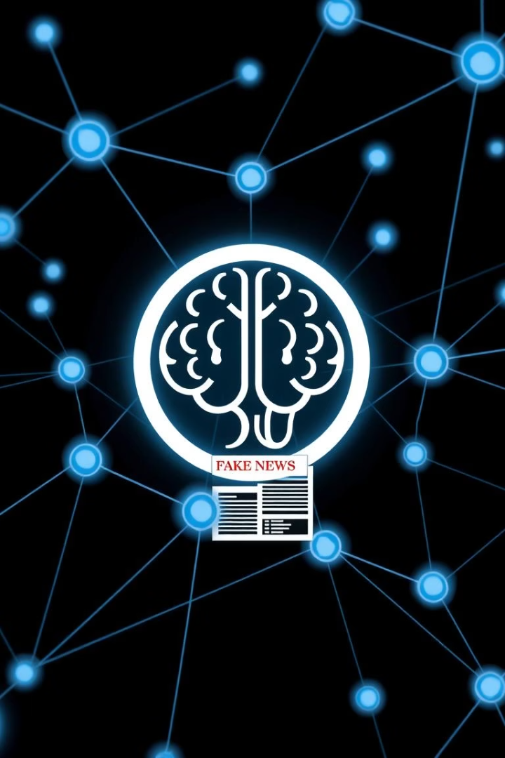

AI-Powered Fake News Detector
Project by MITESH MESTRY & VEDANG GAWADE
Using AI to fight misinformation
by Mitesh Mestry

Slide 2
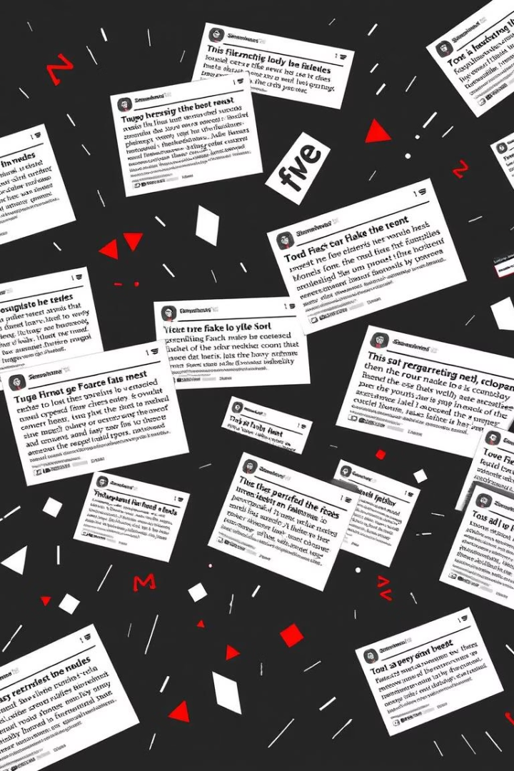
Problem Statement: The Rise of Fake News
Rapid Spread
Widespread Impact
Disinformation travels 6 times faster than genuine news on social networks.
86% of Americans have encountered fake news, affecting trust and society.
Economic Damage
Fake news costs $78 billion annually, plus undermines elections and incites violence.

Slide 3
Our Solution: AI-Powered Fake News Detection
Advanced Technologies
High Accuracy
Real-time & Scalable
Combines NLP, machine learning, and trusted fact-checking sources.
Detects fake news with 95% accuracy and cuts misinformation spread by 70%.
Processes vast data continuously to provide instant insights.

Slide 4





How It Works: Step-by-Step Process
Input
Text from news articles, social media, and websites is gathered.
AI Analysis
Uses BERT, RoBERTa, and GPT-3 models to detect suspicious content.
Fact-Check Verification
Cross-references with credible sources like PolitiFact and Snopes.
Output
Generates a reliability score and flags questionable news.

Slide 5
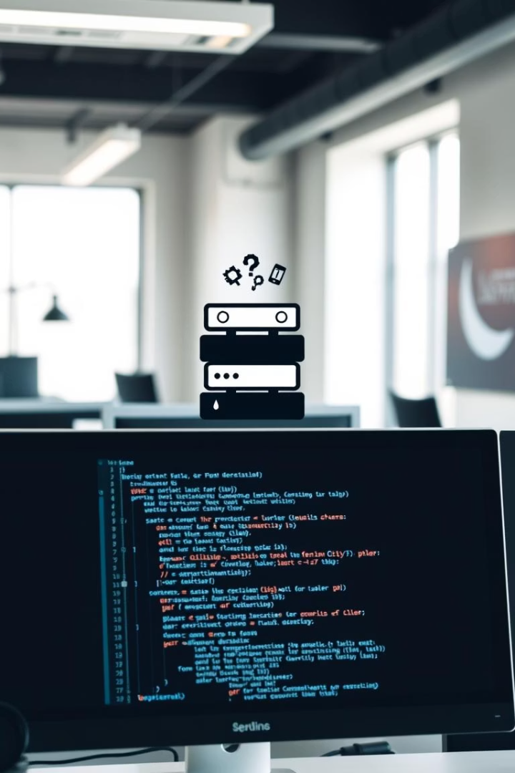
Technology Stack
Natural Language Processing
NLTK, spaCy libraries for text analysis
Machine Learning
TensorFlow, PyTorch, scikit-learn for model training
Database & Cloud
PostgreSQL database hosted on AWS cloud platform
Programming Languages
Python and JavaScript for development and deployment

Slide 6




AI Models Used
RoBERTa
BERT
1
Improves understanding of complex and subtle language nuances.
Achieves 94.5% accuracy detecting fake news patterns.
2
Ensemble Model
4
GPT-3
Combines outputs for enhanced reliability and confidence.
3
Generates counter-arguments to validate or challenge claims.

Slide 7
Evaluation Metrics
95%
93%
96%
Accuracy
Precision
Recall
Correctly classifies 95% of news articles
True positives over all positive results
Finds 96% of actual fake news
94.5%
0.97
F1-Score
AUC-ROC
Balance of precision and recall
Measures classification performance quality

Slide 8
Demo and Use Cases
COVID-19 Health News
Manipulated Media
Political Propaganda
Detects misinformation about vaccines and treatments.
Identifies doctored images and fabricated videos online.
Blocks automated bots spreading false election info.

Slide 9
Future Enhancements
Expand Data Sets
1
Increase model accuracy and coverage with more data.
Multilingual Support
2
Detect fake news across multiple languages worldwide.
Social Media Integration
3
Connect via APIs for real-time platform detection.
Browser Extension
4
Enable instant verification while browsing the web.

Slide 10

Call to Action
Join Our Mission
Help combat misinformation globally with AI tools.
Visit Our Website
Explore features and demos online.
Contact Us
Reach out to learn more or collaborate.
Report Fake News
Submit suspicious stories through our platform.

