Slide 1
Benchmarking Task Execution Frameworks of Many-Task Computing
Team Members -
Mitesh Patekar
Urvish Shah
Girija Ogale

Slide 2
Index
Introduction
Problem Statement
Proposed Work
Evaluation
Problem Faced
Future Work
Conclusion
References

Slide 3
Introduction
Emergence of exascale system have unraveled many new challenges in the field of distributed and cloud computing
Centralized architecture of Task Execution Frameworks(TEFs) gives poor scalability and other performance related issues
Many Task Computing(MTC) needs distributed TEFs to handle billions of jobs/tasks
MATRIX, YARN, Legion, Charm++, Swift, Spark, HPX, Sparrow are some of the distributed TEFs

Slide 4
Problem Statement
Aim of this project is
To benchmark TEFs of Charm++, Legion, YARN, Swift and MATRIX
To measure performance using metrics like throughput, average scheduling latency and efficiency

Slide 5
Proposed Solution
To understand architecture of all the systems to be benchmarked
Installed all the TEFs on cloud
Modify code to assign workloads wherever required
Measure throughput for comparison purpose

Slide 6
YARN
Stands for “Yet-Another-Resource-Negotiator”
New framework that facilitates writing arbitrary distributed processing frameworks and applications
Provides the daemons and APIs necessary to develop generic distributed applications

Slide 7
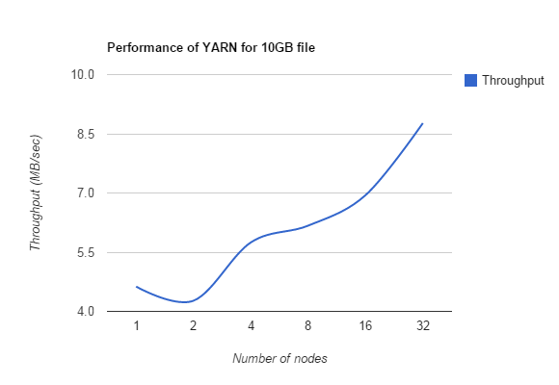
Evaluation

Slide 8
MATRIX
Fully-distributed task execution framework for Many-Task Computing data intensive applications
Utilizes a distributed key-value store, i.e. ZHT, for distributed task metadata management
Applies adaptive work stealing techniques for distributed load balancing

Slide 9
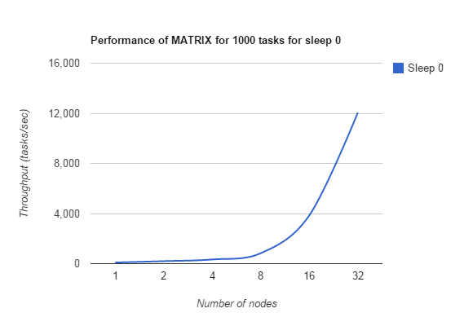
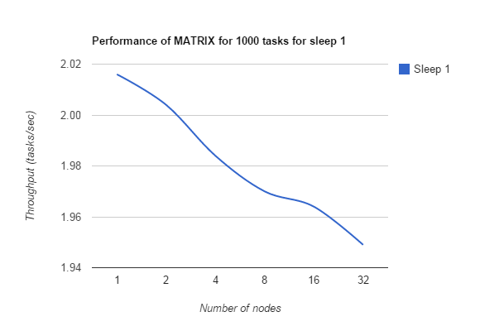
Evaluation
Throughput of MATRIX for 1000 tasks for sleep 0 and sleep 1 on m3.large instance:

Slide 10
Legion
Data-centric parallel programming system for writing portable high performance programs targeted at distributed heterogeneous architecture
Legion provides a common framework for implementing applications which can achieve portable performance across a range of architectures

Slide 11
Charm++:
Object-oriented, asynchronous message passing parallel programming framework in C++ supported by an adaptive runtime system
Enhances user productivity and allows programs to run portably from small multicore computers to the largest supercomputers
Enables users to easily expose and express much of the parallelism in their algorithms while automating many of the requirements for high performance and scalability

Slide 12
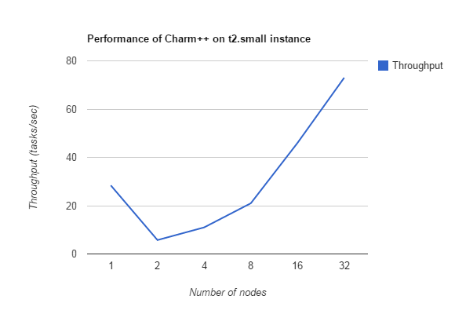
Evaluation
Throughput of Charm++ on t2.small instance:

Slide 13
Swift:
Parallel scripting language that allows the writing of scripts that distribute program execution across distributed computing resources including multicores, clusters, clouds, grid and supercomputers
Fast, easy and flexible

Slide 14
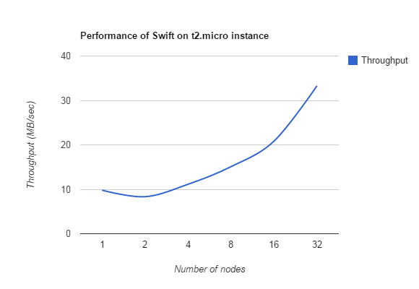
Evaluation

Slide 15
References:
[1] Ke Wang, Anupam Rajendran, Xiaobing Zhou, Kiran Ramamurthy, Iman Sadooghi, Michael Lang, Ioan Raicu. Distributed Load-Balancing with Adaptive Work Stealing for Many-Task Computing on Billion-Core Systems. Under preparation at Journal of ACM Transactions on Parallel Computing (TOPC), 2014
[2] Vinod Kumar Vavilapalli, Arun C Murthy, Chris Douglas, Sharad Agarwal, Mahadev Konar, Robert Evans, Thomas Graves, and Jason Lowe, Hitesh Shah, Siddharth Seth, and Bikas Saha, Carlo Curino, Owen O'Malley and Sanjay Radia, Benjamin Reed, and Eric Baldeschwieler. Apache Hadoop YARN: Yet Another Resource Negotiator [Industrial Paper]
[3] Michael Bauer, Sean Treichler, Elliott Slaughter, Alex Aiken. Legion: Expressing Locality and Independence with Logical Regions. International Conference on Supercomputing (SC 2012)
[4] Gengbin Zheng, Laxmikant Kale, Eric Bohm, Abhinav Bhatele, Chao Mei, Filippo Gioachin, Ramprasad Venkataraman, Yanhua Sun. Parallel Languages/Paradigms: Charm ++ - Parallel Objects. SC14
[5] Ioan Raicu, Ian T. Foster, Yong Zhao. Many-Task Computing for Grids and Supercomputers. MTAGS 2008.

Slide 16
Thank you ..

