Slide 2
User Manual- FSTI
Information
Front end-file location.
Logo Editing
Name Editing
About file editing
Installer Package
Installation Application Setup

Slide 3
Front end-file location.
Company logo & application
File name: fMain.Designer.cs
- Location: "localCopy\FSTI_GUI\PumpSimulationGui\PumpSimulationGui\fMain.Designer.cs"
- (Note: Code is Written in C#)
Launch Logo: File Name: fSplashScreen.Designer.cs
- Location: "localCopy\FSTI_GUI\PumpSimulationGui\PumpSimulationGui\fSplashScreen.Designer.cs“
(Note : Add the required sources in the Resource file i.e. (.jpeg) & (.gif) )

Slide 4
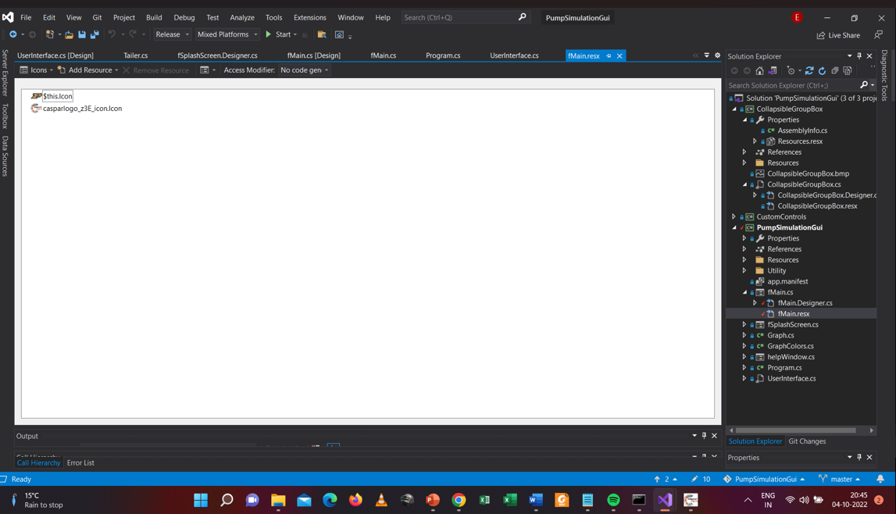
Logo updating
Open the file PumpSimulationGui.sln
Add logo here

Slide 5
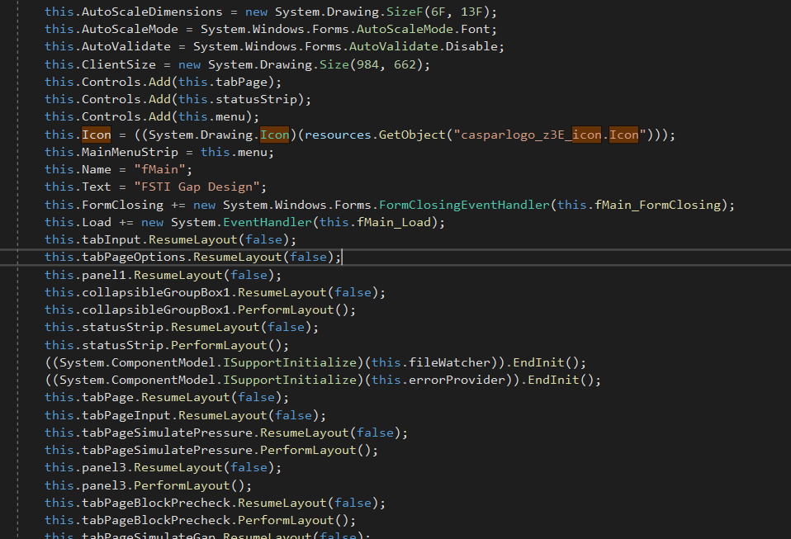
Editing Application Logo : fMain.Designer.cs
Icon File

Slide 6
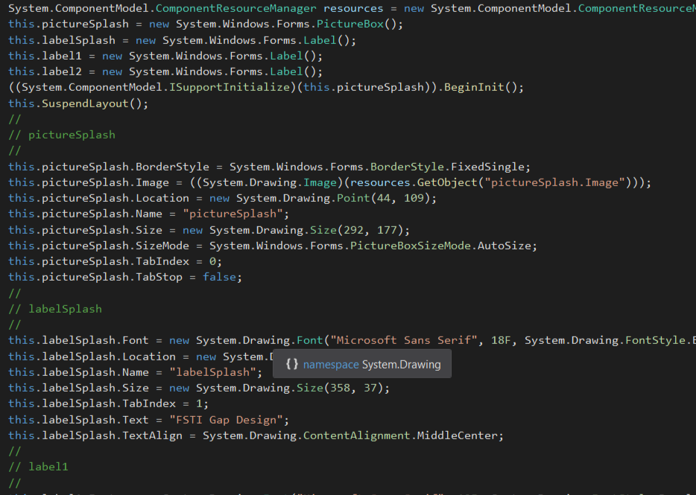
Editing Front Logo : fSplashScreen.Designer.cs
Logo File

Slide 7
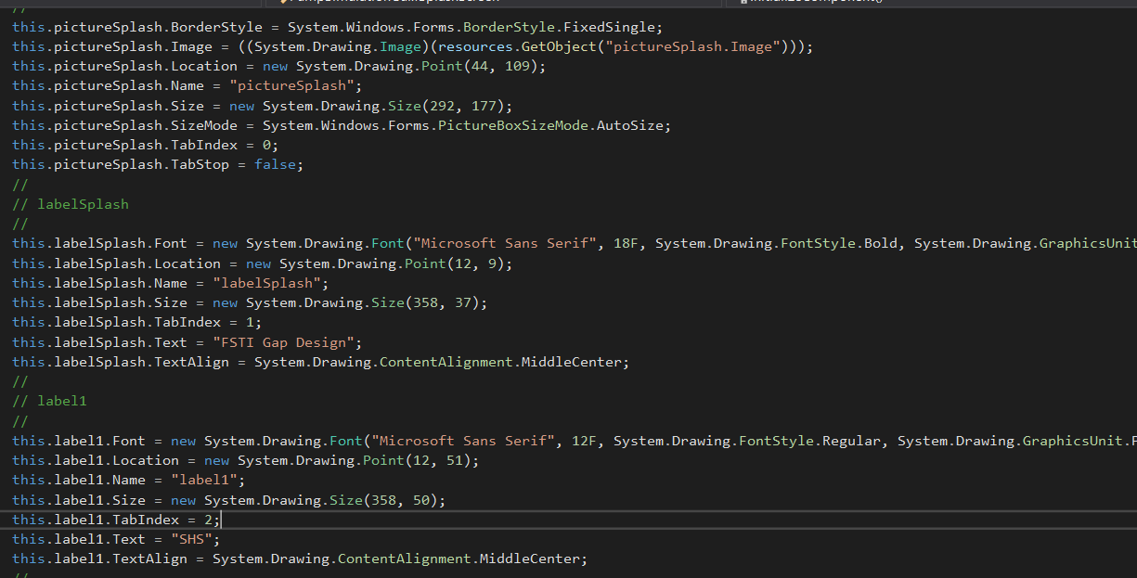
Name Editing
File: fMain.Designer.cs
Change Name

Slide 8
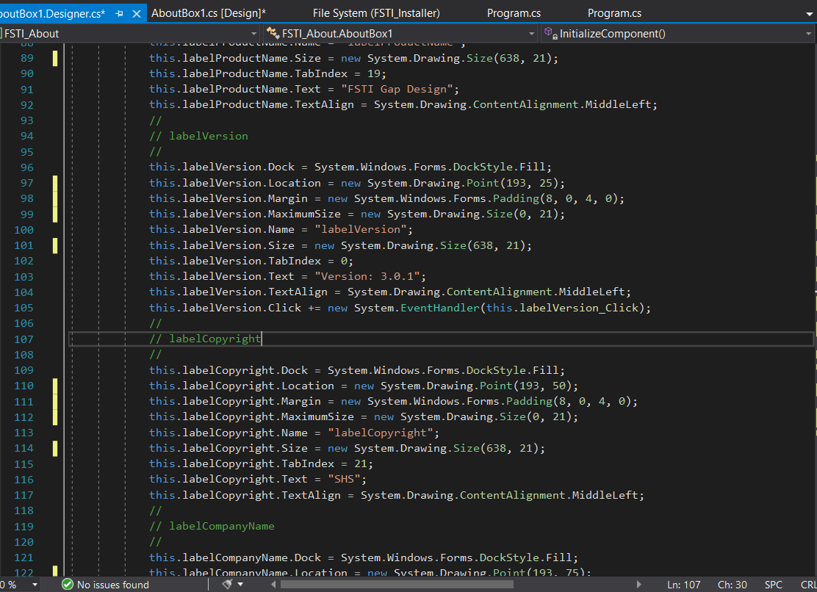
About File

Slide 9
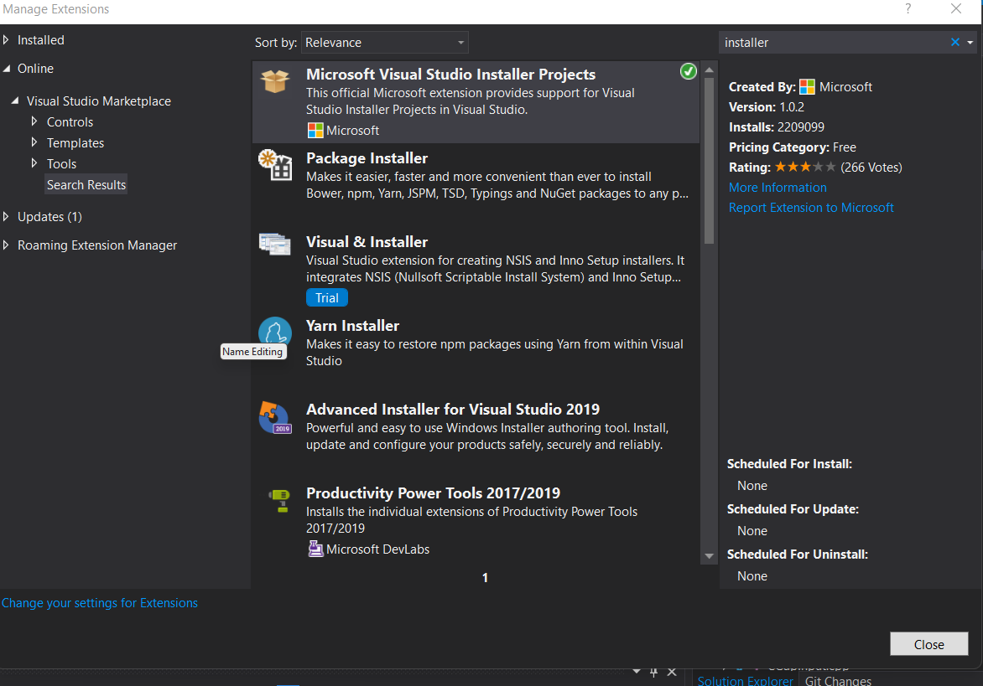
Installer Package (information)
Windows Installer Package needs to be installed in the visual studio for manufacturing an installer application.
How,
- Visual Studio – Extensions – Online – Microsoft visual studio Installer Projects

Slide 10
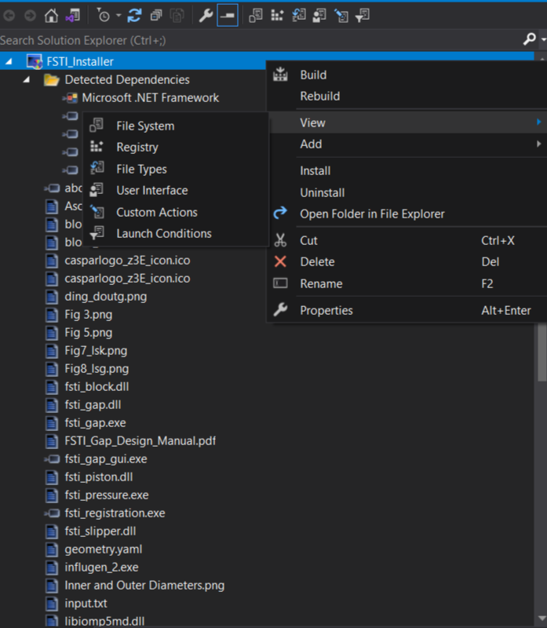
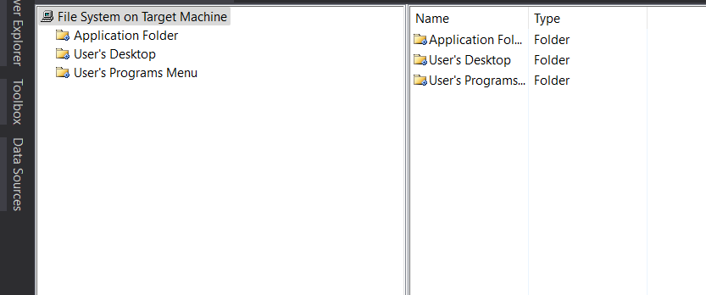
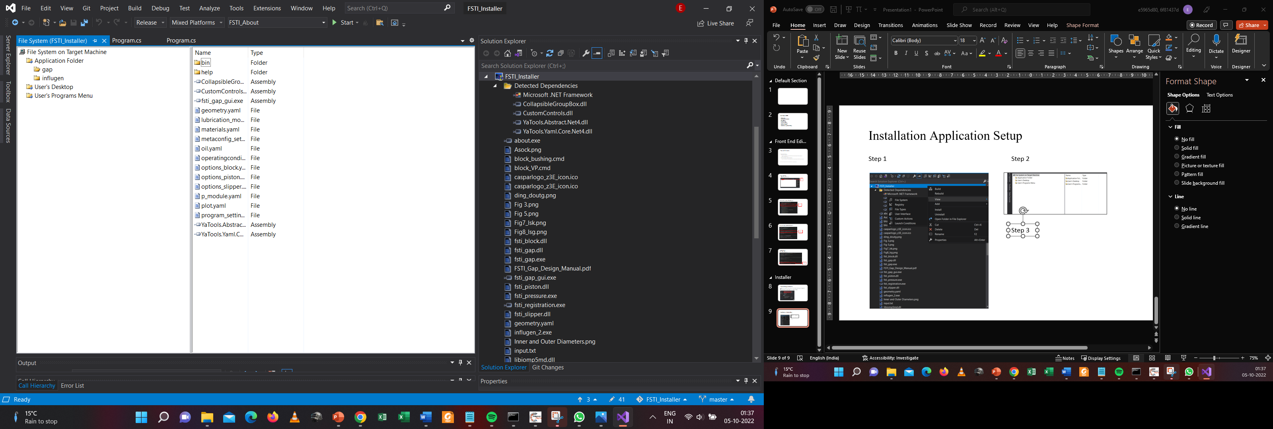


Installation Application Setup
Step 1
Step 2
Step 3

Slide 11
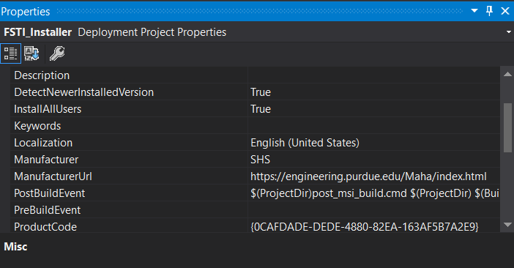
Installation Path

