Slide 1
Title: PROTEIN STUDY IN CELL IMAGES USING PYTHON AND ML
Debaraj Roy 19BCE1789
Amitesh Roy 19BCE1507
Mithesh Raja A 19BCE1799

Slide 2
Abstract
Proteins are the mode of expression of the genetic information. They perform a variety of duties in the cells such as they act as the structural components of cells, enzymes, hormones, pigments, storage proteins and some toxins in the cells. The aim of this project is to develop a model capable of classifying mixed patterns of proteins in microscopic images. This model can then be taken further to identify a protein’s location from a high throughput image.Thanks to advances in high throughput microscopy, these images are generated at a far greater pace than what can be manually evaluated. Pinpointing sub-cellular protein localisations from microscopy images is easy to the trained eye. However, we need to automate this process to accelerate the understanding of human cells and diseases. The deep learning model we have used to predict and classify the class or classes of protein organelle localisation for images as each image can have more than one class or label is Transfer Learning.

Slide 3
Keywords
Proteins ,
high output ,
deep learning model ,
Transfer Learning ,
subcellular macromolecule patterns

Slide 4
MOTIVATION
Proteins are thought of as the “doers” in the human call, executing many functions that together enable life. Historically, classification of proteins has been limited to single patterns in one or a few cell types but in order to fully understand the complexity of the human cell, models must classify mixed patterns across a range of different human cells. Pinpointing sub cellular protein localisation from microscopy images is easy to the trained eye. However it is very challenging to automate. Once we’re able to find the localisation Non of these protein localisations, it can be integrated with a smart-microscopy system to identifying a protein's location from a high throughout image. Therefore, the need is greater than ever for automation biomedical image analysis to accelerate the understanding of human cells and disease.

Slide 5
Research Gaps Identified
The object of this project is to predict and classify the class or classes of protein organelle localisation for images as each image can have more than one class or label. There are a total of 28 different classes or labels present.The main aim of this project is classification of mixed protein patterns. Unlike most image labelling tasks, where binary or multi class labelling is considered, in this task each image can have multiple labels.Also, there is a four channel input to the model that is RGBY from the dataset. This makes it impossible to use pre trained models as itis. This is where our solution comes in.

Slide 6
Related works
1.Classification of Sub-cellular Protein Patterns in Human Cells with Transfer Learning
2.Prediction of Interaction between Viral and Host Proteins Using Supervised Machine
3.BioCircuit - A Hardware Based Methodology for ProteinRecognition
4.DrugMiner[LM1]: comparative analysis of machine-learning algorithms for predictionof potential durable proteins
5.Near Perfect Protein Multi-Label Classification with Deep NeuralNetworks6.Automated analysis of high-content microscopy data with deeplearning

Slide 7
Timeline:
Abstraction- 09-10-21
Introduction- 21-10-21
Literature survey- 15-11-21
Related works- 20-11-21
Experiment evaluation- 5-12-21
Conclusion- 6-12-21
Final review- 10-12-21

Slide 8
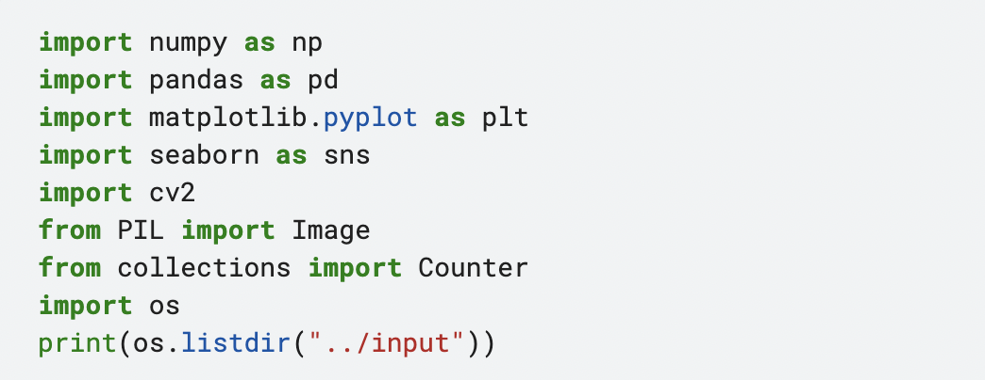
Code snippets:

Slide 9
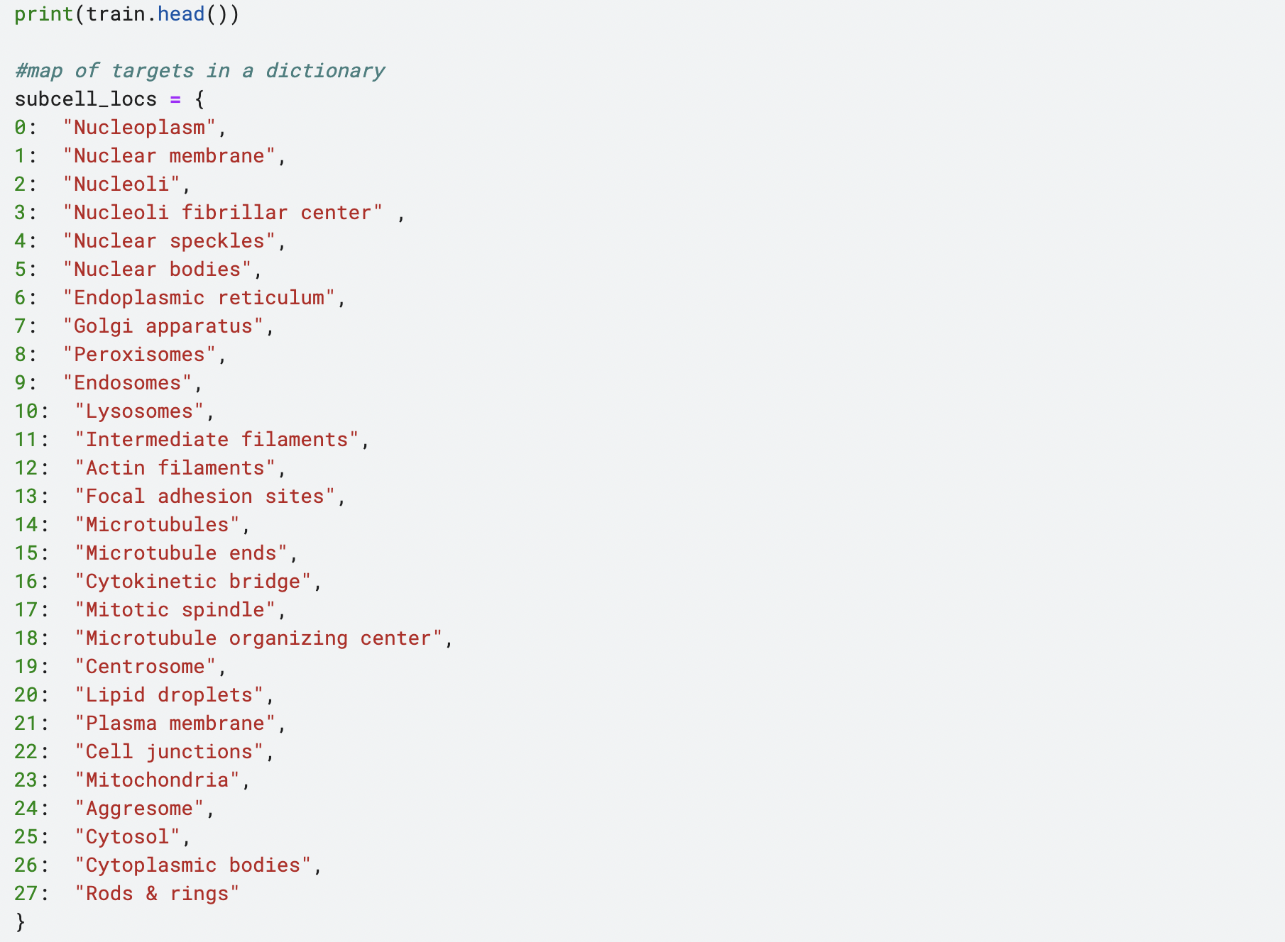
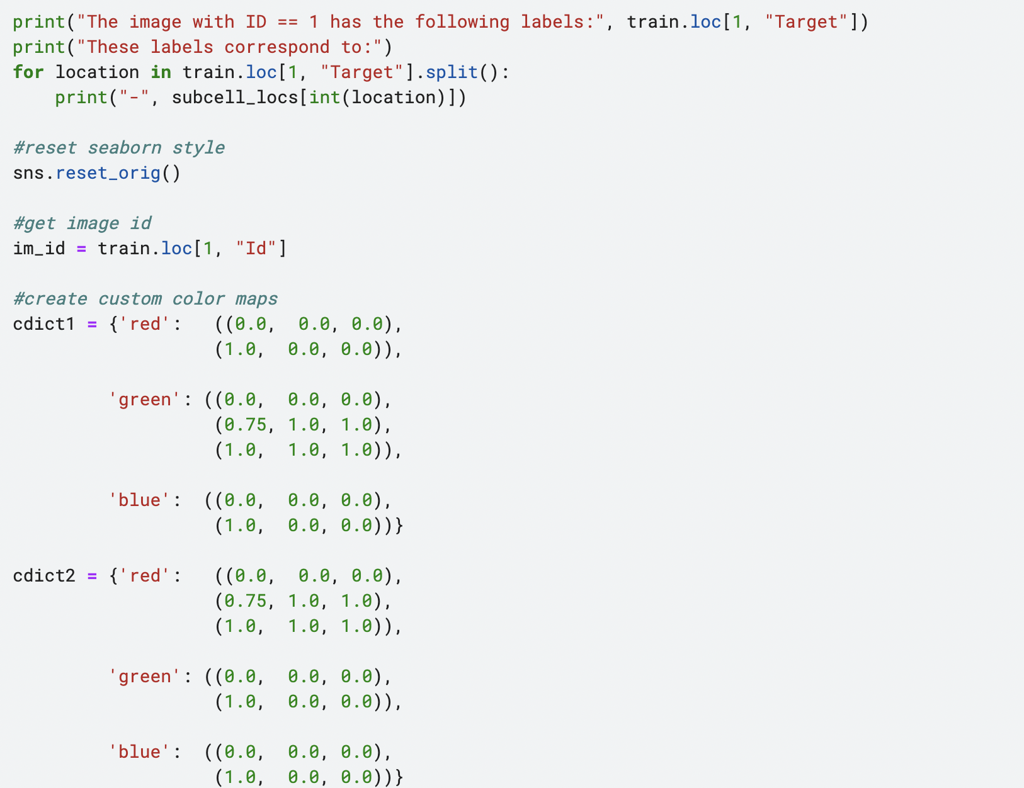
Snippet

Slide 10
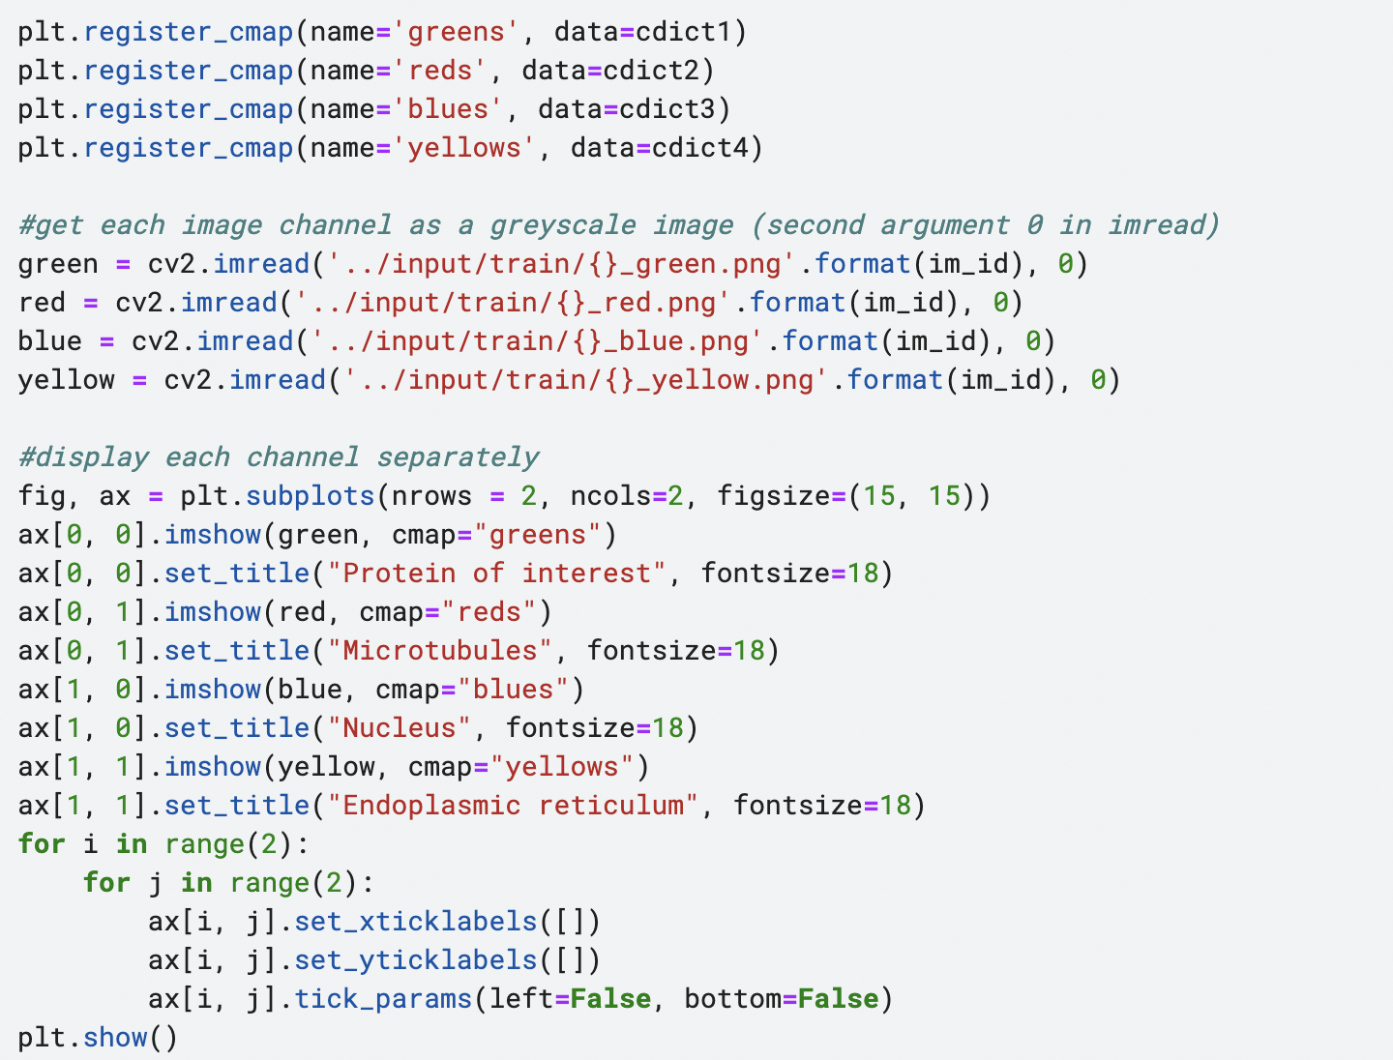
Code snippets(continued):

Slide 11
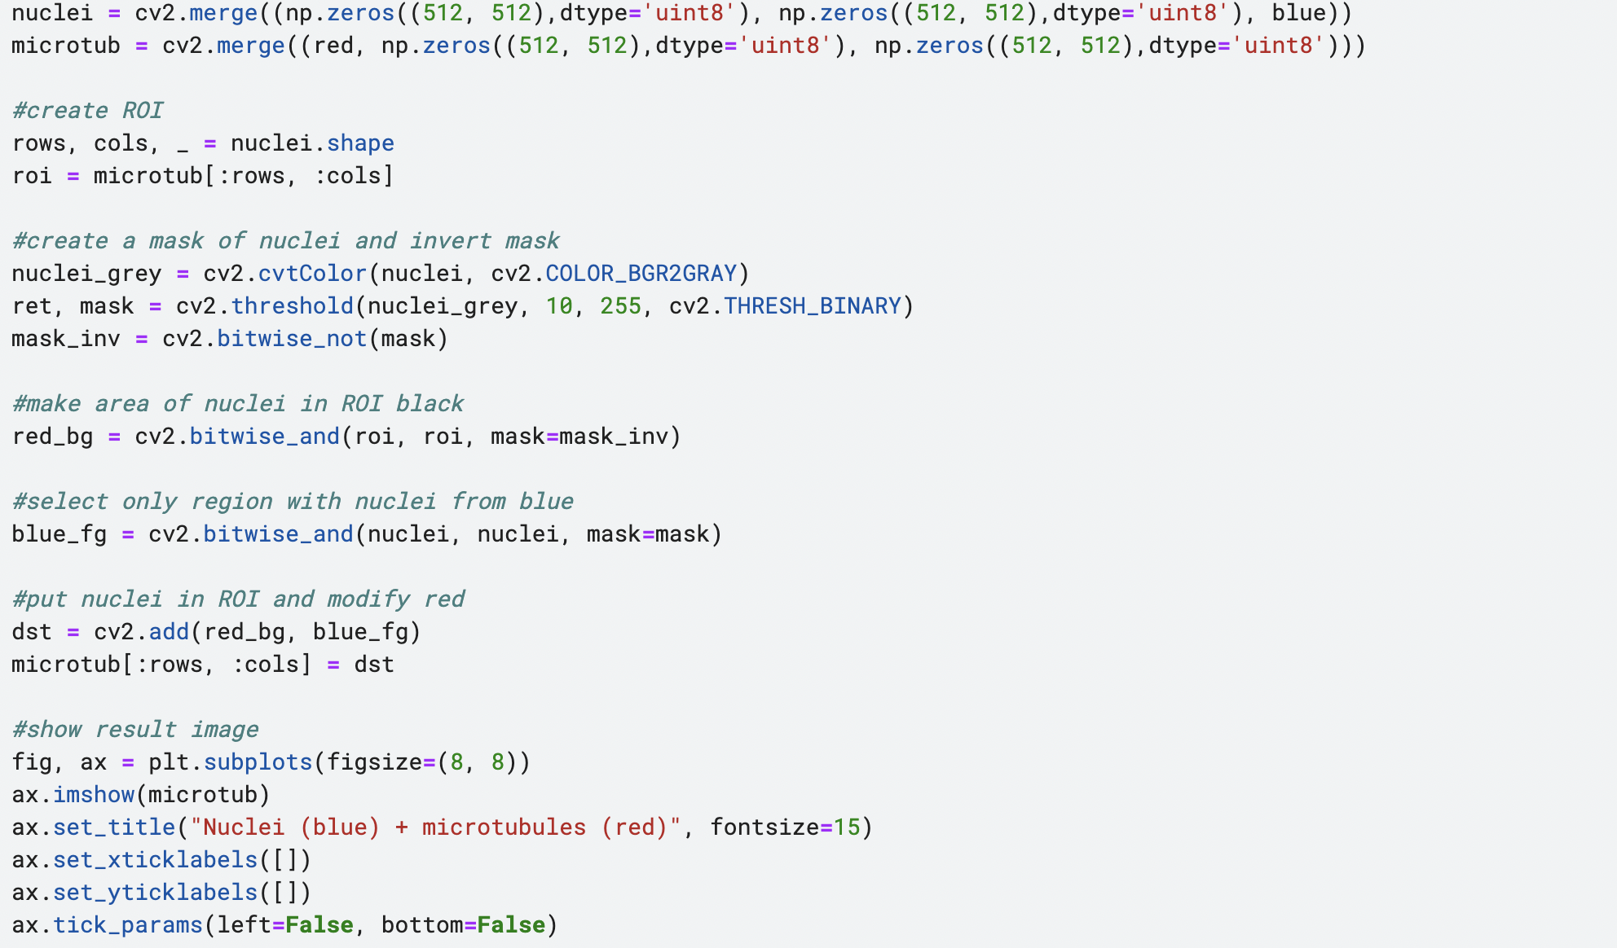
Snippets

Slide 12
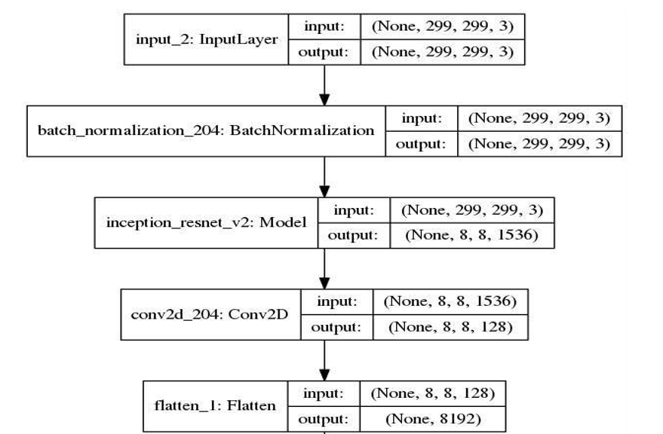
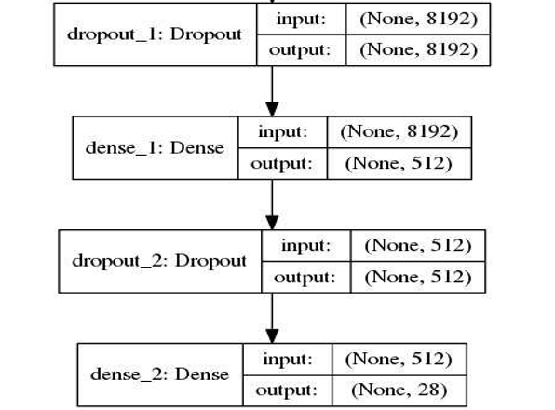
Architecture of neural network:

Slide 13
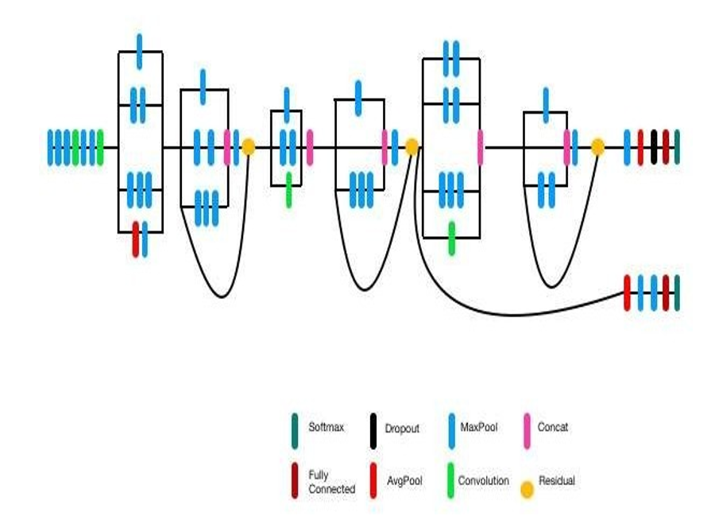
Architecture of resnet model:

Slide 14
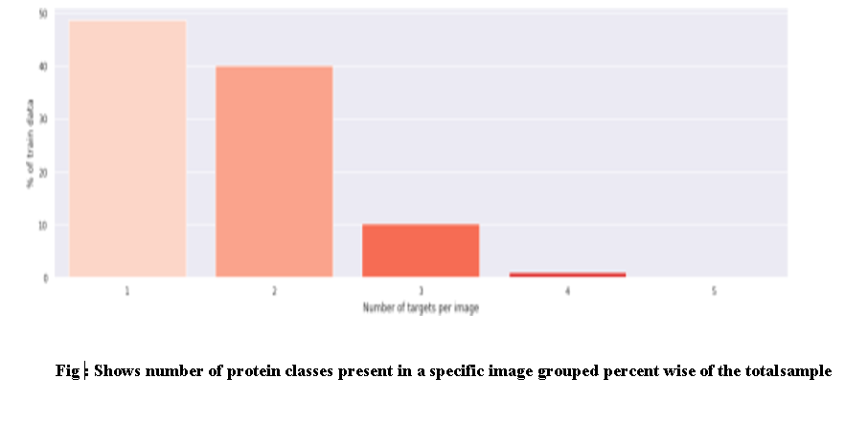
An exemplar bar data graph showing protein classes:

Slide 15
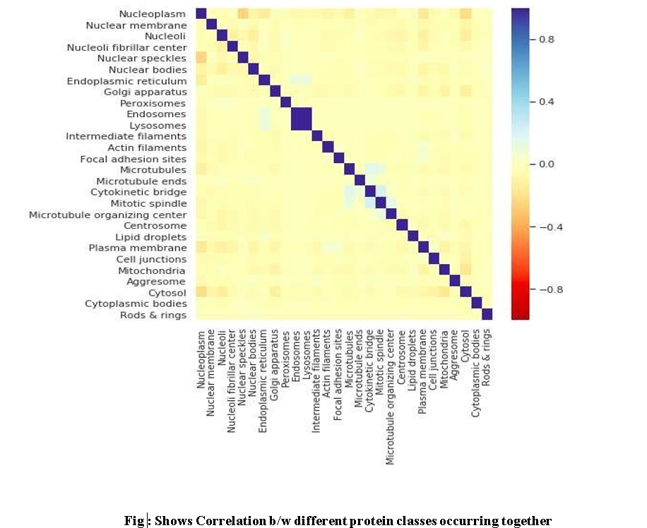
Correlation between different protein classes:

Slide 16
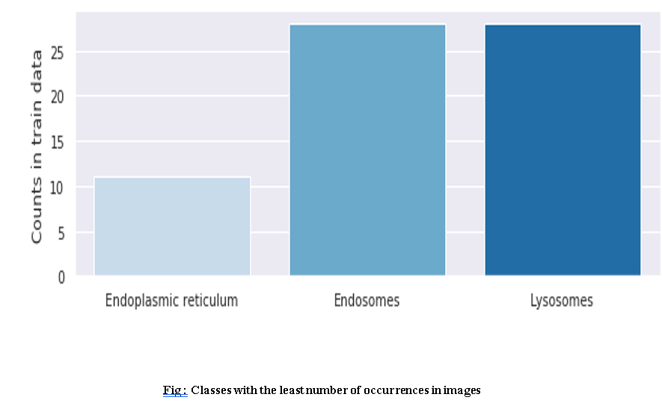
Classes with least occurrences:

Slide 17
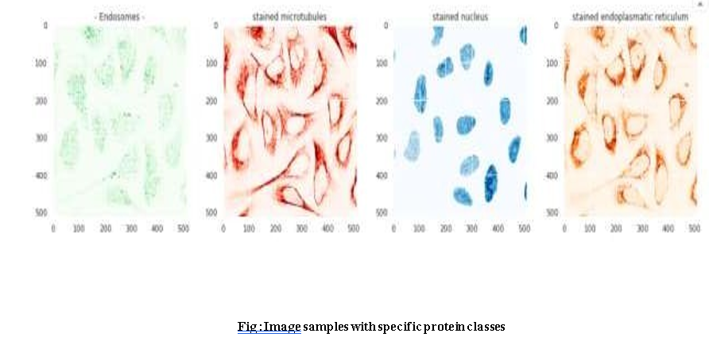
Image samples of protein classes:

Slide 18
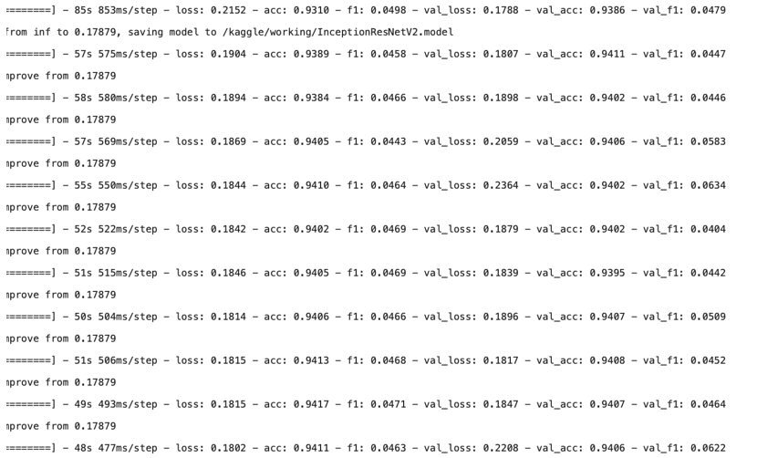
Result:

Slide 19
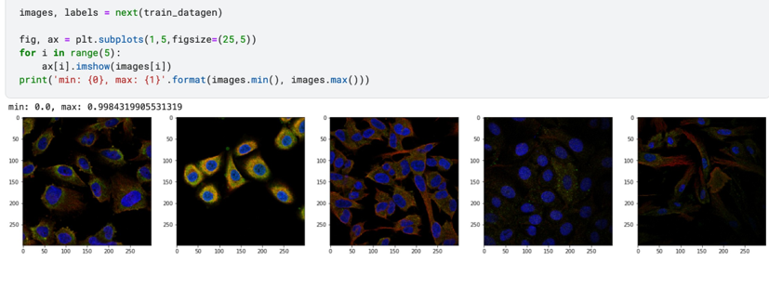
Results: (cont.)

Slide 20
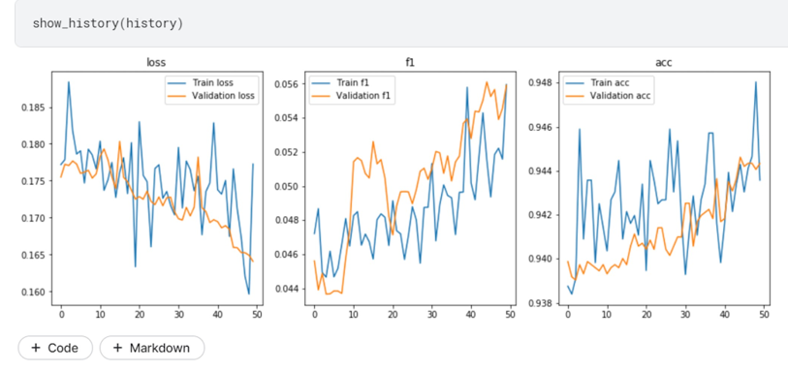
Graph results:

Slide 21
References:
Classification of Subcellular Protein Patterns in Human Cells with Transfer Learning
Authors: Li, Zongyao, Togo, Ren, Ogawa, Takahiro, Haseyama, Miki
Source: 2019 IEEE 1st Global Conference on Life Sciences and Technologies (LifeTech) Life Sciences and Technologies (LifeTech), 2019 IEEE 1st Global Conference on.
:273-274 Mar, 2019
Publisher Information: IEEE
Publication Year: 2019
Link: http://ieeexplore.ieee.org.egateway.vit.ac.in/document/8884002/
BioCircuit - A Hardware Based Methodology for Protein Recognition
Authors: Gajda, Dominik ,Pulka, Andrzej
Source: 2018 International Conference on Signals and Electronic Systems (ICSES) Signals and Electronic Systems (ICSES), 2018 International Conference on. :289-294 Sep, 2018 Link: http://ieeexplore.ieee.org.egateway.vit.ac.in/document/8507340

