Slide 1
PROJECT ~ 1
Customer Churn Prediction

Slide 2
TABLE OF CONTENTS
01
INTRODUCTION
02
DATASET & DESCRIPTION
03
DATA CLEANING AND ANALYSIS
04
LEARNING AND OUTCOME

Slide 3
INTRODUCTION
01

Slide 4
Overview:
Customer churn prediction uses data analysis and machine learning to anticipate which customers may leave a business. By analyzing customer behavior, predictive models forecast churn probabilities, enabling businesses to implement targeted retention strategies and improve customer satisfaction.

Slide 5
Purpose of analysis :
Business continuity and Growth
Resource Allocation
Strategic Decision Making
Revenue Impact
Customer Satisfication

Slide 6
DATASET & DESCRIPTION
02

Slide 7
Problem Statement:
Customer churn is a crucial concern for businesses across sectors. Understanding customer behaviors, identifying key factors contributing to churn, and predicting when customers are likely to churn are vital for reducing revenue loss and enhancing customer retention strategies.

Slide 8
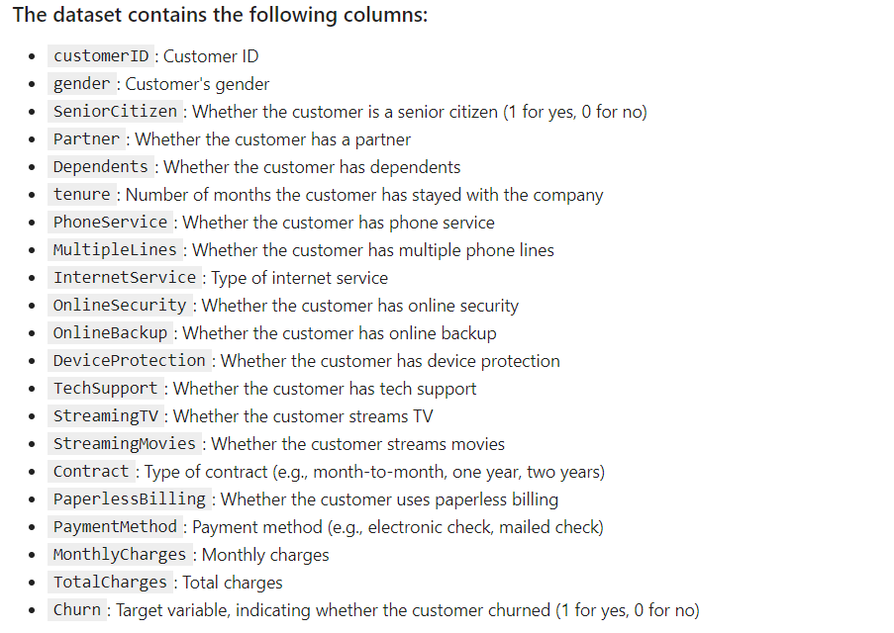

Slide 9
DATACLINING & ANALYSYS
03

Slide 10

Write a code to check NULL values

Slide 11
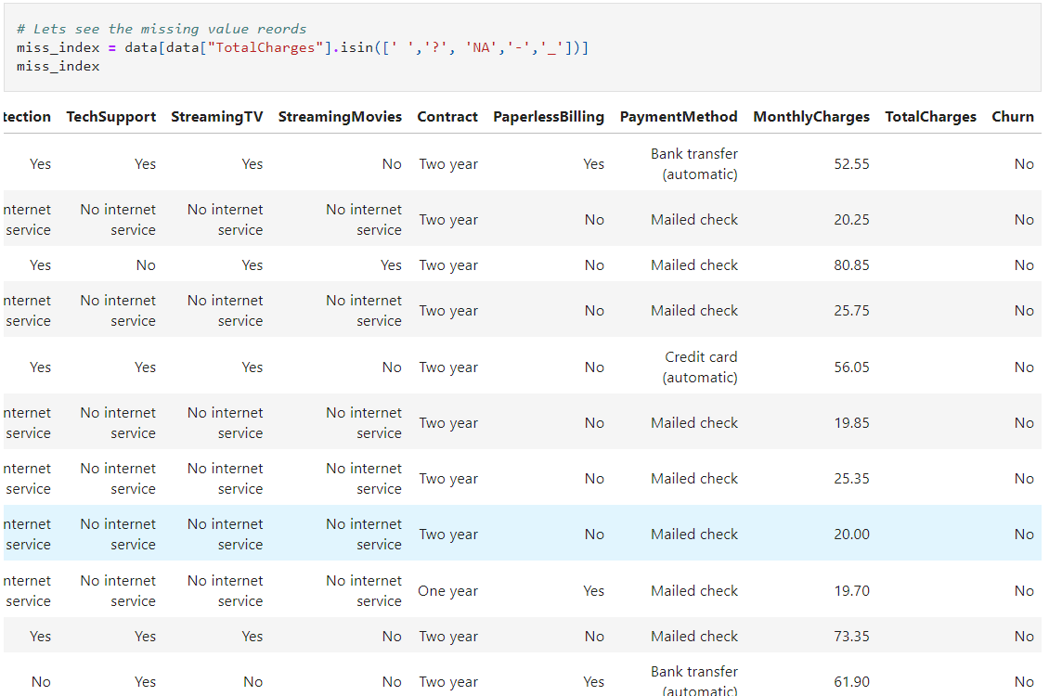

Slide 12
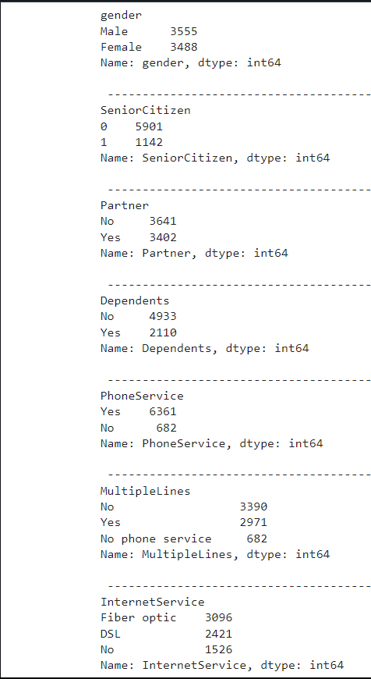
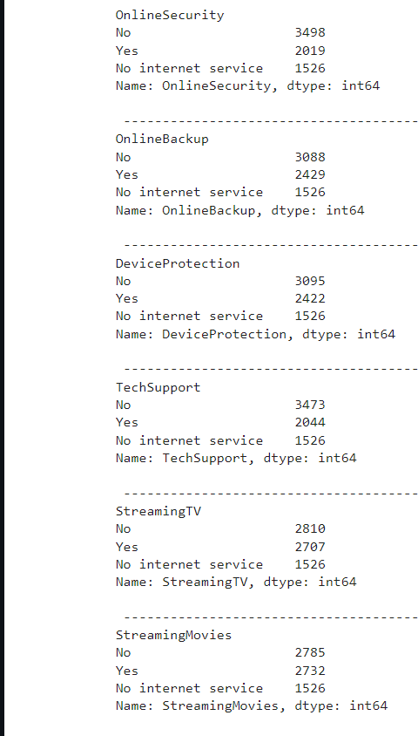
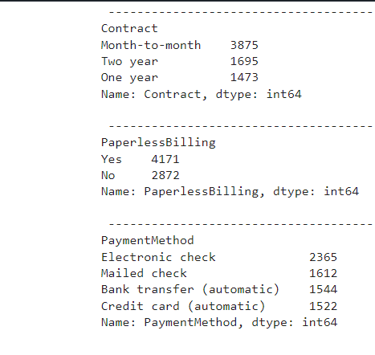
Value Counts by features.
The features "OnlineSecurity", "OnlineBackup", "DeviceProtection", "TechSupport","PaymentMethod", "StreamingTV","StreamingMovies" has 3 values which are yes,no and No internet service

Slide 13
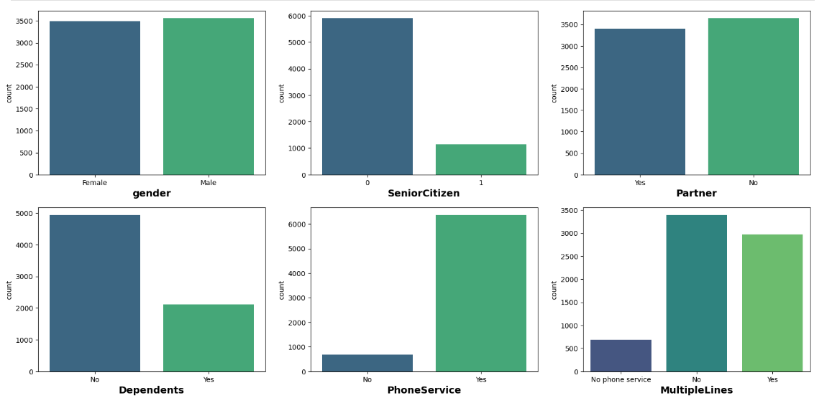
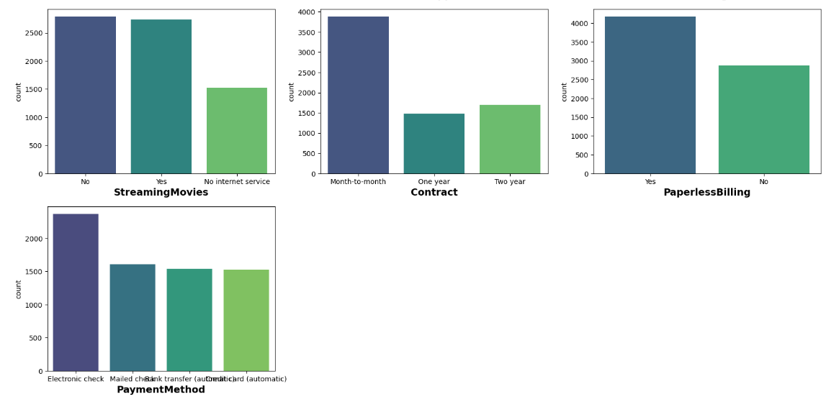
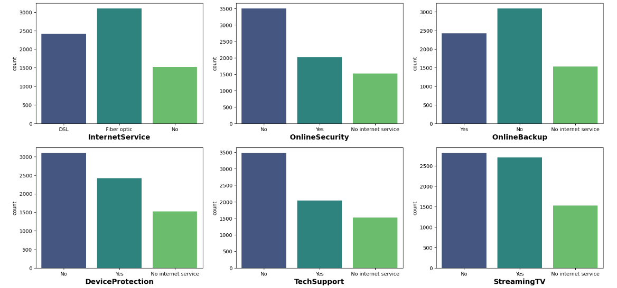
Observations :
We have almost same number of male and female customers
Most of the customers are youngsters(5901), where as only 1142 customers are Senior Citizen
The very less customers are dependent (2110), as compare to the independent customers(4933)
Almost 90% customers have Phone Service (6361)
Only 2019 customers have online services where as 3498 customer don't have online security, also 1526 customers don't have any internet services

Slide 14
Numerical columns Description
tenure : Number of months the customer has stayed with the company
The average tenure of a customer is 32 months which is nearly 3 years
The highest tenure is 72 months which is 6 years
The least tenure is 18 months which is 1.5 years
Monthly Charges
The average monthly charges to the customer is 64.77
The maximum monthly charge is 118.76
The minimum monthly charge is 18.2
Total Charges
The average Total charges to the customer is 2283.30
The maximum Total charge is 8684.80
The minimum Total charge is 18.80

Slide 15
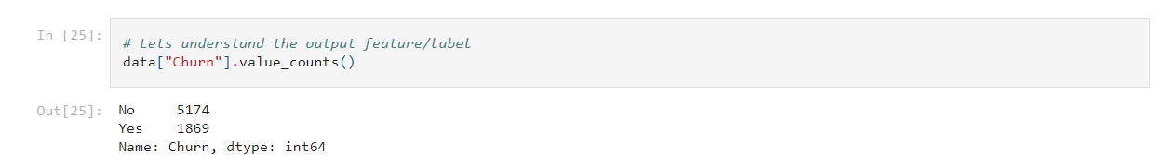
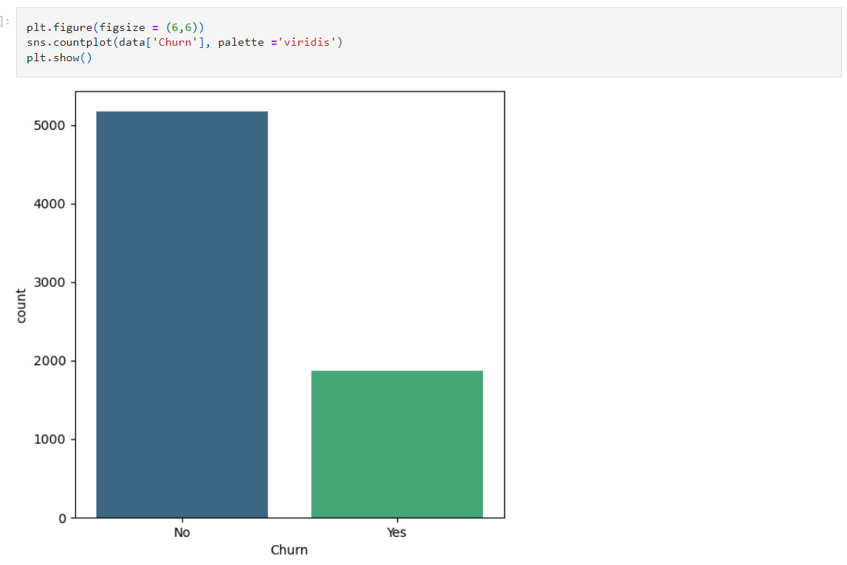
Output Feature

Slide 16
converting the string values into the numbers
data['gender'].replace({'Female': 0, 'Male': 1},inplace = True)
data['Partner'].replace({'No': 0, 'Yes': 1},inplace = True)
data['Dependents'].replace({'No': 0, 'Yes': 1},inplace = True)
data['PhoneService'].replace({'No': 0, 'Yes': 1},inplace = True)
data['PaperlessBilling'].replace({'No': 0, 'Yes': 1},inplace = True)
data['MultipleLines'].replace({'No': 0, 'Yes': 1,'No phone service':2},inplace = True)
data['InternetService'].replace({'No': 0, 'Fiber optic': 1,'DSL':2},inplace = True)
data['OnlineSecurity'].replace({'No': 0, 'Yes': 1,'No internet service':2},inplace = True)
data['OnlineBackup'].replace({'No': 0, 'Yes': 1,'No internet service':2},inplace = True)
data['DeviceProtection'].replace({'No': 0, 'Yes': 1,'No internet service':2},inplace = True)
data['TechSupport'].replace({'No': 0, 'Yes': 1,'No internet service':2},inplace = True)
data['StreamingTV'].replace({'No': 0, 'Yes': 1,'No internet service':2},inplace = True)
data['StreamingMovies'].replace({'No': 0, 'Yes': 1,'No internet service':2},inplace = True)
data['Contract'].replace({'Month-to-month': 0, 'One year': 1,'Two year':2},inplace = True)
data['PaymentMethod'].replace({'Electronic check': 0, 'Mailed check': 1,'Bank transfer (automatic)':2,'Credit card (automatic)':3},inplace = True) data['Churn'].replace({'No': 0, 'Yes': 1},inplace = True)

Slide 17
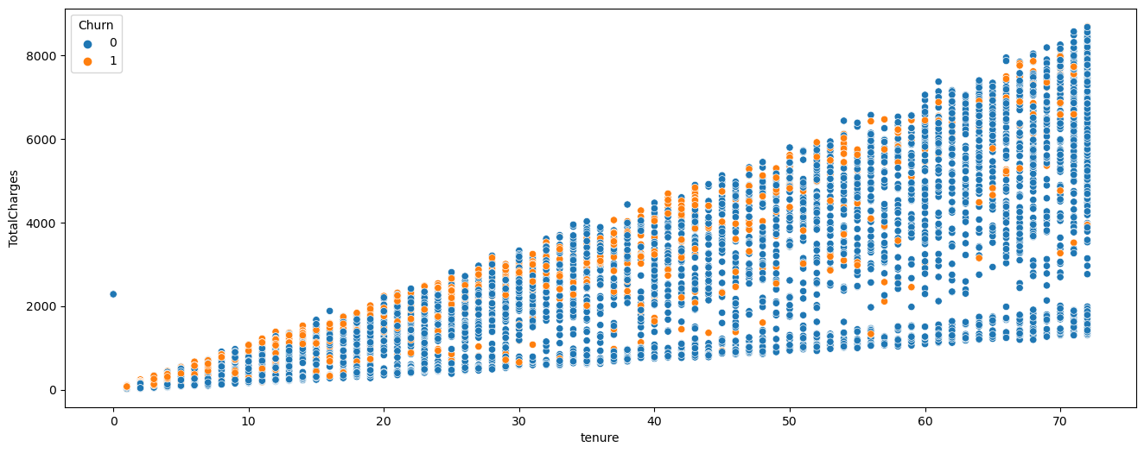
Tenure vs Total Charges
Observation:
The Total Charges of the customer is increase with increase in tenure

Slide 18
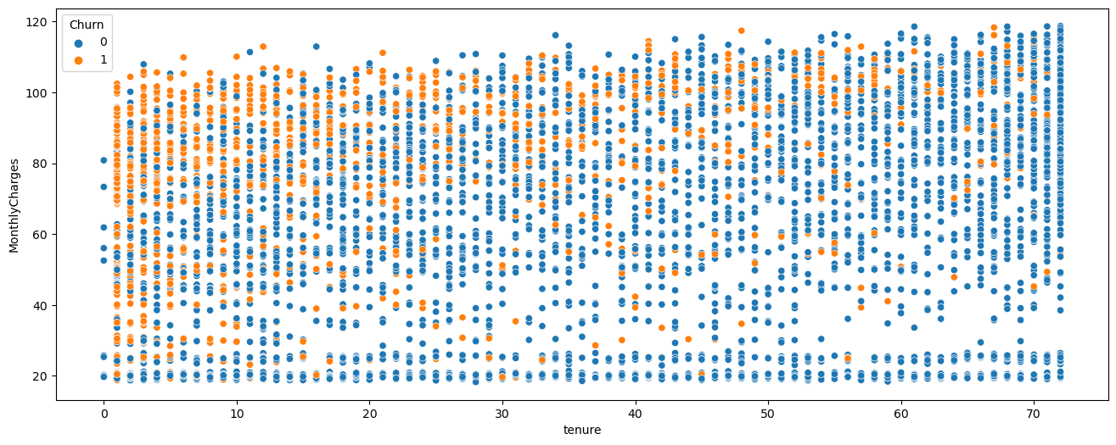
Tenure vs Monthly Charges
Observation:
We can see the uniform distributation for the monthly charges
The monthly charges are same for all the customers

Slide 19
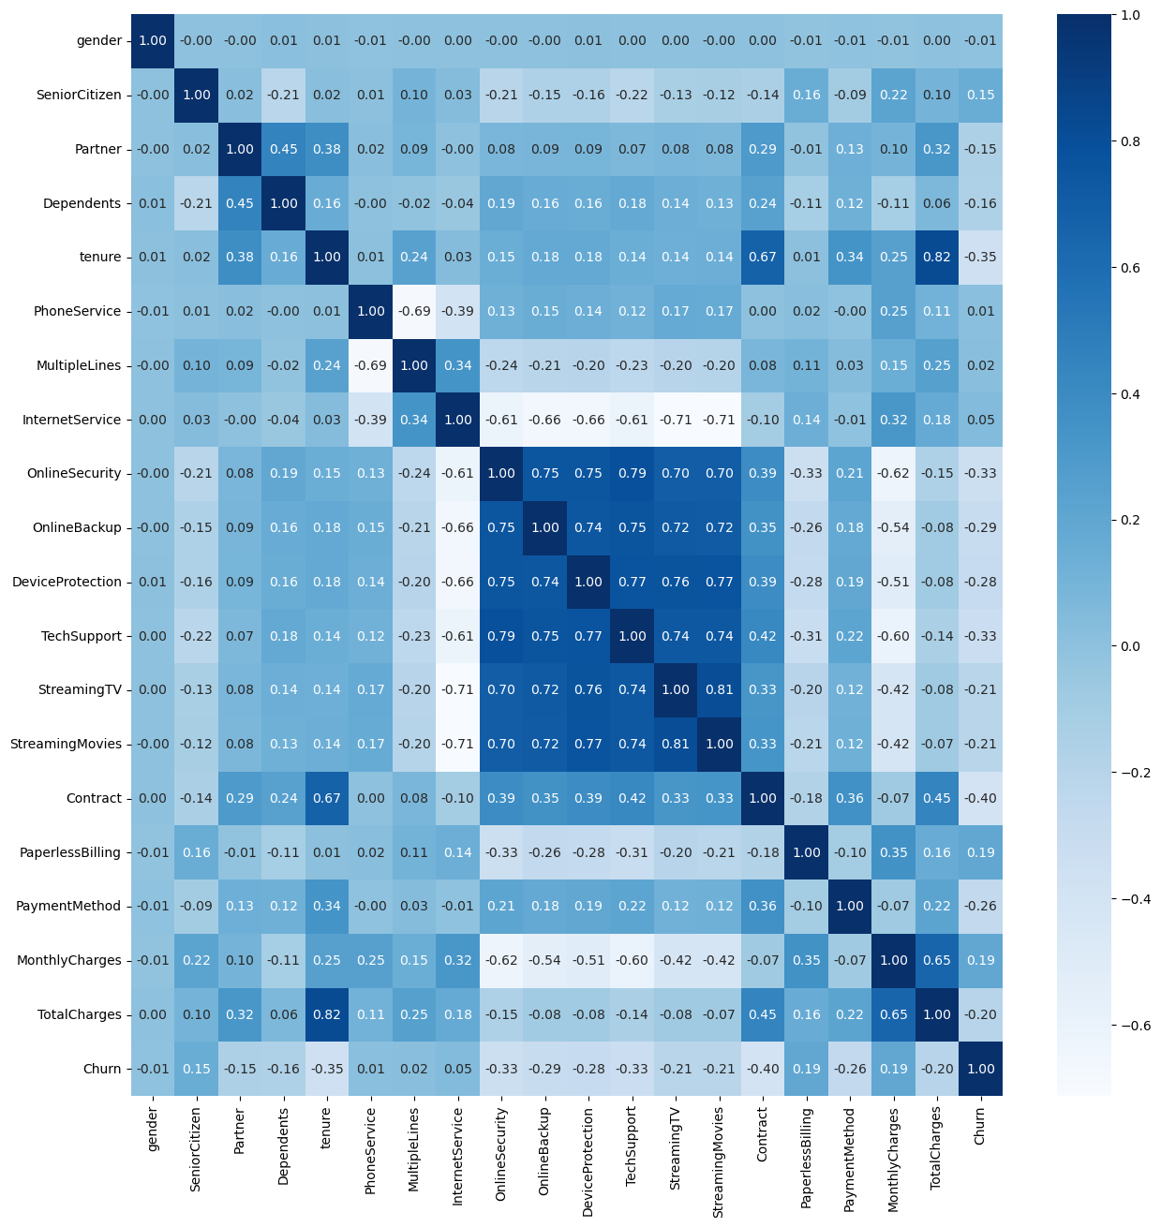
Heatmap

Slide 20
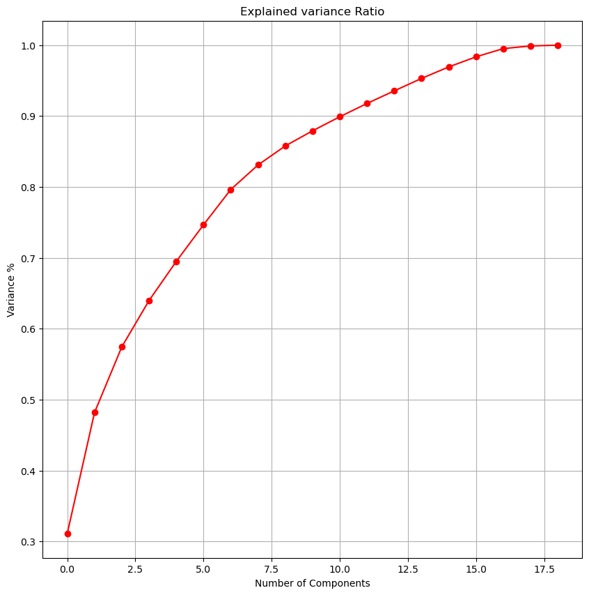
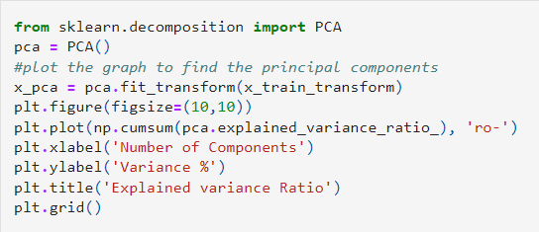
Principal Components Analysis
Observation :
AS per the graph, we can see that 10 principal components attribute for 90% of variation in the data. We shall pick the first 10 components for our prediction

Slide 21
LEARNING AND OUTCOME
04

Slide 22
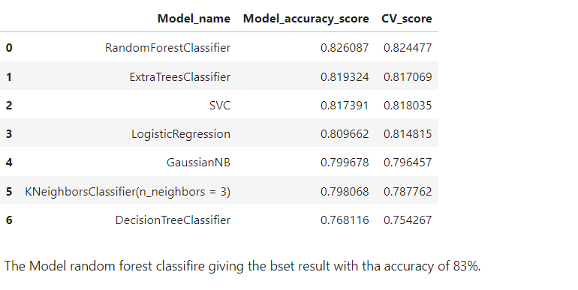
Model Performance
Observation:
The Model random forest classifier giving the best result with the accuracy of 83%.

Slide 23
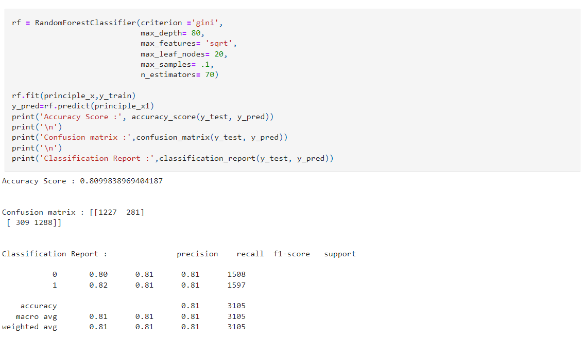
Model Learning : Random forest classifier

Slide 24
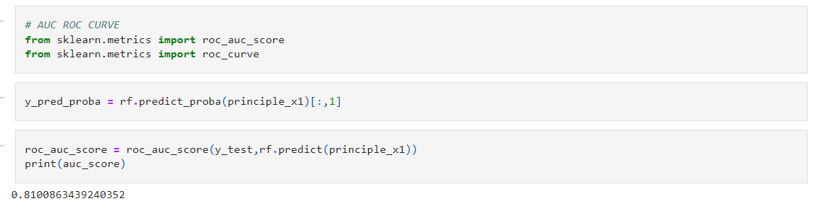
Model Evaluation

Slide 25
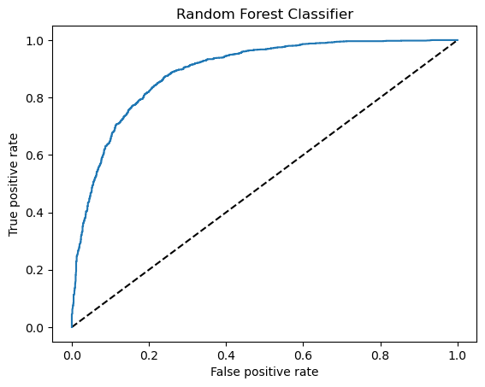
ROC Curve :

Slide 26
Reduce Customer Churn and Conclusion :
Reduce customer churn and predictions
Engage with your customers
Define your most valuable customers
Give better services
Pay attention to the complaints
Flaunt your competitive advantages
Offer long term contracts

Slide 27
Thank You

