Slide 1
Collect speech signals from your groupmates. Build a machine learning model capable of estimating various frequencies and signal-to-noise ratios within the speech signals.
Shusria Sharmin Mithila
Sakib Reza
Mir Bayazid Protik

Slide 2
Classify sounds and reduce noise in audio signals.
Techniques Used:
LSTM and HuggingFace for sound classification and noise reduction.
RNN with Fourier Transformation for sound classification and noise reduction.
Key Metric: Signal-to-Noise Ratio (SNR) for evaluating audio quality.
Outcome:
High classification accuracy.
Effective noise suppression.
Improved sound clarity.

Slide 3
Our Work Novelty
1. Dual Approach: Combines LSTM for sound classification and RNN with Fourier Transformation for noise reduction, unlike prior single-model methods .
2. Focus on SNR: Improves audio clarity by enhancing SNR, extending beyond the methods in .
3. Unique Framework: Modular design integrates preprocessing, training, and evaluation for flexibility, unlike fast but less flexible approaches .
4. Comprehensive Metrics: Evaluates models using classification accuracy, SNR improvement, and noise suppression, unlike isolated metrics in previous works. effectiveness, unlike prior works that focus on isolated metrics.

Slide 4
Methodology
1. Objective: Improve sound quality using LSTM, RNN, and Fourier transformation, measured by SNR.
2. Data Preprocessing: Transform audio to the frequency domain for feature extraction.
3. Noise Reduction (RNN): Suppresses noise while preserving essential sound features, enhancing SNR.
4. Sound Classification (LSTM): Classifies audio types with temporal patterns; evaluated via accuracy and F1-score.
5. Deployment: Real-time pipeline delivers clear, categorized sound outputs.
6. Data Analysis:
- Waveform: Amplitude over time indicates sound intensity.
- Spectrogram: Frequency components visualized to differentiate noise from structured sounds.

Slide 5
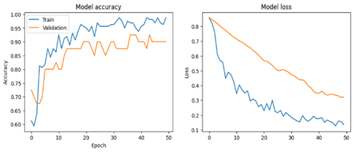
LSTM for sound classification

Slide 6
LSTM for Sound Classification.
Metric | Score
Accuracy | 0.8750
Precision | 0.8859
Recall | 0.8521
F1-score | 0.8649

Slide 7
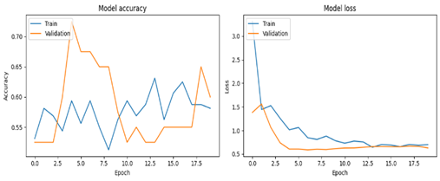
LSTM for sound Denoising

Slide 8
LSTM for Sound Denoising.
Metric | Score
Accuracy | 0.7750
Precision | 0.7889
Recall | 0.6421
F1-score | 0.6649

Slide 9
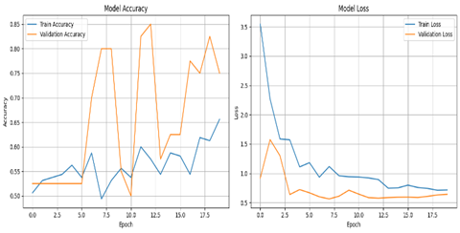
RNN for sound classification

Slide 10
RNN model for Sound Classification
Metric | Score
Accuracy | 0.8050
Precision | 0.8789
Recall | 0.8321
F1-score | 0.8449

Slide 11
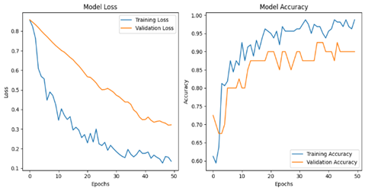
RNN for sound Denoising

Slide 12
RNN model for Denoising sound
Metric | Score
Accuracy | 0.8750
Precision | 0.8589
Recall | 0.8321
F1-score | 0.849

Slide 13

Thank you

