Slide 1
Optimizing Deep Learning: A Comparative Analysis of Weight and Filter Pruning for Enhanced Model Efficiency and Deployment"
Md Shahriar Kabir
Doctoral Instructional Assistant Dept. of Computer Science
Texas State University
Mayesha Maliha Rahman Mithila
Doctoral Instructional Assistant Dept. of Computer Science
Texas State University

Slide 2
Introduction
Model pruning, an optimization technique for deep neural networks, involves removing redundant parameters to enhance efficiency.
This process necessitates evaluating key performance metrics such as model size, GPU training time, and memory usage.
Understanding the interplay between these metrics is vital for optimizing model efficiency and resource utilization in real-world applications.
It’s also crucial to address the issue how altering these parameters affect training performance.

Slide 3
Problem Definition
Resource Overuse and Large Models: Deep learning models often demand excessive resources and are oversized, hindering deployment in resource-limited environments.
Why model pruning is crucial:
Enhanced Deployment Feasibility: Shrinking model size and resource demands enables deployment on mobile devices and embedded systems, widening their application.
Improved Computational Efficiency: Smaller models require less computing power and memory, leading to cost savings and increased accessibility for users with limited hardware.

Slide 4
Research Questions
How does varying the level of weight and filter pruning impact the balance between reducing model size and maintaining accuracy?
How do different levels of pruning influence GPU training durations and memory consumption?
Between weight and filter pruning, which technique offers superior performance efficiency across different types of neural networks?

Slide 5
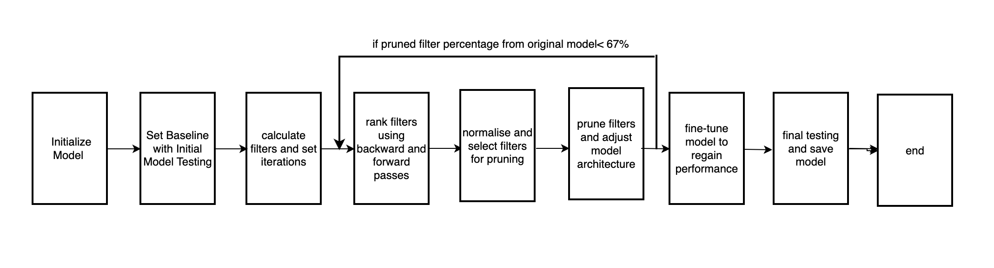
Methodology
Fig 1: Filter pruning

Slide 6
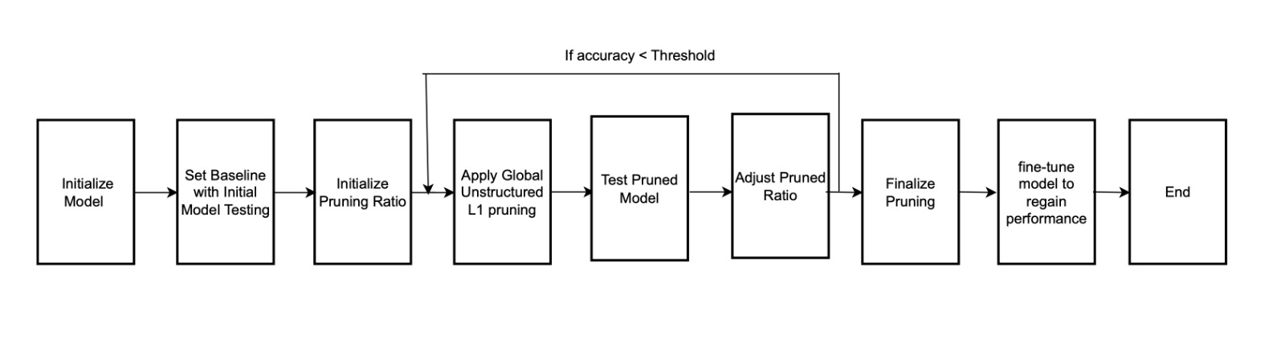
Methodology
Fig 2: Weight pruning

Slide 7
Experiment
Model: VGG16 [1]
Dataset: RealWaste dataset from UCI repository [2]
Number of workers=4
A100: 3 GPUs of 39GB

Slide 8
Results (Weight Pruning)
Table 1: Results of weight pruning
 | Accuracy (%) | Model Size (MB) | GPU training time (sec) | Memory usage (MB)
Pre-pruning | 85% | 512 | 180 | 20830
Post-pruning | 83% | 512 | 145 | 20750

Slide 9
Results (Filter Pruning)
Table 2: Results of filter pruning
 | Accuracy (%) | Model Size (MB) | GPU training time (sec) | Memory usage (MB)
Pre-pruning | 86% | 512 | 75 | 20830
Post-pruning | 84% | 253 | 78 | 18900

Slide 10
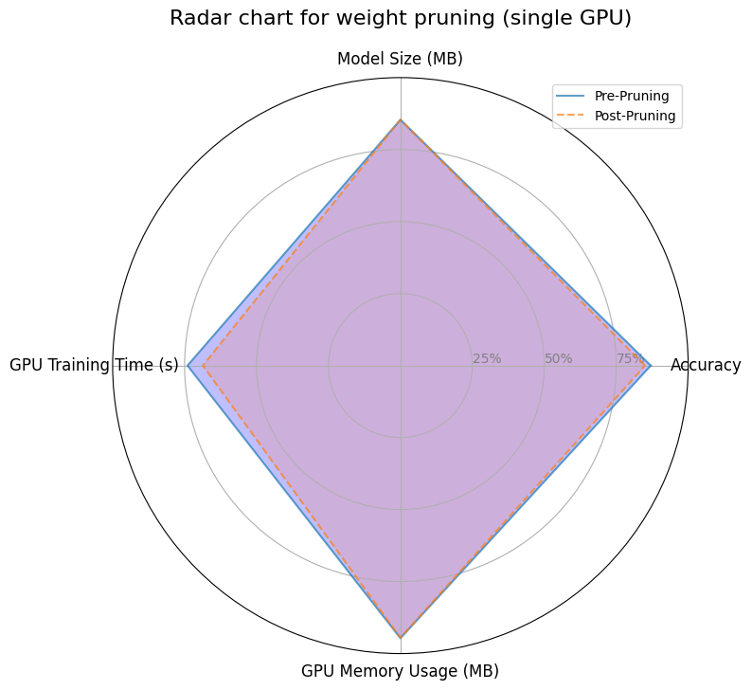
Results (Weight Pruning)
Fig 3: Radar chart for weight pruning in a single GPU

Slide 11
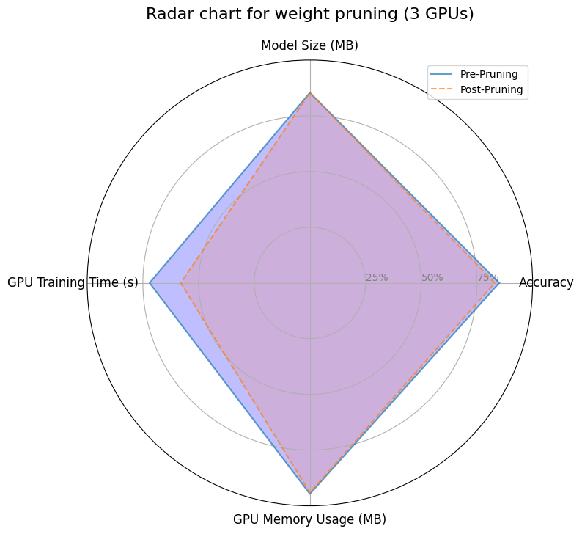
Results (Weight Pruning)
Fig 4: Radar chart for weight pruning in 3 GPUs

Slide 12
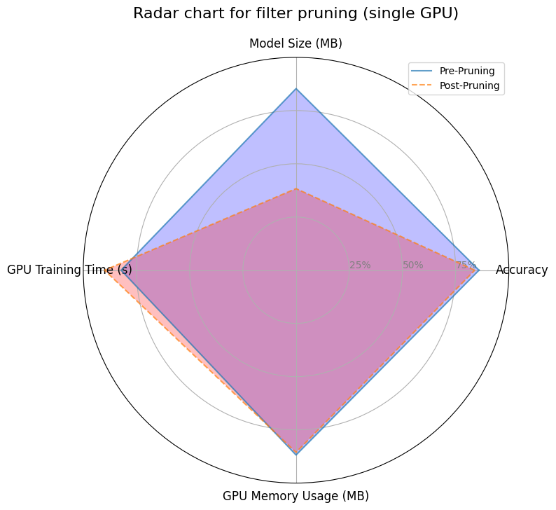
Results (Filter Pruning)
Fig 5: Radar chart for filter pruning in a single GPU

Slide 13
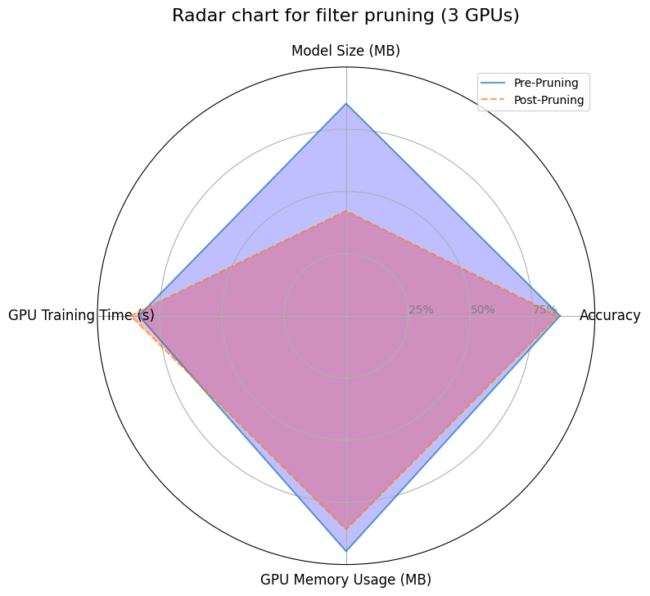
Results (Filter Pruning)
Fig 6: Radar chart for filter pruning in 3 GPUs

Slide 14
Discussion
Weight pruning results in same model size, slightly less memory usage, less GPU training time for 2% less accuracy.
Filter pruning results in reduced model size, less memory usage, more GPU training time for 2% less accuracy.
Increasing or decreasing GPUs affect the magnitude of these changes.
Presence of sparse matrix results in little change in memory usage in weight pruning.

Slide 15
Takeways from This Course
Diiferent scaling strategies like shared/distributed parallelism, data parallelism (nn.Dataparallel), model parallelism etc.
Parallelism like number of workers for data loading
MPI and OpenMP
Evaluation of parallel system
Checkpointing

Slide 16
Conclusion
Weight pruning and filter pruning applied for enhancement of deep learning architecture.
Weight pruning preferred for less memory usage and model, filter pruning for less training time when model size stays the same.
A trade off between memory usage and training time is shown in this study.

Slide 17
References
[1] Simonyan, K., & Zisserman, A. (2014). Very deep convolutional networks for large-scale image recognition. arXiv preprint arXiv:1409.1556.
[2] https://archive.ics.uci.edu/dataset/908/realwaste

Slide 18


