Slide 2
About us

Slide 3
Products & Services
PRE-IPO
INSURANCE
INTERNATIONAL FUND
LOANS
IT
REAL ESTATE
PORTFOLIO MANAGEMENT SERVICE [PMS]
MUTUAL FUND

Slide 4
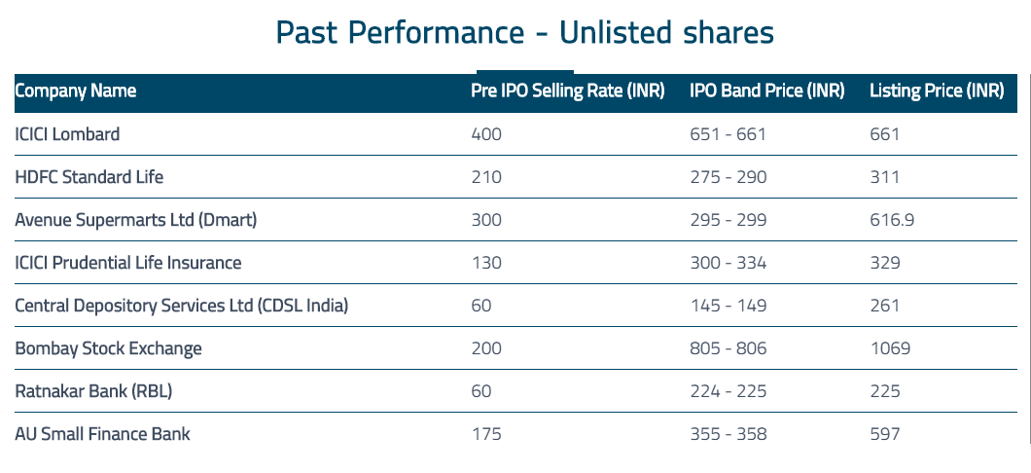
PRE-IPO
An offering of shares of a company before its initial Public Offer . i.e. Before they get listed on the Stock Exchange

Slide 5
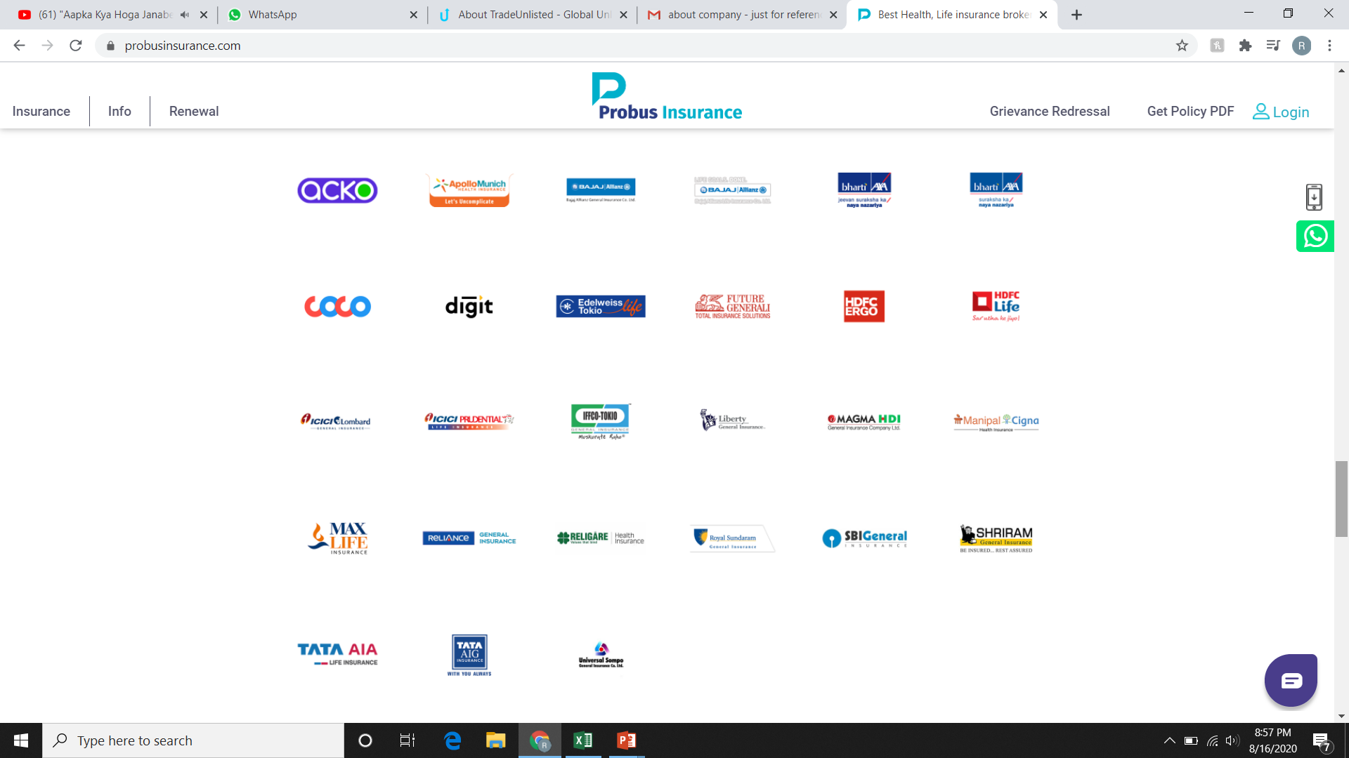
INSURANCE
TERM INSURANCE | GENERAL INSURANCE | ULIP| ENDOWMENT | MONEYBACK

Slide 6
INTERNATIONAL FUND
US $ FUND
UK FUND
INTERNATIONAL PRE-IPO*
INTERNATIONAL EQUITY [US]*
*Coming Soon………………………………….!

Slide 7
US $ FUND
Investing into USA Real Estate Market
5 year Bond
Fixed 14% Yield, coupon paid every month in US dollar account.
Locked-in 30 months
Minimum Investment $15000
Free 10year Business H1 Visa investing upon $50,000
Investment also cover EB5 scheme for PR investment upon $450000

Slide 8
UK £ FUND
Investing into UK Real Estate
5 year Bond | Equity fund
Locked-in 60 months
Minimum Investment
Bond - £10,000 |Coupon Q-8%| H-8.25%| Y-8.5%| M-8.75%
Equity £ - 50,000 [IRR- 17%] 5% paid every year

Slide 9
REAL ESTATE
Commercial
Residential
Pan India
Dubai
UK
US
Canada
Turkey

Slide 10
PORTFOLIO MANAGEMENT SERVICES
Handle client’s full Equity Portfolio
25% Hurdle rate
Over and above 25%, 50%-50% profit sharing
Review every month last Saturday
Payout every month last Saturday
Incase of loss, 3 month time to recover from loss or cancellation of contract.
Investing into Equity is High risky investment

Slide 11
Mutual Funds
One Time Investment
SIP – Systematic Investment Plan
SWP – Systematic Withdrawal Plan
FMP – Fixed Maturity Plan

Slide 12
LOANS
HOME LOAN
PERSONAL LOAN
BUSINESS LOAN
LOAN AGAINTS PROPERTY
OVERDRAFT LOAN – SALARIED PERSON
CONSTRUCTION LOAN
AGRICULTURAL LOAN
PROJECT LOAN
MACHINERY LOAN

Slide 13
IT
COMING SOON………………………………

Slide 14
THANK YOU!!

