Slide 1
Fake News
Classifier
NLP Binary Classification Pipeline
Ironhack AI Bootcamp · 2026

Slide 2
Project Overview
Goal: classify news articles as Fake (0) or Real (1) using NLP and traditional ML.
1
2
3
4
5
6
7
Load & Inspect
EDA
Preprocessing
TF-IDF
Train Models
Evaluate
Best Model
39,942 articles
5 columns
Balance, length,
subject, timeline
Clean text,
combine fields
Bigrams
50k features
4 classifiers
compared
Acc, F1, AUC,
Confusion Matrix
Gradient Boosting
99.6% accuracy

Slide 3
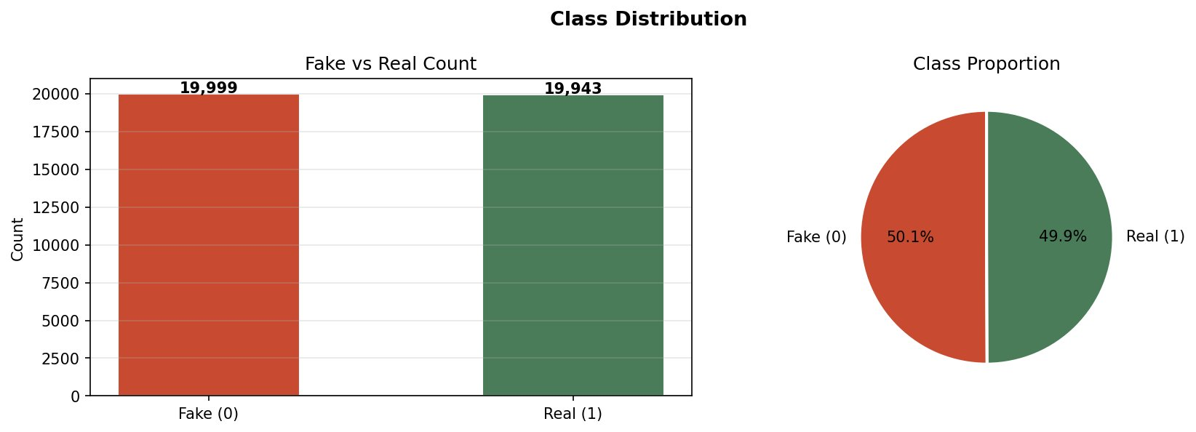
Dataset
39,942
50 / 50%
6
2016–2017
Total Articles
Balanced Classes
Subjects
Date Range

Slide 4
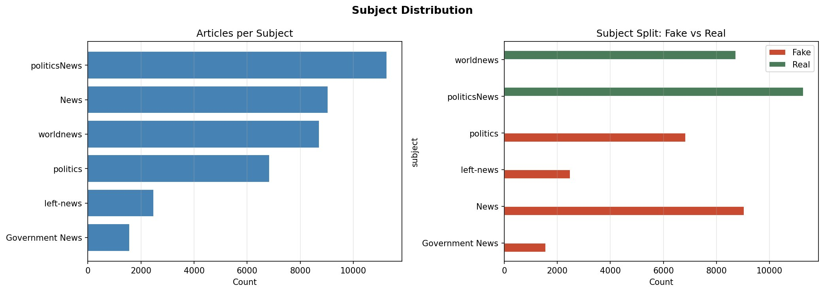
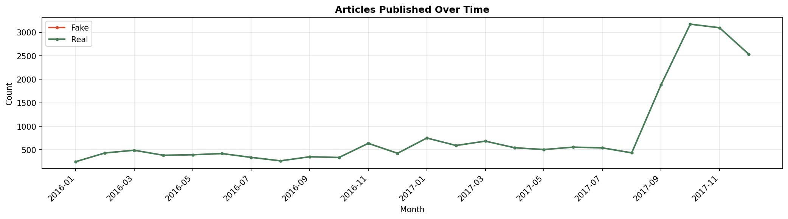
Exploratory Data Analysis
Subject distribution (left) — Real articles concentrate in politicsNews & worldnews; Fake spans politics, News and left-news.
Timeline (Real only): Dates available only for Real articles (2016–2017). Fake articles had no valid dates — a structural dataset difference.

Slide 5
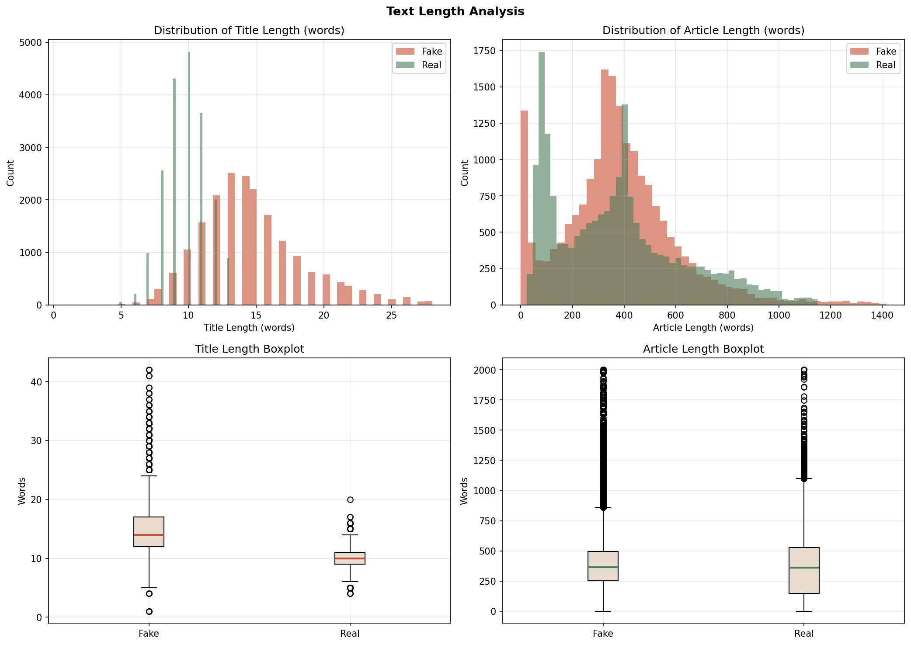
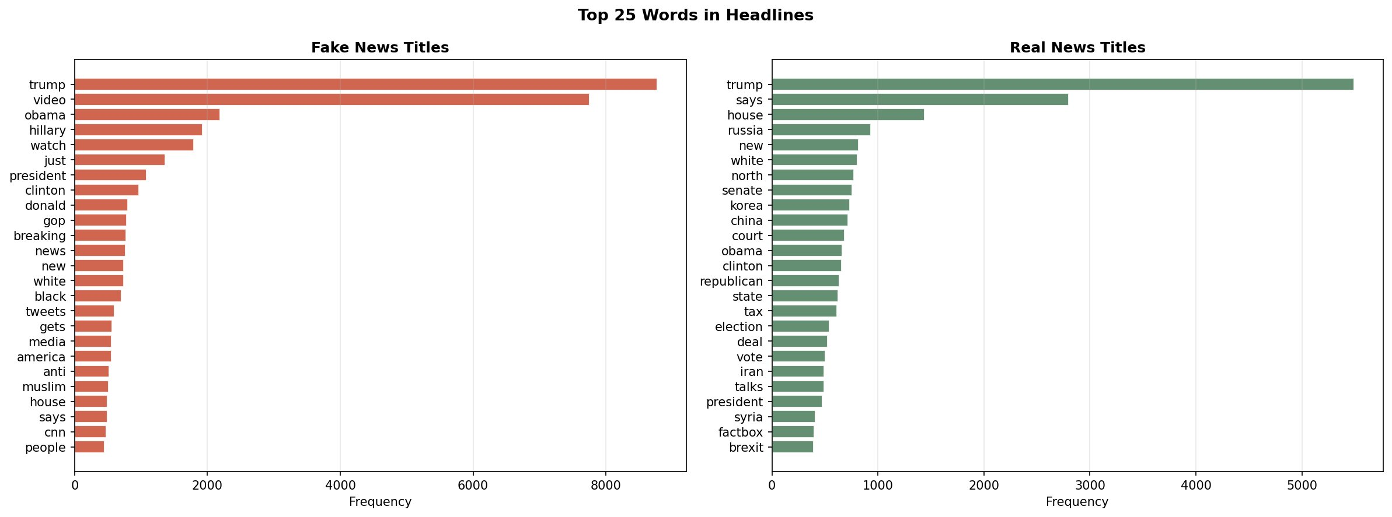
Text Analysis
Title & Article Length
Top 25 Words in Headlines
Fake titles are longer (~15 words vs ~10 for Real)
Fake: video, image, watch. Real: says, house, russia

Slide 6
Preprocessing & Features
①
Drop nulls & duplicates
Cleaned dataset before splitting
②
Lowercase + remove URLs & punctuation
Standardized raw text
③
Combine title + text
Single combined_text field per article
④
Stratified 80/20 split
29,143 train · 7,286 test · balanced labels

Slide 7
Feature Extraction: TF-IDF
Text cannot be fed directly to a model — TF-IDF converts each article into a numerical vector.
TF
IDF
TF-IDF
Term Frequency
×
Inverse Document Freq.
=
Score per word per doc
How often a word appears
in a single document
(normalised by doc length)
Downweights words that appear
in many documents
(common ≠ informative)
High score = word is frequent
here but rare elsewhere
(discriminative signal)
Configuration used in this project
Vocabulary size:
50000 features
Stop words:
English stop words removed
N-grams:
Unigrams + Bigrams (1,2)
Output matrix:
29143 × 50,000 (train)

Slide 8
Models — Baselines
Start simple — establish a performance floor before adding complexity.
Naive Bayes
Logistic Regression
Probabilistic
95.9%
Linear Classifier
98.8%
Based on Bayes' theorem — calculates the probability of each class given the words in the article
Learns a weight for each word — positive weights push toward Real, negative toward Fake
Assumes all words are independent of each other (the "naive" assumption)
Applies a sigmoid function to output a probability between 0 and 1
Very fast to train — works directly with TF-IDF scores (non-negative values)
Strong NLP baseline — consistently competitive with more complex models
Surprisingly strong for text despite its simplicity
Fast to train, easy to interpret (inspect word weights directly)
Best used as a fast first baseline to beat
solver='liblinear' — efficient for sparse high-dimensional data like TF-IDF

Slide 9
Models — Advanced
Ensemble methods — combine multiple decision trees for higher accuracy and robustness.
Random Forest
Gradient Boosting
Parallel Ensemble
97.6%
Sequential Ensemble
99.6% ⭐
Builds 100 independent decision trees, each trained on a random subset of data and features
Builds trees sequentially — each new tree focuses on correcting the errors of the previous one
Each tree votes — the majority class wins ("bagging")
"Boosting" = iteratively improve weak learners into a strong combined model
More robust than a single tree — individual errors cancel out across the ensemble
Slower to train than Random Forest but consistently the most accurate
n_jobs=-1 trains all trees in parallel using all CPU cores
Requires careful tuning (learning rate, tree depth) to avoid overfitting
Less prone to overfitting than a single deep tree
Our best model — 99.6% accuracy, 99.9% AUC-ROC on unseen test data

Slide 10
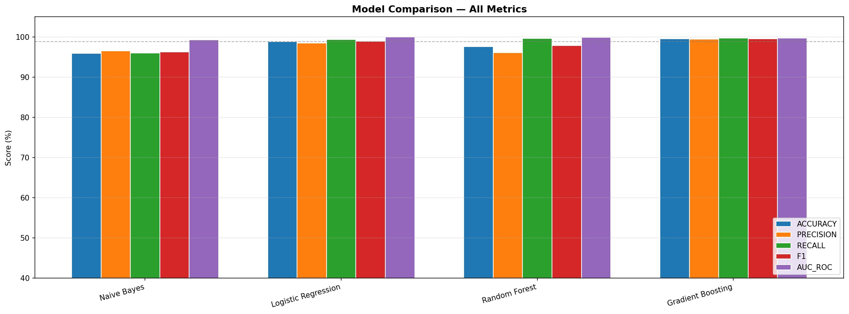
Model Comparison
4 classifiers evaluated: Naive Bayes · Logistic Regression · Random Forest · Gradient Boosting

Slide 11
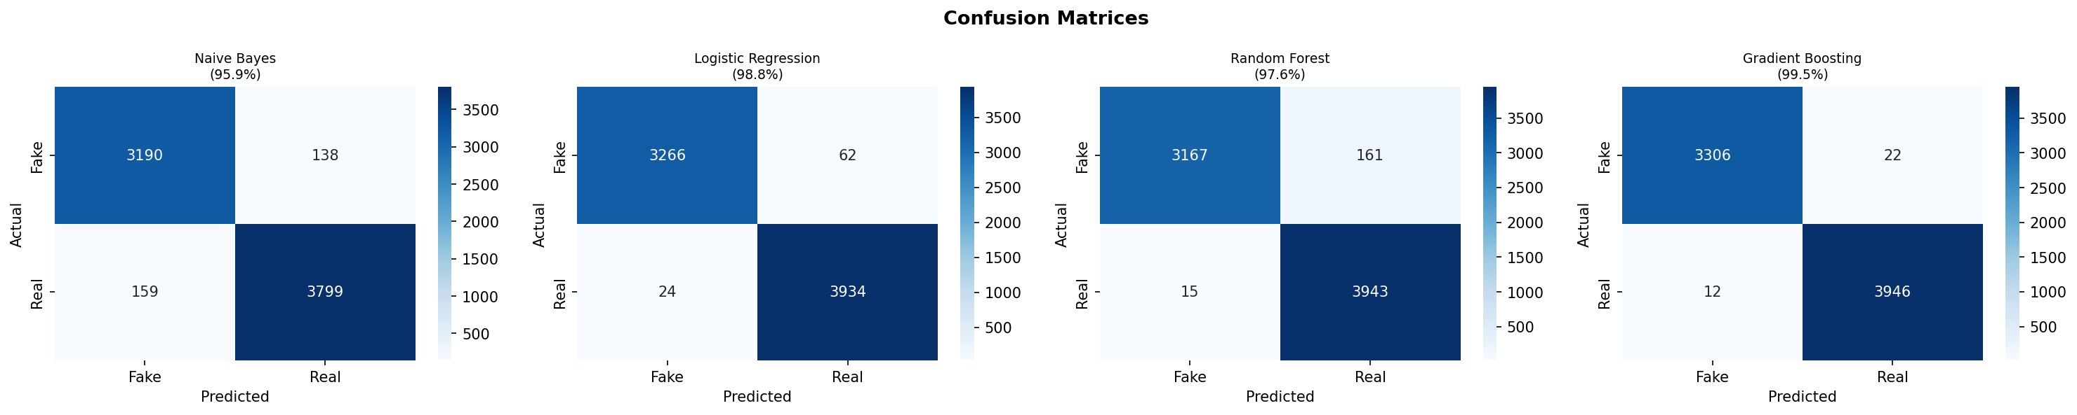
Confusion Matrices
Gradient Boosting achieves the fewest errors: 22 FP + 12 FN out of 7,989 test articles.

Slide 12
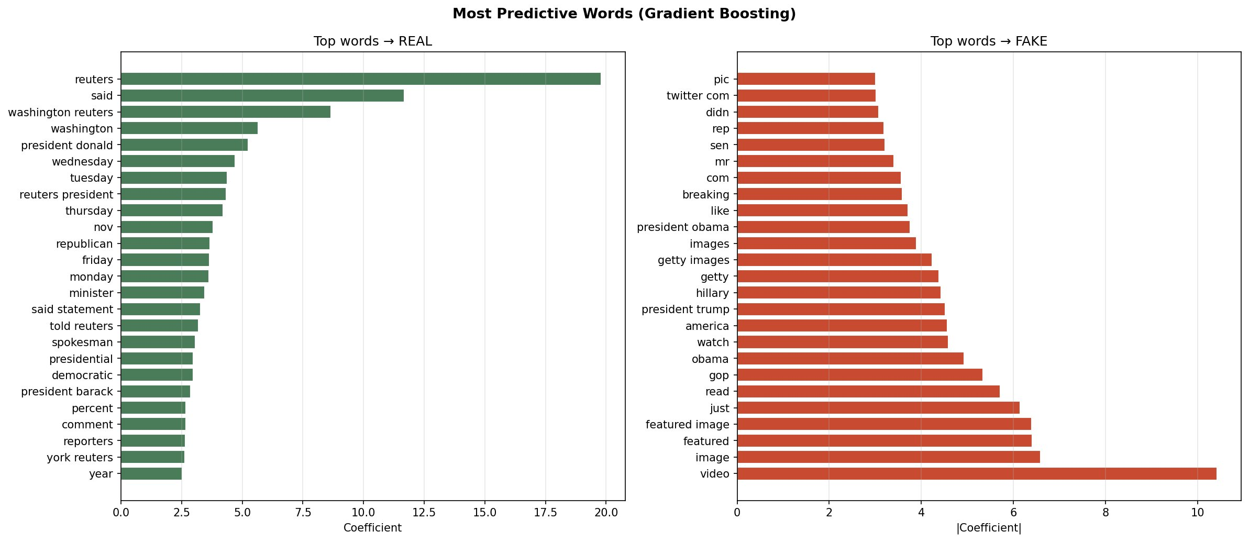
Best Model: Gradient Boosting
99.6%
99.5%
99.7%
99.6%
99.9%
Accuracy
Precision
Recall
F1 Score
AUC-ROC

Slide 13
Conclusions
TF-IDF is enough
Simple bag-of-words with bigrams captures discriminative signals effectively
Source matters most
"reuters" is the strongest single predictor of real news; "video/image" for fake
Style over content
Fake titles are longer (~15 words) and use more informal/emotional language
Gradient Boosting wins
99.6% accuracy — outperforms Logistic Regression, Naive Bayes and Random Forest
Dataset caveat
Real articles all have dates; Fake do not — model may partly detect formatting, not just content

