Slide 1
AI ENGINEERING FINAL PROJECT
Sri Lanka
Business Intelligence
Copilot
Grounded business research and multimodal land intelligence in one traceable application
RAG Agent routing Vision OpenStreetMap LangSmith
Don Mithila Meshan Palliya Guruge | September 2026
Notes:
Good morning. My project is called Sri Lanka Business Intelligence Copilot.
It combines document grounded question-answering with a separate workflow that reads land plans, resolves location context, and prepares evidence-based business recommendations.
I will show the architecture, a live demonstration, the traces, and the measured evaluation results.
Transition: “Let me begin with the problem I wanted to solve.”

Slide 2
The decision problem
Business evidence exists, but decision makers must assemble it manually.
01
Official information is fragmented
Investment, export, economic and sector evidence sits across separate institutions and PDF reports.
02
Land documents need specialist interpretation
Survey plans contain boundaries, measurements, access roads and location clues that are difficult to use directly.
03
Generic AI can hide its evidence
A fluent answer is not enough when the user cannot inspect its sources or understand how the system reached it.
SRI LANKA BUSINESS INTELLIGENCE COPILOT
2
Notes:
Business information about Sri Lanka is spread across government websites and long PDF reports.
Land-related decisions are even more difficult because survey plans contain measurements, boundaries and location details that require interpretation.
General AI systems may provide answers without clearly showing their evidence.
My project brings this information together and makes the evidence visible.

Slide 3
One application, three user journeys
Each journey shares the same evidence and source model.
ASK AI
BUSINESS ADVISOR
LAND INTELLIGENCE
Research official documents
Turn evidence into decisions
Interpret a survey or site plan
Questions, follow-ups and citations
Opportunities, risks and next steps
Vision, location and nearby context
The interface keeps document evidence, external map data and AI interpretation visibly separate.
SRI LANKA BUSINESS INTELLIGENCE COPILOT
3
Notes:
The application has three main modes. Ask AI answers factual questions using official documents.
Business Advisor converts evidence into opportunities, risks and recommendations.
Land Intelligence analyses a survey plan or land image and adds geographic information.
These workflows are available through one interface.
Transition: “Behind these three modes is the following architecture.”

Slide 4
System architecture
The agent connects the interface to retrieval, advice and land-analysis tools.
Knowledge search
RAG pipeline
PostgreSQL
+ pgvector
Next.js UI
FastAPI
Agent router
+ memory
Business Advisor
Land Intelligence
Vision + OSM
LangSmith traces
Official PDFs become retrievable evidence. Land documents become structured reports. Every multi-step run can be inspected.
SRI LANKA BUSINESS INTELLIGENCE COPILOT
4
Notes:
“The user interacts with a Next.js frontend, which sends requests to the FastAPI backend.
The Business Copilot Agent uses conversation memory and an LLM-based router to choose between Knowledge Search and Business Advisor.
Knowledge Search connects to PostgreSQL and pgvector.
Land Intelligence uses vision and OpenStreetMap services. LangSmith records each multi-step workflow.”
Point at each component while speaking:
Next.js interface
FastAPI backend
Agent router and memory
Knowledge Search or Business Advisor
Database or Land Intelligence
LangSmith tracing
Transition: “I will first explain how the official document collection is prepared.”

Slide 5
Document ingestion and source metadata
Collect PDFs
Parse text
Chunk content
Create embeddings
Store in pgvector
Configured official sources
Metadata retained
Central Bank of Sri Lanka
Board of Investment of Sri Lanka
Department of Census and Statistics
Sri Lanka Export Development Board
Department of Agriculture Sri Lanka
Title, publisher, category, document type, publication date, sector and original URL
SRI LANKA BUSINESS INTELLIGENCE COPILOT
5
Notes:
Before users ask questions, the system processes official PDF documents.
It extracts the text, divides it into smaller chunks and creates an embedding for every chunk.
The chunks and embeddings are stored in PostgreSQL with pgvector.
Metadata such as publisher, category, filename, date and original URL is also retained.”
Transition: “Once the documents are stored, the RAG pipeline can search them.”

Slide 6
Retrieval-augmented generation
The model receives selected evidence rather than the entire collection.
1
2
3
4
5
6
Question
Vector search
Reranker
Context
Answer
Sources
User intent
20 candidates
Top passages
Best 3 chunks
Grounded response
Links + scores
Grounding rule
The answer should use retrieved context, acknowledge missing evidence, and return the supporting documents to the interface.
SRI LANKA BUSINESS INTELLIGENCE COPILOT
6
Notes:
“When a user asks a question, the system first retrieves twenty potentially relevant chunks using vector similarity.
A cross-encoder reranks those candidates more carefully.
The best three chunks become the context for the language model.
The final response includes the answer and the supporting source information.”
If asked why RAG is needed:
“RAG grounds the answer in the project’s document collection instead of relying only on the model’s general knowledge.”
Transition: “The system also needs to decide when RAG is the correct tool.”

Slide 7
Agent routing and conversational memory
Knowledge Search
Factual questions
Question +
conversation ID
LLM chooses
the appropriate tool
Answer + sources
Business Advisor
Recommendations or land report
Memory
Previous messages contextualize follow-up questions before routing.
Why this qualifies as agentic
The model selects a tool at runtime and records its reason. The path is not a fixed pipeline.
SRI LANKA BUSINESS INTELLIGENCE COPILOT
7
Notes:
The agent receives the current question, conversation history and an optional land report.
An LLM chooses between Knowledge Search and Business Advisor.
Factual questions normally go to Knowledge Search,
while recommendations and feasibility questions go to Business Advisor.
The model also records a reason for its decision.”
“The system stores conversation messages using a conversation ID.
This allows it to understand follow-up questions such as ‘Which of those sectors have export potential?’”
Important line:
“This qualifies as agentic because the model selects the tool at runtime. The path is not permanently fixed.”
Transition: “The second major workflow handles land documents.”

Slide 8
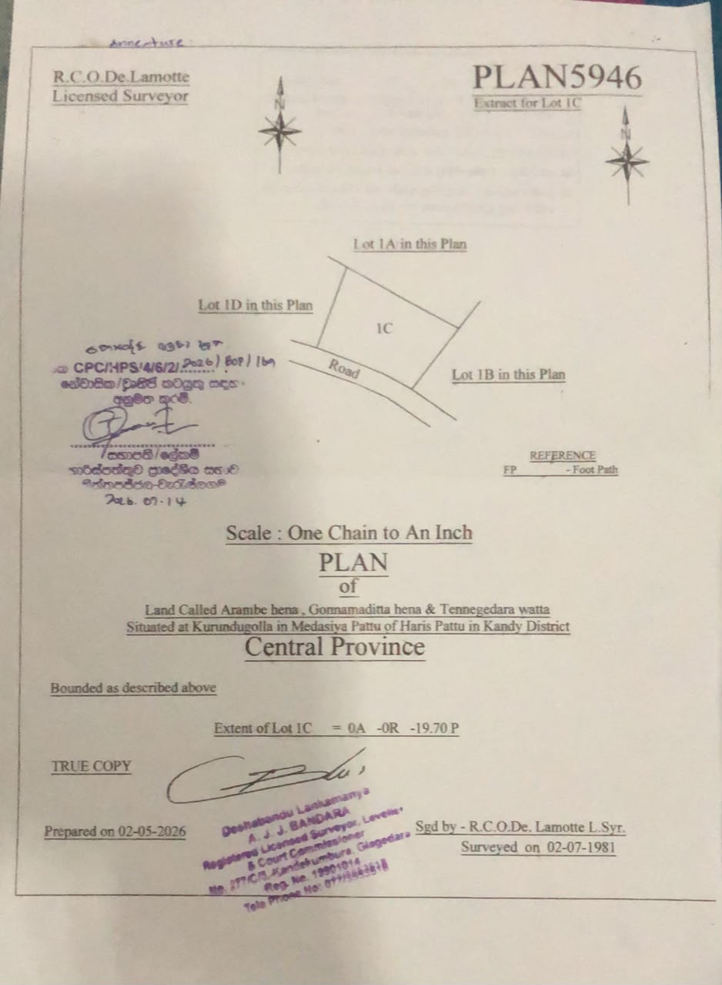
Multimodal Land Intelligence
The image itself contributes evidence to the analysis.
01
Parse the PDF or image
02
Extract boundaries, area, roads and location clues
03
Normalize and geocode the location
04
Retrieve nearby OpenStreetMap features
05
Generate opportunities, risks and verification gaps
Location confidence is reported because a broad district match cannot prove an exact parcel location.
SRI LANKA BUSINESS INTELLIGENCE COPILOT
8
Notes:
Land Intelligence accepts a PDF or image.
The parser prepares the document for the vision model.
The vision model extracts boundaries, area, road access, survey details and location clues.
The location is normalized and geocoded, and OpenStreetMap provides nearby roads and facilities.
The system then generates opportunities, risks and verification requirements.”
Transition: “Because this analysis combines several information types, evidence separation is important.”

Slide 9
Evidence boundaries in the land report
DOCUMENT EVIDENCE
EXTERNAL EVIDENCE
MODEL INTERPRETATION
Observed
Enriched
Inferred
Measurements, boundaries, survey numbers, access roads, landmarks and location text
Geocoding match, coordinates, confidence and nearby OpenStreetMap features
Business opportunities, risks, missing information and recommended verification
The report does not replace a surveyor, lawyer, valuer or planning authority.
SRI LANKA BUSINESS INTELLIGENCE COPILOT
9
Notes:
“The report separates information into three categories. Document evidence comes directly from the uploaded plan.
External evidence comes from OpenStreetMap.
Model interpretation contains business opportunities, risks and recommendations.
This separation helps prevent an AI interpretation from being presented as a surveyed fact.”
Important line:
“The system supports early-stage decisions, but it does not replace legal, surveying, valuation or planning professionals.”
Transition: “All this functionality is available through the final user interface.”

Slide 10
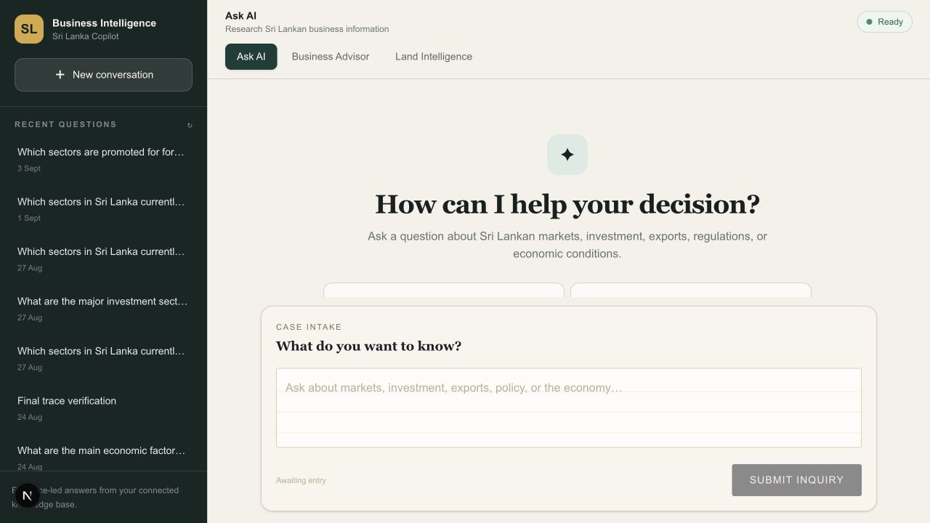
Production-oriented user experience
Conversation history, fixed prompting and source inspection support a longer research session.
Ask AI, Business Advisor and Land Intelligence remain available from one responsive interface.
SRI LANKA BUSINESS INTELLIGENCE COPILOT
10
Notes:
“The interface combines Ask AI, Business Advisor and Land Intelligence.
Conversation history appears in the sidebar, and users can restore previous conversations.
The prompt area remains fixed while messages scroll.
Source information appears at the end of the relevant answer, where users can inspect the supporting documents.”
“The land report also includes an ‘Ask Business Advisor about this land’ action. This sends the structured land report into the advisor workflow.”
Transition: “To understand what happens behind the interface, I used LangSmith.”

Slide 11
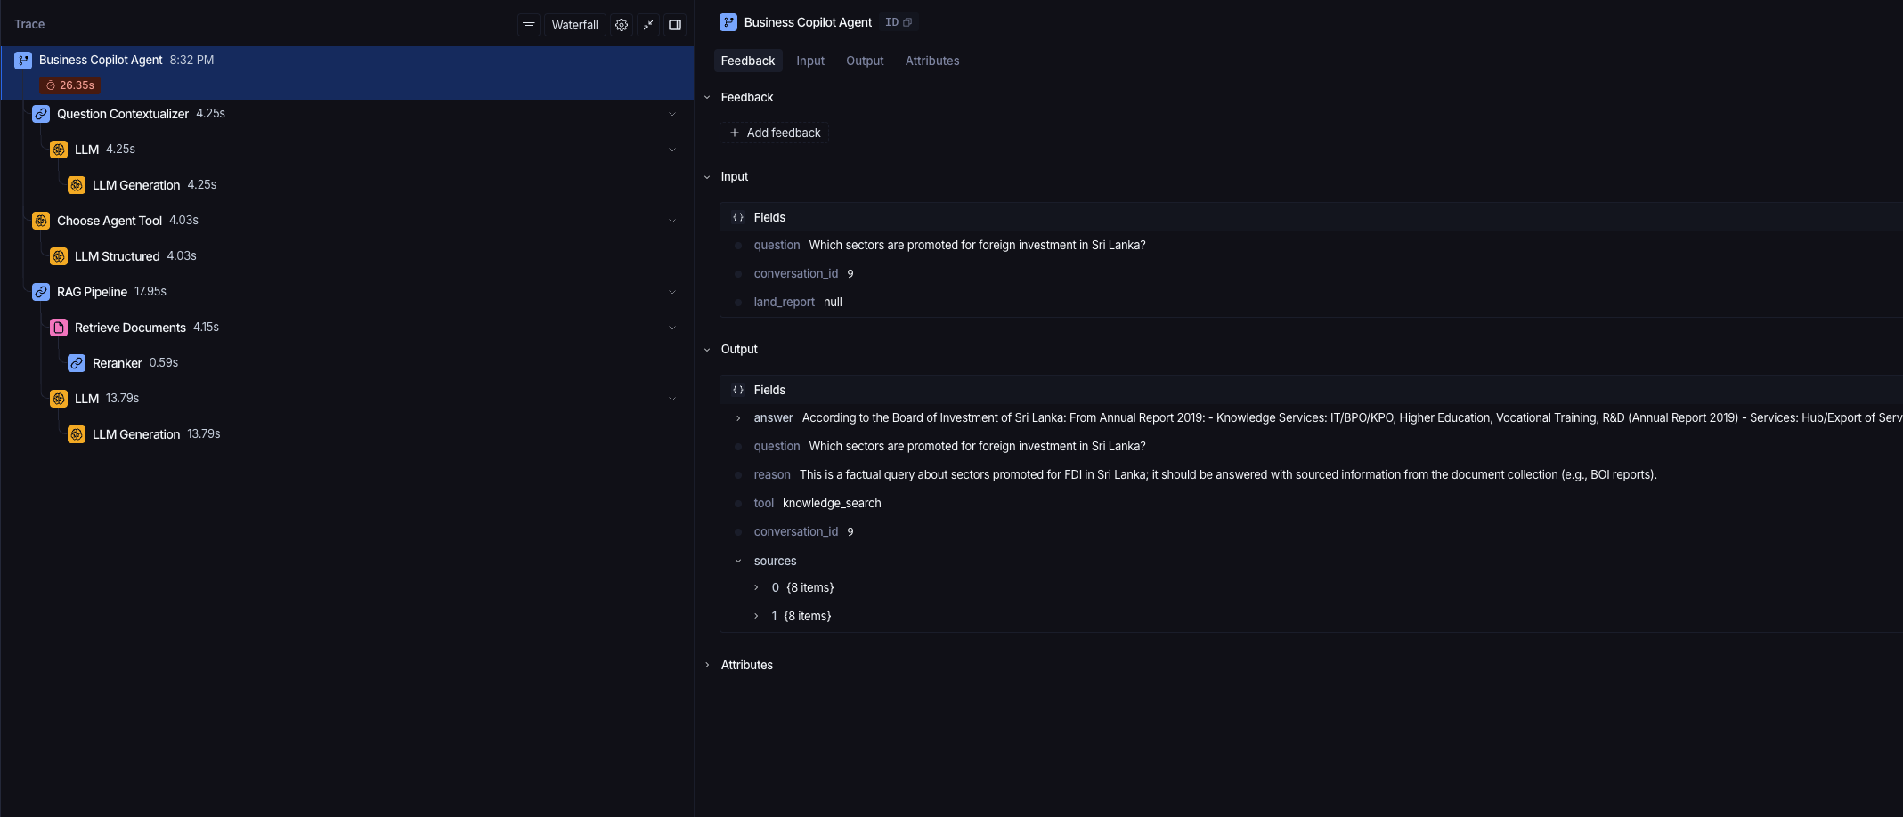
LangSmith observability
A real Agent run exposes the model decision and downstream tools.
1
Contextualize the follow-up question
2
Choose Knowledge Search and record the reason
3
Retrieve, rerank and generate a sourced answer
SRI LANKA BUSINESS INTELLIGENCE COPILOT
11
Notes:
“This screenshot shows a real Business Copilot Agent trace. The root represents the complete request.
First, the question is contextualized using conversation history.
Next, Choose Agent Tool selects Knowledge Search and records the reason. The RAG pipeline then retrieves documents, reranks them and generates the answer.”
“The root output contains the answer, selected tool, routing reason, conversation ID and sources. This allows me to explain exactly how the agent reached the result.”
If asked why a trace step is sometimes missing:
“The Question Contextualizer may not appear for a first question because there is no previous conversation to contextualize.”
Transition: “I also measured the retrieval quality instead of relying only on demonstrations.”

Slide 12
Retrieval evaluation
Thirty benchmark questions compare the baseline with the production retrieval pipeline.
The baseline slightly outperformed reranking on this dataset.
Strongest coverage
Investment 100%
Agriculture 80%
Export 80%
Largest gaps
Statistics 20%
Tax and compliance 0%
The result identifies data coverage and reranker tuning as measurable improvement areas.
SRI LANKA BUSINESS INTELLIGENCE COPILOT
12
Notes:
“I created a benchmark of thirty questions across investment, agriculture, exports, economy, statistics, tourism and tax topics.
Vector-only retrieval achieved 70 percent Hit at three. The vector-plus-reranker pipeline achieved 66.7 percent.”
“The reranker did not improve the result on this benchmark.
This identifies a real improvement area rather than something to hide. Investment achieved 100 percent coverage, while statistics and tax showed the largest gaps.”
If asked what Hit@3 means:
“Hit at three checks whether at least one expected source appears in the first three returned documents.”
If asked what MRR means:
“MRR rewards the system for placing the first relevant source higher in the results.”
If asked what Precision@3 means:
“Precision at three measures how many of the first three results came from an expected authority.”
Transition: “Based on the implementation and evaluation, this is the current requirement coverage.”

Slide 13
Final project requirement coverage
Requirement | Status | Evidence
RAG | Complete | pgvector retrieval, reranking and citations
Agents | Complete | Runtime tool selection, memory and routing reason
Tracing | Complete | Agent and Land Intelligence LangSmith traces
Multimodal | Complete | PDF/image land-plan interpretation
Evaluation | Complete | 30 questions, baseline, metrics and failures
Web application | Complete | FastAPI and responsive Next.js interface
Deployment | Pending | Production configuration prepared; public URL remains
Presentation | Ready | Final deck, live demo flow and evidence screenshots
The remaining submission risk is the public deployment URL.
SRI LANKA BUSINESS INTELLIGENCE COPILOT
13
Notes:
“The project covers the main technical requirements: RAG, dynamic agent routing, tracing, multimodal analysis, evaluation and a working web interface.
The presentation and demonstration materials are also ready.”
“The remaining submission risk is the public deployment URL. Until deployment is complete, I will describe it accurately as a working local web application.”
Transition: “I will now show how these components work together in the live demonstration.”

Slide 14
Live demonstration
A short sequence proves grounding, memory, multimodal analysis and agent behavior.
1
2
3
4
5
Ask AI
Follow up
Inspect sources
Analyze land
Ask Advisor
Investment question
Conversation memory
Document evidence
Vision + location
Recommendation
DEMO QUESTION
Which sectors are promoted for foreign investment in Sri Lanka?
Backup: keep the trace screenshots and completed land report open in separate tabs.
SRI LANKA BUSINESS INTELLIGENCE COPILOT
14
Notes:
“My demonstration has five parts.
First, I will ask a factual investment question. Then I will ask a follow-up question to demonstrate memory. I will inspect the sources, analyse a land plan and finally send the report to Business Advisor.”
Use these questions:
“Which sectors are promoted for foreign investment in Sri Lanka?”
“Which of those sectors have the strongest export potential?”
“Based on this land report, which business opportunities appear most suitable, and what should be verified first?”
Transition after the demo: “The demonstration shows the working system, but the project also has measurable limitations.”

Slide 15
Measured limitations and next steps
Current limitations
Next iteration
The reranker trails the vector-only baseline on the current benchmark.
Statistics and tax sources need broader document coverage.
Vision quality depends on scan clarity and legibility.
OpenStreetMap coverage and geocoding precision vary by location.
Public deployment remains pending.
Expand the official document collection in weak categories.
Tune or replace the reranker using domain-labelled examples.
Add human-reviewed answer-quality and land-task scoring.
Complete production deployment and monitoring.
Add legal, planning and environmental datasets where permitted.
The system supports decisions. It does not replace professional due diligence.
SRI LANKA BUSINESS INTELLIGENCE COPILOT
15
Notes:
“The evaluation shows that the reranker requires domain-specific tuning. Statistics and tax also need stronger document coverage. Land analysis depends on image clarity, and OpenStreetMap coverage varies by location. Public deployment remains unfinished.”
“The next iteration would expand the document collection, tune or replace the reranker, add human-reviewed answer-quality scoring and complete production deployment.”
Important line:
“These limitations are clearly reported so users understand what the system can and cannot verify.”
Transition: “I will finish with the project’s main contribution.”

Slide 16
CONCLUSION
Grounded research and land intelligence in one traceable application
The project combines official documents, agent tool selection, multimodal analysis and visible evidence to support Sri Lankan business decisions.
Questions
Live demo available
Notes:
“The Sri Lanka Business Intelligence Copilot brings official-document research, agent routing and multimodal land analysis into one traceable application. It provides answers and recommendations while keeping the supporting evidence visible.”
“The project demonstrates RAG, dynamic tool selection, conversation memory, multimodal processing, evaluation and LangSmith observability. Thank you.
I am happy to answer questions or demonstrate any part of the system again.”

