Slide 1


Selenium Intro-01
By Mithilesh Singh

Slide 2


Selenium
Selenium is a community which provides automated testing framework, it is used to validate web applications
across different platforms(different browsers) using supported programming language like java, C#, python etc.

Slide 3

Selenium community is collection of tools, here is the list of tools.
1. SELENIUM INTEGRATED DEVELOPMENT ENVIRONMENT(IDE). "SHINYA KASATANI "​
2. SELENIUM REMOTE CONTROL(RC). " PAUL HAMMANT"​
3. WEBDRIVER. "SIMON STEWART"​
4. SELENIUM GRID. "PATRICK LIGHTBODY"​

Slide 4
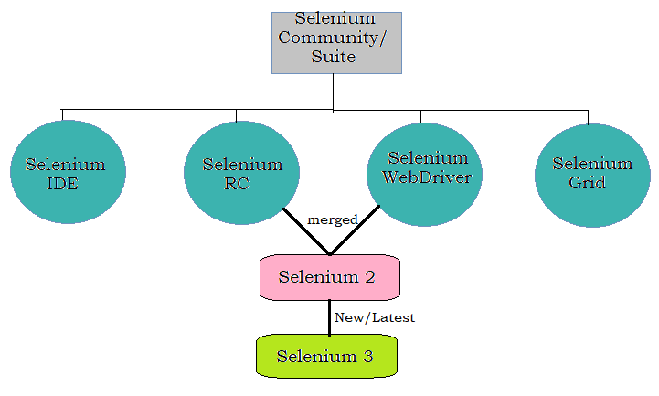
Diagrammatic Representation

Slide 5

Why selenium is called so?
It is very interesting to discuss, During selenium's development
another automated testing framework was very much popular
named "Mercury Interactive". selenium was getting popular and
other's like mercury losing the market, since selenium is well known antidote for mercury poisoning
this name is took by Jason teammate.

Slide 6
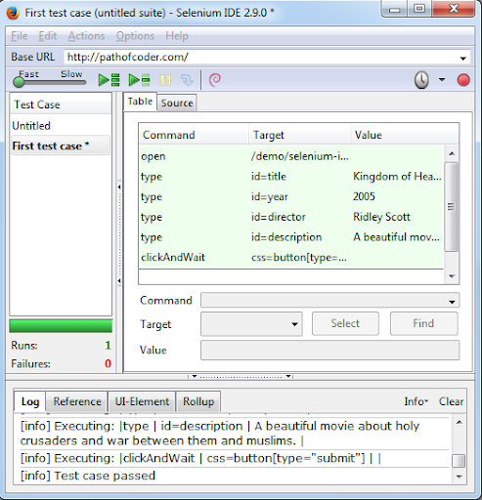
Selenium integrated development Environment(IDE):
It is the Firefox plugin, it has recording and play back option. Advantages:
1.Easy to use 2.People can work without coding knowledge
Disadvantages:
1.only available for Firefox 2.Test execution is very compare to wend river 3.to add some extra steps needs to do recording from the scratch again.

Slide 7
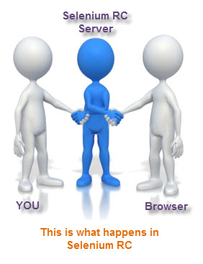
Selenium RC:
Advantage:
1. Faster execution than selenium IDE
2. Supports different browsers
3. Helpful for data driven testing
Disadvantage:
1. Installation is more complicated than IDE
2. Slower execution than WebDriver.
3. need selenium RC server.
4. must have knowledge of programming language

Slide 8

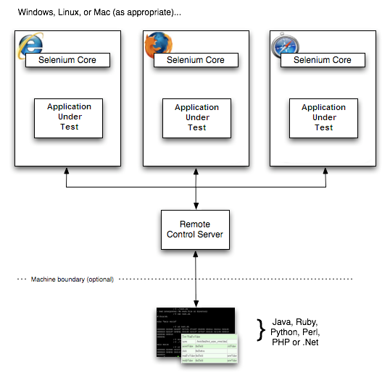
How does the Selenium RC work?
The working of the Selenium RC is based on its components. Each of the components has a role to play in running the test scripts. 1. Selenium Server 2. Client Libraries
The Selenium Server which launches and kills browsers, interprets and runs the Selenese commands passed from the test program, and acts as an HTTP proxy, intercepting and verifying HTTP messages passed between the browser and the AUT.
Client libraries which provide the interface between each programming language and the Selenium RC Server.

Slide 9

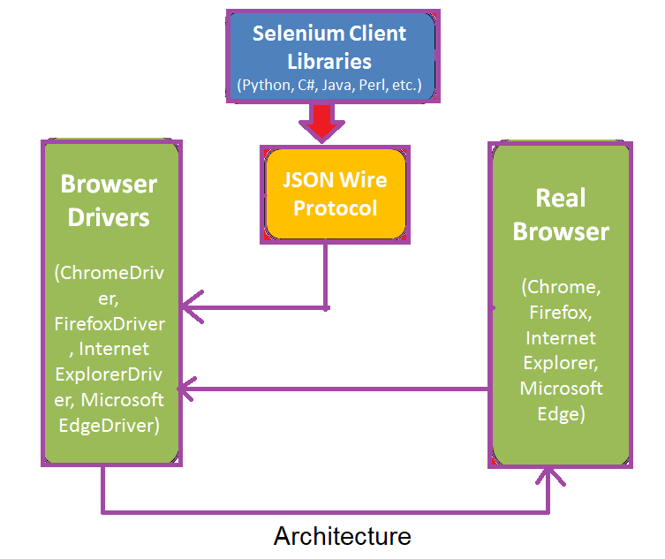
Selenium WebDriver
selenium web drive is an open source collection of API which helps to automate web applications with direct browser interaction at OS level
It mainly supports browsers like Firefox, Chrome, Safari and Internet Explorer.
Language supports: java, .Net, php, Python, perl, Ruby

Slide 10
How webDriver differs from Selenium RC?
WebDriver is a tool for testing web applications across different browsers using different programming languages.
You are now able to make powerful tests because WebDriver allows you to use a programming language of your choice in designing your tests.
WebDriver is faster than Selenium RC because of its simpler architecture.
WebDriver directly talks to the browser while Selenium RC needs the help of the RC Server in order to do so.
WebDriver's API is more concise than Selenium RC's.
WebDriver can support HtmlUnit while Selenium RC cannot.
The only drawbacks of WebDriver are:
It cannot readily support new browsers, but Selenium RC can.
It does not have a built-in command for automatic generation of test results.

Slide 11

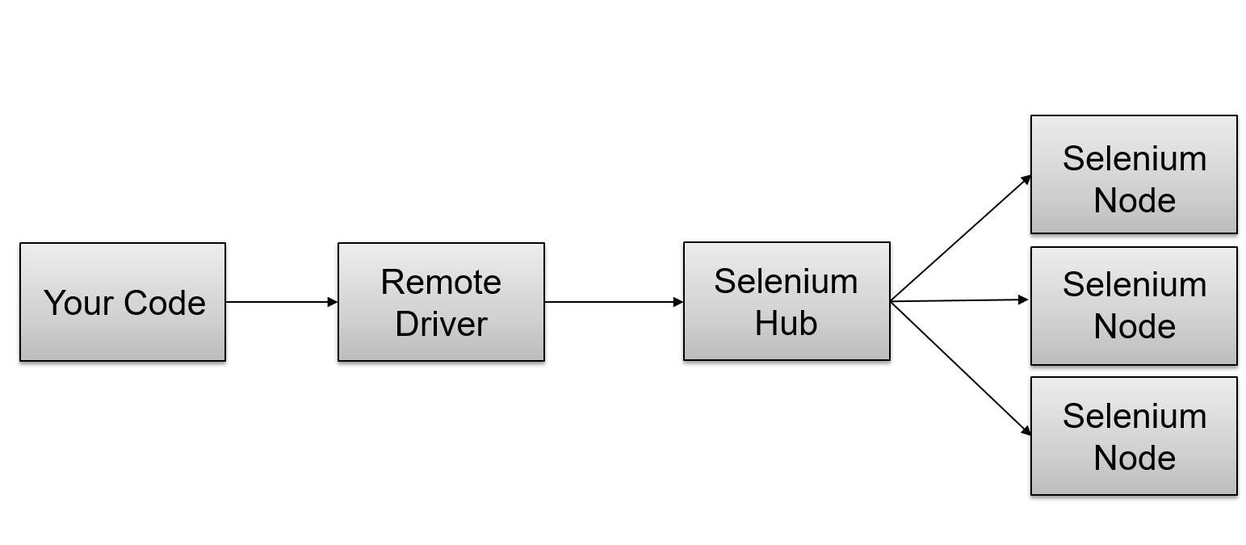
Selenium grid
Selenium Grid allows the execution of WebDriver scripts on remote machines (virtual or real) by routing commands sent by the client to remote browser instances.
Selenium Grid allows us to run tests in parallel on multiple machines

Slide 12
When to use Grid?
TO RUN YOUR TESTS AGAINST MULTIPLE BROWSERS, MULTIPLE VERSIONS OF BROWSER, AND BROWSERS RUNNING ON DIFFERENT OPERATING SYSTEMS.
TO REDUCE THE TIME IT TAKES FOR THE TEST SUITE TO COMPLETE A TEST PASS.

Slide 13



