Slide 1

UNIX Shell Scripting Training

Slide 2
Introduction to shell scripting
UNIX shell scripts are text files that contain sequences of UNIX commands
It has variables, conditionals and loops
Like high-level source files, a programmer creates shell scripts with a text editor or vi Editor
Shell scripts do not have to be converted into machine language by a compiler.This is because the UNIX shell acts as an interpreter when reading script files
As an interpreter reads the statements in a program file, it immediately translates them into executable instructions, and causes them to run
After you create a shell script, you simply tell the operating system that the file is a program that can be executed

Slide 3
Using variables
A variable is a character string to which we assign a value. The value assigned could be a number, text, filename, device, or any other type of data.
The name of a variable can contain only letters ( a to z or A to Z), numbers ( 0 to 9) or the underscore character ( _).
Defining variable:
variable_name=variable_value
Accessing Values:
Message=“hello”
echo $Message
Unsetting Variables:
Unsetting or deleting a variable tells the shell to remove the variable from the list of variables that it tracks. Once you unset a variable, you would not be able to access stored value in the variable.
unset variablename

Slide 4
Special Variables
Variable | Description
$0 | The filename of the current script.
$n | These variables correspond to the arguments with which a script was invoked. Here n is a positive decimal number corresponding to the position of an argument (the first argument is $1, the second argument is $2, and so on).
$# | The number of arguments supplied to a script.
$* | All the arguments are double quoted. If a script receives two arguments, $* is equivalent to $1 $2.
$@ | All the arguments are individually double quoted. If a script receives two arguments, $@ is equivalent to $1 $2.
$? | The exit status of the last command executed.
$$ | The process number of the current shell. For shell scripts, this is the process ID under which they are executing.
$! | The process number of the last background command.

Slide 5
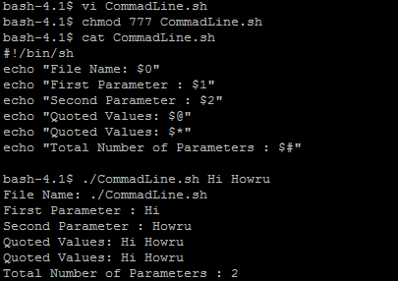
Command-line arguments
The command-line arguments $1, $2, $3,...$9 are positional parameters, with $0 pointing to the actual command, program, shell script, or function and $1, $2, $3, ...$9 as the arguments to the command.
Eg:

Slide 6
Operators
Arithmetic Operators.
Relational Operators.
Boolean Operators.
String Operators.
File Test Operators.

Slide 7
Arithmetic Operators
a holds 10 and variable b holds 20
Operator | Description | Example
+ | Addition - Adds values on either side of the operator | `expr $a + $b` will give 30
- | Subtraction - Subtracts right hand operand from left hand operand | `expr $a - $b` will give -10
* | Multiplication - Multiplies values on either side of the operator | `expr $a \* $b` will give 200
/ | Division - Divides left hand operand by right hand operand | `expr $b / $a` will give 2
% | Modulus - Divides left hand operand by right hand operand and returns remainder | `expr $b % $a` will give 0
= | Assignment - Assign right operand in left operand | a=$b would assign value of b into a
== | Equality - Compares two numbers, if both are same then returns true. | [ $a == $b ] would return false.
!= | Not Equality - Compares two numbers, if both are different then returns true. | [ $a != $b ] would return true.

Slide 8
Relational Operators:
Assume variable a holds 10 and variable b holds 20 then
Operator | Description | Example
-eq | Checks if the value of two operands are equal or not, if yes then condition becomes true. | [ $a -eq $b ] is not true.
-ne | Checks if the value of two operands are equal or not, if values are not equal then condition becomes true. | [ $a -ne $b ] is true.
-gt | Checks if the value of left operand is greater than the value of right operand, if yes then condition becomes true. | [ $a -gt $b ] is not true.
-lt | Checks if the value of left operand is less than the value of right operand, if yes then condition becomes true. | [ $a -lt $b ] is true.
-ge | Checks if the value of left operand is greater than or equal to the value of right operand, if yes then condition becomes true. | [ $a -ge $b ] is not true.
-le | Checks if the value of left operand is less than or equal to the value of right operand, if yes then condition becomes true. | [ $a -le $b ] i

Slide 9
Boolean Operators
Assume variable a holds 10 and variable b holds 20
Operator | Description | Example
! | This is logical negation. This inverts a true condition into false and vice versa. | [ ! false ] is true.
-o | This is logical OR. If one of the operands is true then condition would be true. | [ $a -lt 20 -o $b -gt 100 ] is true.
-a | This is logical AND. If both the operands are true then condition would be true otherwise it would be false. | [ $a -lt 20 -a $b -gt 100 ] is false.

Slide 10
String Operators
Assume variable a holds "abc" and variable b holds "efg"
Operator | Description | Example
= | Checks if the value of two operands are equal or not, if yes then condition becomes true. | [ $a = $b ] is not true.
!= | Checks if the value of two operands are equal or not, if values are not equal then condition becomes true. | [ $a != $b ] is true.
-z | Checks if the given string operand size is zero. If it is zero length then it returns true. | [ -z $a ] is not true.
-n | Checks if the given string operand size is non-zero. If it is non-zero length then it returns true. | [ -n $a ] is not false.
str | Check if str is not the empty string. If it is empty then it returns false. | [ $a ] is not false.

Slide 11
File tests operators
Test can be used to test the various file attributes like its type (file, directory or symbolic link) or its permissions (read, write, execute, SUID, etc )
File-related Tests with test
-f file | file exists and is regular file
-r file | file exists and is readable
-w file | file exists and is writable
-x file | file exists and is executable
-d file | file exists and is directory
-s file | file exists and has a size greater than zero
-e file | file exists
-u file | file exists and has SUID bit set
-k file | file exists and has a sticky bit set
-L file | file exists and is a symbolic link
f1 -nt f2 | f1 is newer than f2
f1 -ot f2 | f1 is older than f2
f1 -et f2 | f1 is linked to f2

Slide 12
The if CONDITIONAL
FORM 1
if command is successful
then
execute commands
fi
FORM2
if command is successful
then
execute commands
else
execute commands
fi
FORM3
if command is successful
then
execute commands
elif command is successful
then ....
else ......
fi
Eg:ifeg.sh
#!/bin/bash
#checks department exists or not
echo "enter a department:"
read department
if grep "$department" emplist.lst
then
echo "Department found"
else
echo "Department not found"
fi

Slide 13
Case statement
echo "Enter character:\c"
read var
case $var in
[a-z])
echo "you entered a lower case alphabet ";;
[A-Z])
echo "you entered a Upper case alphabet";;
?)
echo "you entered special character";;
*)
echo "you entered more than one character";;
esac
syntax
case expression in
pattern1) ;;
pattern2) ;;
pattern3) ;;
.......
Esac

Slide 14
While Looping
Loops let you perform a set of instructions repeatedly.
Shell features 3 types of loops: while, until, and for
All of them repeat the instruction set enclosed by certain keywords as often as their control command permits.
While loop performs set of instructions till the controls command retunes a true exit status
While loop syntax: While condition is true do Commands….. Done

Slide 15
For loop
Syntax:
for variable in list
do
commands….
done
Eg:
for var in 0 1 2 3 4 5 6 7 8 9
do
echo $var
done

Slide 16
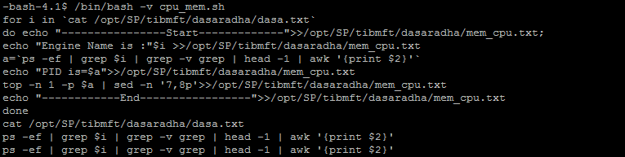
Debug options
/bin/bash –v
Echo’s each command before executing it
Eg:

Slide 17
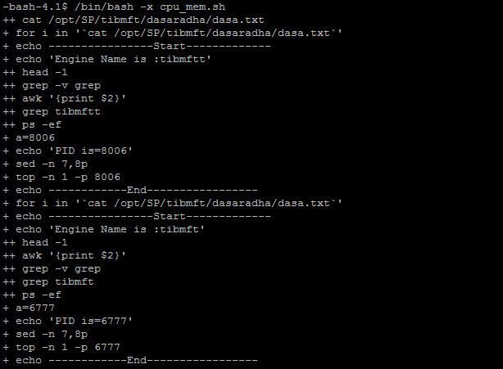
Debug cont..
/bin/bash –x
Echo’s the results of each command
Eg:/bin/bash -x cpu_mem.sh

Slide 18
Debug conn..
/bin/bash –n
Eg:
/bin/bash -n cpu_mem.sh

Slide 19
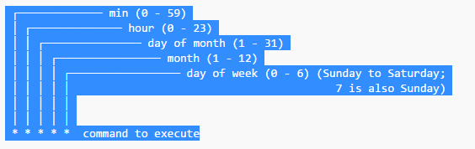
Cron
Cron is a time-based job scheduler in Unix-like computer operating systems

