Slide 1

Learning Unix

Slide 2
Introduction: What is Unix?
An operating system
Developed at AT&T Bell Labs in the 1960’s
Command Line Interpreter
Currently there are different versions and variants of UNIX such as SunOS, Linux, Solaris, BSD,AIX,HP-UX…
It is a multiuser operating system

Slide 3
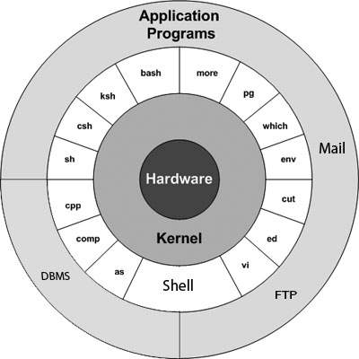
Unix Architecture
Kernel
Shell
Commands and Utilities
Files and Directories

Slide 4
Unix Commands
Command | Meaning
ls | list files and directories
ls -a | list all files and directories
mkdir | make a directory
cd directory | change to named directory
cd | change to home-directory
cd ~ | change to home-directory
cd .. | change to parent directory
pwd | display the path of the current director

Slide 5
Commands continue
Command | Meaning
cp file1 file2 | copy file1 and call it file2
mv file1 file2 | move or rename file1 to file2
rm file | remove a file
rmdir directory | remove a directory
cat file | display a file
less file | display a file a page at a time
head file | display the first few lines of a file
tail file | display the last few lines of a file
grep 'keyword' file | search a file for keywords
wc file | count number of lines/words/characters in file

Slide 6
Command: ls
ls has many options
  -l long list (displays lots of info)
  -t sort by modification time
  -S sort by size
  -h list file sizes in human readable format
  -r reverse the order
“man ls” for more options
Options can be combined: “ls -ltr”

Slide 7
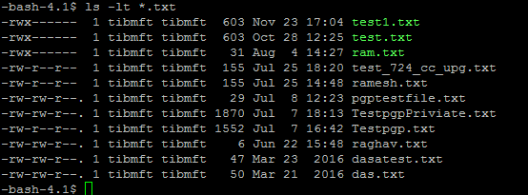
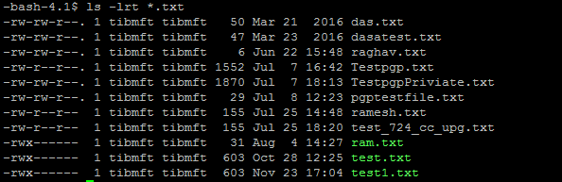
ls Cont..
ls –lt and ls –lrt output

Slide 8
Commad: gzip and gunzip
Gzip: This reduces the size of a file, thus freeing valuable disk space. For example, type
gzip <<filenme>> →output filename.gz
To expand the file, use the gunzip command.
gunzip <<filename.gz>> →output filename

Slide 9
Command: find
This searches through the directories for files and directories with a given name, date, size, or any other attribute you care to specify. It is a simple command but with many options - you can read the manual by typing man find.
To search for all fies with the extention .txt, starting at the current directory (.) and working through all sub-directories, then printing the name of the file to the screen, type
find . -name "*.txt" -print
To find files over 1Mb in size, and display the result as a long listing, type
find . -size +1M -ls

Slide 10
Displaying a file
Various ways to display a file in Unix
  cat
  less
  head
  tail

Slide 11
Command: cat
Dumps an entire file to standard output
Good for displaying short, simple files

Slide 12
Command: less
“less” displays a file, allowing forward/backward movement within it
  return scrolls forward one line, space one page
  y scrolls back one line, b one page
use “/” to search for a string
Press Shift+G to go the end
Use “?” to search for sting from end
Press q to quit

Slide 13
Command: head
“head” displays the top part of a file
By default it shows the first 10 lines
-n option allows you to change that
“head -n50 file.txt” displays the first 50 lines of file.txt

Slide 14
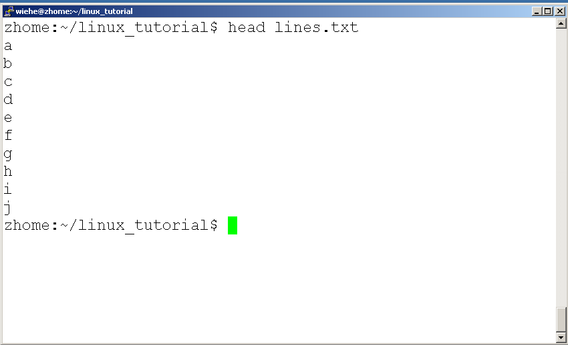
Command: head
Here’s an example of using “head”:

Slide 15
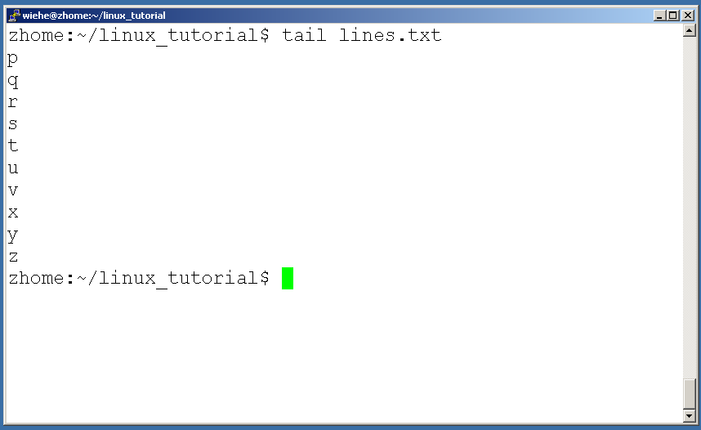
Command: tail
Same as head, but shows the last lines

Slide 16
Command: rm
To remove a file “recursively”: rm –r
Used to remove all files and directories
Be very careful, deletions are permanent in Unix/Linux

Slide 17
Input/Output Redirection (“piping”)
Programs can output to other programs called “piping”
“program_a | program_b”
  program_a’s output becomes program_b’s input
“program_a > file.txt”
  program_a’s output is written to a file called “file.txt”
“program_a < input.txt”
  program_a gets its input from a file called “input.txt”

Slide 18
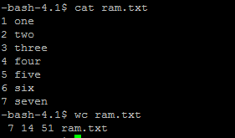
Command: wc
To count the characters, words, and lines in a file use “wc”
The first column in the output is lines, the second is words, and the last is characters

Slide 19
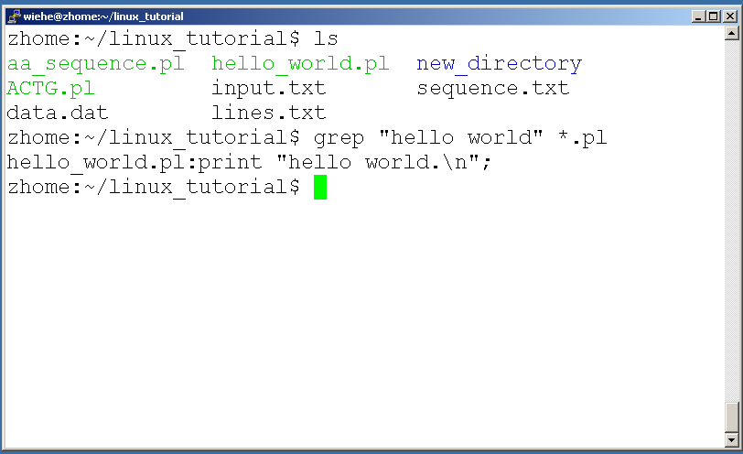
Command: grep
To search files in a directory for a specific string use “grep”

Slide 20
ssh, scp
ssh is used to securely log in to remote systems, successor to telnet
ssh [username]@[hostname]
Scp is used to copy files to/from remote systems, syntax is similar to
scp [local path] [usernme]@[hostname]:[remote file path]
cp /opt/SP/tibmft/training/new.txt /opt/SP/tibmft/
To copy to remote
scp /opt/SP/tibmft/training/new.txt user@IP : /opt/SP/tibmft
Or, you could specify a remote location as the source location if you want to download files
scp user@IP:/opt/SP/tibmft/training/new.txt /opt/SP/tibmft/training

Slide 21
FTP and SFTP
sftp username@host →Default port
sftp -oport=<<port>> username@host →Other than default port
Commads:cd,put,get,mput,mget..etc

Slide 22

AWK
AWK is an interpreted programming language. It is very powerful and specially designed for text processing and typically used as a data extraction and reporting tool.
EXAMPLE:
To get size and filename from ls –lrt output

Slide 23
Sed
Stream editor for filtering and transforming text
SED can be used in many different ways, such as:
Text substitution,
Selective printing of text files,
In-a-place editing of text files,
Non-interactive editing of text files, and many more.

Slide 24
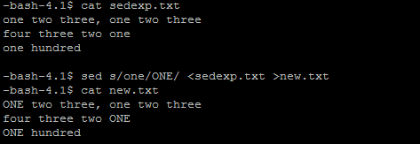
Sed Continue
Examples:
sed s/one/ONE/ <sedexp.txt >new.txt
echo /usr/local/bin | sed 's|/usr/local/bin|/common/bin|'
/common/bin

