Slide 1
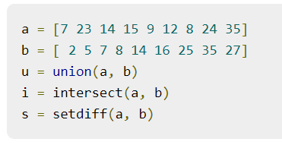
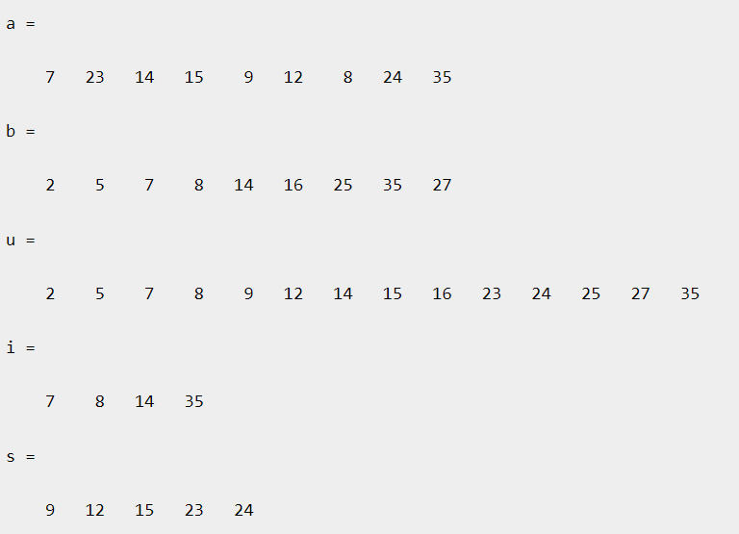
Set Operations in Matlab
Any array can be treated as a set in Matlab
Can you create your own functions for
union
intersection
and setdiff

Slide 2
Cartesian Product of two sets
You have 3 pants and 3 shirts
Generate all possible ordered pairs

Slide 3
%Cartprod
clear all
x=["p1 "; "p2 "; "p3 "]; % 3 strings in a set
y=["s1"; "s2"; "s3"]; % 3 strings in a set
cartprod=[] ; % for storing
for i=1:3
a=x(i); % retrieve ith element from x
for j=1:3
b=y(j);% retrieve ith element from y
cartprod=[cartprod; strcat(a,b)]; % append
end
end
cartprod
"p1 s1"
"p1 s2"
"p1 s3"
"p2 s1"
"p2 s2"
"p2 s3"
"p3 s1"
"p3 s2"
"p3 s3"
String Concatenation

Slide 4
cell array
A cell array is a data type with indexed data containers called cells, where each cell can contain any type of data. Cell arrays commonly contain either lists of text, combinations of text and numbers, or numeric arrays of different sizes. Refer to sets of cells by enclosing indices in smooth parentheses, (). Access the contents of cells by indexing with curly braces, {}.

Slide 5
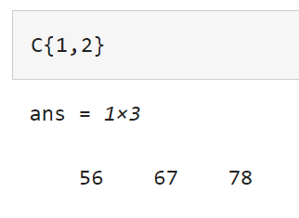
>>C = {'2017-08-16',[56 67 78]}
C=1×2 cell array
{'2017-08-16'} {[56 67 78]}
>>C(2,:) = {'2017-08-17',[58 69 79]};
>>C(3,:) = {'2017-08-18',[60 68 81]}
C=3×2 cell array
{'2017-08-16'} {[56 67 78]}
{'2017-08-17'} {[58 69 79]}
{'2017-08-18'} {[60 68 81]}
Access the contents of cells by indexing with curly braces, {}.

Slide 6
%Cartprod
clear all
x={"p1"; "p2"; "p3"}; % cell array
y={"s1"; "s2"; "s3"};
cartprod=[]
for i=1:3
a=x(i); % retrieve ith element from x
for j=1:3
b=y(j);% retrieve ith element from y
cartprod=[cartprod; strcat(a,b)];
end
end
cartprod
cartprod =
9×1 cell array
{["p1 " "s1"]}
{["p1 " "s2"]}
{["p1 " "s3"]}
{["p2 " "s1"]}
{["p2 " "s2"]}
{["p2 " "s3"]}
{["p3 " "s1"]}
{["p3 " "s2"]}
{["p3 " "s3"]}

Slide 7
Soon you will have to use it along
with permutation and combination
programs

