Slide 1


K. RAMAKRISHNAN COLLEGE OF ENGINEERING
(AUTONOMOUS), SAMAYAPURAM – TRICHY
DEPARTMENT OF CSE(ARTIFICIAL INTELLIGENCE AND MACHINE LEARNING)
CGB1221 – DATABASE MANAGEMENT SYSTEMS
ONLINE SHOPPING APPLICATION DATABASE
PRESENTED BY SUPERVISOR
MITHRA S Mr. P.Nagaraj, M.E.,
8115U24AM036 Assistant Professor / AI&ML
Date of Review : 06.05.2026

Slide 2
PRESENTATION OVERVIEW
Objective
Problem Analysis
System Architecture
Methodology
Entities used
Modules
Implementation
Conclusion
Future Scope

Slide 3
OBJECTIVE
To develop a web-based vegetable shop management system using Flask.
To allow users to browse products, add items to cart, and purchase easily.
To manage product details, cart, and purchase history efficiently.
To provide a simple and user-friendly interface for online shopping.

Slide 4
PROBLEM ANALYSIS
Traditional vegetable shopping lacks digital tracking.
No proper system to manage cart and purchase history.
Manual billing is time-consuming and error-prone.
Lack of centralized system for managing products and users.
Difficulty in maintaining inventory records.

Slide 5
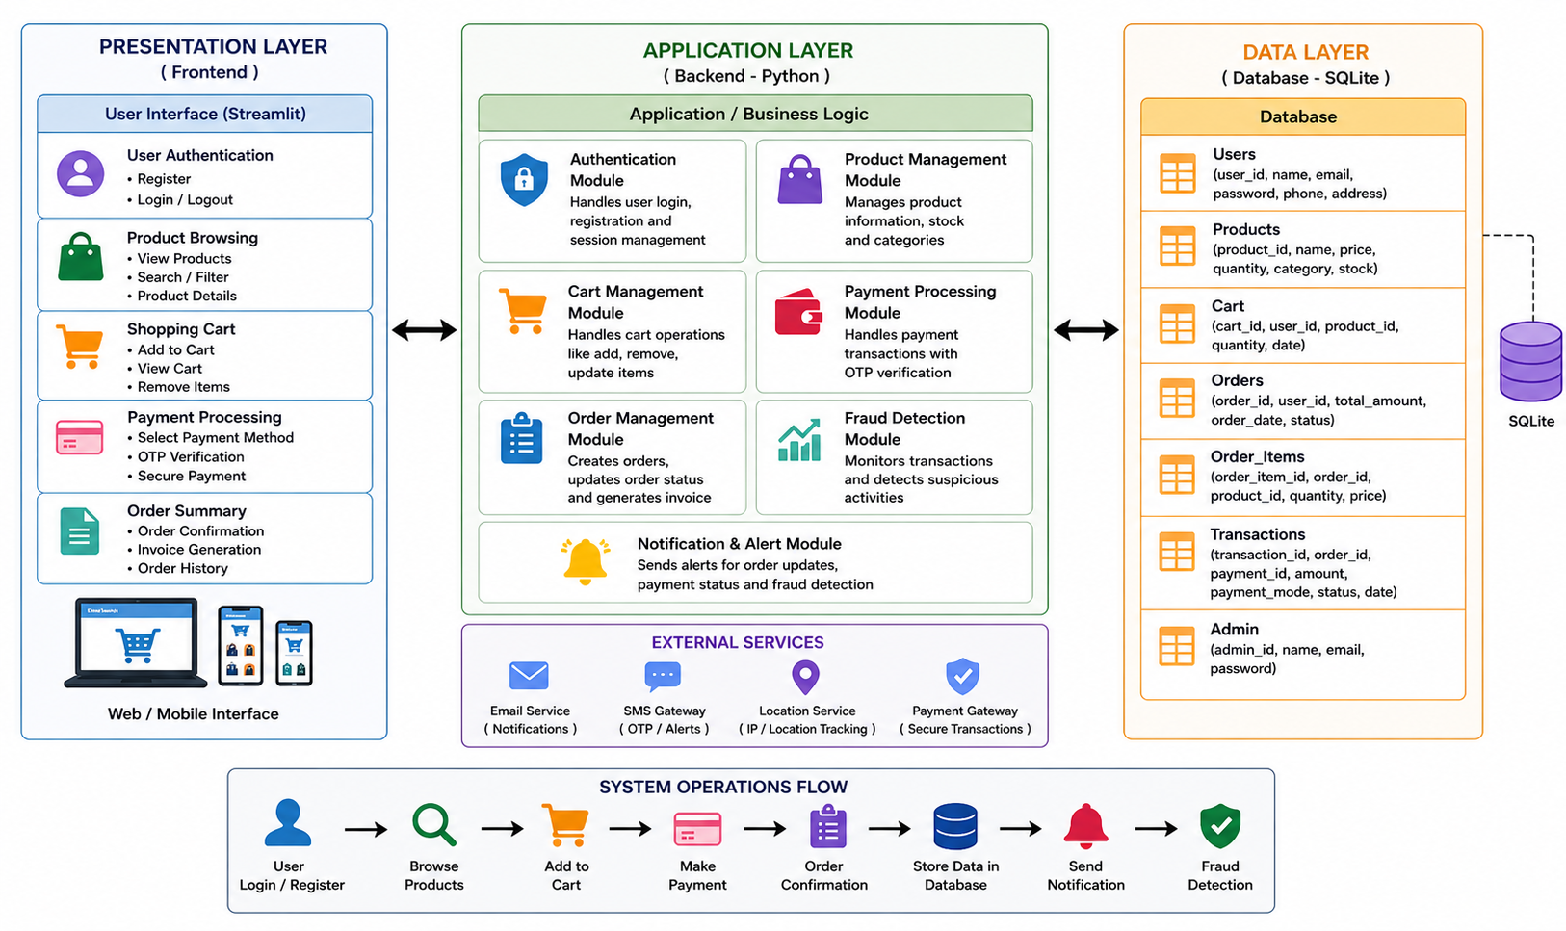
SYSTEM ARCHITECTURE

Slide 6
METHODOLOGY
User authentication using session management
CRUD operations for products
Cart management system
Purchase processing logic
Database interaction using SQLite
Dynamic HTML rendering using Flask

Slide 7
ENTITIES USED
Users
user_id, username, password
Products
product_id, name, price
Cart
cart_id, user_id, product_id
PurchaseHistory
purchase_id, user_id, item, price

Slide 8
MODULES
1. Login Module
Authenticates users using username and password
Maintains user session for secure access
2. Dashboard Module
Displays total products, cart items, and purchase history
Provides quick navigation to all sections
3. Product Module
Allows adding new vegetable products with price
Displays available products for users

Slide 9
MODULES
4. Cart Module
Enables users to add items to cart
Calculates and displays total bill amount
5. Purchase Module
Moves cart items to purchase history after checkout
Clears cart after successful purchase

Slide 10
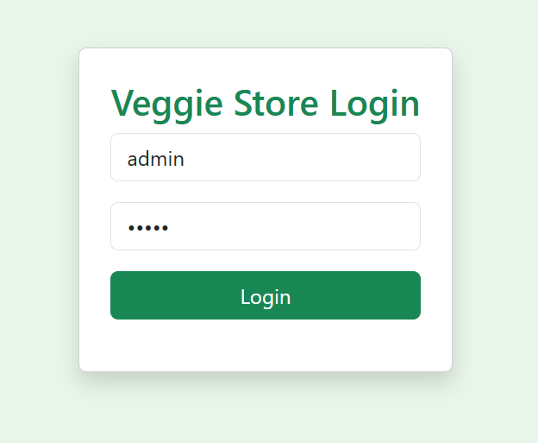
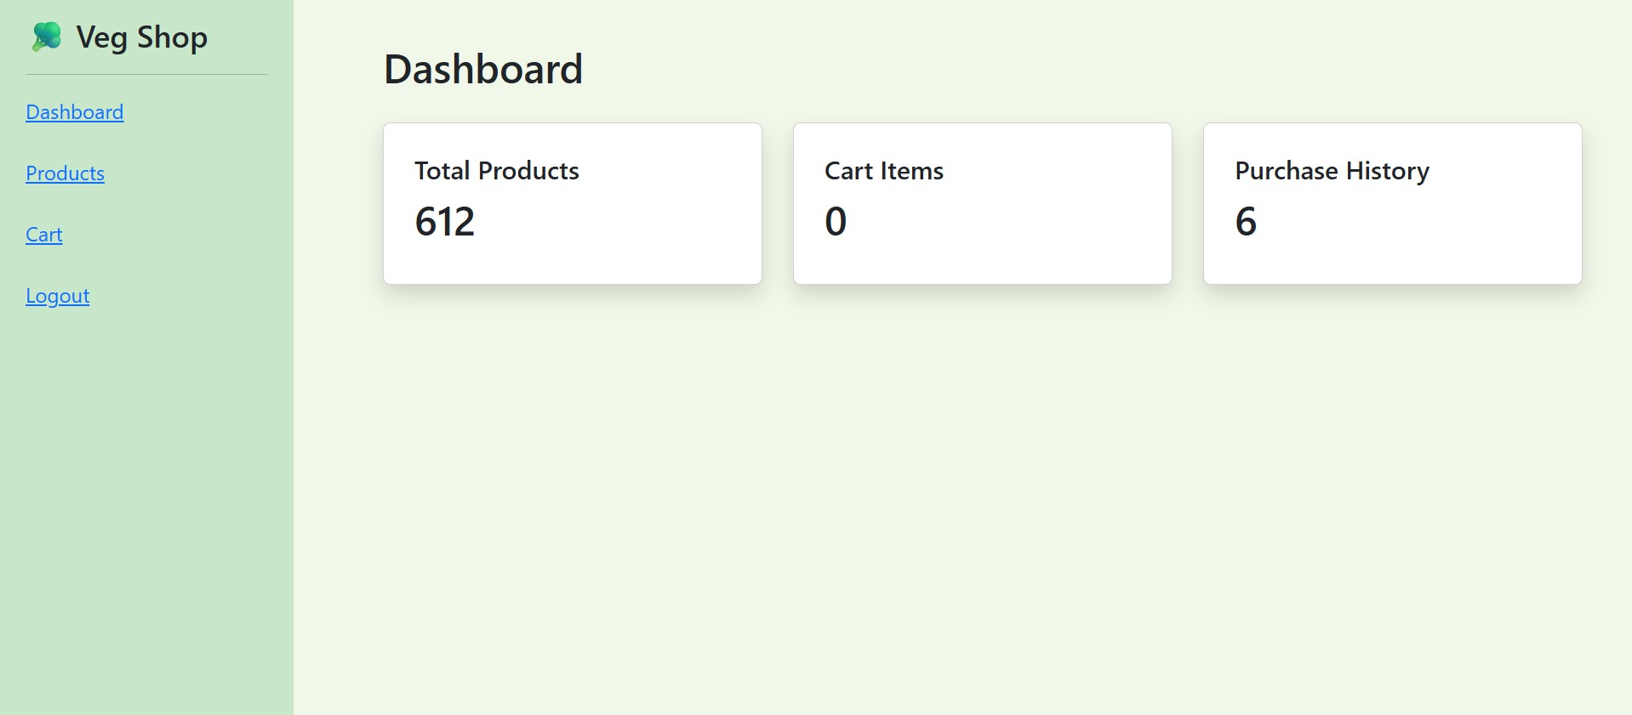
IMPLEMENTATION

Slide 11
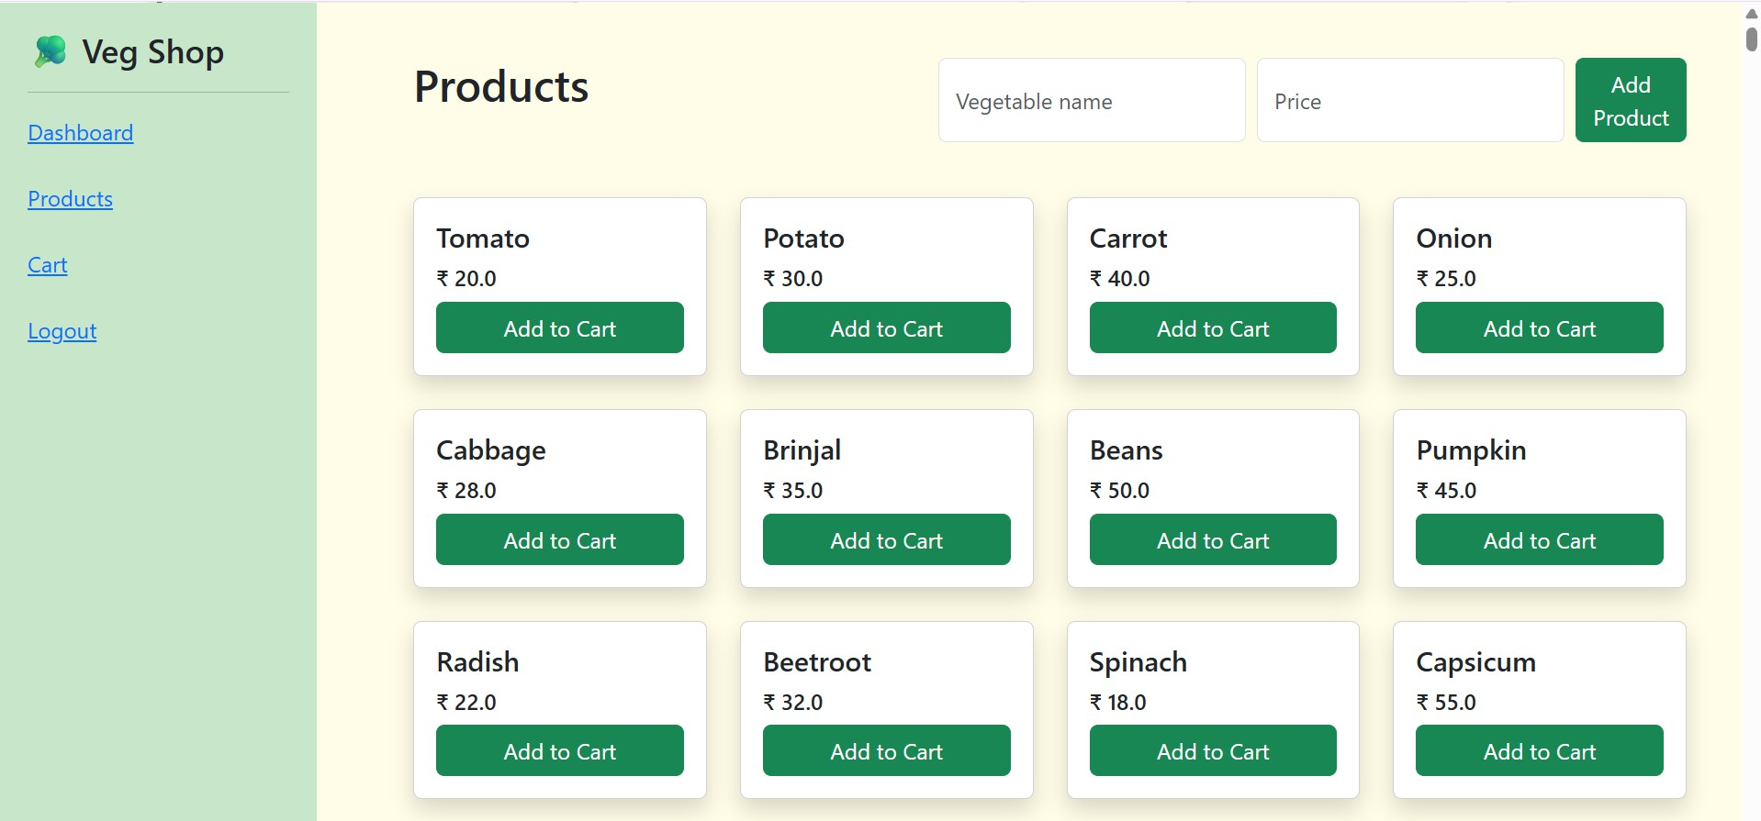
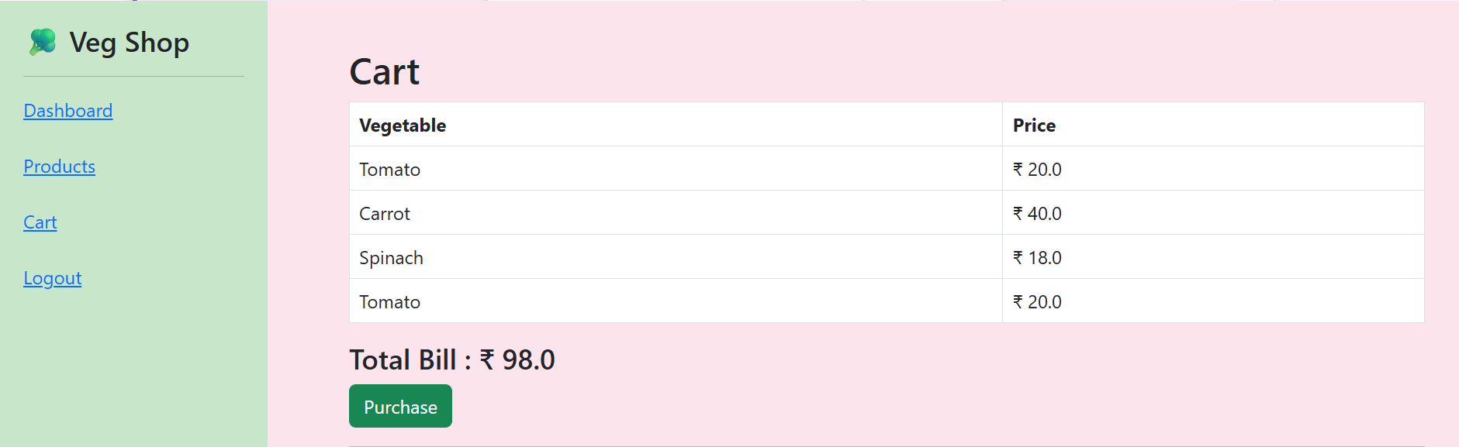
IMPLEMENTATION

Slide 12
CONCLUSION
The system simplifies vegetable shopping process.
Provides efficient cart and purchase management.
Reduces manual work and improves accuracy.
Easy to use and scalable for small businesses.

Slide 13
FUTURE SCOPE
Add payment gateway integration
Implement admin panel for inventory control
Add quantity management for products
Use MySQL instead of SQLite for scalability
Add user registration system
Deploy on cloud (AWS / Heroku)
Add mobile app support

Slide 14


