Slide 1

Capstone Project: Machine Learning on Production Line Data
Professional Certificate in Machine Learning and Artificial Intelligence
Mithran Menon

Slide 2
Introduction & Problem Statement
Objective: Develop a predictive model to classify automotive parts as good or defective based on data collected from multiple manufacturing stations of a leading Tier-1 supplier.
Business Motivation: Early detection of defective parts can reduce production waste, cost, and downtime, improving overall manufacturing efficiency and quality assurance.
Research Question: Determine whether model performance metrics — Precision, Recall, AUC-ROC, and F1-Score — between predicted and observed outcomes fall within an acceptable range for the test dataset.
Why These Metrics Matter:
Capture both false positives and false negatives.
Particularly suited for imbalanced classification problems (defective parts ≪ good parts).
Provide a balanced evaluation of accuracy vs. defect detection sensitivity.

Slide 3
Introduction & Problem Statement
Dataset Overview:
Source: Bosch Production Line Performance (Kaggle) https://www.kaggle.com/competitions/bosch-production-line-performance/overview
Size:
Training: 1,184,687 samples
Test: 1,183,748 samples
Features:
968 numerical
2,140 categorical
1,156 date/time features
Labels: Good (0) vs. Defective (1)
Sampling Strategy:
Used a randomized subset for modeling:
100,000 rows from training data
30,000 rows from test data
Enables faster prototyping and iterative model refinement.

Slide 4
Baseline Models: Logistic Regression & Decision Tree
Models Used (Baseline):
Logistic Regression (L1 Regularization)
Decision Tree (Depth = 5)
Both models tuned using hyperparameter optimization
Key Findings:
Both baseline models were ineffective at detecting defects.
The dataset’s severe class imbalance caused models to predict mostly the majority class (“good parts”).
Logistic Regression (L1):
Predicted only negatives → failed to detect any defective parts.
RMSE: 0.0756 → low numeric error but meaningless for classification.
Precision = 0, Recall = 0, F1 = 0 → collapsed model.
Conclusion: Cannot be used for reliable defect prediction.
Decision Tree (Depth = 5):
Increasing threshold to 0.9 made it more conservative (fewer false positives).
Slightly improved precision, but recall remained poor.
F1 Score: 0.09 → still very weak classification.
Conclusion: Marginally better than Logistic L1, but not deployable.

Slide 5
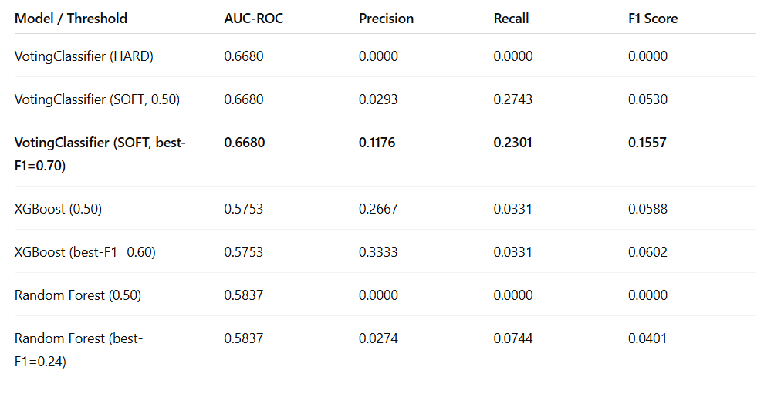
Ensemble Models: VotingClassifier, XGBoost, Random Forest
Soft VotingClassifier (SOFT, best-F1 = 0.70) delivered the best overall performance for this imbalanced dataset.

Slide 6
Ensemble Models: VotingClassifier, XGBoost, Random Forest
Best Performing Model:
VotingClassifier (SOFT, best-F1 = 0.70)
Achieved highest F1 (0.1557) and balanced trade-off between precision and recall.
Confusion Matrix: [TN=19674, FP=195, FN=87, TP=26]
Captured more true positives with moderate false positives.
XGBoost:
Higher precision (0.3333) but very low recall (0.0331).
Confusion Matrix: [TN=19856, FP=8, FN=117, TP=4]
Extremely conservative — predicts almost all samples as “good parts”.
Random Forest: Poor precision and recall overall (F1 = 0.0401).
Confusion Matrix: [TN=19545, FP=319, FN=112, TP=9]
Despite being a powerful ensemble method, it failed to identify enough defects.
Conclusion:
Soft VotingClassifier (SOFT, best-F1 = 0.70) delivered the best overall performance for this imbalanced dataset.
Outperformed XGBoost and Random Forest by finding more true defects without excessive false alarms.

Slide 7
Data Acquisition
Sampling Approach:
Used random sampling to reduce dataset size for faster processing and model experimentation. Training Sample: ~100,000 rows. Test Sample: ~30,000 rows
Training Data Overview:
train_numerical: (99,922 × 970), First ID = 49
train_categorical: (99,922 × 2,141), First ID = 49
train_date: (99,922 × 1,157), First ID = 49
Test Data Overview:
test_numerical: (30,001 × 969), First ID = 19
test_categorical: (30,001 × 2,141), First ID = 19
test_date: (30,001 × 1,157), First ID = 19
Missing Data Observations:
Large number of NaN values across all feature types.
Average Missing Values per Row:
Numerical: 785, Categorical: 2,083, Date: 951

Slide 8
Data Acquisition
Impact of Missing Data:
Logistic Regression: Highly sensitive to missing values — cannot handle NaNs directly.
XGBoost / Random Forest: May overfit if missing patterns are not handled properly.
Mitigation needed before modeling.
Data Cleaning Strategy:
Dropped rows with excessive missing values.
Applied Imputers(Median) to fill missing data appropriately.
Used PCA and/or L1 regularization to reduce unimportant features and manage dimensionality.
Next Steps:
Proceed with feature engineering, scaling, and encoding for model training.
Validate data integrity before model evaluation.

Slide 9
Data Preprocessing & Preparation
Handled missing values using imputers (numeric, categorical, date).
Applied SVD and L1 regularization to reduce dimensionality and noise.
Built pipelines combining imputation → encoding → scaling/SVD → model.
Used HalvingRandomSearchCV and 30K tuning subset for faster hyperparameter tuning.
Reduced SVD components (~50) to speed up convergence on 100K training rows.

Slide 10
Baseline Modeling
Models: Logistic Regression (L1) and Decision Tree (Depth = 5).
Faced non-convergence due to high-dimensional OHE data.
Optimized with liblinear solver, compressed features via SVD, and tuned efficiently.
Models finally converged and produced baseline Precision, Recall, and F1 scores.

Slide 11
Advanced Modeling
VotingClassifier (Soft & Hard):
Combined Logistic + Tree (weighted 3:1).
Soft voting + threshold tuning (0.5→0.7) improved F1 and Recall.
XGBoost:
Used tree-based preprocessing, compressed OHE (~100 SVD comps), tuned with HalvingRandomSearchCV.
Random Forest:
Parallelized, reduced SVD size, tuned on 30K subset for comparison.
Result: VotingClassifier (Soft) delivered best overall F1-score among models.

Slide 12
Model Evaluation
Baseline Models
Logistic Regression (L1): Predicted only negatives → Recall/Precision/F1 = 0.
Decision Tree (Depth = 5): Slightly better (F1 = 0.09), still missed most defects.
➤ Both unusable for defect detection.

Slide 13
Ensemble Models
VotingClassifier (SOFT @ 0.70):
Best overall — F1 ≈ 0.16, Precision ≈ 0.12, Recall ≈ 0.23, AUC = 0.668.
Captured 26 true positives with moderate false positives.
XGBoost: High precision, very low recall (~0.03) → too conservative.
Random Forest: Low recall (~0.07) and poor precision.
➤ VotingClassifier (SOFT @ 0.70) clearly outperformed all.

Slide 14
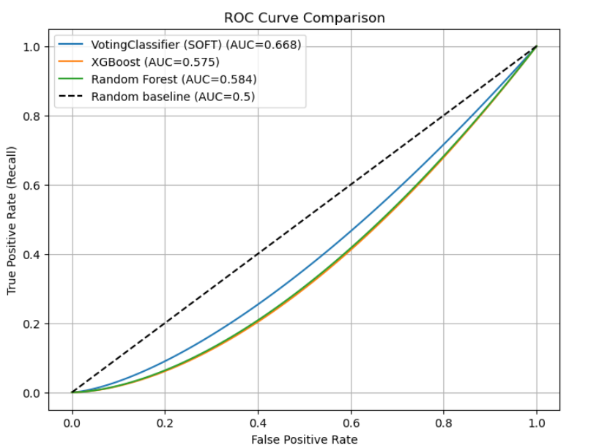
ROC Curve Comparison
VotingClassifier (SOFT) clearly sits above the other two curves, reflecting its higher AUC (0.668).
XGBoost (0.575) and Random Forest (0.584) are only slightly better than random guessing (AUC = 0.5).
This shows why the VotingClassifier gave a better trade-off between sensitivity (recall - 0.23, versus XGBoost recall - 0.03, and Random Forest recall - 0.07) and specificity, and why threshold tuning helped it outperform the others.

Slide 15
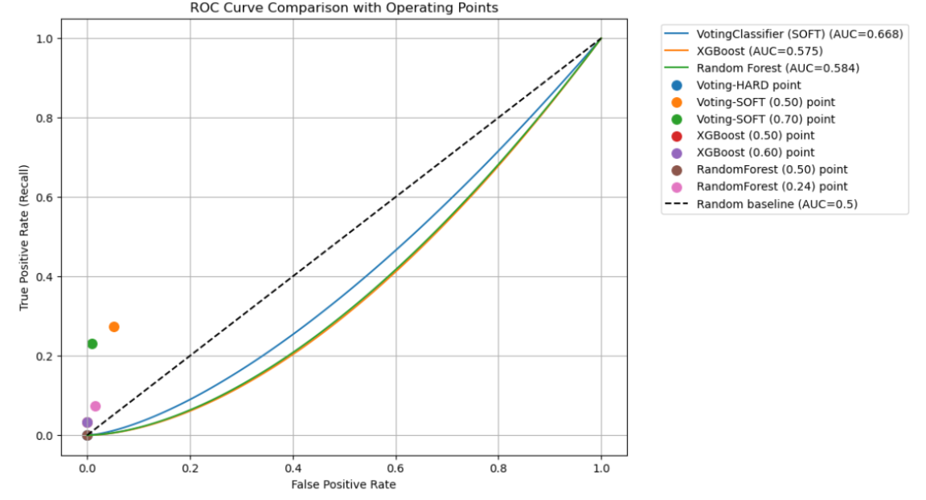
ROC curve comparison with points
VotingClassifier (SOFT @ 0.70) sits in a better region: higher recall than XGBoost/RandomForest with moderate false positives.
XGBoost points are way down near the x-axis — almost zero recall, which explains why it missed nearly all positives.
Random Forest also clusters near the baseline with very low recall.
VotingClassifier (SOFT @ 0.50) has higher recall but at the cost of more false positives.
This figure confirms that only the VotingClassifier (SOFT) provided usable trade-offs on the ROC curve, while the other ensembles defaulted to predicting negatives too aggressively.

Slide 16
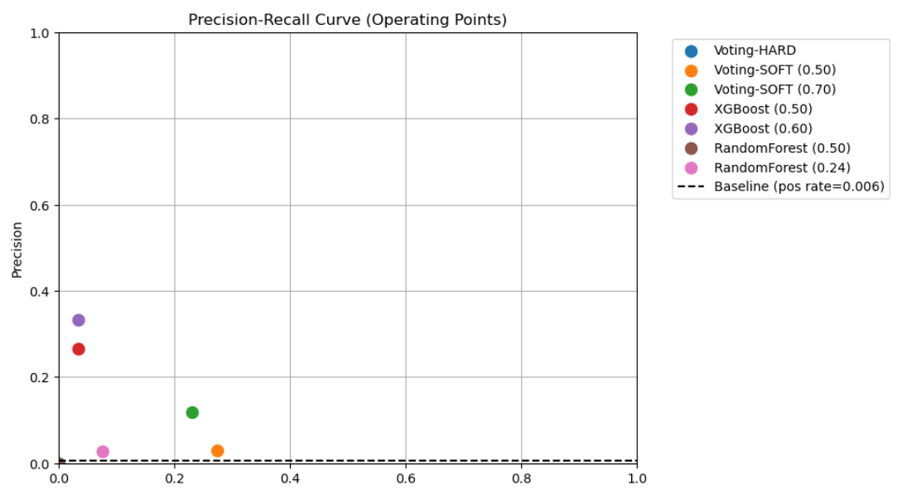
Precision-Recall curve
VotingClassifier (SOFT @ 0.70) again stands out:
Precision ~0.12 with Recall ~0.23 — better balance than the others.
XGBoost points are high precision but very low recall (bottom-left corner) → it only catches a handful of positives.
Random Forest sits near the baseline, barely above random guessing.
VotingClassifier (SOFT @ 0.50) trades higher recall (~0.27) for very low precision (~0.03).

Slide 17
Why VotingClassifier (SOFT) Outperformed XGBoost & Random Forest
Class Imbalance:
Dataset heavily skewed toward “good” parts.
XGBoost & Random Forest optimized for overall accuracy → predicted mostly negatives.
Result: very few false positives but almost no true positives (e.g., XGBoost TP = 4).
Probability Averaging Advantage:
Combines Logistic Regression (smooth) + Decision Tree (sharp) → balanced probabilities.
Soft averaging reduces extremes → allows better threshold tuning.
At threshold 0.70, detected 26 true positives with reasonable precision.

Slide 18
Why VotingClassifier (SOFT) Outperformed XGBoost & Random Forest
Model Simplicity & Robustness:
Complex models (XGBoost/RF) can overfit noisy, sparse data.
Simpler models (Logit + Tree) complement each other, capturing weak but meaningful signals.
Threshold Optimization:
Adjusting threshold 0.50 → 0.70 improved recall without too many false positives.
XGBoost/RF probabilities too skewed to benefit from tuning.
Summary:
VotingClassifier (SOFT) balanced precision & recall better.
Outperformed by blending diverse learners + effective threshold tuning.

Slide 19
Business Impact and Conclusion
Problem:
Defective parts can lead to costly recalls, reputation damage, and lost business.
Goal: Maximize defect detection to prevent faulty parts from reaching customers.
Model Choice:
VotingClassifier (SOFT, threshold = 0.70) offers the best trade-off:
Precision ≈ 0.12, Recall ≈ 0.23, F1 ≈ 0.16, AUC = 0.668.
Detects ~23% of defects, outperforming XGBoost and Random Forest (<7%).
Alternative:
XGBoost minimizes false alarms but misses most defects → not suitable for quality control.

Slide 20
Business Impact and Conclusion
Recommendation:
Deploy VotingClassifier (SOFT, 0.70) for production defect screening.
Provides balanced precision and recall, improving defect capture while controlling false positives.
Business Value: Even small gains in defect detection can yield major cost savings and reduce recall risk.

