Slide 1

Education Webpage

Slide 2
software Requirement:-
HTML - Hyper Text Markup Language
CSS - Cascading Style Sheets
JS - Java Script

Slide 3
HTML-Hyper Text Markup Language:-
HTML is the language for describing the structure of Web pages. HTML gives authors the means to:
Publish online documents with headings, text, tables, lists, photos, etc.
Retrieve online information via hypertext links, at the click of a button.
Design forms for conducting transactions with remote services, for use in searching for information, making reservations, ordering products, etc.
Include spread-sheets, video clips, sound clips, and other applications directly in their documents..

Slide 4
CSS-Cascading Style Sheets:-
CSS is used for defining the styles for web pages.
It describes the look and formatting of a document which is written in a markup language. It provides an additional feature to HTML.
It is generally used with HTML to change the style of web pages and user interfaces.

Slide 5
JS-Java Script:-
Java script is used for scripting the webpages.
JavaScript enables dynamic interactivity on websites when it is applied to an HTML document.
JavaScript helps the users to build modern web applications to interact directly without reloading the page every time.
JavaScript is commonly used to dynamically modify HTML and CSS to update a user interface.
It is mainly used in web applications.

Slide 6
Introduction:
Our Education Website is developed using HTML,CSS,JS with multiple modules in it.
In our Educational Website we have worked on few models they are,
About,
Course,
Review,
Contact,
Login Section,
Facilities Section ,

Slide 7
Project Structure:
HOME PAGE
ABOUT
REVIEW
LOGIN
COURSE
CONTACT
FACILITIES

Slide 8


Slide 9
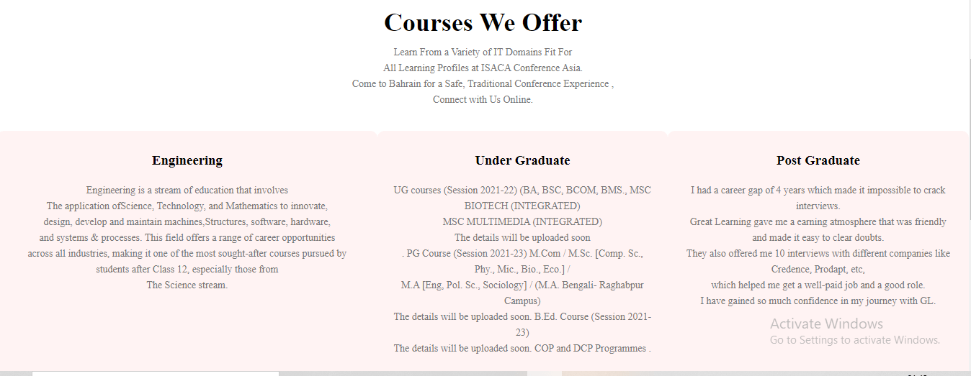

Slide 10
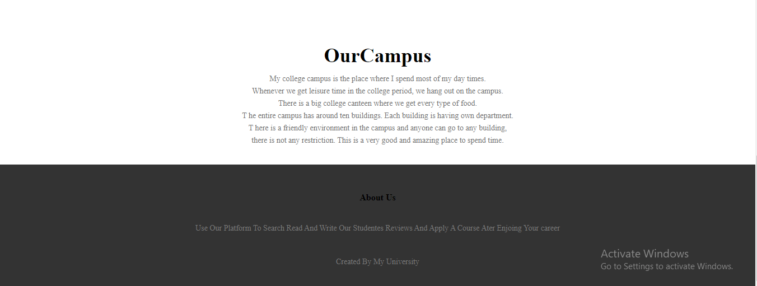

Slide 11


Slide 12


Slide 13


Slide 14


Slide 15
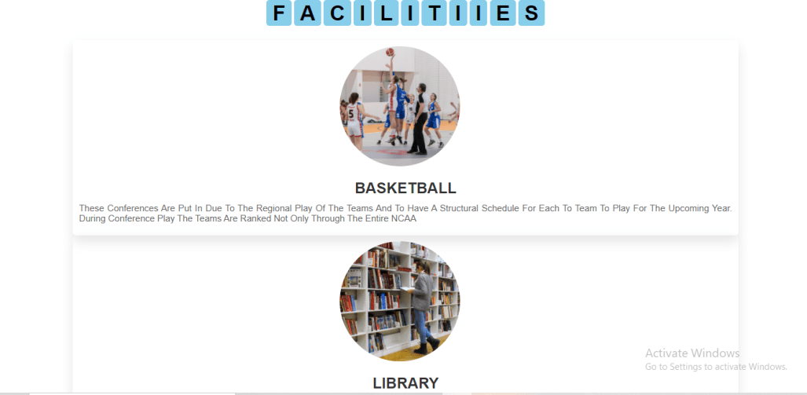


Slide 16
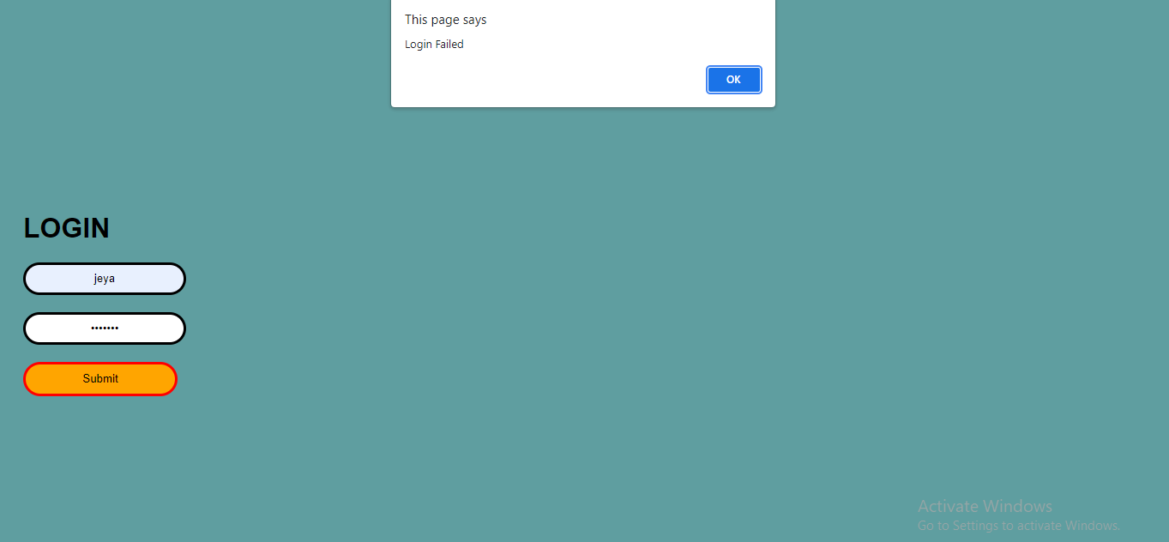

Slide 17
References
www.google.com
www.school.com
www.font awesome icon.com

Slide 18


THANK YOU

