Slide 1

TROT RIGHT IN
Team Name: BAM Software
Frontend: Evan Kohn. James Lomeo. Justin Trantham.
Backend: Jordan Kayse. James Lomeo. Jessica Yeh. Story Zanetti.

Slide 2
Product Idea
Problems are everywhere
Parking
Solutions are waiting
Pony Park
Driven by User Data

Slide 3
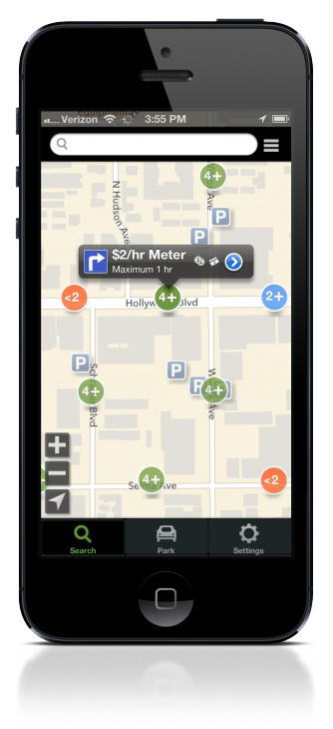
Market Analysis
Parker (by Streetline)
Similar
Includes ability to search for parking
Includes ability to filter parking spaces (street vs. lot & garage, payment methods, permits)
Different
Only shows if parking is extremely limited (less than two spaces or no spaces)
Presents a map view instead of information about the parking lots
Does not allow for user input
Does not have a desktop version
Android Downloads: 10,000-50,000

Slide 4
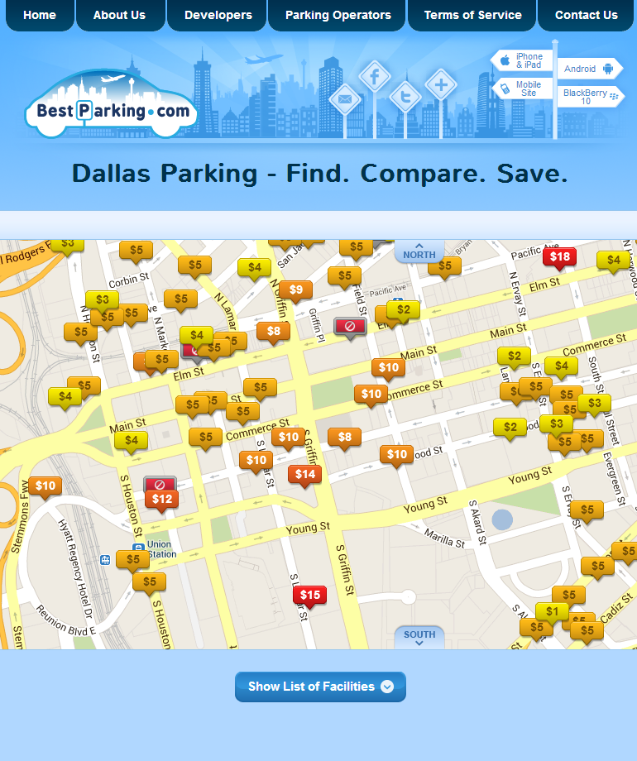
Market Analysis Continued
BestParking
Similar
Allows user to search by area
Lists parking lots due to location and price
Provides information on parking lots (price, hours of operation, picture)
Does have a desktop version
Different
Focuses on price of parking
Focuses on extended parking
Does not allow user input
Android Downloads: 100,000 to 500,000

Slide 5
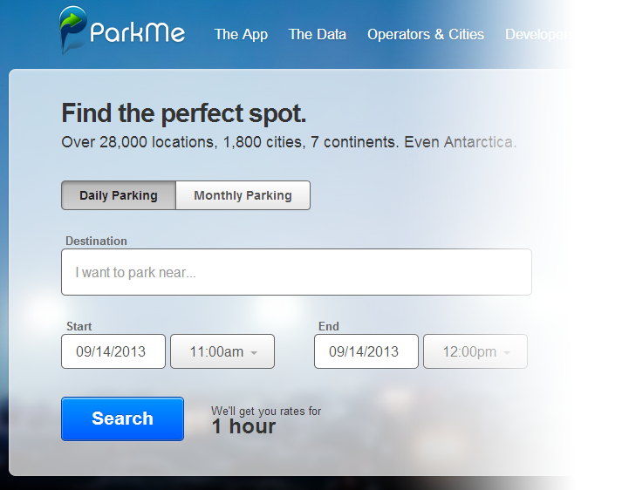
Market Analysis Continued
ParkMe
Similar
Allows user to search by area
Lists parking lots due to location and price
Does have a desktop version
Different
Focuses on price of parking
Focuses on extended parking
Does not allow user input
Android Downloads: 10,000 to 50,000

Slide 6
Market Analysis Continued
Conclusion: Our product, in comparison to our competitors, focuses more on user input and user preference.
Whereas many of our opponents focus simply on the facts of different parking lots (location, price, etc.), our product focuses on the user’s experience and allows users to have a more personalized parking experience.

Slide 7
Product Features
Want to sign up?
Facebook and social media plugins available for login or signup
Allows sharing comments with others about your favorite parking
My Account:
Favorite Garages
Phone Number/Email - For optional notifications
Commute times for notification
Requests for new parking garages

Slide 8
Product Features (Continued)
User Features:
Rate parking capacity
Full = 1 pony
Scarce = 2 ponies
Some = 3 ponies
Plenty = 4 ponies
Empty = 5 ponies
Add brief (140 characters or less) comments about a parking garage
View times when garage is least or most active

Slide 9
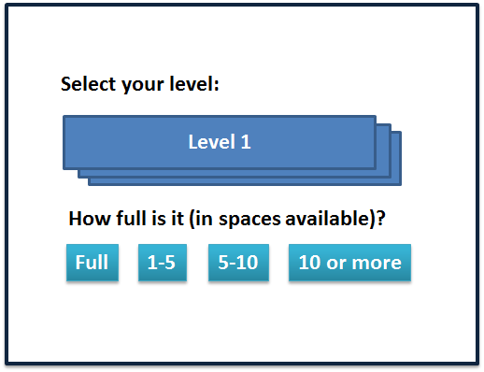
Product Features (Continued)
User Features:
Rate parking capacity
Full = 1 pony
Scarce = 2 ponies
Some = 3 ponies
Plenty = 4 ponies
Empty = 5 ponies
Add brief (140 characters or less) comments about a parking garage
View times when garage is least or most active

Slide 10
Product Features (Continued)
User Features (Continued):
Remember where I was? → Allow user to post memo or record location to remember location in one click
One click Google Map directions to parking garage
QR code accessibility
Filter parking garages by cost, distance, and capacity
Ability to report a user if necessary
For foul language or faulty ratings

Slide 11

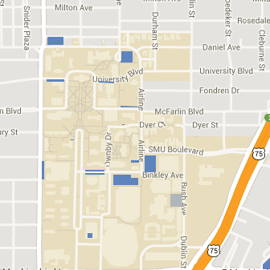
List or Map based Viewing/Searching
Airline Garage
Looking good at only **
Last: 2hrs ago
SMU Dallas TX Parking
User can report 1-5 level
Report
Get me there
*** Airline Garage .5mile
Last:
2hrs ago
Get me there
**** Binkley Garage .7mile
Last:
1 day ago
Get me there

Slide 12
Intended Users
College Commuters
Working Commuters
Downtown Travelers

