Slide 1

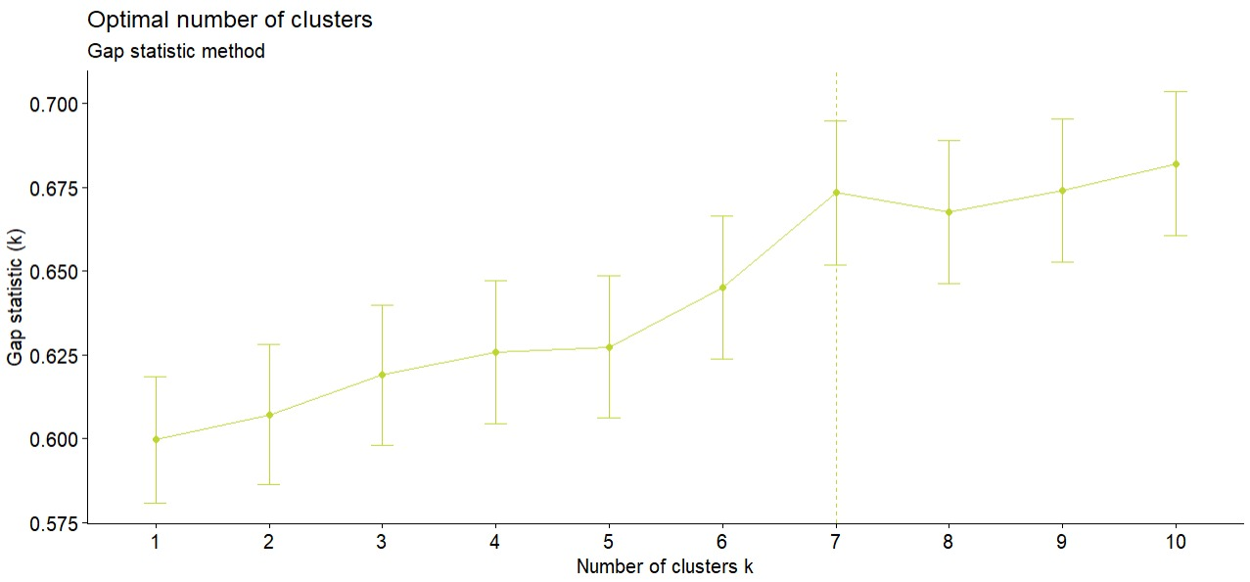
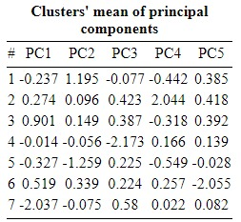
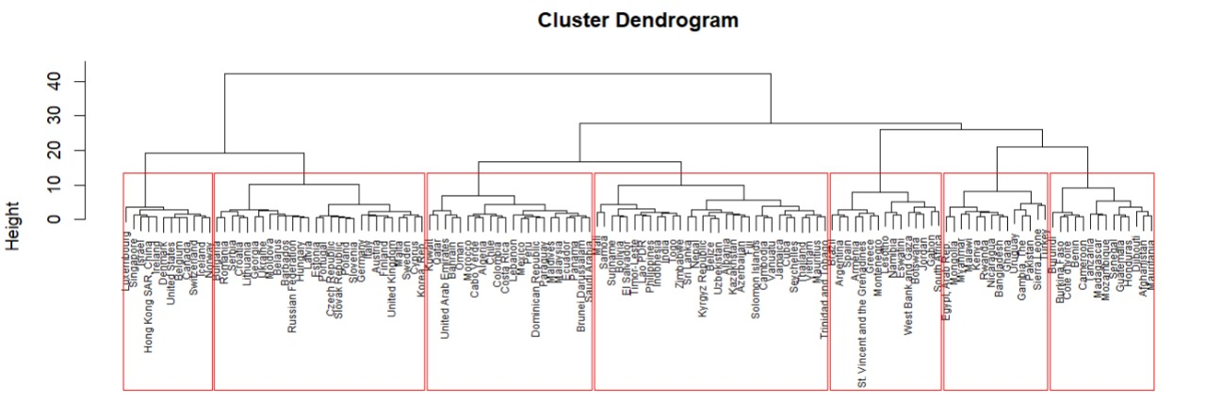
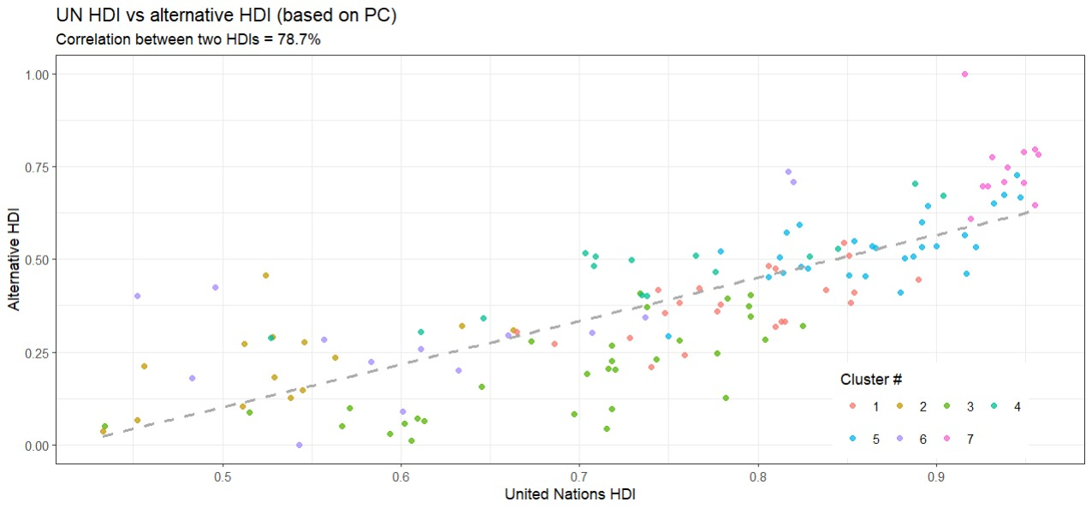
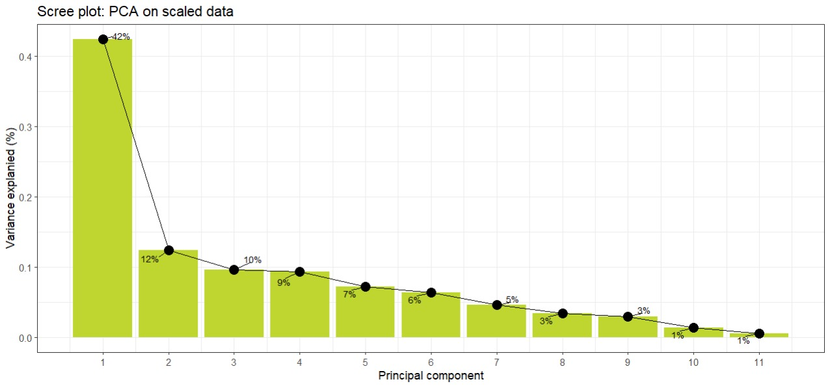
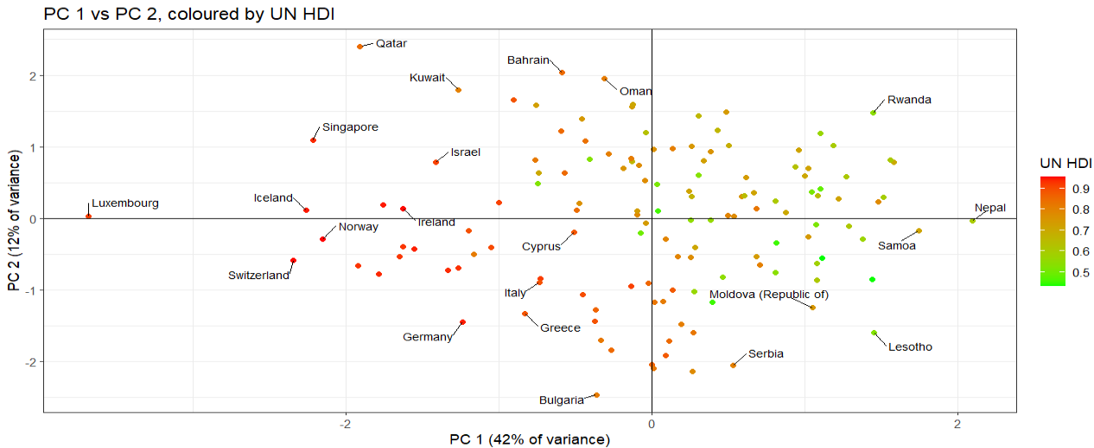
MULTIVARIATE DATA ANALYSIS
TEAM
RGB 92/102/108
FINAL PROJECT
Dmitrii Diachkov - #20211367
Pedro Carvalho - #20211363
Rodolfo Tavares - #20210405
Zukiswa Mdingi - #20210408
Developing of HDI index
with a breakdown by country
RGB 190/214/47
OVERVIEW
The Human Development Index (HDI) is an index developed by the United Nations Development Programme (UNDP) and it is used to measure the human development of a country. The HDI calculates and ranks countries according to the HDI score which is composed of 3 key dimensions: 1)Life expectancy at birth; 2)Education: includes two variables, mean years of schooling and expected years of schooling, and 3) Standard of living: measured by the gross national income per capita. The aim of this project is to create an Alternative Human Development Index (AHDI) by country, using a set of previously chosen indicators and using multivariate data analysis techniques.
Figure 2: Optimal number of cluster
Figure 3: Cluster’s mean of PC’s
METHOD & DATA
To achieve the proposed objectives, two multivariate techniques will be used: Principal Components Analysis (PCA) with a varimax rotation of loadings and Cluster Analysis (CA) with a hierarchical clustering of Ward’s distances. The PCA is one of the techniques or tools used to reduce dimensions in a multidimensional data and it is widely used in the construction of indices (Mylevaganam, 2017). This technique will be used to reduce number of variable and create the new variable (main components such as indices) for each country. Then, these indices will be used to rank the countries according to the presented score, based on results of the cluster analysis. For this, we used the data from World Development Indicators (WBI) that is a collection of development indicators. We started by including in the analysis the dataset from all countries (cases) published by the WB and 25 variables (indicators- an extension of the WB HDI) grouped into key dimensions of development that reflect social and economic welfare: a long and healthy life, access to knowledge and a decent standard of living (Javaid, Akbar & Nawaz, 2018). After data manipulation (eliminating missing values, standardization, etc), the final dataset consists of 136 countries and 11 variables. The data used refers to the year 2019.
Figure 4: Cluster plot base on PCA - country grouping
From Fig. 2, according to the rules (gap statistic metric after 1000 iterations of boot-strapped hierarchical clustering), the optimal number of cluster is 7. In Fig3 we present the cluster’s mean of principal components. From figure 4 we identified which country belong to which cluster. The 1st cluster has 22 countries, the 2nd cluster 14 countries, 3rd cluster 31 countries, the 4th cluster 15 countries, the 5th cluster 28 countries, the 6th cluster 14 countries and the rest join the 7th cluster, based to Ward’s distances, providing clustering of proportional sizes.
RESULTS & CONCLUSION
Using all 11 most significant initial variables, from Fig. 1 we can conclude that by using 5 Principal Components, at least 81% variance on the dataset can be explained by the component that we created.
Figure 5: Correlation between UN HDI and Alternative HDI
Figure 1: Percentage of explained variance
These 5 PCs represent the following:
PC1 - is a measure of overall wealth/ comfort of life. This is strongly correlated with 4 of the original variables, and all with negative sign - it is mean this component decreases when GDP per capta, levels of urbanization, broadband internet penetration and life expectancy increases (all vary together).
PC2 - is measure of overall risks of death. It increases when we observe high risks of death.
PC3 - is measure of labour market condition. It Increases as unemployment rises.
PC4 - is a measure of education level and quality of life. It decreases when the levels of primary completion rate in schools, levels of immunization and life expectancy, levels of children mortality and undernourishment increases (all vary together).
PC5 - is a measure of inflation of countries.
Figure 6: PC1 vs PC2 by UN HDI
In Fig. 5 we plot the correlation between AHDI, that we built as integrated weighted values of all principal components loadings, with UN HDI. We can conclude that even using a number of different indicators (variables), the two indices are highly correlated (78.7%) and can complement each other. Fig. 6 shows that first two components of AHDI is adequately corresponds to UN HDI and provides and intuitively understandable results.
REFERENCES
Javaid. A, Akbar. A. and Nawaz, S. (2018). A Review on Human Development Index. Pakistan Journal of Humanities and Social Sciences. 6 (3), 357 – 369.
Mylevaganam, S. (2017). The Analysis of Human Development Index (HDI) for Categorizing the Member States of the United Nations (UN). Open Journal of Applied Sciences. 7, 661- 690.

