Slide 1
HOTEL MANAGEMENT SYSTEM
Deployment on Microsoft Azure
TEAM NUMBER : 03
CB.SC.U4AIE24116 - J. Lakshmi Tejaswi
CB.SC.U4AIE24130 - Vishnu Teja
CB.SC.U4AIE24135 - Mithul Akshay
CB.SC.U4AIE24136 - Mohan Innani
22AIE303
Cloud Computing
Notes:
Good morning. Our project takes the Hotel Management System we built for the database course and deploys it on Microsoft Azure. The application already works; what we are presenting is the cloud architecture, the infrastructure code that builds it, and the reasoning behind each choice.

Slide 2
Introduction
What the system is, and why it moves to the cloud
The Hotel Management System handles guest registration, room inventory, bookings, check-in and check-out, billing and payments.
It is already built and working as a three-tier application: a Streamlit web front end, a Python data access layer, and a MySQL database of six normalised tables.
Today it runs on a single machine. That machine is a single point of failure, is reachable from nowhere else, and has a capacity fixed by the hardware it sits on.
This project migrates the system to Microsoft Azure so it becomes highly available, reachable from anywhere, and able to grow and shrink with demand.
The whole environment is defined as code, so it can be created, destroyed and recreated identically rather than assembled by hand through a portal.
Scope of this project
The application logic is not rewritten. What changes is where it runs, who is responsible for the layers beneath it, and how it is provisioned. That is a deliberate choice: a migration is cheapest when the application was layered properly to begin with, which is what the database project established.
22AIE303
Cloud Computing · Hotel Management System
2
Notes:
The key framing: this is a migration project, not a rewrite. The application is finished. What we are designing and building is the infrastructure underneath it.

Slide 3
Problem Statement & Objectives
Six limitations of the local deployment, and what the cloud design sets out to fix
Single point of failure
No remote access
Fixed capacity
Application and database share one machine. If it fails, the hotel cannot take a booking until it is repaired.
Staff can only work at that one computer. A manager cannot check occupancy from another branch.
Hardware is sized for peak season and idles the rest of the year. A surge means buying a bigger machine.
Manual backups
Capital cost upfront
Maintenance burden
Backups depend on someone remembering. A disk failure loses every guest and payment record.
Servers and UPS must be bought before the first guest is served, and replaced every few years.
Patching the operating system, database and network is the hotel's problem, not a specialist's.
Objectives
Migrate to a public cloud · replace the self-hosted database with a managed service · scale elastically with demand · survive the loss of a datacentre · hold no credential in source code · define the whole environment as reproducible code
22AIE303
Cloud Computing · Hotel Management System
3
Notes:
Six problems, and the objectives that answer them. The last objective - infrastructure as code - is the one that distinguishes this from a design exercise, because it is the part we actually wrote and validated.

Slide 4
Existing System vs Proposed System
What actually changes when the application moves to Azure
ON-PREMISE (existing)
AZURE (proposed)
Application and database on one laptop
Reachable only on that machine
Capacity fixed by the hardware bought
Backups taken by hand, if at all
Failure means downtime until repaired
Large upfront capital expenditure
Database password sits in db_config.py
Environment assembled manually, once
VM Scale Set plus managed MySQL service
Reachable from any browser, anywhere
Autoscale adds instances on demand
Automated daily backups, 7-day retention
Zone-redundant standby takes over
Pay-as-you-go operational expenditure
Password held in Key Vault, fetched at boot
Whole environment defined in Bicep
The last two rows are the ones worth noticing: they are improvements the migration forces, not just relocations of the same thing.
22AIE303
Cloud Computing · Hotel Management System
4
Notes:
Most rows are a straight relocation. The last two are genuine improvements: the credential moves out of source control into Key Vault, and the environment becomes reproducible instead of hand-built.

Slide 5
Cloud Service Models
IaaS, PaaS and SaaS - and where each part of this project sits
IaaS
PaaS
SaaS
Infrastructure as a Service
Platform as a Service
Software as a Service
The provider supplies virtual machines, storage and networking. We manage the operating system and everything above it.
The provider also manages the runtime or database engine. We supply only schema, configuration and data.
The provider runs a finished application. The customer opens a browser and uses it, owning nothing.
In this project
In this project
In this project
Azure Virtual Machine Scale Sets run the application. We choose Ubuntu, install Python and Streamlit, and maintain them.
Azure Database for MySQL Flexible Server. Azure patches the engine, takes backups and handles failover; we design the schema.
The finished system is itself delivered this way to hotel staff, who visit a URL and own no infrastructure at all.
The project deliberately uses all three levels. The higher up the stack a component sits, the less we manage and the less we control.
22AIE303
Cloud Computing · Hotel Management System
5
Notes:
A likely question is which model the project uses. The honest answer is all three, at different layers. Being able to place each component is what the examiner is checking.

Slide 6
Cloud Deployment Models
Why a public cloud, and when it would be the wrong answer
Public cloud
CHOSEN
Why public cloud
Infrastructure owned by a provider and shared among many tenants. Lowest cost, nothing to buy, effectively unlimited capacity.
No capital expenditure; runs on an Azure for Students account
Availability Zones give datacentre redundancy with no extra work
Resources can be created and destroyed as the project needs them
A single hotel has no regulation forcing data to stay on its own premises
The skills transfer directly to industry
Private cloud
Infrastructure dedicated to one organisation. More control and easier regulatory compliance, but the capital cost returns.
Hybrid cloud
A combination: sensitive data kept private, general workloads in the public cloud. Flexible, but harder to operate.
Community cloud
Shared by organisations with common requirements, such as a hotel group or a university consortium.
When it would be wrong: a hotel chain legally required to keep guest identity documents inside its own country, or on its own hardware, would need a private or hybrid arrangement instead.
22AIE303
Cloud Computing · Hotel Management System
6
Notes:
Four models, one chosen, with the reasons. The last line matters: being able to say when your own choice would be wrong is usually what separates a good answer from a memorised one.

Slide 7
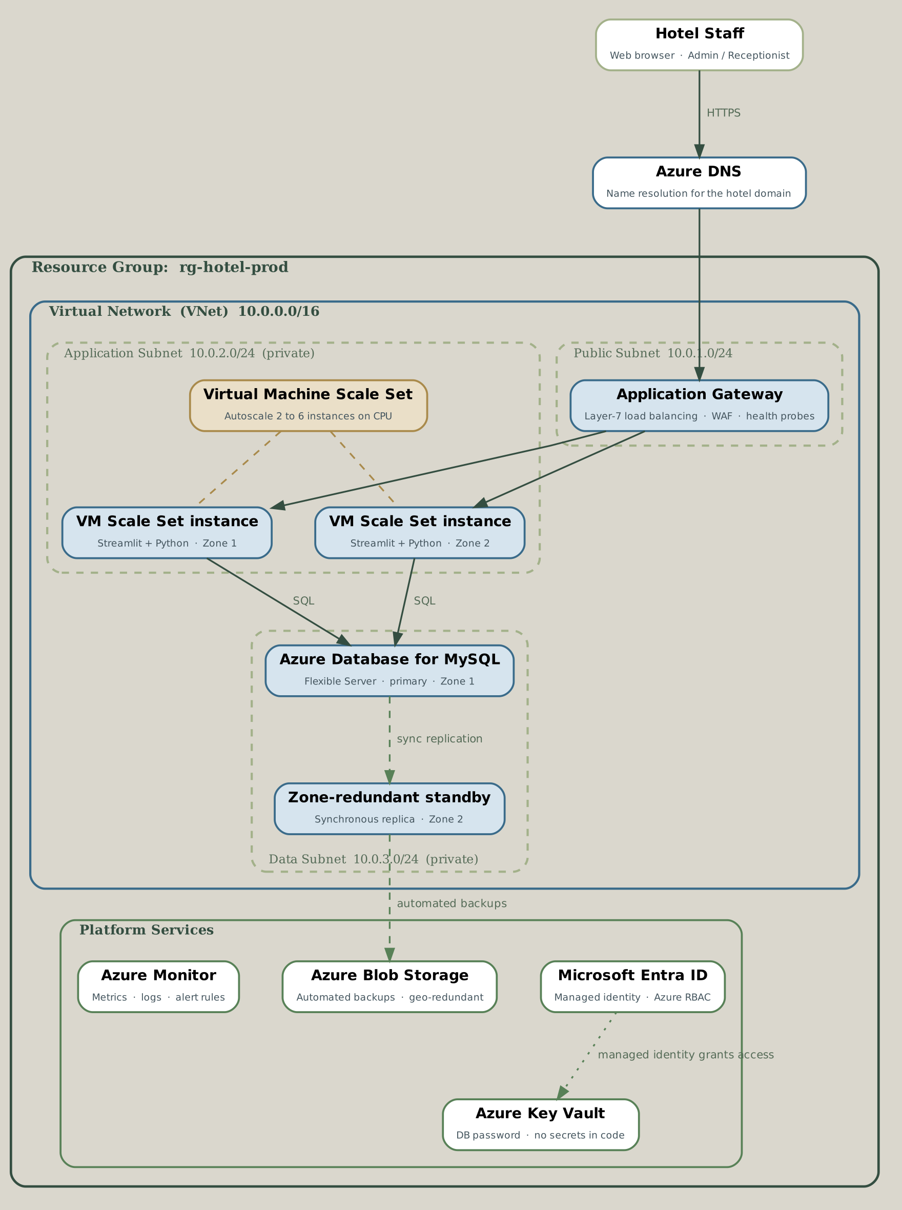
Proposed Cloud Architecture
Three tiers inside one virtual network, spread across two Availability Zones
Entry point
Azure DNS resolves the hotel's domain to an Application Gateway, which load-balances across healthy instances and stops routing to any that fail a probe.
Application tier
A Virtual Machine Scale Set in a private subnet runs the Streamlit application, spread across Zone 1 and Zone 2, autoscaling between two and six instances.
Data tier
Azure Database for MySQL Flexible Server holds the six tables, VNet-integrated so it has no public endpoint at all. A zone-redundant standby can take over automatically.
Secrets
The database password lives in Azure Key Vault. Each VM reads it at boot using its managed identity, so no credential exists in the repository or the VM image.
Operations
Azure Monitor collects metrics, logs and alert rules; Blob Storage holds automated database backups.
22AIE303
Cloud Computing · Hotel Management System
7
Notes:
Walk the diagram top to bottom. The security property worth stating out loud: nothing except the Application Gateway is reachable from the internet. The VMs have no public IP and the database has no public endpoint.

Slide 8
Azure Services Used
Each service, and the cloud concept it demonstrates
Virtual Machine Scale Sets
IaaS, elasticity
Azure Database for MySQL
PaaS, managed services
Run the Streamlit application
Managed database, Flexible Server
Application Gateway v2
Load balancing
Azure Virtual Network
Network isolation
Layer-7 load balancing and health probes
Private network with three subnets
Network Security Groups
Defence in depth
Azure Key Vault
Secrets management
Per-tier firewall rules
Stores the database password
Microsoft Entra ID
Identity and access
Azure Monitor
Observability
Managed identity and Azure RBAC
Metrics, logs and alert rules
Azure Blob Storage
Durable object storage
Availability Zones
Fault tolerance
Automated database backups
Two physically separate datacentres
Azure Bicep
Infrastructure as code
Azure for Students
Pay-as-you-go pricing
Declares the whole environment as code
Free credit, cost control
22AIE303
Cloud Computing · Hotel Management System
8
Notes:
Twelve services, each tagged with the syllabus concept it demonstrates. If the examiner asks where a particular idea appears in the project, this slide is the index.

Slide 9
Infrastructure as Code
The entire environment is declared in Azure Bicep, not clicked together in the portal
// modules/compute.bicep - autoscale rule
resource autoscale 'Microsoft.Insights/autoscalesettings@2022-10-01' = {
properties: {
profiles: [ {
capacity: { minimum: '2', maximum: '6', default: '2' }
rules: [ {
metricTrigger: {
metricName: 'Percentage CPU'
timeWindow: 'PT5M'
operator: 'GreaterThan'
threshold: 70
}
scaleAction: {
direction: 'Increase'
value: '1'
cooldown: 'PT5M'
} } ] } ] } }
main.bicep
Orchestrates all six modules and wires their outputs together
modules/network.bicep
VNet, three subnets, three network security groups
modules/database.bicep
MySQL Flexible Server, private DNS zone, HA options
modules/keyvault.bicep
Key Vault and the database password secret
modules/gateway.bicep
Application Gateway, public IP, health probe
modules/compute.bicep
Scale set, managed identity, autoscale rules
modules/monitoring.bicep
Log Analytics workspace and alert rules
cloud-init.yaml
Bootstraps each VM: packages, secret, systemd service
Why this matters
deploy.sh / destroy.sh
One command to build the stack, one to remove it
The environment can be destroyed after a demonstration and rebuilt identically in one command. Nothing depends on remembering which buttons were pressed, and the architecture is reviewable in version control like any other code.
All seven Bicep files compile to a valid ARM template with no errors or warnings; the shell scripts pass shellcheck and the cloud-init document parses as valid YAML.
22AIE303
Cloud Computing · Hotel Management System
9
Notes:
This is the slide that separates our project from a design exercise. The infrastructure is real, validated code. We can run the compile in front of you if asked.

Slide 10
Database Migration Strategy
Local MySQL to Azure Database for MySQL, without touching a single query
1
Export
Dump schema and data with mysqldump: six tables, three views, two triggers and one stored procedure in a single file.
Step 3 is the one that catches people
Azure enables binary logging by default. With it on, creating a trigger or stored procedure needs a privilege the administrator account does not have, and the import fails partway through.
Setting that one server parameter first is the difference between a clean import and a confusing error.
It is declared in database.bicep, so it is applied before anyone tries the import.
2
Provision
Create the Flexible Server inside the delegated data subnet, with a private DNS zone so it has no public endpoint.
3
Configure
Set log_bin_trust_function_creators to ON, so the triggers and stored procedure can be created without SUPER privilege.
4
Import
Load the dump from inside the VNet. The schema transfers unchanged because the service runs genuine MySQL 8.0.
5
Repoint
db_config.py is written at boot from Key Vault, pointing at the Azure hostname. No application code changes.
6
Verify
Re-run the CRUD operations and the four reports, and compare row counts against the source database.
Because every SQL statement lives in database.py and every credential in db_config.py, moving the database is a configuration change rather than a code change.
22AIE303
Cloud Computing · Hotel Management System
10
Notes:
The strongest point here is step three. It is a real operational detail that we handled in the template rather than discovering during the demo.

Slide 11
Scalability and Elasticity
How the deployment copes with a busy season
Vertical scaling (scale up)
Horizontal scaling (scale out)
Give the existing machine more CPU or memory. Simple, but there is a ceiling and the machine usually restarts.
Add more machines and share the load between them. No practical ceiling, and instances join while the system runs.
Used for the database: the server can be resized to a larger tier if queries slow down.
Used for the application tier: the scale set adds instances automatically.
The autoscale rules, as deployed
Normal load
Two instances, one in each Availability Zone
Average CPU above 70% for 5 minutes
One instance added, up to a maximum of six
Average CPU below 30% for 10 minutes
One instance removed, never below two
Instance fails its health probe
Gateway stops routing to it; the scale set replaces it
Cooldown
5 minutes after scaling out, 10 after scaling in, so one burst does not cause repeated scaling
Scalability is the ability to grow; elasticity is doing it automatically, in both directions, in response to live demand.
22AIE303
Cloud Computing · Hotel Management System
11
Notes:
A very common viva question is the difference between scalability and elasticity. Scalability is the capability; elasticity is the automation of it in both directions. Our autoscale profile is the elastic part, and the cooldowns are what stop it oscillating.

Slide 12
High Availability and Fault Tolerance
What happens when something breaks
One application instance fails
An entire Availability Zone fails
The gateway's health probe stops routing to it within seconds, and the scale set launches a replacement. Guests notice nothing.
The instance and the database standby in the other zone keep serving. Capacity halves; the system stays up.
The primary database fails
Data is deleted by mistake
Azure promotes the zone-redundant standby automatically. The server hostname does not change, so the application reconnects without a code change.
Restore from an automated backup. Point-in-time restore covers the retention window, which is seven days by default.
Recovery objectives
RTO - recovery time objective - is how long the hotel can be down; zone failover completes in minutes. RPO - recovery point objective - is how much data may be lost; synchronous replication makes this effectively zero for a zone failure.
An honest limitation
Zone-redundant database HA requires a General Purpose tier. The Burstable tier a student subscription can afford does not support it, so our deployed configuration runs without database HA while the design provides for it. The template takes a flag and reports which mode is actually active.
22AIE303
Cloud Computing · Hotel Management System
12
Notes:
Know RTO and RPO; they are asked constantly. And raise the Burstable limitation yourself rather than being caught by it - the template exposes an output saying whether HA is genuinely on.

Slide 13
Cloud Security
Layered controls, from the network inward
Network isolation
Network security groups
No secrets in code
The VNet gives a private network. Only the Application Gateway sits in a public subnet; the VMs have no public IP and the database no public endpoint.
One per tier. The database accepts port 3306 only from the application subnet; the application accepts 8501 only from the gateway subnet.
The database password lives in Key Vault. Each VM reads it at boot with its managed identity, so nothing is committed to the repository.
Managed identity and RBAC
Encryption
Shared responsibility
The scale set's identity is granted exactly one role - Key Vault Secrets User - and nothing else. No keys exist to leak.
TLS in transit, enforced on MySQL connections; Azure encrypts the database and backups at rest. Guest ID and contact details are covered by both.
Azure secures the cloud itself - hardware, hypervisor, managed services. We secure what we put in it - data, access rules, configuration.
Carried over from the database project: passwords are stored as SHA-256 hashes and every query is parameterised, so the application is not vulnerable to SQL injection.
22AIE303
Cloud Computing · Hotel Management System
13
Notes:
If you remember one thing from this slide, make it the shared responsibility model with a concrete example on each side: Azure patches the hypervisor, we decide who may read the guests table.

Slide 14
Monitoring and Cost Model
Watching the system, and paying only for what runs
Monitored by Azure Monitor
Pay-as-you-go cost model
CPU utilisation
Drives the autoscale rules and a high-CPU alert
Compute
Billed per second a VM runs, so scaling in at night costs nothing to do
Health probe status
Shows instances the gateway has taken out of rotation
Database
Billed per hour by tier, plus the storage consumed
Database connections
Warns before the connection limit is reached
Gateway
Billed hourly plus capacity units; the largest fixed cost in this design
Storage used
Alerts before the server runs out of space
Storage
Per GB per month; backup snapshots are incremental
Application logs
Collected centrally, so failures are traceable without SSH
Egress
Inbound free, outbound charged per GB
Capital expenditure versus operational expenditure
Buying a server is a capital expense: paid once, owned, and depreciating whether used or not. Cloud is operational: paid monthly, matched to usage, and stopped the moment a resource is switched off. For a hotel with a seasonal occupancy pattern the second model fits demand far more closely.
It is not automatically cheaper. For a steady, always-on workload with predictable load, owning hardware can work out less expensive over several years. The cloud wins on variable demand, on not paying before you start, and on not having to replace anything.
22AIE303
Cloud Computing · Hotel Management System
14
Notes:
Do not claim the cloud is always cheaper - it is not, and a sharp examiner will test that. Our destroy script exists precisely because an idle Application Gateway will drain a student subscription over a weekend.

Slide 15
Work Completed and Implementation Plan
What exists today, and what happens next
Completed
Remaining
Three-tier application built and working: Streamlit front end, Python data access layer, MySQL database
Six normalised tables in 3NF with foreign keys, three views, two triggers and a stored procedure
Cloud architecture designed: network layout, service selection, scaling policy and security model
Infrastructure as Code written: seven Bicep files, cloud-init bootstrap, deploy and teardown scripts
Templates validated - the full stack compiles to a valid ARM template with no errors or warnings
Migration procedure documented, including the binary-logging parameter the import depends on
Phase 1
Provision the resource group and run the deployment
Phase 2
Load the schema and verify row counts against the local database
Phase 3
Confirm the gateway reports both instances healthy
Phase 4
Load-test the autoscale rules and capture the instance count rising
Phase 5
Record the running cost, then tear the environment down
Stated plainly
The environment has not been provisioned yet. What exists is a complete, validated infrastructure definition that creates it in a single command. We chose to invest the time in making the deployment reproducible rather than clicking through the portal once and screenshotting the result.
22AIE303
Cloud Computing · Hotel Management System
15
Notes:
Be straightforward about this. Saying the infrastructure is written and validated but not yet provisioned is far stronger than implying a deployment that cannot be shown. And the reproducibility argument is a real one.

Slide 16
Challenges and Considerations
Problems we had to design around, stated honestly
Streamlit holds session state in memory
Burstable tiers cannot do HA
The database has no public endpoint
A user sent to a different instance mid-session would be logged out. Solved with cookie-based session affinity on the Application Gateway.
The affordable database tier does not support zone redundancy. The template takes a flag and reports which mode is actually active.
Deliberate, but it means the schema cannot be loaded from a laptop. We load it by running a command on an instance already inside the VNet.
Cost can run away quietly
Binary logging blocks trigger creation
Vendor lock-in
An idle Application Gateway bills by the hour. Mitigated with a teardown script, a capped instance count and a budget alert.
Azure MySQL needs log_bin_trust_function_creators set before the import, or it fails partway through.
Managed services make moving provider harder. Mitigated by keeping standard MySQL and plain Python, so only the infrastructure layer is Azure-specific.
Every item here was found while writing the templates, not during the presentation. Each one has a mitigation already in the code.
22AIE303
Cloud Computing · Hotel Management System
16
Notes:
Raising weaknesses yourself is much stronger than being caught by them. The Streamlit session-state point is one most teams miss entirely when they put a stateful app behind a load balancer.

Slide 17
Conclusion and Future Scope
Always available
Reachable anywhere
Follows demand
Spreading across two zones removes the single point of failure the laptop version had.
Staff open a browser; nothing is installed on any hotel computer.
Capacity rises for the season and falls again, with no one watching.
Credentials protected
Reproducible
Predictable spend
Key Vault and managed identity remove the password from source control.
The environment is code, so it can be destroyed and rebuilt identically.
Monthly operating cost in place of an upfront hardware purchase.
Future scope
Conclusion
Containerise the application and run it on Azure Kubernetes Service
Add read replicas so reporting queries do not compete with bookings
Introduce a CI/CD pipeline in GitHub Actions, so a commit deploys itself
Extend to a second region for disaster recovery beyond a single geography
A working three-tier database application has been designed for migration to Microsoft Azure, using IaaS for compute and PaaS for data, spread across two Availability Zones, and defined entirely as infrastructure code that compiles and validates.
The application itself is unchanged - which is the clearest evidence that separating the data access layer from the interface in the database project was the right decision.
22AIE303
Cloud Computing · Hotel Management System
17
Notes:
Close on the architectural point: the migration is cheap precisely because the application was layered properly from the start. That ties the cloud work back to the database work and shows the two courses connecting.

Slide 18
THANK YOU
Questions welcome
22AIE303
Cloud Computing · Hotel Management System
Notes:
Thank you. We can walk through the Bicep templates or the architecture in more detail if you would like.

