Slide 1
HOTEL MANAGEMENT SYSTEM
22AIE303 · Database Management Systems · Final Project Review
TEAM NUMBER : 03
CB.SC.U4AIE24116 – J. Lakshmi Tejaswi
CB.SC.U4AIE24130 – Vishnu Teja
CB.SC.U4AIE24135 – Mithul Akshay
CB.SC.U4AIE24136 – Mohan Innani
Notes:
Introduce the team and the project: a Hotel Management System built on MySQL with a Python (Tkinter) desktop front end. Roughly 10 minutes: problem, design, normalization, SQL features, live demo, conclusion.

Slide 2
Problem Statement & Objectives
THE PROBLEM
OBJECTIVES
Manual registers – guest, room and booking details sit in paper registers: slow to update and easy to lose.
Double booking – with no central occupancy record, one room gets promised to two guests.
Billing errors – rate × nights is worked out by hand, so totals are wrong or disputed.
Slow retrieval & redundancy – finding one guest’s history means paging through records; repeat guests are re-entered and drift apart.
No consolidated view – occupancy, revenue and pending dues have to be compiled manually.
01
Centralised database designed in 3NF – 6 tables in MySQL
02
Full CRUD on every entity through a Python GUI, no SQL typed by the user
03
Prevent invalid bookings – date-overlap check and CHECK constraints
04
Automate billing – nights × price per night using a SQL join
05
Enforce integrity inside the database – PK, FK, UNIQUE, CHECK, ENUM, triggers
06
Reports using aggregates, GROUP BY and HAVING
Team 03 · 22AIE303 Database Management Systems · Hotel Management System
2
Notes:
Paper registers cause four concrete failures: double booking, wrong bills, slow lookup, and no overall view. Our six objectives map one-to-one to these failures and to the DBMS concepts the course covers.

Slide 3
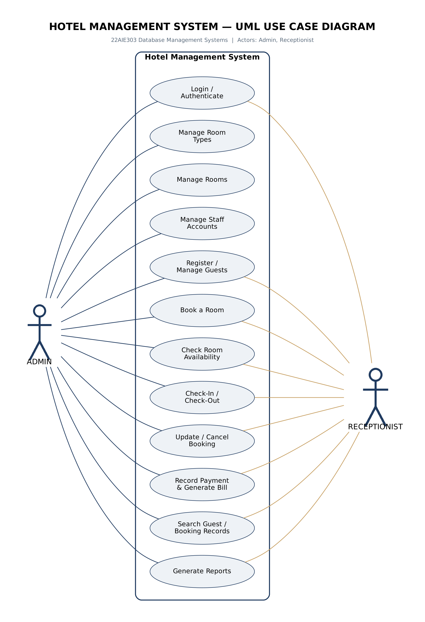
UML Use Case Diagram
Twelve use cases, two actors
Actors – Admin and Receptionist. Both sign in through the same Login use case.
Admin only – manage room types, rooms and staff accounts.
Shared – register / manage guests, book a room, check availability, check-in / check-out, update or cancel a booking, record payment and generate bill, search records, generate reports.
System boundary – the rectangle is the application; use cases map to its tabs and to the data-access functions in the back end.
Role rules – the diagram states the intended permissions; enforcing them in the GUI and with MySQL GRANT is listed under future work.
Team 03 · 22AIE303 Database Management Systems · Hotel Management System
3
Notes:
Walk the diagram: Admin has all twelve use cases, Receptionist has login plus the eight operational ones. Be honest if asked: role-based tab locking and a staff-accounts screen are not built yet (add_user exists in database.py).

Slide 4
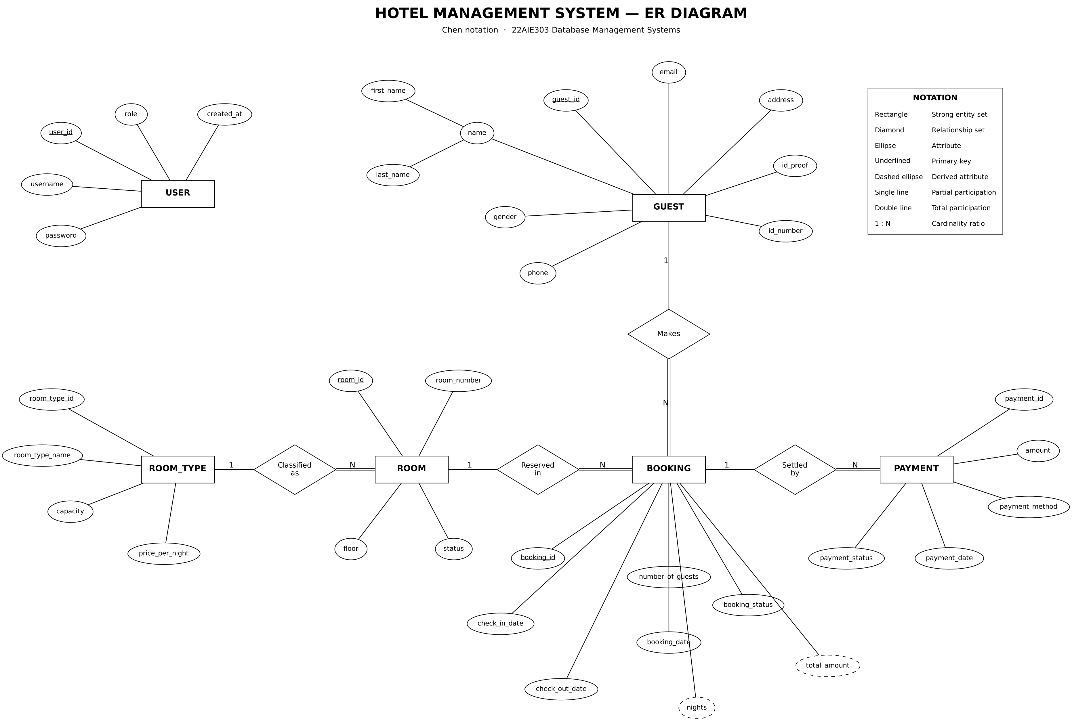
Database Design – ER Diagram
Chen notation: entities, attributes, relationships
6 entities
USER, ROOM_TYPE, ROOM, GUEST, BOOKING, PAYMENT
4 relationships, all 1 : N
Classified as · Reserved in · Makes · Settled by
Total participation
BOOKING, PAYMENT and ROOM always belong to their parent (double line)
Derived
nights and total_amount are computed, never stored (dashed)
Composite
GUEST.name = first_name + last_name
Team 03 · 22AIE303 Database Management Systems · Hotel Management System
4
Notes:
Read the diagram left to right: ROOM_TYPE classifies ROOM, ROOM is reserved in BOOKING, GUEST makes BOOKING, BOOKING is settled by PAYMENT. All four relationships are one-to-many so no junction table is needed. PAYMENT is a strong entity with its own key payment_id.

Slide 5
Relational Schema
ER diagram mapped to tables – PK, FK and constraints
USERS
ROOM_TYPES
ROOMS
user_id PK
username UNIQUE
password (SHA-256)
role ENUM
created_at
room_type_id PK
room_type_name UNIQUE
capacity CHECK 1–10
price_per_night CHECK > 0
room_id PK
room_number UNIQUE
room_type_id FK → ROOM_TYPES (RESTRICT)
floor CHECK 0–50
status ENUM
GUESTS
BOOKINGS
PAYMENTS
guest_id PK
first_name, last_name
gender ENUM
phone UNIQUE
email, address
id_proof ENUM, id_number
UNIQUE (id_proof, id_number)
booking_id PK
guest_id FK → GUESTS (CASCADE)
room_id FK → ROOMS (RESTRICT)
check_in_date, check_out_date
CHECK check_out > check_in
number_of_guests CHECK 1–10
booking_date, booking_status ENUM
payment_id PK
booking_id FK → BOOKINGS (CASCADE)
amount CHECK ≥ 0
payment_method ENUM
payment_date
payment_status ENUM
Team 03 · 22AIE303 Database Management Systems · Hotel Management System
5
Notes:
Every table has an auto-increment surrogate primary key; natural keys (phone, room number, username, ID document) are enforced with UNIQUE. Foreign keys: ROOMS to ROOM_TYPES (RESTRICT), BOOKINGS to GUESTS (CASCADE) and ROOMS (RESTRICT), PAYMENTS to BOOKINGS (CASCADE).

Slide 6
Normalization: Why 3NF and BCNF
Every relation passes the stricter BCNF test, so it is also in 3NF
The two tests
Why the six tables pass
3NF – for every FD X → A, X is a superkey or A is part of a candidate key.
BCNF – for every FD X → A, X must be a superkey (no exception).
The only determinants are the primary key and UNIQUE candidate keys.
Every determinant is a superkey → BCNF holds, and BCNF implies 3NF.
How the flat register was decomposed
1NF – all values atomic; guest name stored as first_name + last_name.
2NF – no partial dependency: every table has a single-column surrogate key.
3NF – room → room type → price was a transitive dependency; the price now lives only in ROOM_TYPES.
Derived data – nights and total are computed in the view and procedure, never stored.
Deliberate exception PAYMENTS.amount is kept on purpose: it records what was actually paid at that day’s tariff, so it is not an FD violation.
Team 03 · 22AIE303 Database Management Systems · Hotel Management System
6
Notes:
Say it simply: in every table the only things that determine other columns are the primary key and the UNIQUE columns. Those are candidate keys, so BCNF holds, and BCNF implies 3NF. The price lives in ROOM_TYPES, not ROOMS, which removed the transitive dependency. PAYMENTS.amount is stored deliberately as a historical fact, and ROOMS.status is kept consistent by triggers.

Slide 7
Functional Dependencies
Candidate keys determine every attribute in each relation
Relation | Functional dependencies | NF
USERS | user_id → all ; username → all | BCNF
ROOM_TYPES | room_type_id → all ; room_type_name → all | BCNF
ROOMS | room_id → all ; room_number → all | BCNF
GUESTS | guest_id → all ; phone → all ; (id_proof, id_number) → all | BCNF
BOOKINGS | booking_id → all | BCNF
PAYMENTS | payment_id → all | BCNF
BCNF check in every relation each determinant (primary key, or a UNIQUE column such as phone or room_number) is a candidate key, so the dependencies above are the only ones and BCNF holds.
Team 03 · 22AIE303 Database Management Systems · Hotel Management System
7
Notes:
Key argument: the price lives in ROOM_TYPES, not ROOMS, which removes the transitive dependency. Candidate keys are the primary key plus UNIQUE columns, so every determinant is a candidate key and the schema is in BCNF.

Slide 8
Advanced SQL & Query Design
SQL operations used in the Hotel Management System
JOIN – retrieves booking, guest, room and room-type data from several tables.
Subqueries – NOT IN finds free rooms; correlated EXISTS finds guests who owe money.
Aggregate functions – SUM, COUNT and AVG for revenue, occupancy and record counts.
GROUP BY / HAVING – groups payments by room type or bookings by guest and filters the groups.
ORDER BY – sorts bookings, revenue and room lists.
INSERT, UPDATE, DELETE – adds and modifies guests, bookings and payments.
Views, procedures, triggers – vw_booking_details, sp_generate_bill and the room-status triggers.
Parameterized queries – connect the Tkinter app with MySQL safely (%s placeholders).
Example: Revenue by Room Type
SELECT rt.room_type_name,
SUM(p.amount) AS revenue
FROM payments p
JOIN bookings b ON p.booking_id = b.booking_id
JOIN rooms r ON b.room_id = r.room_id
JOIN room_types rt
ON r.room_type_id = rt.room_type_id
WHERE p.payment_status = 'Paid'
GROUP BY rt.room_type_name
HAVING SUM(p.amount) > 5000
ORDER BY revenue DESC;
Joins four tables, keeps only paid payments, groups by room type and shows the types that earned more than Rs 5,000.
Team 03 · 22AIE303 Database Management Systems · Hotel Management System
8
Notes:
Pick two to show live: the NOT IN overlap subquery (this is what Find Available Rooms runs) and the GROUP BY / HAVING revenue query. All eleven documented queries are in database/advanced_queries.sql and every one was run on the sample data.

Slide 9
DBMS Concept Mapping
Where each DBMS concept appears in the Hotel Management System
Hotel Management Function | DBMS Concept
Guest registration | INSERT
Guest and room management | SELECT / UPDATE
Room booking | INSERT / SELECT
Booking details (guest, room, tariff) | JOIN (4 tables)
Room availability for given dates | Subquery (NOT IN) / date-overlap condition
Data validation | CHECK / ENUM / NOT NULL constraints
Unique guest and room details | UNIQUE constraint
Entity relationships | Primary Key / Foreign Key
Occupancy and revenue reports | COUNT / SUM / GROUP BY / HAVING
Room status consistency | Triggers + stored procedure
Bill generation | Stored procedure / View
Team 03 · 22AIE303 Database Management Systems · Hotel Management System
9
Notes:
Use this slide to link every feature of the app back to a syllabus concept. The trigger row refers to the three booking triggers that call sp_refresh_room_status.

Slide 10
Work Completed & Output
Three layers, all working end to end
FRONT END app.py
Tkinter GUI: login + 7 tabs. Validates input, shows results. Contains no SQL.
Completed
Login with SHA-256 hashed passwords
Full CRUD on Room Types, Rooms, Guests, Bookings, Payments
Live search on guests and bookings
Double booking blocked by overlap check
Automatic bill: nights × price
Room status maintained by triggers
Dashboard with live aggregate cards
4 reports with GROUP BY / HAVING
BACK END database.py
Data-access layer: every SQL statement, parameterised with %s placeholders; hashes passwords.
DATABASE MySQL hotel_db
6 tables, 4 foreign keys, 3 views, 4 triggers, 2 stored procedures, 4 indexes.
Team 03 · 22AIE303 Database Management Systems · Hotel Management System
10
Notes:
Layer separation is the design point: the GUI never writes SQL; database.py holds every query with placeholders (no SQL injection); the database enforces integrity.

Slide 11
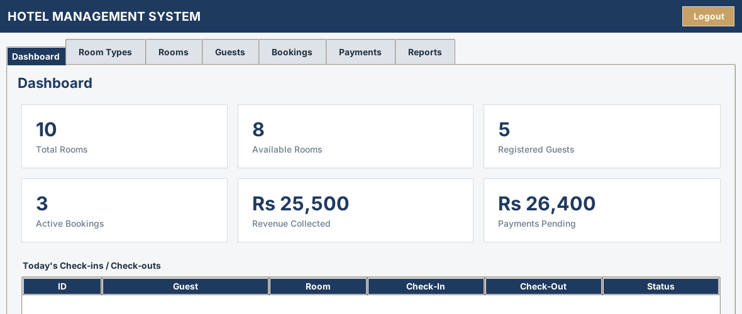
Output – Dashboard
Six live aggregate queries (COUNT, SUM) on the home screen
Team 03 · 22AIE303 Database Management Systems · Hotel Management System
11
Notes:
Dashboard: total rooms, available rooms, registered guests, active bookings, revenue collected, payments pending. Each card is its own aggregate query against the live database.

Slide 12
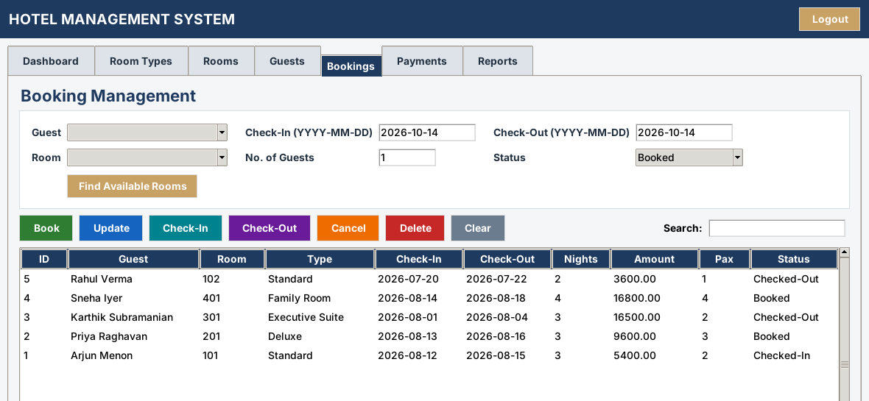
Output – Bookings
4-table join with computed nights and amount; Book / Check-In / Check-Out / Cancel buttons
Team 03 · 22AIE303 Database Management Systems · Hotel Management System
12
Notes:
Show: Find Available Rooms (NOT IN subquery), book a room, try the same room again (blocked), Check-In then Check-Out and watch the Rooms tab change.

Slide 13
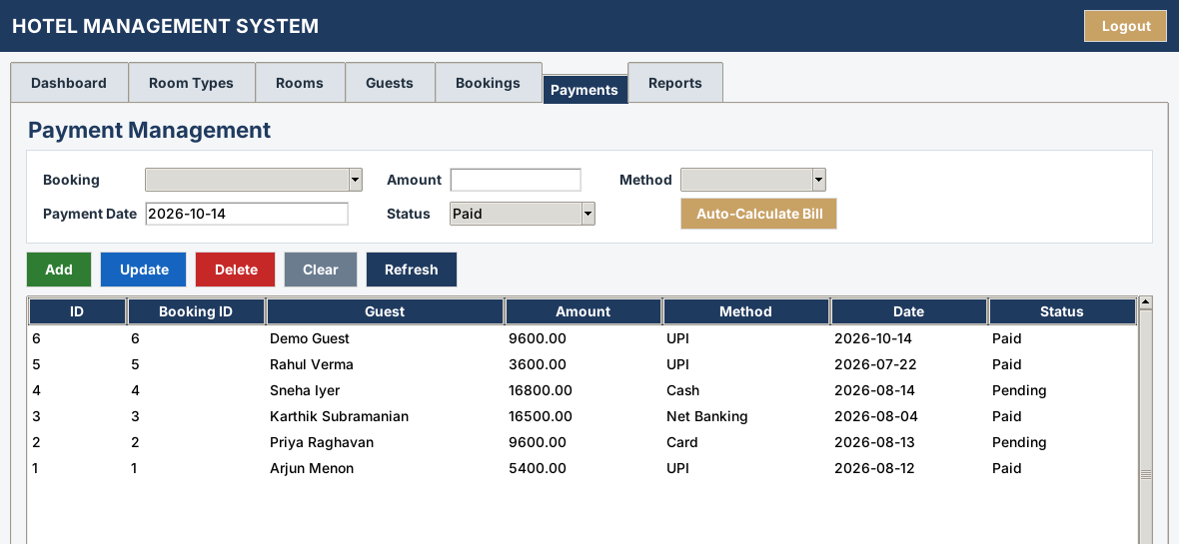
Output – Payments
Auto-Calculate Bill fills the amount from a JOIN (nights × price per night)
Team 03 · 22AIE303 Database Management Systems · Hotel Management System
13
Notes:
Pick a booking, press Auto-Calculate Bill, choose the method and Add. The stored amount records what was actually paid.

Slide 14
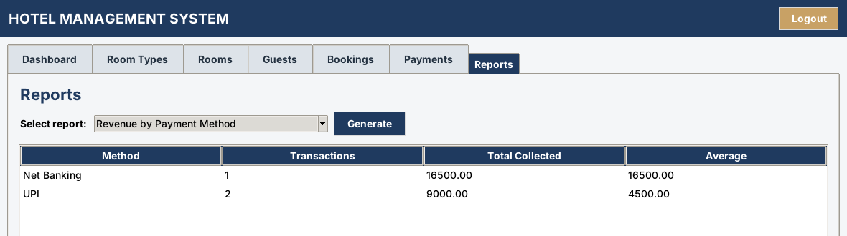
Output – Reports
Revenue by payment method – aggregate functions with GROUP BY
Team 03 · 22AIE303 Database Management Systems · Hotel Management System
14
Notes:
Four reports: Room Availability by Type, Revenue by Payment Method, Guest Booking Summary, Pending Payments.

Slide 15
Conclusion & Future Enhancements
CONCLUSION
FUTURE ENHANCEMENTS
A working GUI → data-access layer → MySQL pipeline replaces the paper registers.
Integrity is enforced by the database: PK, FK, UNIQUE, CHECK, ENUM and triggers.
All six relations are in 3NF and BCNF; derived values are never stored.
Billing, availability and reports are computed by SQL – joins, subqueries, GROUP BY / HAVING, views, procedures.
Role-based access: lock Admin-only tabs for Receptionists, backed by MySQL GRANT.
Staff-accounts screen (add_user already exists in the back end).
Booking + payment inside one COMMIT / ROLLBACK transaction in the app.
Move the overlap check into a database trigger.
PDF invoice export per booking.
Analytics: monthly occupancy and revenue charts; web front end for multi-user access.
Team 03 · 22AIE303 Database Management Systems · Hotel Management System
15
Notes:
Be upfront about what is not done: role enforcement, staff screen, application-level transactions. These are the natural next steps.

Slide 16
THANK YOU
Team 03 · 22AIE303 Database Management Systems
Notes:
Invite questions. Keep the app open on the Bookings tab for any live request.

